Slide 1
What We Know and What We Do Not Know About Long-acting PrEP
Raphael J. Landovitz, MD MSc
Professor of Medicine
UCLA Center for Clinical AIDS Research & Education
Equitable LAI PrEP Workshop, February 27, 2023

Slide 2
Disclosure
Raphael J. Landovitz has served on Scientific Advisory Boards for Merck.

Slide 3
HPTN 083/084 Study Design
CAB
TDF/FTC
(20% Intralipid solution)
Landovitz RJ et al. AIDS 2020, #OAXLB0101

Slide 4
EFFICACY

Slide 5
HPTN 083 HIV Incidence: CAB vs. TDF/FTC
Primary blinded period, through May 2020
Open to
Enrollment
Open to
Enrollment
Year 1 Unblinded
Analysis
Primary
Analysis
Year 1 Unblinded
Analysis
Primary
Analysis
1 Year
4.4 Years
1 Year
12-16-2016
4.4 Years
05-14-2021
05-14-2020
05-14-2021
05-14-2020
DEC-2016
DEC-2016
JUN-2017
JUN-2017
DEC-2017
DEC-2017
JUN-2018
JUN-2018
DEC-2018
DEC-2018
JUN-2019
JUN-2019
DEC-2019
DEC-2019
JUN-2020
JUN-2020
DEC-2020
DEC-2020
JUN-2021
JUN-2021
DEC-2021
DEC-2021
Landovitz, R. HIV Glasgow 2022.

Slide 6
HPTN 083 HIV Incidence: CAB vs. TDF/FTC
Combined blinded and unblinded period, through May 2021
Open to
Enrollment
Open to
Enrollment
Year 1 Unblinded
Analysis
Primary
Analysis
Year 1 Unblinded
Analysis
Primary
Analysis
1 Year
4.4 Years
1 Year
12-16-2016
4.4 Years
05-14-2021
05-14-2020
05-14-2021
05-14-2020
DEC-2016
DEC-2016
JUN-2017
JUN-2017
DEC-2017
DEC-2017
JUN-2018
JUN-2018
DEC-2018
DEC-2018
JUN-2019
JUN-2019
DEC-2019
DEC-2019
JUN-2020
JUN-2020
DEC-2020
DEC-2020
JUN-2021
JUN-2021
DEC-2021
DEC-2021
Landovitz, R. HIV Glasgow 2022.

Slide 7
HPTN 084 HIV Incidence: CAB vs. TDF/FTC
Blinded period, through Nov 2020
Delany-Moretlwe, S et al. AIDS 2022. #OALBX0108

Slide 8
HPTN 084 HIV Incidence: CAB vs. TDF/FTC
Combined blinded and unblinded period, through Dec 2021
*Excludes 1 baseline infection from the blinded period
Delany-Moretlwe, S et al. AIDS 2022. #OALBX0108

Slide 9
The Bottom Line: Efficacy
Long-acting cabotegravir is very effective at preventing HIV in MSM, TGW, and cisgender women
  66% reduction in HIV infection when compared to MSM and TGW who were offered TDF/FTC
  89% reduction in HIV infection when compared to cisgender women who were offered TDF/FTC

Slide 10
HPTN 083 HIV Incidence by Subgroup
CAB vs. TDF/FTC
Grinsztejn, B. AIDS 2022. #12707

Slide 11
HPTN 084 HIV Incidence by Subgroup
CAB vs. TDF/FTC
Delany-Moretlwe, S et al. Lancet. 2022.

Slide 12
The Bottom Line: Efficacy in specific populations
Long-acting cabotegravir is also very effective at preventing HIV in:
  Young individuals
  Black individuals
  Transgender women
  Individuals from various regions of the world
  Individuals using various contraceptive methods
  Individuals with higher BMIs

Slide 13
SAFETY

Slide 14
HPTN 083: Injection Site Reactions
80.9%
80%
Cabotegravir
Mild (Grade 1)
Moderate (Grade 2)
Severe (Grade 3)
60%
57.7%
TDF/FTC
Mild (Grade 1)
Moderate (Grade 2)
48.4%
Severe (Grade 3)
Percentage of Participants Reporting an ISR
40%
38.6%
35.7%
34.9%
33.8%
33%
31.2%
30.4%
29.6%
28.3%
28.1%
26.6%
27.7%
26.9%
24.5%
22.8%
22.5%
20%
18.4%
19.6%
15.5%
57.7%
9.3%
57.7%
7.1%
6%
4%
4.9%
4.5%
3.8%
3.8%
3.9%
4.3%
4.5%
3.3%
3%
1.7%
3.2%
1.4%
0
OVERALL
1
2
3
4
5
6
7
8
9
10
11
12
13
14
15
16
17
18
19
20
Injection Number
Cabotegravir, n
2117
2117
2037
1938
1872
1761
1620
1464
1360
1200
1034
877
744
604
465
372
298
234
168
111
8
TDF/FTC, n
2081
2081
2014
1940
1869
1760
1606
1463
1355
1193
1037
903
760
596
482
370
288
220
146
89
6
Landovitz RJ et al. NEJM 2021

Slide 15
HPTN 083: Injection Site Reactions
IQR
Duration: 3 (2, 6)
All ISRs
N=10,666
Time from injection to onset (median and IQR)
Time from injection to resolution (median and IQR)
IQR
Duration: 3 (1, 5)
Pain
n=6,486 (60.8%)
IQR
Duration: 3 (2, 6)
Tenderness
n=2,530 (23.7%)
IQR
Duration: 5 (3, 9)
Other
n=1650 (15.5%)
0
1
2
3
4
5
6
7
8
9
10
11
12
Time in days
*Other injection site reactions include induration, nodule, hematoma, bruising, discoloration, swelling, erythema, itching, warmth, anesthesia, hemorrhage, and abscess
Landovitz RJ et al. NEJM 2021

Slide 16
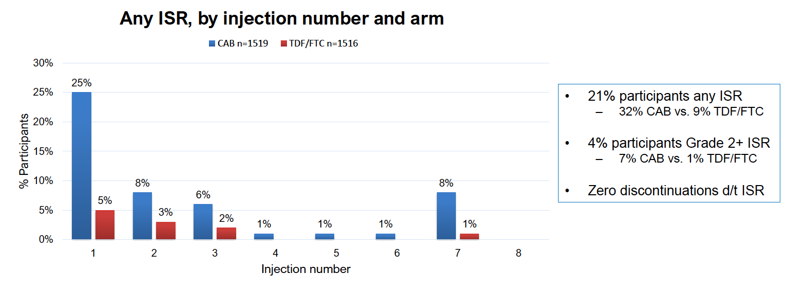
HPTN 084: Injection Site Reactions
Delany-Moretlwe, S. HIV R4P 2021. #LB1479

Slide 17
HPTN 083: Median Change in Weight (kg)
Estimated mean weight change (kg/y)
CAB: +1.23 (95%CI 1.05, 1.42) kg/y
TDF/FTC: 0.37 (95%CI 0.18, 0.55) kg/y
p<0.001
Week 0-40
CAB: +1.26 (95%CI 0.98, 1.54) kg/y
TDF/FTC: -0.50 (95%CI -0.78, -0.22) kg/y
p<0.001
Week 40-105
CAB: +1.11 (95%CI 0.82, 1.41) kg/y
TDF/FTC: +1.19 (95%CI 0.90, 1.49) kg/y
p=0.70
5.0
2.5
Study arm
Median weight change from enrollment (kg)
CAB
TDF/FTC
0.0
-2.5
W0
W2
W4
W5
W9
W17
W25
W33
W41
W49
W57
W65
W73
W81
W89
W97
W105
Visit week
Landovitz RJ et al. NEJM 2021

Slide 18
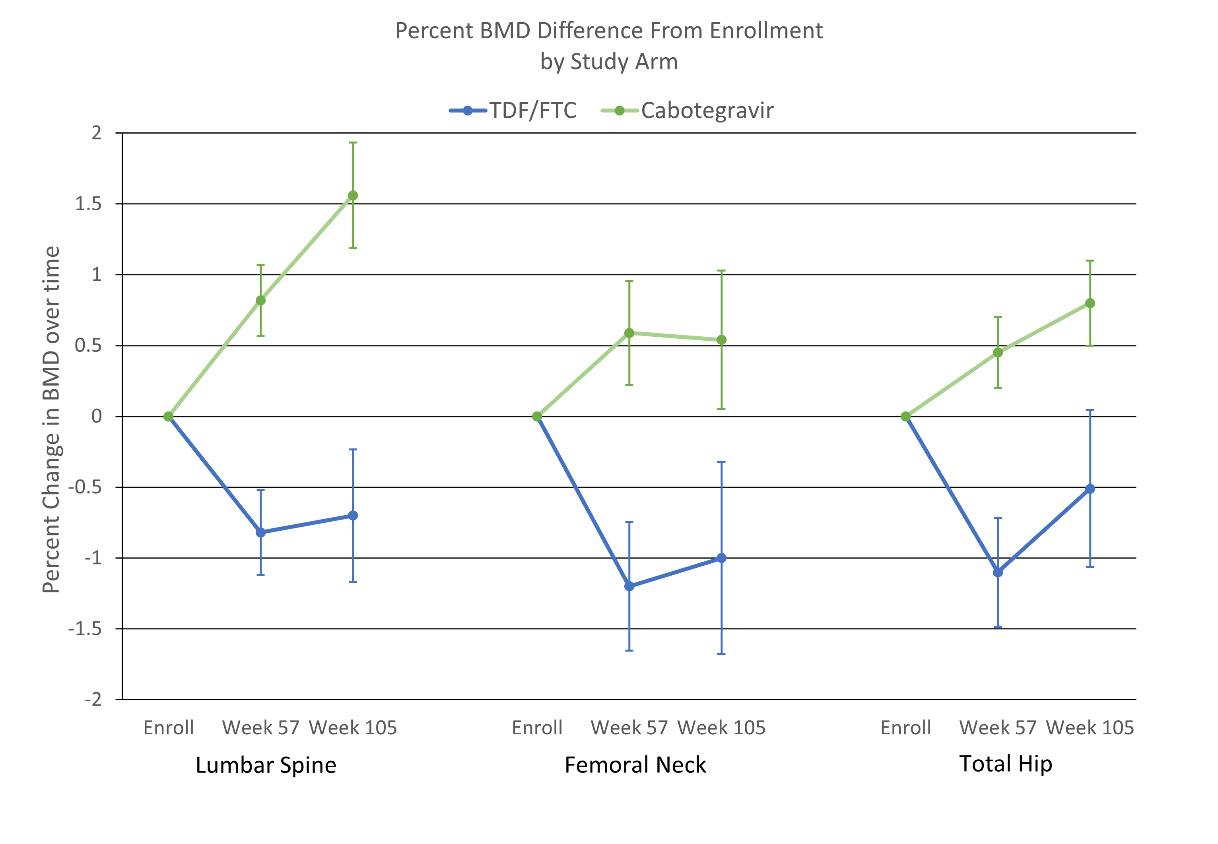
HPTN 083: DXA BMD change over time
BMD decreased in the TDF-FTC arm by 0.5-1.0%
BMD increased in CAB-LA arm 0.5-1.5%
Brown T et al. CROI 2023. Poster #987.

Slide 19
The Bottom Line: Safety
Long-acting cabotegravir was safe and well tolerated
The most common side effect was injection site reaction (ISR)
  The majority were mild to moderate in severity
  Reports of ISRs decreased over time
  Very few ISRs led to the discontinuation of cabotegravir
We’re all gaining weight, people on CAB-LA and TDF/FTC at about the same rate EXCEPT for the first year, where TDF/FTC people LOST weight (but then gained thereafter)
By DXA measurement, CAB-LA had better outcomes than TDF-FTC over two years; no clinical differences

Slide 20
HPTN 084 Cumulative Pregnancy Outcomes
CAB vs. TDF/FTC
 | Total n=132 | CAB n=63 | TDF/FTC n=69
Ongoing | 57 | 23 | 34
Known pregnancy outcomes*
Live births | 61 | 31 | 30
Pregnancy loss
≥37 weeks | 0 | 0 | 0
20-36 weeks | 3 | 1 | 2
<20 weeks** | 13 | 9 | 4
Congenital anomalies | 0 | 0 | 0
*includes multiple births
**includes ectopic pregnancy, elective and spontaneous abortion
Delany-Moretlwe, S. HIV R4P 2021. #LB1479

Slide 21
The Bottom Line: Pregnancy
Data are still being collected on the safety of cabotegravir during pregnancy and breastfeeding
To date, data does not suggest there are any safety concerns

Slide 22
PHARMACOKINETICS

Slide 23
CAB Subsequent to Final Injection (Log Scale)
Males
8x PA-IC₉₀
4x PA-IC₉₀
1x PA-IC₉₀
LLOQ
Landovitz, R et al. HIV R4P, Madrid, 2018. Abstract #OA15.06LB.

Slide 24
CAB Subsequent to Final Injection (Log Scale)
Females
8x PA-IC₉₀
4x PA-IC₉₀
1x PA-IC₉₀
LLOQ
Landovitz, R et al. HIV R4P, Madrid, 2018. Abstract #OA15.06LB.

Slide 25
Schematic for Seroconversions
Eshleman S et al. CROI 2022, #95

Slide 26
Expected Pattern of CAB Concentrations
CAB concentration
CAB injection
First HIV positive visit
First site positive visit
First HIV positive visit and first site positive visit
Time between first HIV positive visit and first site positive visit
Time between last injection and first HIV positive visit

Slide 27
Fast Elimination – One case so far
CAB concentration
CAB injection
First HIV positive visit
First site positive visit
First HIV positive visit and first site positive visit
Time between first HIV positive visit and first site positive visit
Time between last injection and first HIV positive visit

Slide 28
The Bottom Line:
Pharmacokinetics in Men and Women
People born male: the median time from the last injection to the time when CAB concentration fell below the LLOQ was 10.1 Months
People born female: the median time from the last injection to the time when CAB concentration fell below the LLOQ was 1 year and 3.5 months
Higher BMI associated with more prolonged period of exposure
Rapid concentration decay in rare participants remains to be fully explained but likely is not a genetic “fast metabolizer” abnormality
Landovitz, R. Lancet HIV. 2020.

Slide 29
FAILURES

Slide 30
REMINDER: BOTH PrEP MEDICATIONS WORK EXTREMELY WELL
Combined blinded and unblinded period, through May 2021
Open to
Enrollment
Open to
Enrollment
Year 1 Unblinded
Analysis
Primary
Analysis
Year 1 Unblinded
Analysis
Primary
Analysis
1 Year
4.4 Years
1 Year
12-16-2016
4.4 Years
05-14-2021
05-14-2020
05-14-2021
05-14-2020
DEC-2016
DEC-2016
JUN-2017
JUN-2017
DEC-2017
DEC-2017
JUN-2018
JUN-2018
DEC-2018
DEC-2018
JUN-2019
JUN-2019
DEC-2019
DEC-2019
JUN-2020
JUN-2020
DEC-2020
DEC-2020
JUN-2021
JUN-2021
DEC-2021
DEC-2021
Landovitz, R. HIV Glasgow 2022.

Slide 31
FAILURE GROUPS IN HPTN 083
Group A cases: HIV acquired at enrollment
Group B cases: HIV acquired w/o recent CAB exposure
Group BR cases: HIV acquired >6 months after the last CAB injection and an injection given at the time of the first positive visit
Group C cases: HIV acquired during oral lead-in
Group D cases: HIV acquired in the setting of on-time CAB injections
Group DX cases: HIV acquired while on CAB with at least one 10-week delayed injection

Slide 32
FAILURE GROUPS IN HPTN 083
Group A cases: HIV acquired at enrollment
Group B cases: HIV acquired w/o recent CAB exposure
Group BR cases: HIV acquired >6 months after the last CAB injection and an injection given at the time of the first positive visit
Group C cases: HIV acquired during oral lead-in
Group D cases: HIV acquired in the setting of on-time CAB injections
Group DX cases: HIV acquired while on CAB with at least one 10-week delayed injection

Slide 33
CAB arm, Group A
What we learned:
If we do not diagnose HIV before PrEP agents start (acute or eclipse phase infection = very early infection), CAB can make it challenging to diagnose later
Failure to diagnose HIV infection can lead to continued CAB administration, and even continued CAB injections

Slide 34
FAILURE GROUPS IN HPTN 083
Group A cases: HIV acquired at enrollment
Group B cases: HIV acquired w/o recent CAB exposure
Group BR cases: HIV acquired >6 months after the last CAB injection and an injection given at the time of the first positive visit
Group C cases: HIV acquired during oral lead-in
Group D cases: HIV acquired in the setting of on-time CAB injections
Group DX cases: HIV acquired while on CAB with at least one 10-week delayed injection

Slide 35
CAB arm, Group B & BR
What we learned:
If you don’t take CAB, it doesn’t prevent HIV infection
In 3 participants, exposure and HIV acquisition during the “tail” did not result in CAB resistance
  This is reassuring, but DOES NOT RULE OUT THAT IT CAN HAPPEN WE NEED MORE DATA
  When CAB is restarted after prolonged hiatus, failure to diagnose interim newly acquired HIV can lead to INSTI resistance, much as “A” cases can
When people were provided open-label TDF/FTC to “cover they tail” they did not take it – this likely contributed to HIV acquisition

Slide 36
FAILURE GROUPS IN HPTN 083
Group A cases: HIV acquired at enrollment
Group B cases: HIV acquired w/o recent CAB exposure
Group BR cases: HIV acquired >6 months after the last CAB injection and an injection given at the time of the first positive visit
Group C cases: HIV acquired during oral lead-in
Group D cases: HIV acquired in the setting of on-time CAB injections
Group DX cases: HIV acquired while on CAB with at least one 10-week delayed injection

Slide 37
CAB arm, Group C
What we learned:
If you don’t take CAB, it doesn’t prevent HIV infection
  We don’t know how “forgiving” it is to missed doses
There is likely a “time to onset” of protection with oral CAB
  We don’t know how long
If CAB delays new (incident) HIV detection by delaying testing, CAB injections can inadvertently be given
As with the “A” Cases, viral “escape” at HIGH CAB levels can lead to CAB (and other integrase) resistance

Slide 38
FAILURE GROUPS IN HPTN 083
Group A cases: HIV acquired at enrollment
Group B cases: HIV acquired w/o recent CAB exposure
Group BR cases: HIV acquired >6 months after the last CAB injection and an injection given at the time of the first positive visit
Group C cases: HIV acquired during oral lead-in
Group D cases: HIV acquired in the setting of on-time CAB injections
Group DX cases: HIV acquired while on CAB with at least one 10-week delayed injection

Slide 39
CAB arm, Group D & DX
What we learned:
Delays in HIV tests detecting “new” HIV infections
CAB levels in the blood were as expected
  It wasn’t “unexpectedly” low concentrations of CAB that explain the PrEP failure
If HIV “smolders” after a PrEP failure, it can lead to CAB (and other integrase) resistance
  That resistance can be often avoided by earlier detection
When delays occur, CAB levels can drop, losing protection – but not leading to INSTI resistance to-date

Slide 40
Bottom Line:
Summary of HPTN 083 resistance
CAB INITIATED OR RE-INITIATED WITH OCCULT HIV INFECTION
N (%) Integrase Resistance
Initiated 1 (25) Yes
Restarted 1 (50) Yes
HIV ACQUISITION DURING OLI
During OLI 2 (66) Yes
HIV BREAKTHROUGH INFECTION WITH ON-TIME INJECTIONS
On-time failure 6 (100) Yes
HIV BREAKTHROUGH INFECTION WITH AT LEAST ONE 10+ WEEK DELAY
≥1 delay 0 (0) No
HIV INFECTION 6+ MONTHS FROM LAST INJECTION
Tail-phase* 0 (0) No
*No result for one case
Notes:
Cases C1-3: Change E138A/E/K to E138E/A/K. DONE
There was no genotyping results from B4 (failed genotyping). – footnote added - DONE
Changed assay names - DONE

Slide 41
TESTING DELAYS

Slide 42
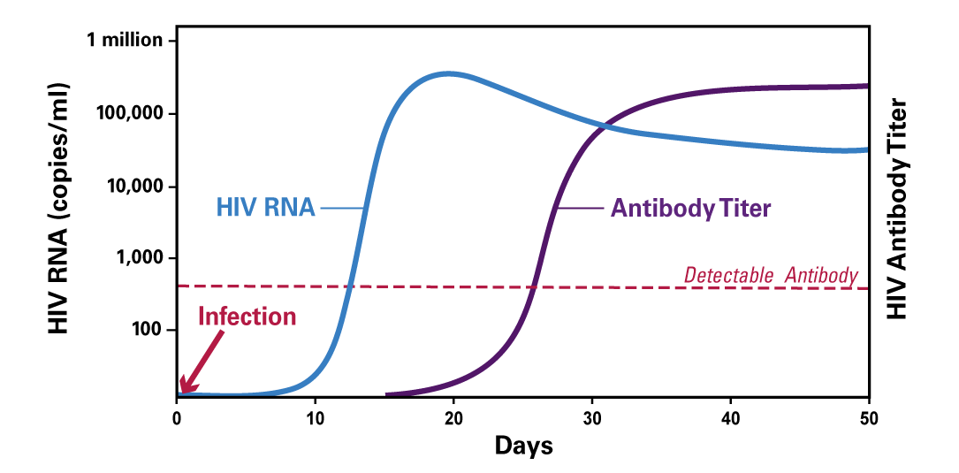
Diagnosing Acute HIV
HIV RNA
Antibody Titer
Detectable Antibody
Infection
HIV RNA “spike” precedes production of detectable HIV antibodies
Notes:
1

Slide 43
Diagnosing Acute HIV
Notes:
1

Slide 44
The Bottom Line:
Testing Delays
RNA testing finds infections earlier, but is costly, may not be feasible in many settings, and may confuse patients and providers
  This is being explored in HPTN 083 and 084 OLE’
No delays seen in MSM/TGW when infection is acquired > 6 months after last injection
  Likely a longer timeline for ciswomen/TGM

Slide 45
CLINICAL USE and
IMPLEMENTATION

Slide 46
Making Good Decisions Absent Good Data
What to start?
  Whatever the patient will adhere/persist with best
  There is no ethical/moral “obligation” to use CAB
Onset of protection?
  PK suggests time from first injection (irrespective of OLI) to 8x PA-IC90 is median 2 days, 95% by 7 days
  Durability – incredibly interpatient variability (077 data), likely varies by sex (maybe BMI), wouldn’t assume more than 9-10 weeks for males, 12+ for females
Breakthroughs (nee: failures)
  Poorly understood to date
  Salvage with NNRTI or r/PI if infection likely to have occurred within 1 year, DTG/BIC-based ART >1 year?
Implementation
  Do we have the global, social, and political will to figure out how to use it?
Notes:
Aptima HIV-1 Quant Dx Assay (Hologic, LLOD: 12 copies/mL, 700 uL)
Cobas HIV-1/HIV-2 Qualitative Test (Roche, LLOD: 12.8 c/mL, 650 uL) 6800/8800 system

Slide 47
CAB PrEP Implementation (similar issues for CAB/RPV for ART)
Insurance variability
Coverage
Residence in pharmacy vs. medical benefit
Share-of-cost implications thereof
Requirement for Buy-and-Bill vs. Specialty Pharmacy
CMS reimbursement not clear until J-code July 1, 2022
Institutional Requirements
Institutional support for Buy-and-Bill
Institutional allowance of Brown/White/Clear Bagging
US CDC, DHHS. PrEP for the prevention of HIV infections in the United States – 2021 Update
Notes:
Aptima HIV-1 Quant Dx Assay (Hologic, LLOD: 12 copies/mL, 700 uL)
Cobas HIV-1/HIV-2 Qualitative Test (Roche, LLOD: 12.8 c/mL, 650 uL) 6800/8800 system

Slide 48
CAB PrEP Implementation (similar issues for CAB/RPV for ART)
Clinic Requirements
Operations/Work flow for administration
Patient Tracking
Bridging with missed doses (inconsistency between RCTs and PI)
Reloading (inconsistency between RCTs and PI)
Provider Hesitancy
Which to recommend?
How to counsel re: Onset? Durability?
Resistance and options for ART choice in breakthrough
Complexity (and anguish!) of discordant results
US CDC, DHHS. PrEP for the prevention of HIV infections in the United States – 2021 Update
Notes:
Aptima HIV-1 Quant Dx Assay (Hologic, LLOD: 12 copies/mL, 700 uL)
Cobas HIV-1/HIV-2 Qualitative Test (Roche, LLOD: 12.8 c/mL, 650 uL) 6800/8800 system

Slide 49
Can CAB be given at
other anatomic sites?
118 participants enrolled in a ATLAS-2M substudy to evaluate the pharmacokinetics, safety, tolerability, and efficacy of CAB+RPV LA following short-term repeat IM thigh administration
Across 704 thigh injections, 327 injection site reactions occurred
  Most were Grade 1 (55–76%) or 2 (19–38%)
  4–7% were grade 3
The median duration of ISRs was 3–3.5 days
One Grade 2 ISR led to withdrawal
Only 28–33% preferred thigh injections
  This was largely due to ease of access
Felizarta, F et al. CROI 2023. Poster Session-H1.

Slide 50
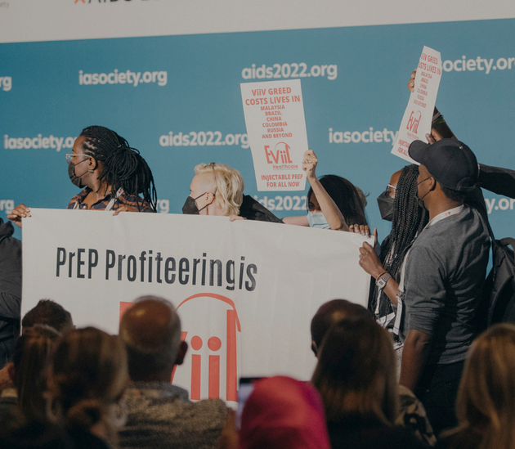
How will it be paid for?
Cabotegravir is currently priced at $22,200 per year
  >185 times higher than the $60–$119 estimated cost-effectiveness threshold for middle-income countries (MICs)
ViiV recently provided access to generic versions in 90 countries with the Medicines Patent Pool (MPP), including all African nations
  Not applicable to all LMICS
Pepperell T, et al. OFID. 2022.

Slide 51
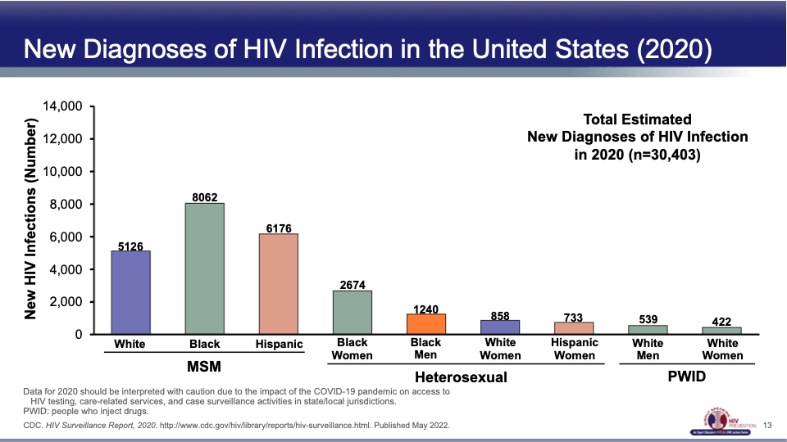
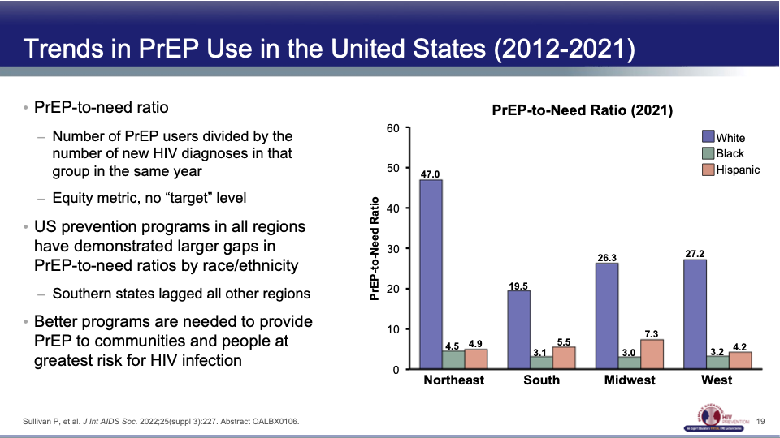
Can we use it Equitably?
PrEP-to-need ratio
  Number of PrEP users divided by the number of new HIV diagnoses in that group in the same year
  Equity metric, no "target" level
US prevention programs in all regions have demonstrated larger gaps in PrEP-to-need ratios by race/ethnicity
  Southern states lagged all other regions
Better programs are needed to provide PrEP to communities and people at greatest risk for HIV infection
PrEP-to-Need Ration (2021)
New Diagnoses of HIV Infection in the United States in 2020 (n=30,403)
CDC. HIV Surveillance Report, 2020. http://www.cdc.gov/hiv/library/reports/hiv-surveillance.html. Published May 2022.
Sullivan P, et al. J Int AIDS Soc. 2022;25(suppl 3): 227. Abstract OALBX0106.

Slide 52
Concluding Thoughts
Long-acting cabotegravir is highly effective for prevention of HIV in MSM, TGW, cisgender women and various subgroups
  So is Tenofovir-based oral PrEP
CAB is safe, generally well-tolerated, and data does not suggest there are safety concerns for use during pregnancy or breastfeeding
The washout period after last CAB injection is longer in individuals born female compared to individuals born male
RNA testing finds CAB breakthrough infections earlier, and often before resistance, but high cost and may not be feasible in many settings
We need strong community advocacy to demand programmatic implication and rapid generic production to bring costs down
If we don’t demand focus on making available biomedical prevention programs to most-affected communities, disparities will only widen
  This is UNACCEPTABLE

Slide 53
Thank you!
Questions? rlandovitz@mednet.ucla.edu

