Slide 1
Technologies to monitor & support CHWs for improved quality of care
Prof Mark Tomlinson
Stellenbosch University
Andi Friedman
Mobenzi

Slide 2
Introduction
3.3 million newborns die in the first month of life every year
500 000 women die annually during pregnancy
Vast majority of these are preventable or treatable with existing interventions
Low cost platforms essential – health care budgets under $30 per person in 33 of 41 African countries

Slide 3
Challenges
Gap between small scale efficacy studies and large scale interventions must be bridged
Supporting supervision and management central
Managers need high quality and timely information
CHW often dispersed – loss of quality in supervisory systems as programs scale

Slide 4
Management framework for supervision (Bosch-Capblanch & Garner, 2008)

Slide 5
Supervision and management

Slide 6
Goodstart 3
An effectiveness study of an integrated, community-based package for maternal, newborn, child and HIV care in South Africa.
Umlazi, Durban
Cluster randomized controlled trial
Focus – exclusive and appropriate feeding, neonatal health, maternal mental health
Partners – Medical Research Council, Stellenbosch University, University of Western Cape, Saving Newborn Lives, Maromi Health Research and University of Uppsala
Funder – Saving Newborn Lives and Centers for Disease Control

Slide 7
Philani Plus (+)
Philani Plus (+): a randomized controlled trial of mentor mother home visiting program to improve infants’ outcomes
Khayelitsha, Cape Town
Cluster randomized controlled trial
Focus: HIV, nutrition, TB, alcohol, maternal mental health
Partners –Stellenbosch University, University of California, Los Angeles, Philani Nutrition Centers, Emory University
Funder – National Institute of Alcoholism and Alcohol Abuse (NIAAA – USA)

Slide 8
Project differences – implications for system development
Goodstart:
Set visit dates and time
Facility component in addition to community
Philani:
Fluid visit dates
Time spent and topics covered

Slide 9
Technology overview
Philani & Goodstart utilised Mobenzi Researcher for mobile data collection
Custom web systems developed in 2008/2009 to support project protocol, supervision & management
Common requirements have been distilled to form Mobenzi Outreach
Platforms consist of mobile and web components

Slide 10
Mobile Application
Data collection, visit guidance, event reporting

Slide 11
Support for feature phones
Familiar, low-cost feature phones were used; now over 500 handsets across 4 platforms supported

Slide 12
Collection of routine & research data
Intuitive step-by-step process allowed both routine visit forms and full research questionnaires to be administered

Slide 13
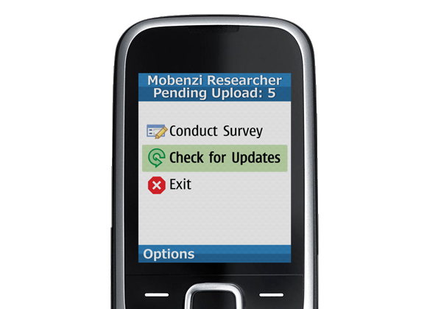
Capture without network reception
To account for poor network conditions, submissions were stored locally & uploaded automatically

Slide 14
Mobenzi Researcher web console
Design & deploy surveys
Control flow with embedded logic
Monitor field activity & analyse data

Slide 15
Design & deploy forms from the web
Visit forms and research surveys built from multiple question types incorporating branching logic & validation

Slide 16
Real-time reports
Generic reports provided real-time view of data gathered; filters now provided powerful mechanism to segment and analyse data

Slide 17
Visualise data geographically
Data can be plotted on an interactive map & configured with custom data overlays (GPS handset required)

Slide 18
API
Pre-populate forms from external data
Build dynamic workflows and custom reports

Slide 19
Take action on real-time data
Consume data immediately for reporting, analysis or operational use

Slide 20
Pre-populate forms dynamically
Insert context-specific content into surveys in real-time

Slide 21
Custom web interfaces
Built using the Mobenzi Researcher API

Slide 22
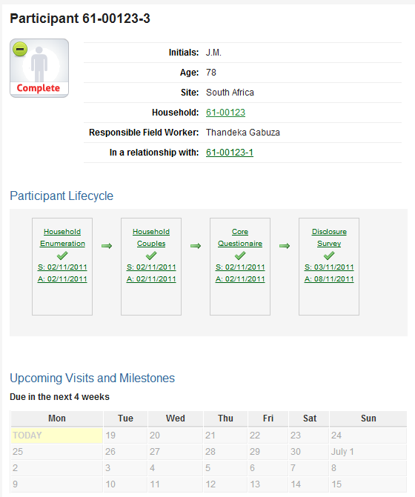
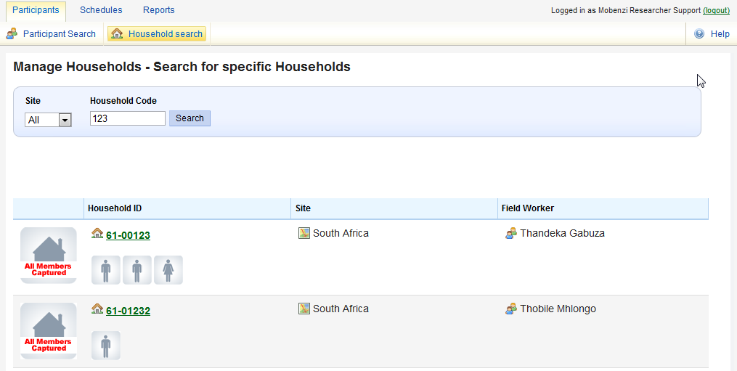
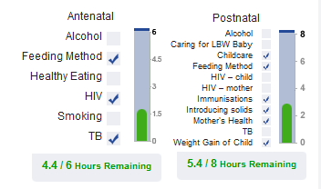
Patient/participant tracking

Slide 23
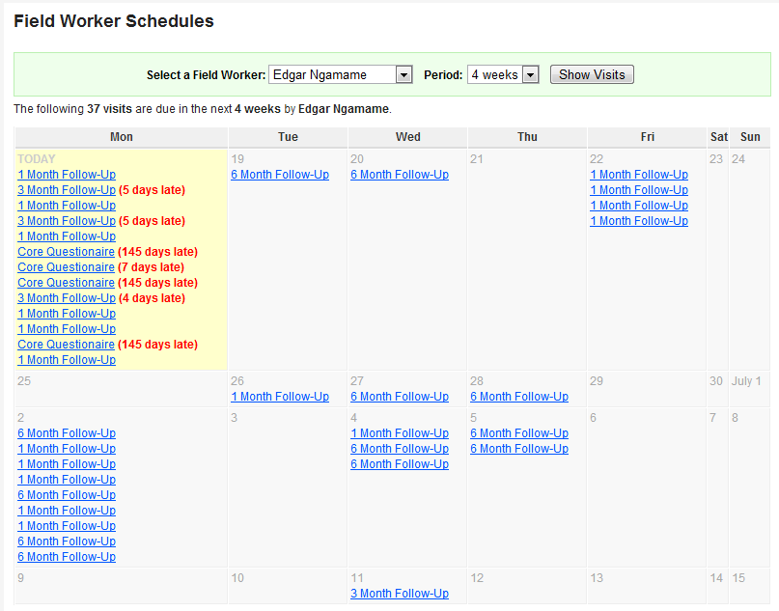
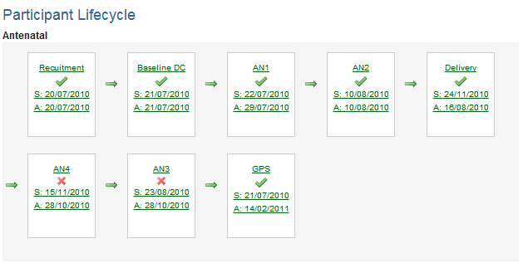
Visit scheduling, roster management

Slide 24
Mobenzi Outreach
Community care platform

Slide 25
Outreach introduction
GS3 & Philani projects highlighted the need for several key requirements:
Secure, longitudinal patient/participant record-keeping
Flexible visit scheduling based on patient profile & project protocol
Contextual visit support
Communication with fieldworkers and patients
Referral and integration with facilities & other systems
Highly configurable web interfaces

Slide 26
Conceptual architecture
Mobenzi Researcher
(Forms, handsets, raw data, generic reports)
Mobenzi Outreach
(Patients, visits, messaging, logic, custom reports)
CHW mobile interface
Clinic staff mobile / web interfaces
Integration (DHIS, labs, etc)
Team leader mobile interface

Slide 27
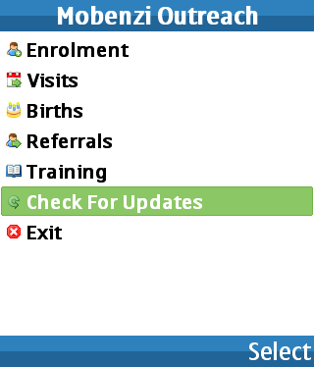
Outreach mobile interface(s)
Mobenzi mobile application interface can be tailored for each stakeholder:
CHW (upcoming visits, client management, assessments)
Team Leader (CHW list, CHW performance reports)
Clinic nurse (referral list, results capture)

Slide 28
Outreach backend
Stores any kind of entity (e.g. patients, facilities, visits) and can evolve over time
Allows data collected via Mobenzi Researcher to be “mapped” to one or more entities
Generates contextual visit forms based on patient profile and defined visit schedule
Generates and distributes automated reports
Sends SMS notifications
Integrates with third-party systems (e.g. DHIS)

Slide 29
Outreach web interface
Replaces need for custom console development – rapid configuration
Common / core entity actions built-in (search, view, edit, export)
Open architecture for extension, collaboration & use of existing tools (e.g. maps, charts, grids)
Granular permissions management
Web-based design environment

Slide 30
Cautionary notes
Evidence evidence evidence
Theory of change
Interoperability
Standards

Slide 31
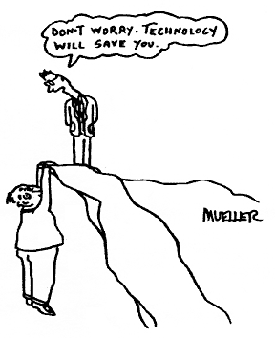

Slide 32
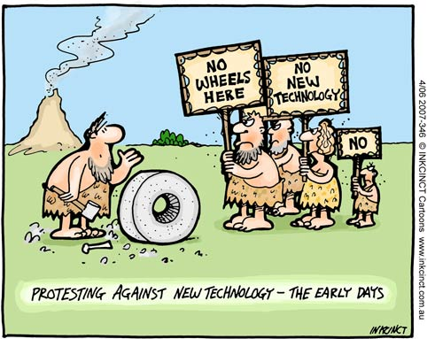

Slide 33
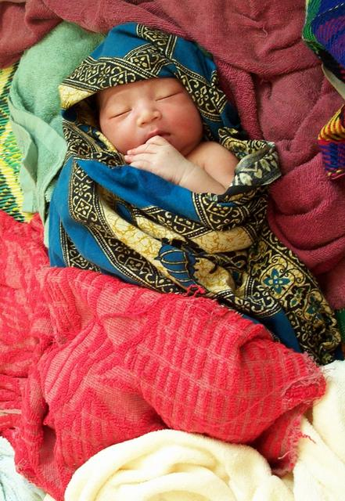
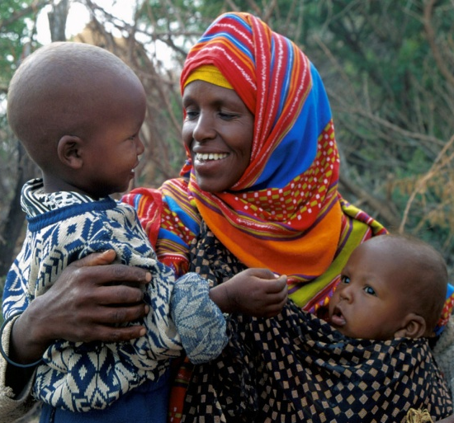
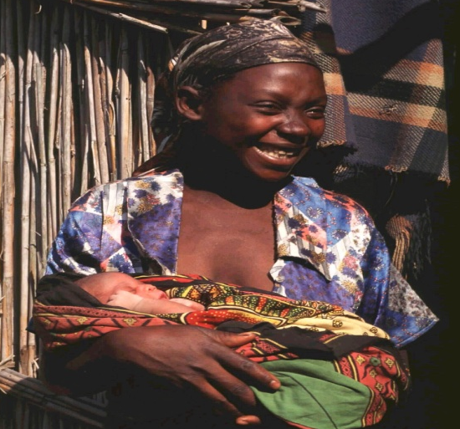
Thank you!
Enkosi. Dankie. Thank you! Zikomo kwambiri! Asante sana, Ye dewaese pii! Danke! Merci beaucoup! Obligado! Cam on!

