Slide 1
Tips and Strategies for Effective Literature Searching
Bethany Myers
Research Informationist
bethanymyers@library.ucla.edu

Slide 2
What I plan to talk about
General hints for searching
Power searching PubMed
Advanced Search
MeSH
Introducing Embase
Special search interfaces
Emtree
Getting full text of articles

Slide 3
General hints for searching
Try putting quotes around exact phrases

Slide 4
General hints for searching
Most databases support truncation: getting multiple word endings by using a special character
Adolescen* = adolescent OR adolescents OR adolescence

Slide 5
General hints for searching
What fields can you search?

Slide 6
General hints for searching
What fields can you search?

Slide 7
Using the PICO framework
PICO helps you structure an answerable question
Population
Intervention
Comparison or control
Outcome
Not all research topics neatly fit into PICO format, but it helps to think about each component concept of your topic before you come up with the keywords you plan to search

Slide 8
Using the PICO framework
Example
Population: Breast cancer patients
Intervention: surgical timing after chemotherapy
Comparison or control:
Outcome: adverse outcomes including mortality

Slide 9
Power searching in PubMed
The Advanced search screen

Slide 10
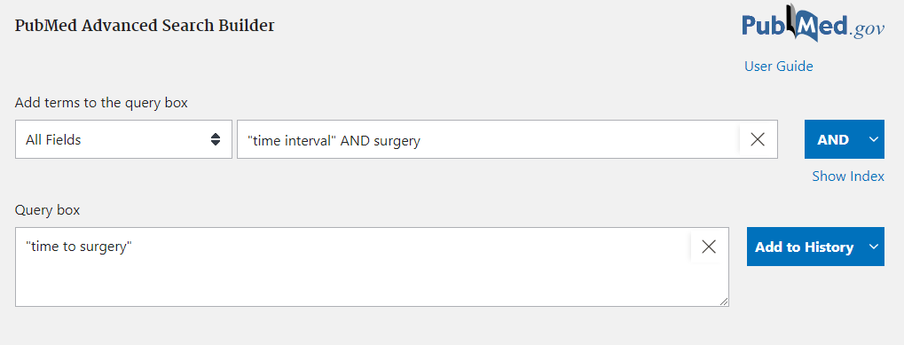
Power searching in PubMed
PubMed constructs the search based on what you type in the builder
Use the AND and OR operators to connect your keywords
This adds it to the history section at the bottom of the page. You can use it again later

Slide 11
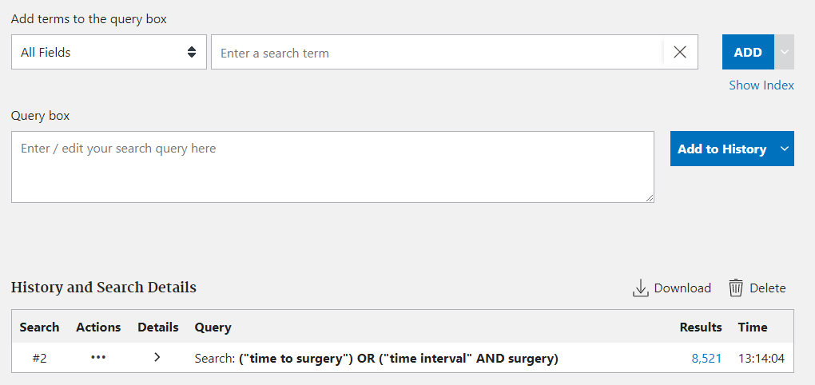
Power searching in PubMed

Slide 12
Power searching in PubMed

Slide 13
Power searching in PubMed
Clicking “Add” puts the searches back into the builder

Slide 14
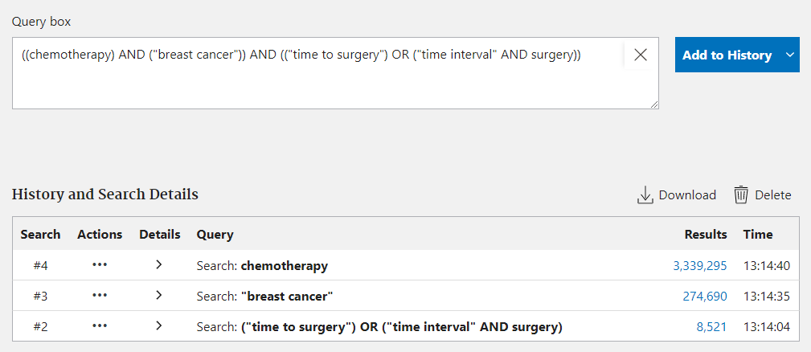
Power searching in PubMed
Use the arrow on the right to change the option back to “Search” to search PubMed

Slide 15
Power searching in PubMed
Why use the Advanced search screen?
Easy way to access fields
When you build your search one piece at a time, it’s easy to go back and edit only a part of the search instead of having to dig through a long search string

Slide 16
Power searching in PubMed
Why did we get this result?
PMID 30877468

Slide 17
Power searching in PubMed
When you don’t specify a field to search, PubMed searches ALL fields

Slide 18
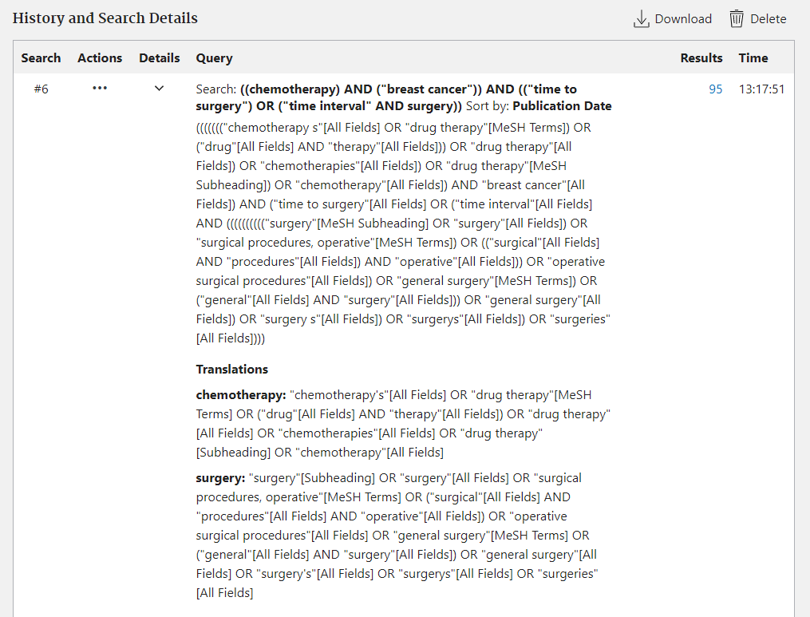
Power searching in PubMed
Automatic Term Mapping
You can see this on the advanced search screen

Slide 19
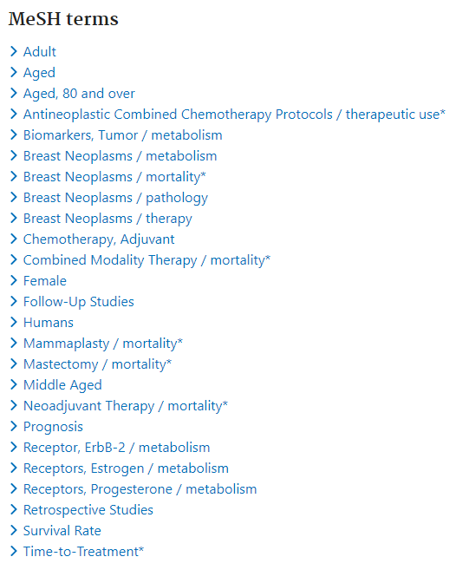
MeSH
MeSH is Medical Subject Headings, a thesaurus and taxonomy used to index MEDLINE records
PubMed has all of MEDLINE in it and some extra records as well, so not everything in PubMed has MeSH terms assigned
Words after a forward slash / are subheadings
Terms with an asterisk * are Major Topic

Slide 20
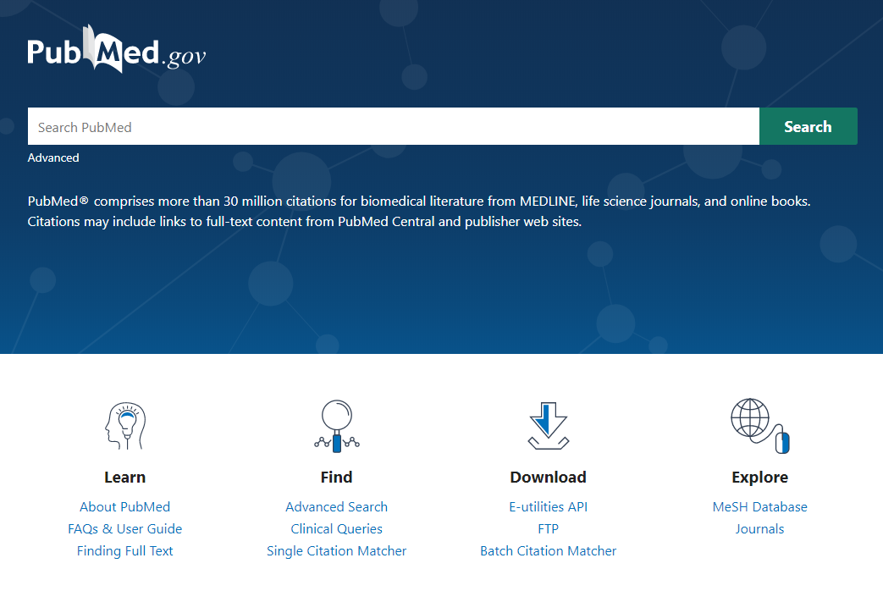
MeSH
To look up a MeSH term, use the MeSH database

Slide 21
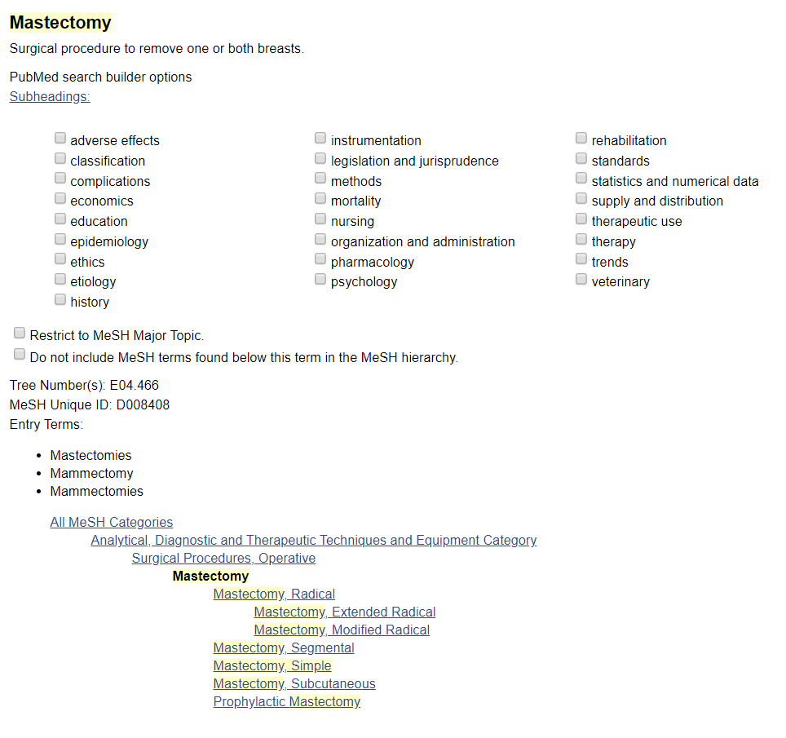
MeSH
MeSH heading and definition
Check the taxonomic tree to make sure you’re in the right place: can go broader or narrower
Check these subheadings to limit to only certain aspects of these topics

Slide 22
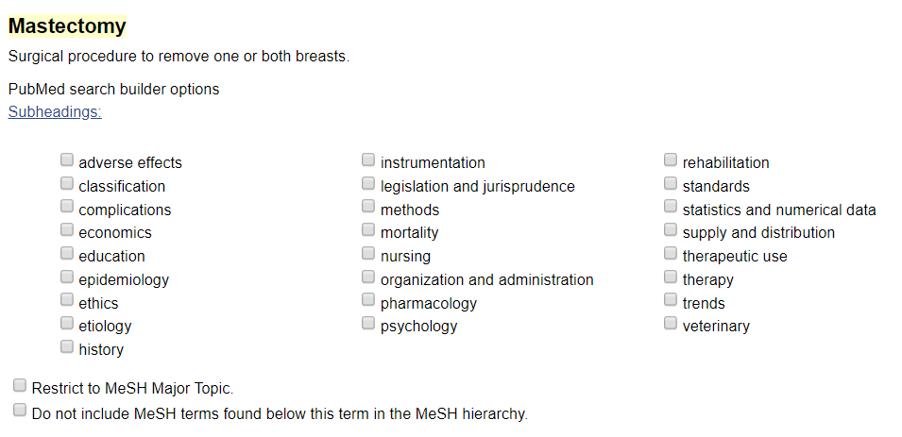
MeSH
The Major Topic box limits to only the most relevant articles

Slide 23
MeSH
Terms with an asterisk * are Major Topics
They indicate that a paper is really about those topics

Slide 24
MeSH
Click Add to search builder if you want to search PubMed with this term

Slide 25
MeSH
Why use MeSH terms at all?
To be quick
Get to the most relevant information by using a subheading with Major Topic
To be thorough
PubMed has many short, vague, or missing abstracts. MeSH indexing gives another source of searchable information about the content besides the publisher-provided title and abstract

Slide 26
Questions?
bethanymyers@library.ucla.edu

Slide 27
Introducing Embase
Large database of biomedical literature similar to PubMed
Embase vs. PubMed/MEDLINE
Embase claims to have 2700+ journals not indexed in MEDLINE
Stronger coverage outside North America
1.75 million conference abstracts from 5500+ conferences
http://www.embase.com
Need proxy or VPN to access from off-campus

Slide 28
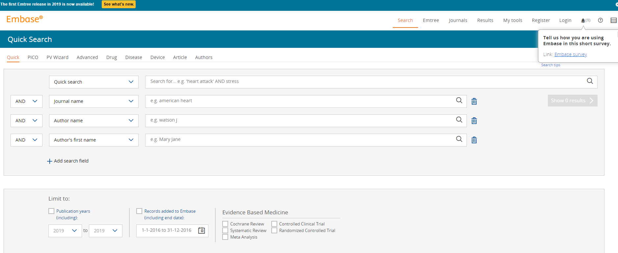
Embase
The default search screen is called “Quick search”

Slide 29
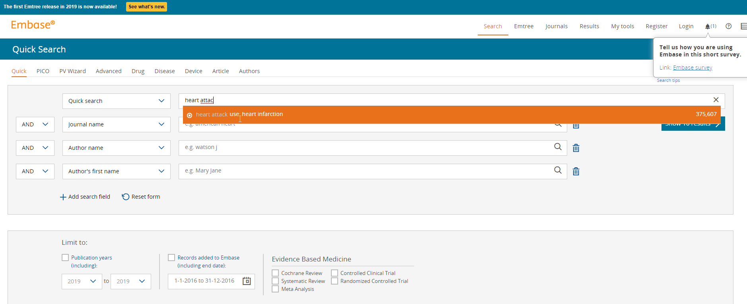
Embase
As you start typing a search query, Embase will prompt you to use a controlled vocabulary term (more on that soon)

Slide 30
Embase
As you start typing a search query, Embase will prompt you to use a controlled vocabulary term (more on that soon)
It will also show you how many results you’ll get for that query

Slide 31
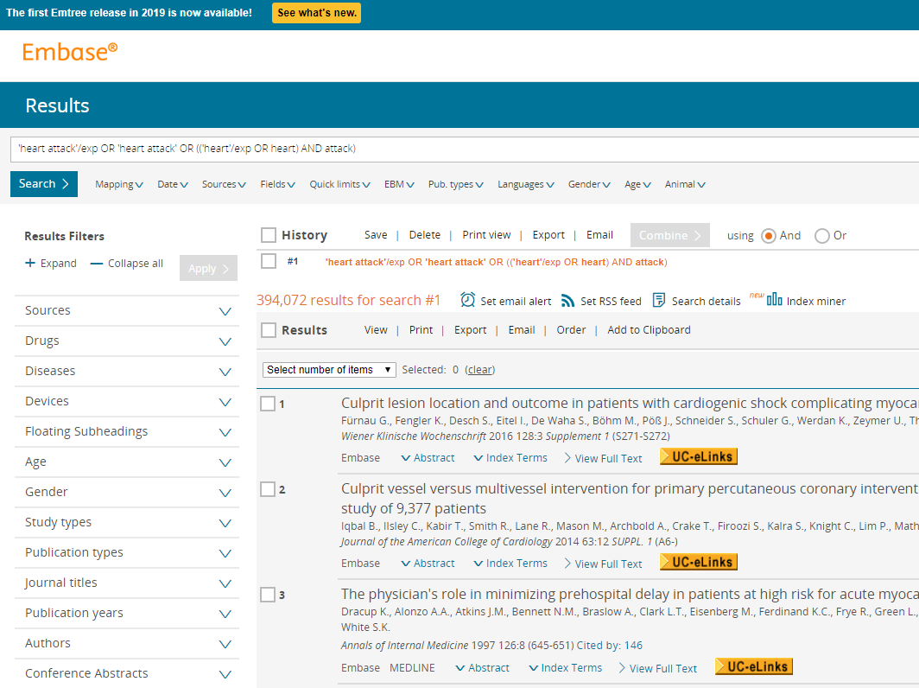
Embase
Your search
Your search history, which can be reused and recombined
Filters

Slide 32
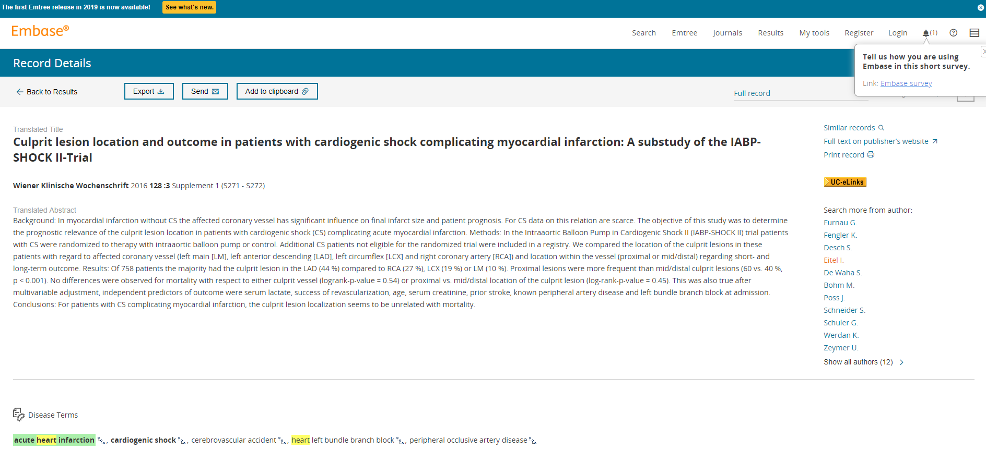
Embase
Emtree terms

Slide 33
Emtree
Emtree is Embase’s version of MeSH
Standardized subject headings
From an Embase record you can click the tiny icon to go to that term’s Emtree record
Or click Emtree in the top right corner of the screen
Bold terms are Major topics

Slide 34
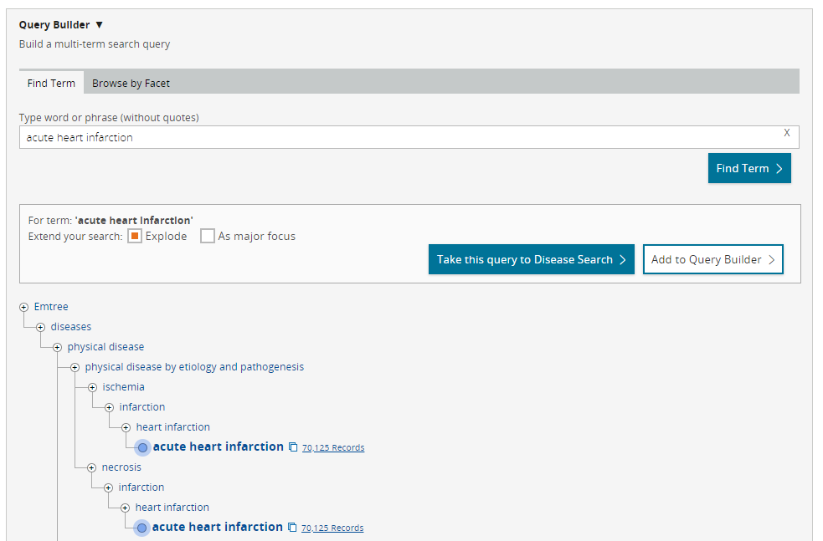
Emtree
Index term in taxonomic tree
Broader
Narrower
Explode to include all narrower terms
Search Embase or add to builder and continue looking up Emtree terms

Slide 35
Embase’s special search screens
Embase has a number of search interfaces that are tailored towards particular types of searches

Slide 36
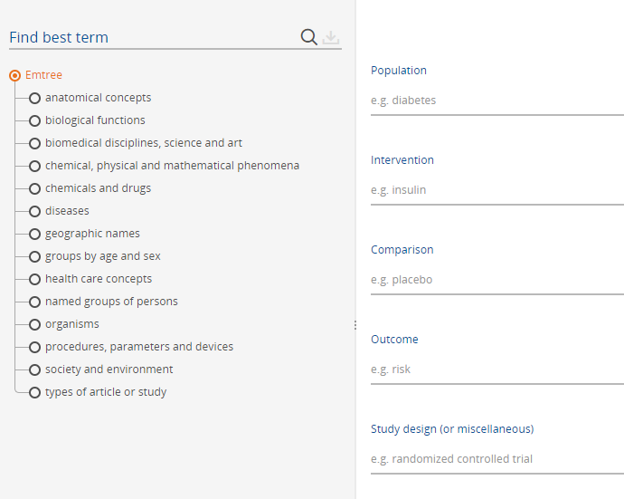
Embase’s special search screens
PICO search prompts you to format your question as PICO
Search or browse Emtree terms, or start typing and accept the pop up suggestions

Slide 37
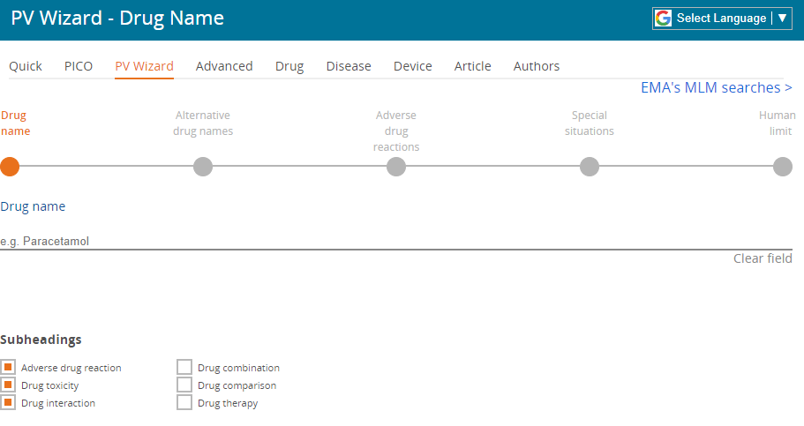
Embase’s special search screens
PV Wizard for pharmacovigilance

Slide 38
Embase’s special search screens
Advanced
More control over fields
Options for Emtree
Search limits

Slide 39
Embase’s special search screens
Drug, Disease, Device
Highlights fields and Emtree subheadings relevant to these topics

Slide 40
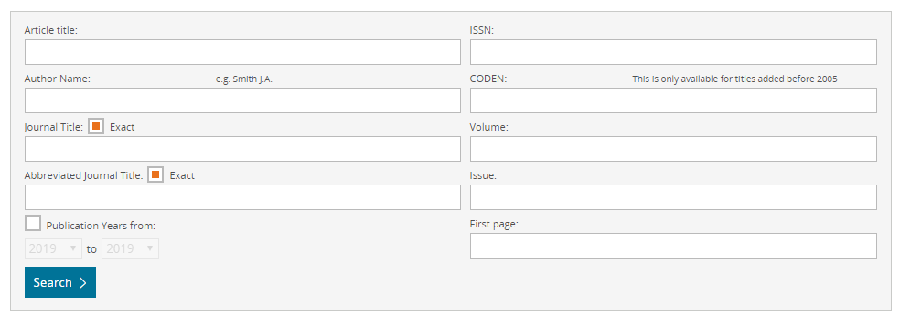
Embase’s special search screens
Article
Citation matching

Slide 41
Embase’s special search screens
Author
Disambiguate authors & their affiliations

Slide 42
Proximity searching
NEAR/X and NEXT/X

Slide 43
Questions?
bethanymyers@library.ucla.edu

Slide 44
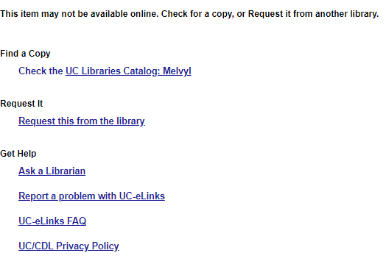
Getting full text of articles
UC eLinks
Interlibrary loan

