Slide 1
Mobile Phones for Self-monitoring & Self-management among People Living with HIV
Dallas Swendeman, PhD, MPH
Assistant Professor & Co-Director
Dept. Psychiatry & Biobehavioral Sciences, UCLA
Center for HIV Identification, Prevention & Treatment Services
Global Center for Children & Families
dswendeman@mednet.ucla.edu

Slide 2
www.ohmage.org & www.openmhealth.org

Slide 3
Methods: 3 related disciplines
Experience Sampling Method (ESM)
Psychology (Hektner, Schmidt, Csikszentmihalyi)
Ecological Momentary Assessment (EMA)
Psychology (Stone, Shiffman, Smyth)
Ambulatory Assessment
medicine / Europe, biomarkers (cortisol, bp, etc.)
Reactivity? – Nuisance or Opportunity?
EMI (Ecological Momentary Intervention)

Slide 4
Participant-involved/generated data
Self-report surveys
Brief open-ended reports & "annotations"
Digital still images, video, audio & associated annotations
EVERYTHING time-stamped and, when appropriate, location-stamped (on smartphones)

Slide 5
Unobtrusive & low-burden data
on Smartphones and similar devices:
Location (GPS, cell tower & wifi triangulation)
infer mobility & location
Accelerometers
infer activity (movement, exercise, sleep, etc.)
Call logs & SMS (text-message) logs
Peripheral devices – biosensors, blood sugar, etc.

Slide 6
Sampling/Triggering Schemes
Participant initiated
Time-based prompts
Location-based prompts
Other sensor data-based prompting
Accelerometers, Blue-tooth & Wifi, Peripherals, others?
Random prompts
Also linked to other data, including other data sources

Slide 7
Sampling Frequency
Anticipate frequency of "experience” :
In the moment / EMA
Multiple times per day “near experience”
Daily "diary" - once per day
Weekly or more – short-term retrospective
Adaptive in some way?
e.g., if lot of "no" reports then reduce frequency of prompts, or if “yes” increase frequency

Slide 8
PLH in L.A. (completed this week)
50 PLH randomly assigned to:
2/3 smartphones w/ daily surveys over 6-weeks
1/3 web-surveys only every two-weeks (control)
Goals – user experience, feasibility, validity, reliability, benefits?
Measures
Medication, Sexual Behaviors, ATOD use 1/day
Depression, Anxiety, Fatigue, Energy 4x/day
“Participatory” Stressful-events & Photo diary
Visualization on website
Next phase
Methamphetamine Using MSM in outpatient tx
Viz on phone, Goal setting, share data w/Counselor

Slide 9
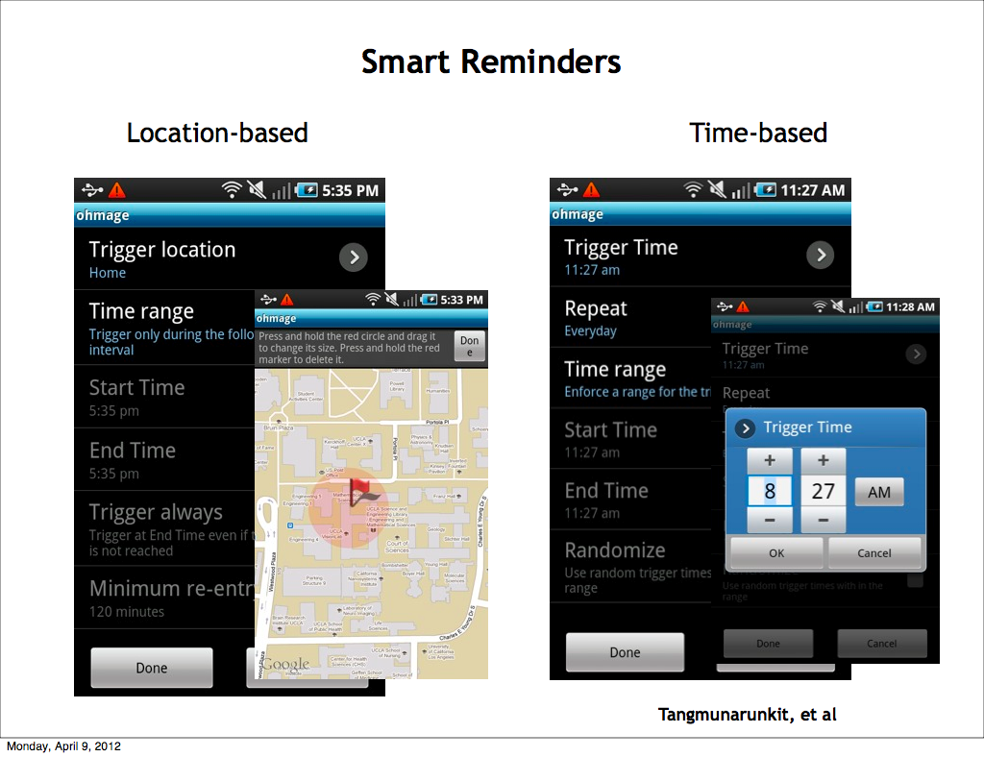

Slide 10
Smartphone Apps
maximum options
time, location/GPS, unobtrusive/background, etc.
more technically involved programming
especially for unobtrusive data, battery life, etc.
App incompatibility across phones
even with same OS (Android) not all devices will work
most likely have to provide phones to participants
Researcher/Clinician authorable web-interfaces
under development, e.g., Ohmage.org

Slide 11
SMS “Text-Messaging” & IVR
Text-messaging (SMS)
Interactive Voice Response (IVR)
Multi-media Messaging (MMS)
universally available on all phones (except MMS)
only time-stamped data and time-based prompts
no GPS/location prompts or unobtrusive data
need SMS/IVR back-end system & programming for anything but small-scale SMS applications

Slide 12
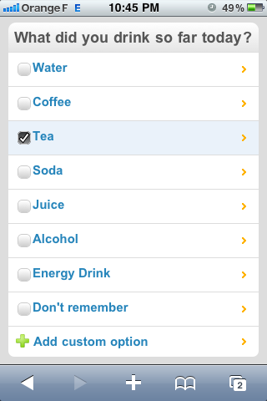
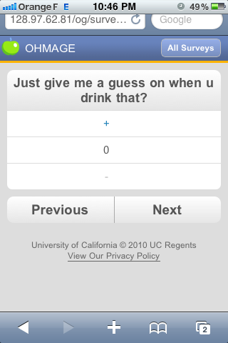
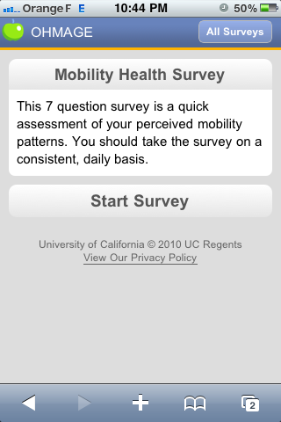
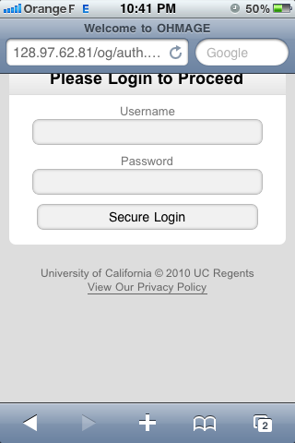
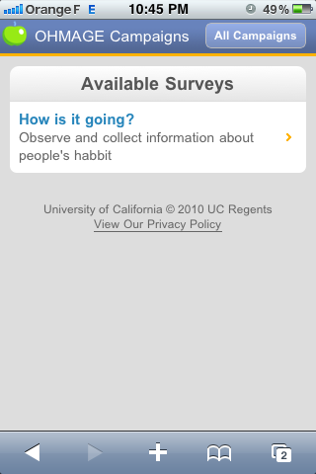
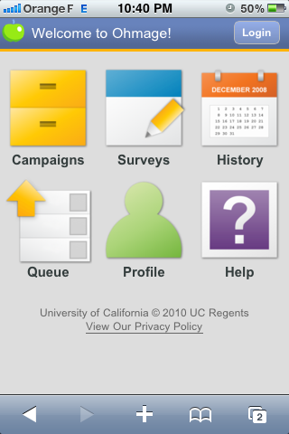
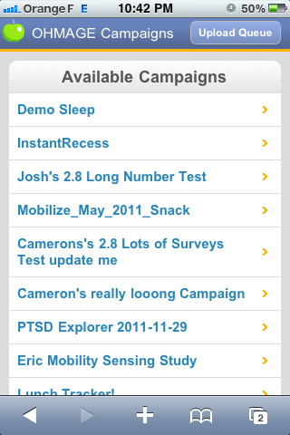
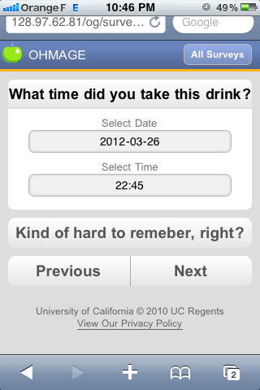
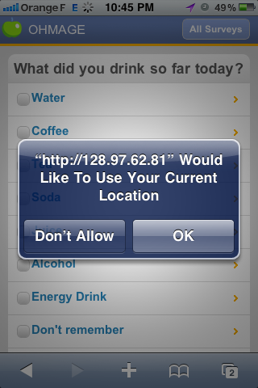
M0bile Web Framework (MWF)

Slide 13
Mobile Web Framework (MWF)
New technology from UCLA (based on HTML-5)
works on any phone with a web browser
better user-interface (than “feature phones”)
more easily programmable than apps
time-stamped data & time-based prompts
GPS/location-based prompts and data
Other unobtrusive data collection (maybe?)
not yet universally available

Slide 14
Validity & Reliability Challenges
Major challenge recognized by mHealth innovators
Lack of gold standards for EMA/ESM
Limited examples of measures to draw upon
most are very specific to a particular research question
e.g., how many dimensions of mood - chunking & splitting issues
Mixed-methods measurement development is an ideal approach
Adapt current gold standard retrospective self-reports is quick and dirty approach

Slide 15
Challenges
Missing data, Multiple data sources
Utilization, Utility, Compliance, Incentives
Participatory approach for engagement versus consistently completing surveys
Data access & utility
real-time processing, visualization, & feedback
Rapid improvements since study start
How to Analyze Data? Stats & mixed methods

