Slide 1



Opioids and HIV in Los Angeles:
Getting the Word Out to Communities and Providers
September 24, 2018
St. Annes | Los Angeles, CA
Notes:
CHIPTS and ACO are proud to be co-hosting this very important event, and we are happy to have you all here.
Etc etc

Slide 2








Thank You to Our Partners
UCLA Family Medicine
Notes:
Take a moment to acknowledge our partners
We also want give special thanks the following for their help:
Ricky and Dahlia from ACO
Michael Marquesen from Los Angeles Community Health Project
Eddie Sanders from Northeast Valley Health Corporation
Sandra and Tom from Los Angeles Region PAETC
Susan Forrest from LACADA
UCLA Department of Family Medicine
Dami and Izzy from CHIPTS

Slide 3

National Overview of the Opioid Crisis: Intersection with HIV
Steve Shoptaw, PhD
September 24, 2018

Slide 4
Acknowledgments
NIDA Grant U01 DA036267
NIMH Grant P30 MH 058107
UCLA CTSI/CFAR UM1 AI068619

Slide 5
HIV Prevalence Among PWID

Slide 6

HIV and Opioid Use:
What We Know From U.S.
Recent Outbreaks of Opioids and HIV
Needle and Syringe Programs
Opioid Agonist Therapy
Antiretroviral Therapy
Stimulants

Slide 7
Recent HIV Outbreaks in People who use injection drugs
Scott County, Indiana
West Virginia
Lowell & Lawrence, Massachusetts

Slide 8
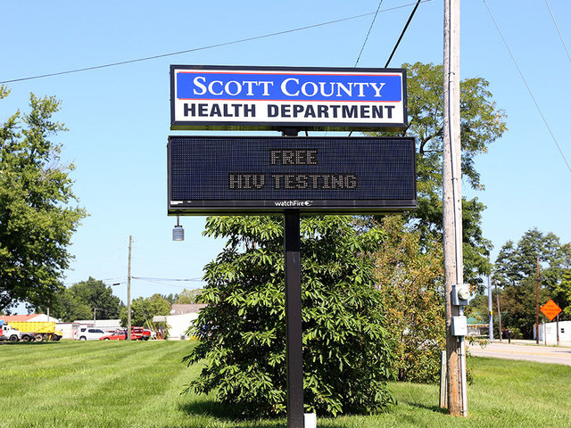
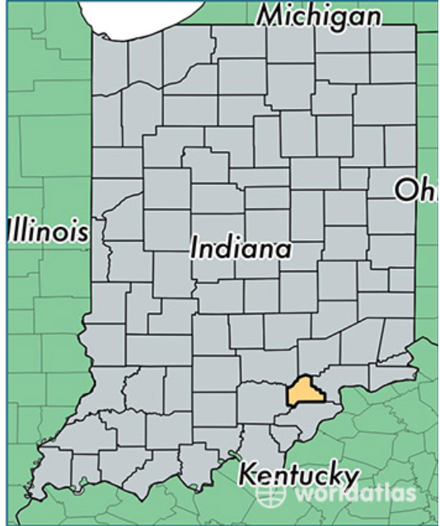
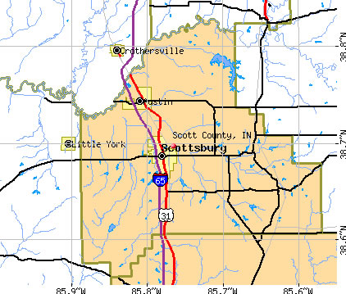
Scott County, Indiana

Slide 9
Scott County Outbreak, 2015

Slide 10
Scott County Outbreak, 2015

Slide 11
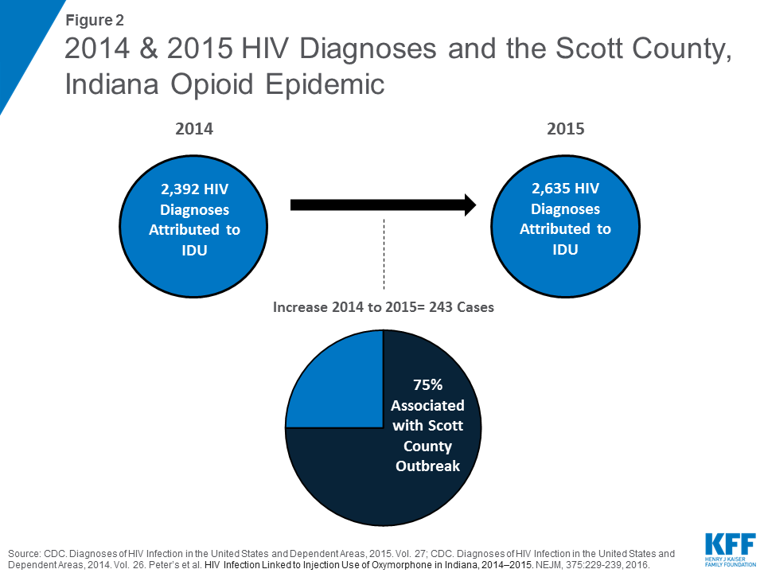

Slide 12
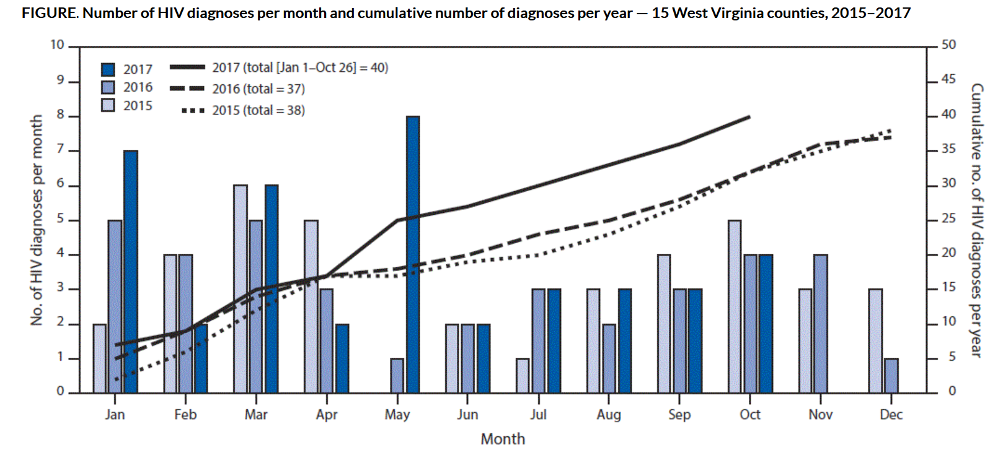
West Virginia Outbreak
https://www.cdc.gov/mmwr/volumes/67/wr/mm6708a6.htm

Slide 13

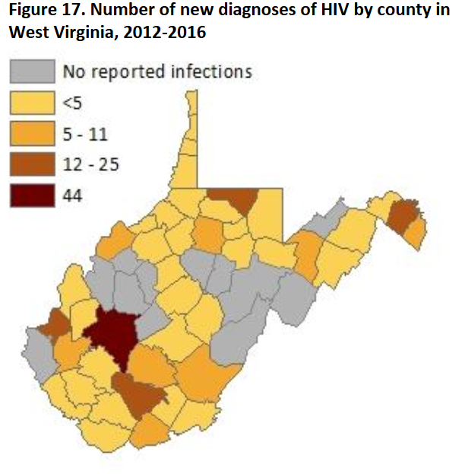
CDC: WV counties where HIV outbreak detected had no needle exchange
By Erin Beck Staff writer
Mar 3, 2018
January to July 2017
MSM 34 cases
IDU 5 cases
MSM+IDU 3 cases
Heterosexual 2 cases
Unknown 13 cases

Slide 14

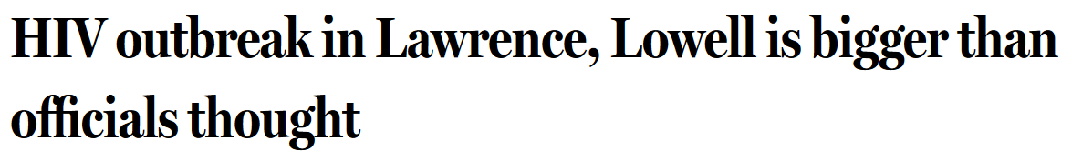
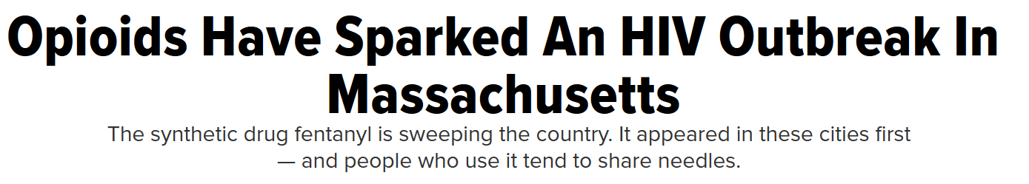

129 new cases of HIV among injecting-drug users in the area since the beginning of 2015

Slide 15
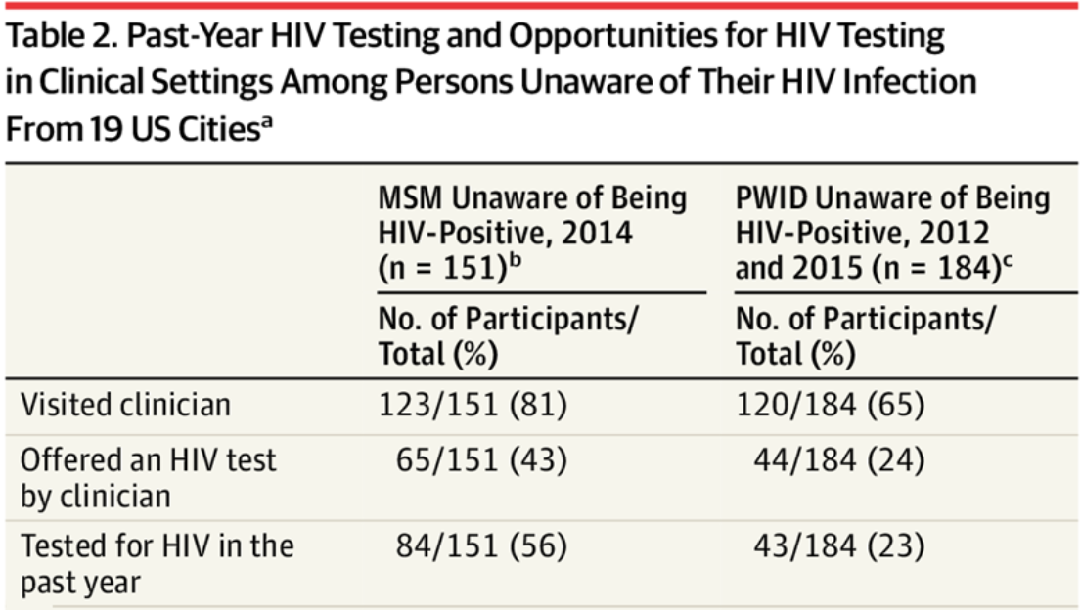
Infectious Disease Factors in Massachusetts Outbreak
HIV Counseling and Testing Differences
Lack of needle and syringe exchange programs
Stigma
Homelessness
Fentanyl
Wejnert, C. et al. (2018). JAMA 320:510.

Slide 16

What We Know…
Simultaneous scale-up of NSP, VCT, OST and ART implemented when CD4 cell counts drop < 350 can reduce HIV incidence up to 63% (Degenhardt et al., 2010)
In countries where HIV epidemics among IDUs are established or emerging, benefits of these combinations are amplified by structural interventions that optimize access or efficacy (Strathdee et al., 2010)

Slide 17
Russia: ART, NSP, OAT Outcomes
Prevalence
Incidence

Slide 18
Needle and Syringe Programs
Reduction of Risks for Infectious Disease Transmission

Slide 19
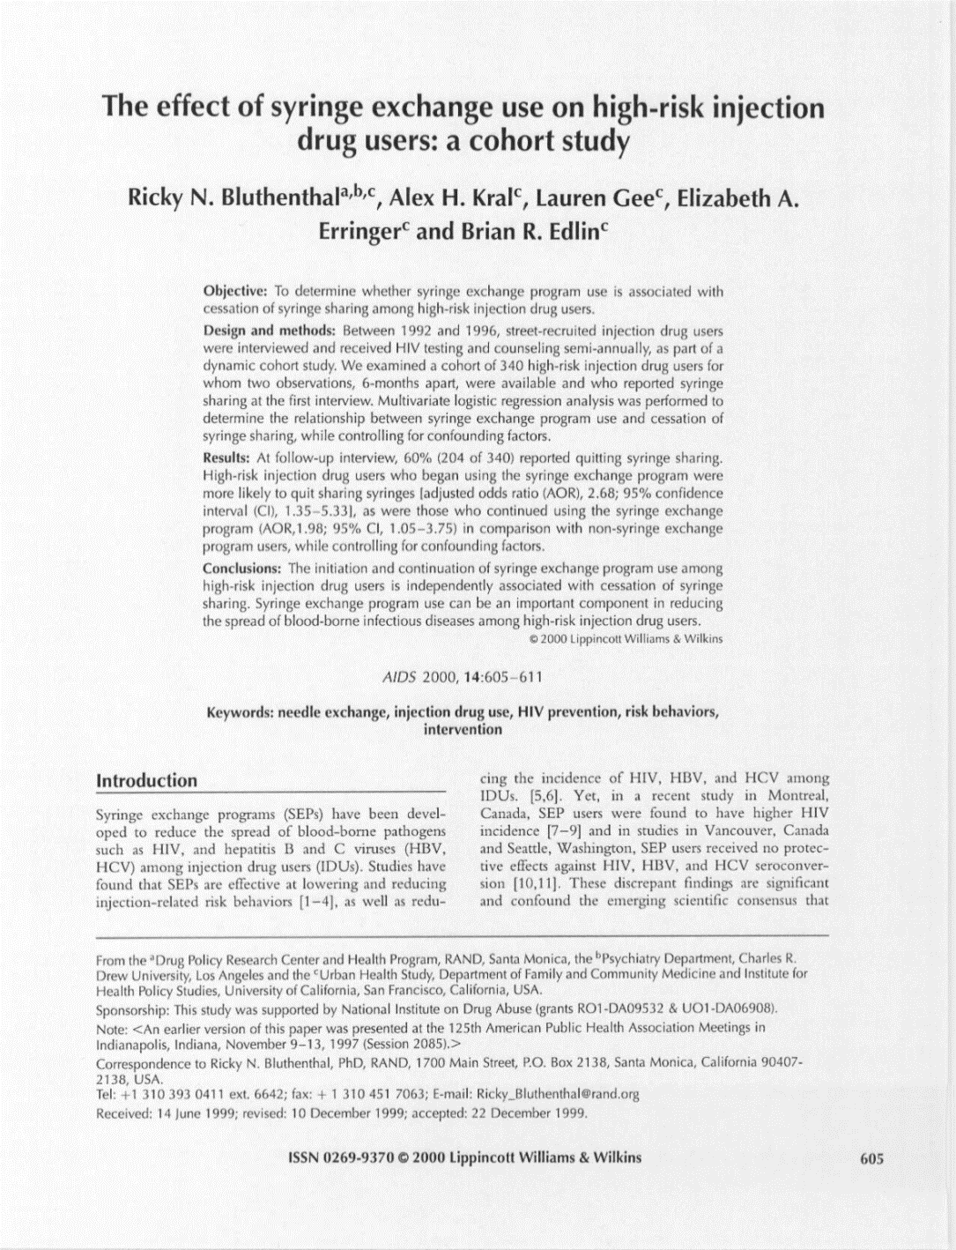
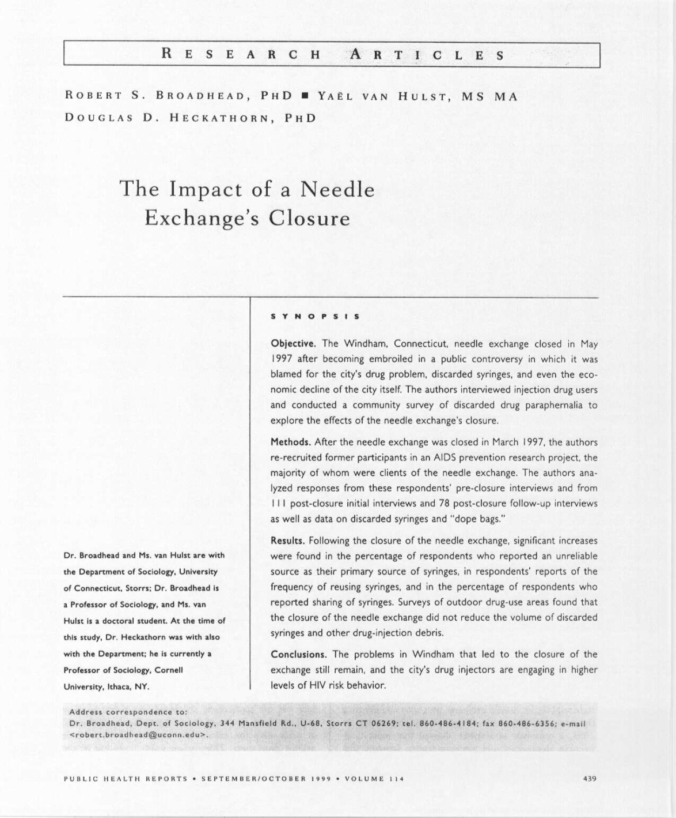
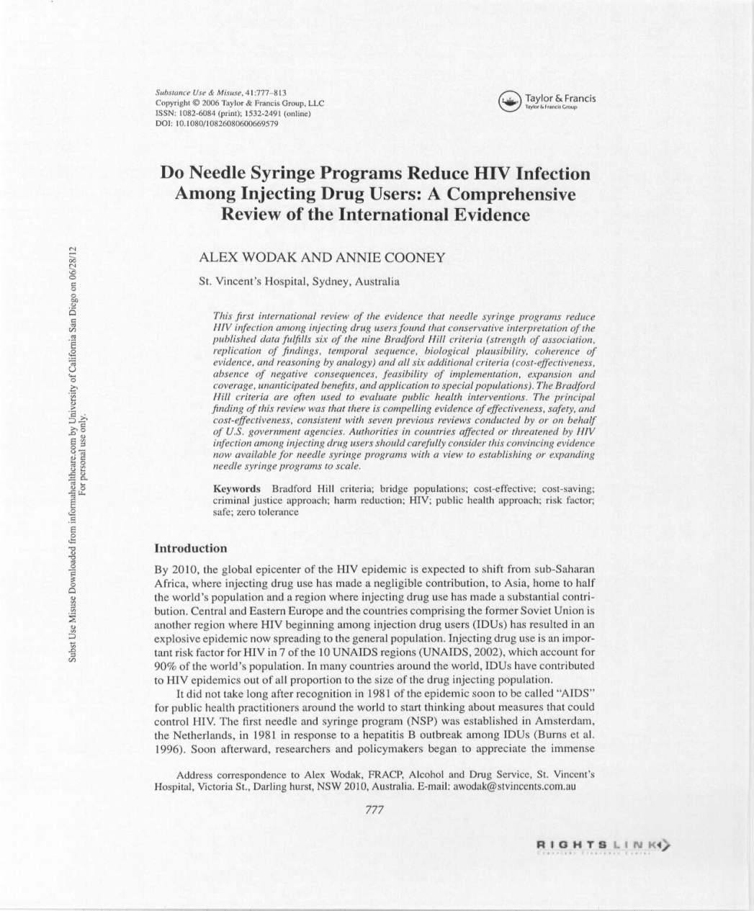
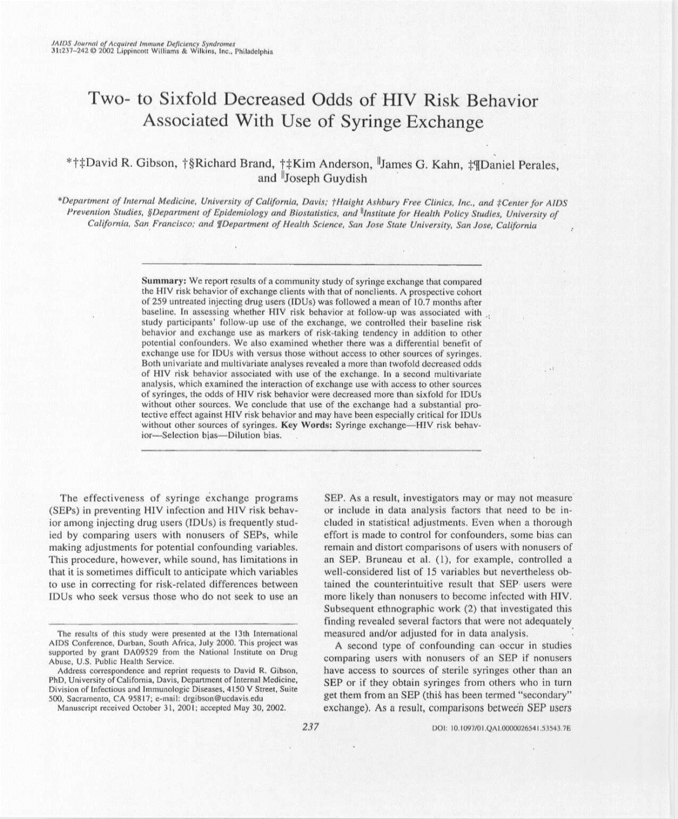
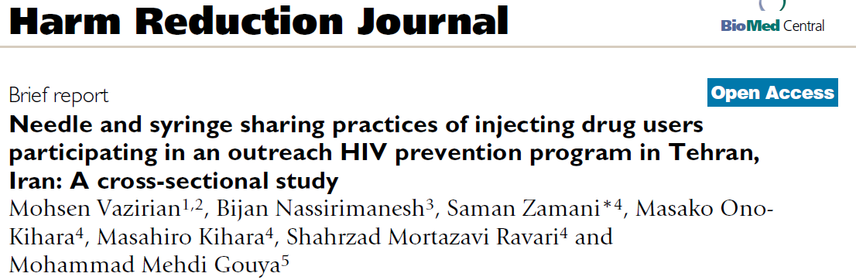
Needle and Syringe Programs
Provide sterile syringes in exchange for used syringes in order to:
  Reduce syringe sharing
  Reduce time that syringes potentially contaminated with HIV, viral hepatitis and other blood-borne pathogens are circulating in the community
  Provide or establish contact to other health services for PWID
  Narcan distribution

Slide 20
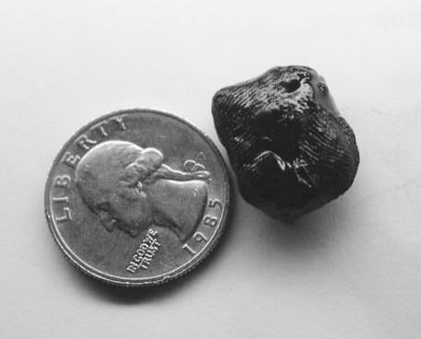
Heroin: Mexican Black Tar…
November 2017: Increasing distribution of brown and white powder heroin in SoCal. – SD Union Tribune
April 2018: 3 cases in San Diego County of wound botulism in 2017 leads to health alert. – LAHAN bulletin
July 2018: 3 cases in Los Angeles of wound botulism linked with injection of black tar heroin. – US News World Report
August 2018: 3 more cases in Los Angeles of wound botulism linked with injection of black tar heroin. – SF Chronicle

Slide 21
Opioid Substitution Therapy
Medication Assisted Therapies

Slide 22
Opioid Detoxification:
A Prescription for Failure
While detox sounds good, less than 2 in 100 successfully achieve drug free status (Day et al., 2005)
  Most don’t consider this treatment, but a necessity for convincing addicts to use agonist
  Psychosocial strategies are less effective (Mayet et al., 2005)
Newly detoxified individuals are extremely vulnerable to relapse. The vast majority fail to remain drug-free.
Opioid maintenance should be the first-line treatment for heroin dependence.
Notes:
Heroin injectors and individuals who abuse other opioids periodically seek detoxification to reduce the negative consequences of opioid dependence. All opioids share the characteristic of inducing tolerance and the cost of an illicit opioid habit usually creeps up over time, eventually becoming too expensive to support. As well, social, legal and interpersonal consequences of opioid dependence can induce users to throw up the flag and seek treatment. The primary treatment goal for opioid abuse among addiction treatment providers is stable maintenance, due to the strong pull of opiates on the individual to relapse. Many opioid abusers who seek treatment may not have the goal of maintenance and instead want detoxification. In a recent review of the evidence, Day and colleagues (2005) reported that while the database is overwhelmingly poor in quality, there are sufficient data to conclude that inpatient detoxification results in acceptable and high levels of patients who achieve the goal of opioid detoxification compared to outpatient programs. The data describing efficacy of outpatient programs, whether using decreasing methadone dosages, clonidine or other alpha-2 adrenergic medications, or (especially) non-medication detoxification strategies are overwhelmingly consistent to describe the approach as a failure (Amato et al., 2004). In fact, the reviewers for the Cochrane Library concluded that the failure rates from opioid detoxification are so high that this intervention is inhumane and should not be considered treatment! (These last statements may elicit strong reactions from the segment of the audience who consider drug-free status as the only acceptable outcome for drug abuse treatments).

Slide 23
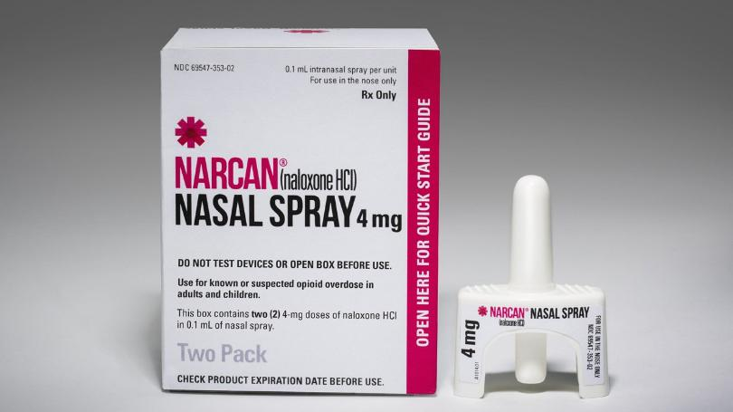
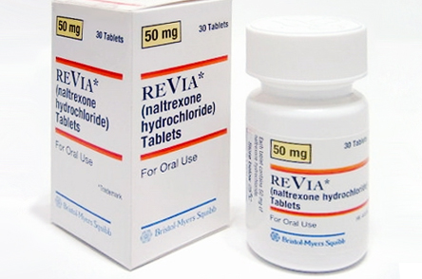
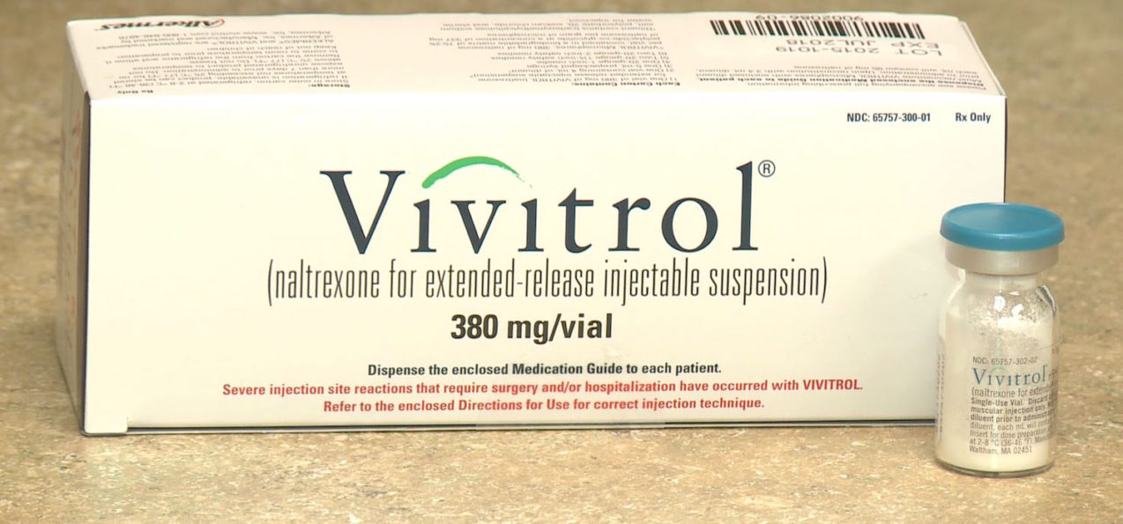
Opioid Antagonist
Naltrexone in many forms

Slide 24
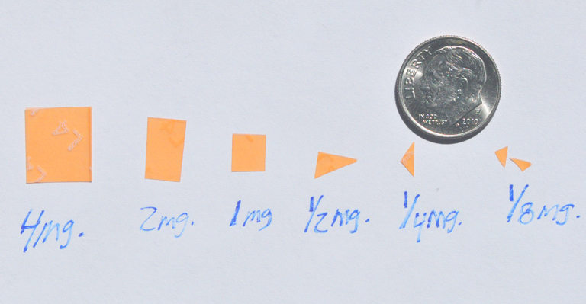
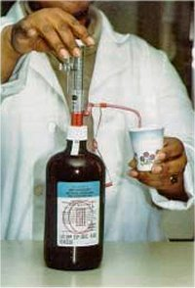
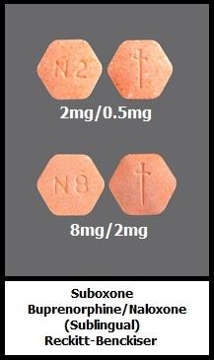
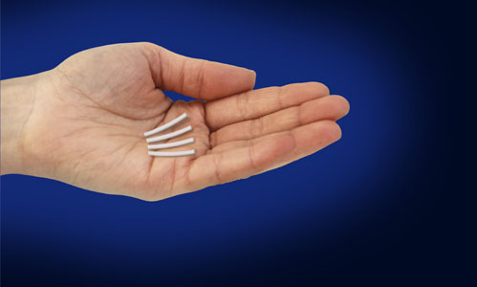
Opioid Agonist Treatments
Cheap (especially for methadone)
Potent
Portable (especially for buprenorphine)

Slide 25
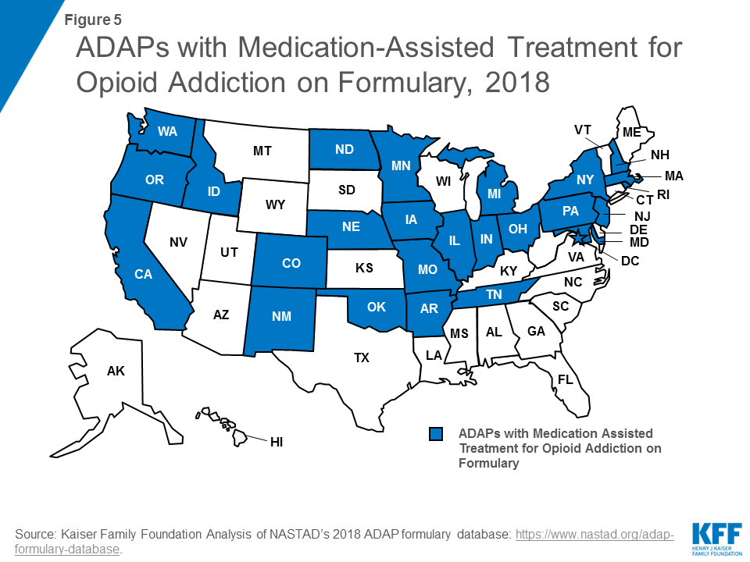

Slide 26
Opioid Treatment Cascade
Williams AR et al. J Subst Abuse Treat. 2018. 91:57-68.

Slide 27
Time to MAT Discontinuation
Most drop out in first month of MAT
Morgan et al., J. Subst. Abuse Treat. 2018. 85:90-96.

Slide 28
Antiretroviral therapy
PWID living with HIV

Slide 29
OD Risks in HIV-Positives, 2012
Green TC…Rich JD. AIDS. 2012. 26(4):403-17

Slide 30

ART in IDUs and NIDUs:
Access Denied
 | EVER Get ART? N=1730 | ART for 95%+ of Time N=1275
Age (per year) | 1.03 CI 1.02-1.04 | 1.02 CI 1.01-1.04
Baseline CD4<200 cell | 4.43 CI 3.19-6.16 | 1.15 CI 0.89-1.48
Baseline PVL>5 log₁₀ | 1.68 CI 1.2-2.35 | 0.68 CI 0.47-0.81
Black Race | 0.57 CI 0.44-0.73 | 0.65 CI 0.51-0.83
IDU History | 0.47 CI 0.33-0.67 | 0.63 CI 0.44-0.90
NIDU History | 0.62 CI 0.47-0.81 | 0.66 CI 0.52-0.85
Advancing the prevention and treatment of chronic illnesses
McGowan et al., 2011. PLOSOne, 6:e18462
UCLA Department of Family Medicine

Slide 31
Not Just the Needle: A Complicated Equation for HIV Transmission
NIDU + HIV = Risk
Substance Use Prevalence Transmission Potential
Type of Substance
Stimulant
Alcohol
NOT cannabis
Route of Use
Oral
Eating
Smoked
Inhaled
Inserted anally
Local Factors on HIV Prevalence
Dual Diagnosed
Poverty
Incarceration
MSM
Street youth
Women
Race/ethnicity
ART
OST
HIV Transmission Risks
Blood (?)
Drug-facilitated sexual transmission
Shoptaw S…Strathdee S. JAIDS, 2013, Suppl 2:S174-8

Slide 32
Stimulants
National and Local

Slide 33
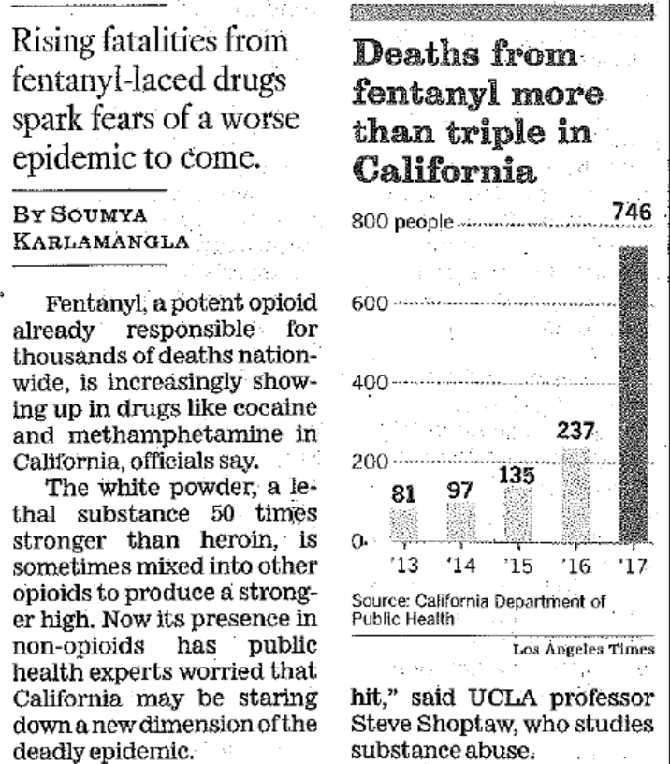
Watchful Waiting: Fentanyl in LA
May 15, 2018, Times Los Angeles

Slide 34
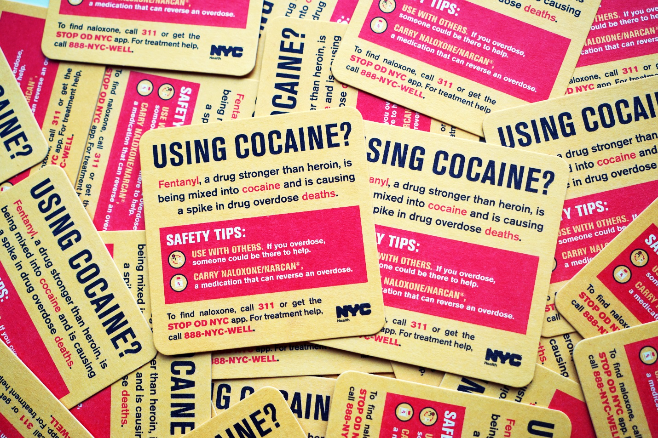
NYC: Fentanyl detected in 37% of cocaine OD Deaths in 2016, up 11% over 2015

Slide 35
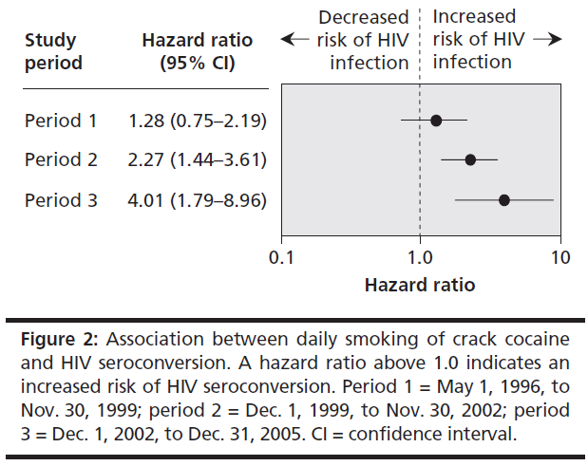
Crack Cocaine Use and HIV Seroconversion among People Who Use Injection Drugs
DeBeck et al., 2009, CMAJ, 181:585-589

Slide 36
Evidence Based Prevention for PWID
Use only new, sterile needles and works each time. NSPs and Pharmacy sales.
Never share needles or works.
Clean used needles with bleach only when you can’t get new ones.
Use sterile water to fix drugs.
Clean your skin with a new alcohol swab before you inject.
Be careful not to get someone else’s blood on hands or works.
Dispose of needles safely after one use. Use a sharps container.
Get tested for HIV at least once a year.
opioid substitution therapy and ART for HIV.
Take PrEP, if you’re negative.
Use PEP when needed after risk exposures.
Don’t have sex if you’re high. Use condoms if you do.

