Slide 1
DHS: LAC Jail Overdose Prevention Program
Opioids and HIV in Los Angeles
Monday, September 24, 2018

Slide 2
Outline
National: Incarcerated HIV, Substance Use Disorder
LA County Jails: HIV, SUD
Reentry Risk Profile: North Carolina, Washington State
LAC Jail Overdose Prevention Response (OPR) Needs Assessment
LAC OPR Program Model
First week
What’s Next

Slide 3
Partners
Los Angeles County Sherriff’s Department
Department of Public Health: Substance Abuse Prevention and Control, SafeMed LA
DHS Partners: Correctional Health Services, Whole Person Care, Office of Diversion and Reentry, Housing for Health
LA County HEART Collaborative
California Department of Public Health

Slide 4
Incarcerated People: HIV and SUD
Substance Use Disorder (2007-2009)
HIV (2001-2010)
58% of state prisoners and 63% of sentenced jail inmates met the criteria for drug dependence or abuse.
10 to 12x higher than U.S. adult population with similar demographic background who met these SUD criteria.
HIV seroprevalence among incarcerated individuals is 1.5%.
Approximately 3x greater than among the general U.S. population.
Notes:
SUD: https://www.bjs.gov/content/pub/pdf/dudaspji0709.pdf
Drug Use, Dependence, and Abuse Among State Prisoners and Jail Inmates, 2007-2009 (NCJ 250546), was written by BJS statisticians Jennifer Bronson and Jessica Stroop, and Stephanie Zimmer and Marcus Berzofsky of RTI International. The report, related documents and additional information about BJS’s statistical publications and programs can be found on the BJS website at www.bjs.gov.
HIV: Maruschak L. HIV in Prisons, 2001–2010. Washington, D.C: US Department of Justice, Bureau of Justice Statistics; [accessed 9/18/12, 2012.]. Report No: NCJ 238877;http://bjs.ojp.usdoj.gov/content/pub/pdf/hivp10.pdf.

Slide 5
LA County Jails
2017 - 110,941 bookings (multiple bookings; 1/3 of arrests)
17,120 average daily census (2018)
2.5-3% HIV+ = 471 people (DHS/ CHS estimate)
68% SUD = 11,641 people (national %; local data soon)

Slide 6
NC Opioid Overdose Mortality Among Former Inmates 2000-2015
230,000 former inmates in North Carolina released 2000-2015 to NC general population.
At 2-weeks, 1-year, and complete follow-up after release, the respective Opioid Overdose Death risk among former inmates was 40x, 11x, and 8.3x as high as general NC resident.
Heroin overdose death risk among former inmates was 74x, 18x and 14x as high as general NC residents.
Shabbar I.Ranapurwala, PhD, MPH, Meghan E. Shanahan, PhD, Apostolos A. Alexandridis, MPH, Scott K. Proescholdbell, MPH, Rebecca B. Naumann, PhD, MPH, Daniel Edwards Jr, MRP, and Stephen W. Marshall, PhD, MPH; AJPH, 7/19/2108: Opioid Overdose Mortality Among Former North Carolina Inmates: 2000–2015

Slide 7
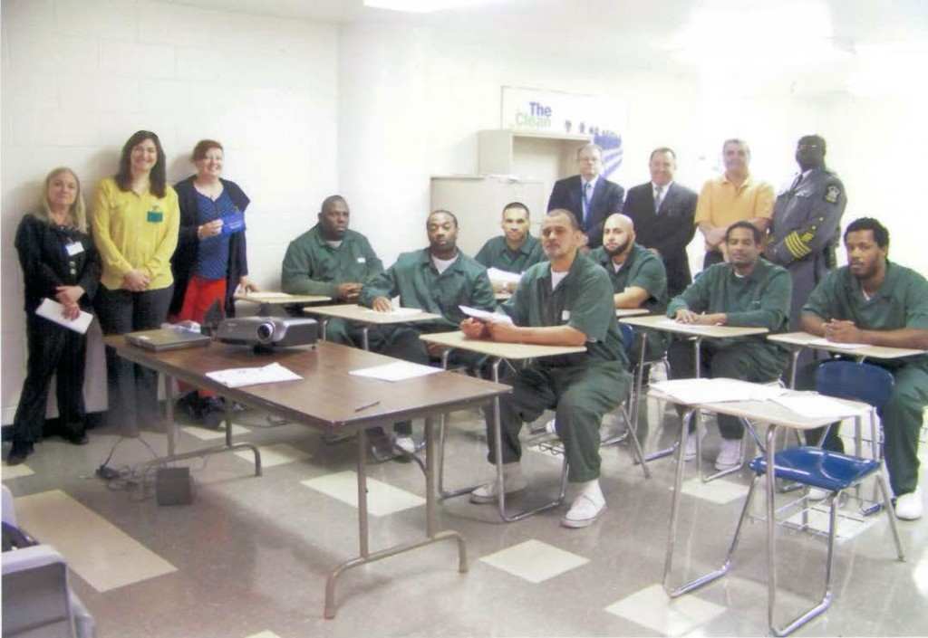
Washington State: Overdose Risk and Reentry
Former inmates had 129x risk of overdose death during the 2 weeks immediately following release from prison than the general population.¹
Overdose was the leading cause of death among former prisoners.²
Opioid overdose was most common during the first two weeks following release from jail or prison.²
¹Binswanger I.A., et al. (2007). Release from prison—a high risk of death for former inmates. NEJM356(2), 157-165;
² Binswanger IA et al. (2013). Mortality after prison release: opioid overdose and other causes of death, risk factors, and time trends from 1999 to 2009. Ann Intern Med159(9), 592-601.
Notes:
Recent studies have shown that people exiting jail and prison and re-entering the community experience very high rates of fatal opioid overdose. Ingrid Binswanger, has conducted several studies of mortality among former inmates in Washington State, and found overdose was the leading cause of death in that population, and that the two weeks immediately following release were the highest risk period; during those two weeks released inmates had a 129 times higher risk of overdose than the general population.

Slide 8
LAC Jail OPR Needs Assessment
Objective: To determine need for overdose prevention and response training (OPR) for inmates in Los Angeles County Jails.
Methods: In 2017, the Los Angeles County Office of Diversion and Reentry collaborated with the Los Angeles County Sheriff Department to conduct an OPR needs assessment evaluation with all inmates entering the jail over a two week period.
Conducted by uniformed custody staff.
3,781 inmates provided complete data for this analysis (3,315 men, 466 women).
*currently under review for the Journal of Addictive Behaviors.

Slide 9
LAC Jail OPR Needs Assessment Results
17% reported using opioids within the last 12 months,
7% reported witnessing an overdose within the last 12 months, and
5% report ever having received medication assisted treatment (MAT).
39% reported interest in being trained in OD prevention and response.
The single largest predictor of interest in OPR was being present at an overdose in the past year.

Slide 10
Other Jail Programs
Similar Models: New York, SF, Chicago, Pittsburg
OPR Education Modalities | Naloxone Distribution
1:1 Groups Video Pharmacist | Belongings Pharmacy Community Referral

Slide 11
LAC Jail OPR Program
VIDEO: Staying Alive on the Outside
1; 5 min; 15-20 min
Group training
Ongoing needs assessment
Whole Person Care enrollment
Transitional Care
Release Meds – Pharmacy
Community Referral
STAYING ALIVE ON THE OUTSIDE
Notes:
California Department of Public Health: 80 units of naloxone for distribution to inmates

Slide 12
LAC Jail OPR Launched at CRDF 9/18 & 9/20
26 Women trained; 25 opted to receive Naloxone on release
36% overdosed in the past
48% have witnessed an overdose
38% are at risk of an overdose
68% know someone at risk of OD
Notes:
SF
23% Overdosed in the past
61% Witnessed an overdoses

Slide 13
Vision & Challenges
SCALE
Some DHS touch points for CJ involved people
Jail and Transition Teams
Homeless Outreach Teams (Multi Disciplinary Teams)
Interim & Permanent Housing Sites
Intensive Case Management Services
Probation Centers
Community Diversion: Law Enforcement Assisted Diversion (LEAD)

Slide 14
Thank you
Shoshanna Scholar
Director of Community Based Diversion
Office of Diversion and Reentry
sscholar@dhs.lacounty.gov
323.505.2443

