Slide 1
Proposal Basics:
Preparing Applications for Research Funding
Laura Sheehan
Manager of Research Administration, Dept. of Family Medicine

Slide 2
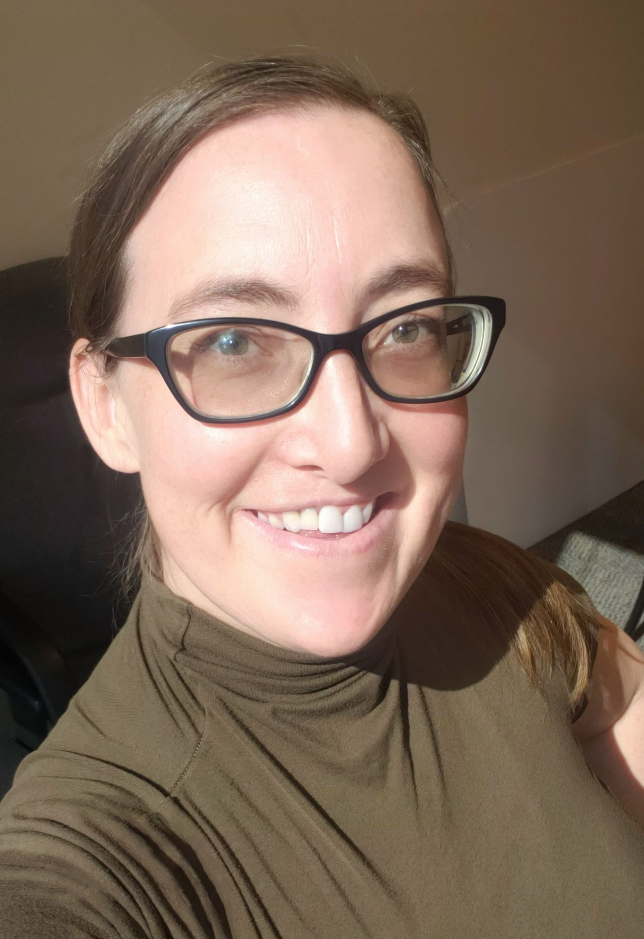
Laura Sheehan
Manager of Research Administration, Department of Family Medicine, David Geffen School of Medicine at UCLA
22 years in academic research administration
3 years in Civil/Environmental Engineering research administration at University of Southern California (USC)
10 years in Pediatric Infectious Diseases research and fellowship administration, and divisional financial management at UCLA
9 years in Family Medicine research administration and financial management at UCLA
Management of approximately $10M in contract and grant funding annually
Department consistently ranks in top 10 nationwide for federal funding among all Family Medicine Departments

Slide 3
Objectives
Provide a basic overview of the research funding process, including identifying appropriate funding opportunities, exploring different kinds of sponsors, and understanding typical proposal components.
Develop an understanding of the lifespan of a research project from development to close-out.
Discuss the fundamentals of preparing a research proposal, including tailoring research plans to specific opportunities, creating a budget, organizing your team, building a timeline for submission, and how to avoid common mistakes.

Slide 4
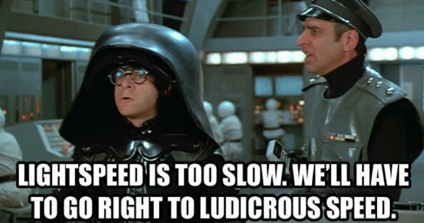

Slide 5
Roles and Responsibilities
Principal Investigator (PI) | Determines funding opportunity to apply for, reviews guidelines, develops proposal, prepares all documents
Research Team | Assists as needed with development of proposal key personnel: contribute to the scientific development or execution of a project in a substantive, measurable way, paid or not
Subaward Research Team | Obtains AO approval at their site, submits subaward packet to PI
Department Administrator | Works with PI, assists with budget/justif/biosketches, obtains signatures on internal forms, submits to AO
Authorized Official (AO) | Reviews proposal for compliance, signs/submits application
Sponsor | Issues guidelines, answers questions, reviews proposals, selects awardees

Slide 6
Subawards
Awarding Agency
(Prime Sponsor)
Awardee
(Pass-Through Entity [PTE]; Sponsor)
Subrecipient
(Subaward, Subgrant, Subcontract)

Slide 7
Research Project Process
Idea
Find Funding
Develop Proposal
Route Proposal for Internal Approval
Authorized Official Submits Proposal
Award Processed
Initiate and Manage Project
Close-Out

Slide 8
Idea Phase
Things to consider
Significance
Innovation
Building your team
Why should I care?
Hasn’t somebody else already done this?
Why on Earth would I trust you to do this?

Slide 9
Finding Funding

Slide 10
Sponsor Types
NIH
Internal
Government
Federal
State
Local
Higher Education
Private/Non-profit
Foundations
For-Profit
Pharmaceutical
Business
PCORI
Bristol Myers Squibb

Slide 11
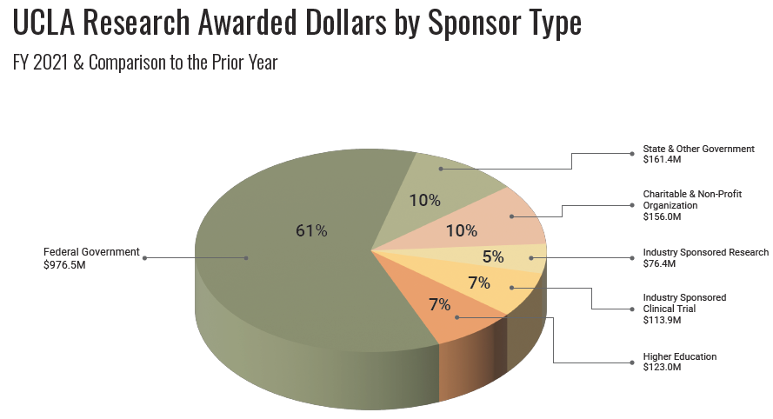
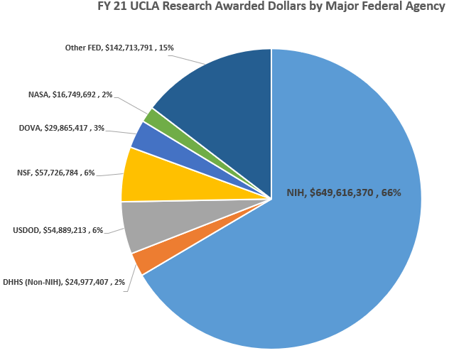

Slide 12
NIH
RePORTER : Repository of NIH-funded research projects and access publications
Matchmaker interface: Input an abstract/scientific text to find a list of the 100 most similar projects NIH is funding.
Explore projects NIH has funded in your area of science
Identify the appropriate IC
Identify the Program Officials to contact that are associated with similarly funded projects
Find experienced collaborators
Figure from nih.gov
Program Officer (PO) | Programmatic/scientific aspects; talk to them before submitting (as well as after)
Scientific Review Officer (SRO) | Admin aspects of scientific review group; talk to them if you have questions during review process
Grants Management Officer (GMO) | Administrative and regulatory aspects; talk to them if you need technical assistance

Slide 13
How to Find Funding Opportunities
Sponsor websites
Grants.gov (for federal opportunities)
Sponsored Programs Information Network (SPIN)
Your institutional research office
UCLA Research Enhancement Office
Colleague referrals
Subscribe to newsletters

Slide 14
Sponsor Guidelines

Slide 15
Sponsor Guidelines
Important bits
Eligibility (limited submission?)
Purpose
Due dates
Required elements/sections (templates, forms, etc.)
Page limits and formatting requirements
Budget restrictions (total amount, unallowable items, etc.)
Submission method (email, online portal, etc.)
Restrictions (LOI required? Over $500k?)
Scoring/Review Process
LSO – Must obtain institutional approval to proceed. UCLA LSO Portal

Slide 16
Common Elements
Abstract
What will you do? Why is it significant? How is it innovative? How will it be done?
Publically available (no proprietary info)
Often limited to 30 lines or less
Often written last

Slide 17
Common Elements
Project narrative
Typical of NIH applications
Addresses relevance of proposed research to public health
2-3 sentences max
Lay language
Tips From “How to Write a Successful Grant Application”
(H. Ardehali, American Heart Assoc., 2014):
Aims should not be dependent on each other
Don’t use phrases like “To study…,” instead say “To determine…”
Specific aims
Some start with a brief background and rationale, followed by hypothesis, then the aims:
Usually 2-4 (no less than 2 unless it’s a small/pilot study)
Engage the reader, but keep it simple
Usually 1 page or less

Slide 18
Common Elements
Research Strategy
Length depends on sponsor (NIH is usually 6 or 12 pgs)
Significance
Get passionate
Convince reviewer your research is essential/fascinating
Innovation
Where are the gaps and how will your research fill them
Approach
Design, Methods, Data Analysis, Prelim Data
Prove feasibility (scope/size must be achievable)
Strengths/Weaknesses
Bibliography (NIH: must include PMCIDs, no links/urls)

Slide 19
Common Elements
Environment
Facilities/Resources
Equipment
Don’t re-invent the wheel
Biosketches (or resumes/CVs)
Formatting is imperative
Typically required of all Key Personnel
Prove to the reviewers that your team is qualified, experienced, and capable

Slide 20
Common Elements
Human subjects / clinical trial information
Must address the “big 4”:
Risk to subjects
Adequacy of protection against these risks
Potential benefits of the research to subjects and others
Importance of the knowledge to be gained
Other
Mentorship plan, Multiple PI Leadership plan, Consortium/Contractual Agreements, Letters of Support, etc.

Slide 22
BUDGET

Slide 23
Budget
Cost Principles:
Allowable
Allocable
Reasonable
Necessary
Consistently applied (regardless of funding source)

Slide 24
Budget
Common elements of budget
Personnel
Effort in percentages or person months
Employees only (no consultants or subaward personnel)
Fringe benefits (UCLA: CBR)
PI Effort: “Typical” effort varies
STTR: minimum 10%/1.2 cal mos
R series: 15%/1.8 mos
MPI: slightly less
K series: 75%/9 cal mos
Equipment
Must be more than $5k per unit
Travel
Study travel vs. conference travel
Foreign vs. domestic vs. local
https://www.gsa.gov/travel/plan-book/per-diem-rates

Slide 25
Budget
Subawards
Each site needs to have its own mini-proposal (budget, justification, scope of work, etc.)
Must be approved by subsite’s Authorized Official
Often main site will give draft budget or budget maximum to subsites
SOW is the main thrust of the agreement with subsite

Slide 26
Budget
Other
Materials and Supplies
Computers, recording devices, tablets
Supplies for the creation, organization, storage of study data
“Project-specific supplies”
Publication Costs
Journal publication charges, color figures, creation of posters
Consultants
Cannot be employees, not considered KP, fixed rate/sponsors may have rate limits
Rent
Participant Incentives
Required Institutional costs (UCLA: TIF, GAEL)

Slide 27
Budget
Indirect Costs
Direct costs are expenses connected to a specific project, whereas indirect costs are expenses involved with maintaining and running an institution.
Indirect costs are frequently called “overhead costs,” “facility and administrative costs” (F&A), or IDC.
The Indirect Cost Rate is a set ratio/percentage of direct cost, it is standardized and often is required to be approved federally. (Institutions without a federally-approved IDC Rate Agreement can utilize the Federal De Minimis rate of 10%.)
Sponsors may restrict IDC to a maximum amount or unallow them entirely (must be a published, standardized policy for all award recipients). Your institution may require approval to accept such an award.
Reach out to your Department Admin or Authorized Official prior to creating your budget to ensure IDCs are correctly calculated.

Slide 28
Budget
Other Considerations
Multiple years
Restrictions
Round to nearest dollar unless otherwise stated

Slide 29
Budget Justification
Narrative explanation
Justify how each item is necessary to achieve project aims
Clarify how the costs were calculated
Organized in same order and with same sections as budget
Categories less than $1,000 can have minimal (e.g. 1 or 2 sentence) explanations
Unusual or expensive items should be justified in detail, including cost-comparisons/alternative explored
Make sure your figures match

Slide 30
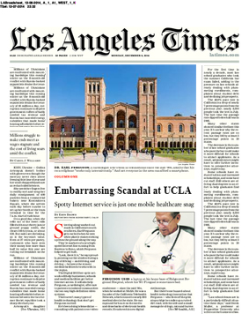
Researcher purchases ridiculous item from tax-payer funds
Fake LA Times Cover

Slide 31
Gameplan

Slide 32
Sample Plan
Element |  | Responsible Party | Due Date
Performance Sites |  | Dept. Administrator, with input from Proj Coord/PI | Sep 12
Key Personnel |  | Project Coord. with input from PI | Sep 12
Budget |  | Dept Administrator and PI | Sep 13
Draft Subaward docs |  | Dept Administrator and PI/Proj Coord will send to subsite | Sep 14
Biosketches |  | All Key Personnel create their own | Sep 20
Budget Justification |  | Dept Administrator and PI | Sep 26
Final Subaward docs |  | Sub will obtain sub AO approval and return final, signed version | Sep 26
Human Subjects |  | PI and Proj Coord | Sep 26
Research Plan |  | PI | Sep 26
 | Specific Aims | PI | Sep 26
 | Research Strategy | PI and Co-I's | Sep 26
 | Resource Sharing Plan | PI and Co-I's | Sep 26
 | Facilities and Resources | Dept. Administrator and Proj. Coordinator | Sep 26
 | Letters of Support | Proj Coord will seek LOS from all sites | Sep 1-26
Cover Page |  | Dept. Administrator | Sep 26-28
Internal Forms |  | Dept. Administrator (will obtain signatures from PI and Co-I's) | Sep 26-28
Submission to AO |  | Dept. Administrator | Sep 28
Submission to Sponsor |  | AO | Oct 5
Build in extra time for review and feedback
Don’t forget to allow for holidays
Assume people will be late

Slide 33
INFORMATION

Slide 34
Internal forms
Proposal Intake Form
Department-specific; due to Dept Admin at the start of pre-proposal process
Gathers basic data for planning purposes
Central Office Extramural Proposal Approval Form (UCLA EPASS)
Submitted by Dept Admin to Central Office, gathers info to ensure proper approvals/certifications are in place
Used for institution-wide tracking and record-keeping
Requires sign-off by PI and Chair/Dean
Conflict of Interest Forms (must be signed by all Key Personnel at your site)
Federal PHS Sponsor/Prime: PHS Disclosures are required (UCLA: eDGE)
Federal non-PHS, CIRM, or UC RGPO/UCOP Sponsor/Prime: 740 and Suppl 740 Form
Non-Government Sponsor/Prime: 700U and 700u Addendum
Exemptions: non-profit, tax-exempt educational institutions and Exempt Organizations

Slide 35
Submission
You are NEVER authorized to submit a proposal without approval from an Authorized Official

Slide 36
Submission
Department Administrator (DA) obtains signatures on all internal forms and submits to one of the offices below at least 5 business days prior to the sponsor deadline.
Sponsor Type | Contracts | Grants | Clinical Trials
Non-Profit/Government | OCGA | OCGA | OCGA
For-Profit/Industry | TDG | TDG | CTC&SR
OCGA: Office of Contract & Grant Administration
TDG: Technology Development Group
CTC&SR: Clinical Trials Contracts and & Strategic Relations
The Authorized Official will review and send back to DA for corrections as needed. They will then sign off and either submit directly, or give the DA/PI permission to submit.

Slide 37
Submission Formats
Email/PDF attachment
Centralized proposal submission software/website
grants.gov/Cayuse (NIH, CDC, HRSA, AHRQ, etc.)
ASSIST (NIH multi-component awards, P/U series)
SmartSimple (UCOP, Research Grants Program Office)
Sponsor-specific website/submission portal (e.g. myRWJF)
Other

Slide 38
After Submission
Timeline
Check guidelines/website
Varies by sponsor
Private/Non-Profit: tend to be quicker
NIH/Federal: 2-7 months scientific merit review; 7-10 months final decision

Slide 39
After Submission
Next steps
If funded
Supplementary information (JIT): Other Support, Training Certifications, Updates
IRB or other certifications/training
Prepare to hire (Job Descriptions and posting)
If not funded
Review feedback, determine if re-submission is doable
Seek alternate funding if re-submission is not feasible
Be like Dory

Slide 40
Tips and Takeaways
READ THE GUIDELINES
Make it pleasant to review
Collaborative work: Communication is key; timeline, have specific action items assigned to specific people with a specific due date
Ensure you have enough time

Slide 41
Resources
UCLA Office of Research Administration (ORA) Training Programs — links to training and professional development resources
UCLA Clinical and Translational Science Institute (CTSI) Funding Search Tools & Grant-Writing Tips – tips on how to write K & R grant proposals
National Institute of Health (NIH) Grants & Funding: Developing Your Budget
NIH Grants Basics: https://grants.nih.gov/grants/grant_basics.htm
NIH Grants Process Overview: https://grants.nih.gov/grants/grants_process.htm
UCLA OCGA FAQs: https://ocga.research.ucla.edu/faq/#proposal-preparation

Slide 42
Special thanks to Spaceballs, the Muppets, Jerry Maguire, Spongebob, that kid drinking from a fire hose, Dory, and the CHIPTS Team

