Slide 1
Analysis of Overdispersed Data in SAS
Jessica Harwood, M.S.
Statistician, Center for Community Health
JHarwood@mednet.ucla.edu

Slide 2
Outline - Overdispersion
Definition, background, and causes of overdispersion
Consequences of ignoring overdispersion
Accounting for overdispersion in regression analysis in SAS
For count data
For binary data
Concluding remarks
2

Slide 3
Overdispersed data
Also known as “extra variation”
Arises when count or binary data exhibit variances larger than those assumed under the Poisson or binomial distributions
3

Slide 4
Count data
Definition: non-negative integer values {0, 1, 2, 3, ...} arising from counting rather than ranking
Example: the number of days a student is absent in one school year
Commonly analyzed using Poisson distribution, e.g., Poisson regression
4

Slide 5
Poisson Distribution
Poisson: number of occurrences of a random event in an interval of time or space.
Poisson regression → IRR (relative risk)
Natural model for count data
Disadvantage - strong assumption: variance = mean
Overdispersion: variance > mean
5

Slide 6
Binary Data
Binary: 0 or 1
Example: ever tested for HIV (1) or not (0)
Grouped binary
Example: proportion tested for HIV
Commonly analyzed using binomial distribution, e.g., logistic regression
Binary: “tested_HIV” Grouped: “num_tested_HIV/num_subjects”
city | tested_HIV | Subject
1 | 1 | 1
1 | 1 | 2
1 | 0 | 3
1 | 0 | 4
2 | 1 | 1
2 | 0 | 2
2 | 0 | 3
city | num_tested_HIV | num_subjects
1 | 2 | 4
2 | 1 | 3
6

Slide 7
Binomial distribution
Binomial: the number of successes in a sequence of random processes that results in one of two mutually exclusive outcomes
Overdispersion: variance larger than that assumed under the binomial distribution
7

Slide 8
Causes of Overdispersion
Observed data rarely follow statistical distributions exactly
The variance of count variables tends to increase with the size of the counts
Correlated (ex: clustered) data
Heterogeneity among observations
Large number of 0’s
8

Slide 9
Consequences of Ignoring Overdispersion
Overdispersion (observed variance larger than that assumed by model)
Standard Errors Underestimated
P-Values Underestimated (insignificant associations appear significant)
Type I Error Inflated (higher false positive rates)
Erroneous Inference
9

Slide 10
Checking for Overdispersion in SAS – Count Data
PROC MEANS
variance > mean?
PROC GENMOD
“dist=negbin” → dispersion parameter significant?
10

Slide 11
Example – Count Data Differences in baseline depression between intervention conditions in a RCT
Independent variable: INTV - intervention condition
1 = Randomized to intervention condition
0 = Randomized to control condition
Dependent variable: EPDS - Edinburgh Postnatal Depression Scale; weighted count of depressive symptoms felt in past week
11

Slide 12
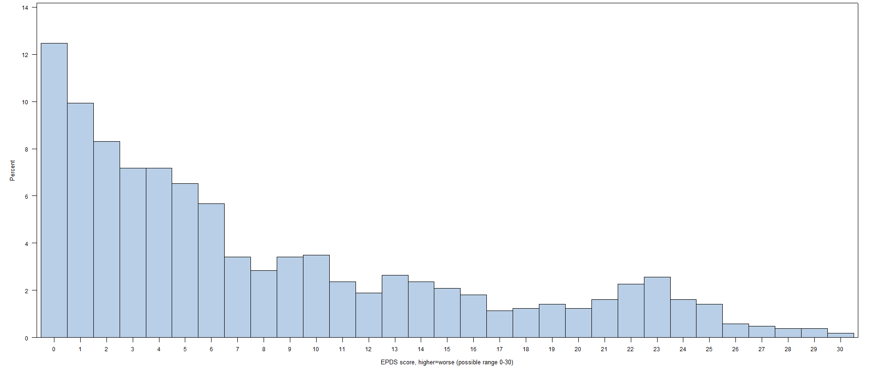
Example – Count Data
HISTOGRAM OF EPDS
14
12
10
Percent
8
6
4
2
0
EPDS Score (range 0-30)
12

Slide 13
Example – Count Data Check mean and variance for overdispersion
_____SAS Code SAS Output_____
*Mean and variance;
proc means data=base mean var;
var EPDS;
run;
Analysis Variable : EPDS
Mean | Variance
11.17 | 47.34
*Conditional mean and variance;
proc means data=base mean var;
var EPDS;
class INTV;
run;
Analysis Variable : EPDS
INTV | N Obs | Mean | Variance
0 | 533 | 11.35 | 48.31
1 | 611 | 11.01 | 46.52
13

Slide 14
Example – Count Data SAS regression analysis
*Poisson regression – ignore overdispersion;
proc genmod data = base;
model EPDS = INTV / dist=poisson;
run;
*Negative binomial regression – account for overdispersion;
proc genmod data = base;
model EPDS = INTV / dist=negbin;
run;
14

Slide 15
Example – Count Data Check for overdispersion: negative binomial regression in PROC GENMOD
Dispersion parameter significantly different from zero (see 95% CI):
Indicates significant over- (> 0) or under- (< 0) dispersion
Use negative binomial rather than Poisson
Negative binomial regression- account for overdispersion
Analysis Of Maximum Likelihood Parameter Estimates
Parameter | DF | Estimate | Standard Error | Wald 95% Confidence Limits |  | Wald Chi-Square | Pr > ChiSq
Intercept | 1 | 2.1244 | 0.0478 | 2.0306 | 2.2181 | 1973.7 | <.0001
INTV | 1 | -0.0974 | 0.0659 | -0.227 | 0.0318 | 2.18 | 0.1394
Dispersion | 1 | 1.0192 | 0.0514 | 0.9185 | 1.1198
15

Slide 16
Example – Count Data
Results
P-values quite different
Different conclusions regarding similarity of intervention conditions at baseline
EPDS: Poisson regression- ignore overdispersion
Analysis Of Maximum Likelihood Parameter Estimates
Parameter | DF | Estimate | Standard Error | Wald 95% Confidence Limits |  | Wald Chi-Square | Pr > ChiSq
Intercept | 1 | 2.1244 | 0.0155 | 2.094 | 2.1547 | 18805 | <.0001
INTV | 1 | -0.0974 | 0.0218 | -0.14 | -0.055 | 19.95 | <.0001
Scale | 0 | 1 | 0 | 1 | 1
EPDS: Negative binomial regression- account for overdispersion
Analysis Of Maximum Likelihood Parameter Estimates
Parameter | DF | Estimate | Standard Error | Wald 95% Confidence Limits |  | Wald Chi-Square | Pr > ChiSq
Intercept | 1 | 2.1244 | 0.0478 | 2.0306 | 2.2181 | 1973.7 | <.0001
INTV | 1 | -0.0974 | 0.0659 | -0.227 | 0.0318 | 2.18 | 0.1394
Dispersion | 1 | 1.0192 | 0.0514 | 0.9185 | 1.1198
16

Slide 17
Accounting for overdispersion in SAS: count data
Negative binomial
Variance-adjustment models
Quasi-likelihood Estimation
Empirical (aka robust, sandwich) variance estimation
Models for correlated data
Zero-inflated models
17

Slide 18
Negative binomial (NB)
Negative binomial distribution: variance is larger than the mean → excellent model for overdispersed count data
Negative binomial regression → relative risk
Disadvantage: estimating extra parameter (dispersion)
PROC GENMOD
PROC COUNTREG
18

Slide 19
SAS code: negative binomial regression
proc genmod data = base;
model EPDS = INTV / dist=negbin;
run;
proc countreg data = base;
model EPDS = INTV / dist=negbin;
run;
19

Slide 20
SAS output: negative binomial regression
PROC GENMOD
Analysis Of Maximum Likelihood Parameter Estimates
Parameter | DF | Estimate |  | Standard Error |  | Wald 95% Confidence Limits |  | Wald Chi-Square | Pr > ChiSq
Intercept | 1 | 2.1244 |  | 0.0478 |  | 2.0306 | 2.2181 | 1973.73 | <.0001
INTV | 1 | -0.0974 |  | 0.0659 |  | -0.2265 | 0.0318 | 2.18 | 0.1394
Dispersion | 1 | 1.0192 |  | 0.0514 |  | 0.9185 | 1.1198
PROC COUNTREG
Parameter Estimates
Parameter | DF | Estimate |  | Standard Error |  | t Value | Approx
 |  |  |  |  |  |  | Pr > |t|
Intercept | 1 | 2.1244 |  | 0.0478 |  | 44.43 | <.0001
INTV | 1 | -0.0974 |  | 0.0659 |  | -1.48 | 0.1394
_Alpha | 1 | 1.0192 |  | 0.0514 |  | 19.84 | <.0001
Compare to Poisson regression:
INTV: Estimate=-0.0974; SE=0.0218; P<.0001
20

Slide 21
SAS output: negative binomial regression
NB: Variance > mean
Variance = mean + k *mean²
SAS estimate of dispersion parameter k: “Dispersion”, “_Alpha”
If k significantly different from zero → use NB rather than Poisson
PROC GENMOD
Analysis Of Maximum Likelihood Parameter Estimates
Parameter | DF | Estimate | Standard Error | Wald 95% Confidence Limits |  | Wald Chi-Square | Pr > ChiSq
Intercept | 1 | 2.1244 | 0.0478 | 2.0306 | 2.2181 | 1973.73 | <.0001
INTV | 1 | -0.0974 | 0.0659 | -0.2265 | 0.0318 | 2.18 | 0.1394
Dispersion | 1 | 1.0192 | 0.0514 | 0.9185 | 1.1198
PROC COUNTREG
Parameter Estimates
Parameter | DF | Estimate | Standard Error | t Value | Approx
 |  |  |  |  | Pr > |t|
Intercept | 1 | 2.1244 | 0.0478 | 44.43 | <.0001
INTV | 1 | -0.0974 | 0.0659 | -1.48 | 0.1394
_Alpha | 1 | 1.0192 | 0.0514 | 19.84 | <.0001
21

Slide 22
Count data: Quasi-likelihood Estimation (QLE)
QLE allows for adjusting variance without specifying distribution exactly
Variances inflated by
Deviance/DOF (GENMOD: “dscale”)
Pearson’s Chi-Square/DOF
GENMOD: “pscale”
GLIMMIX: “random _residual_”
Poisson and negative binomial regression (and logistic regression)
22

Slide 23
QLE – Example - SAS Code Use “dscale” as the norm!
*Poisson regression- no adjustment for overdispersion;
proc genmod data=base;
model EPDS = INTV/ dist=poisson;
run;
*Poisson regression- adjust for overdispersion using “DSCALE”;
proc genmod data=base;
model EPDS = INTV/ dist=poisson dscale;
run;
23

Slide 24
QLE- standard errors (SE) corrected
24

Slide 25
QLE- Poisson vs. NB
25

Slide 26
QLE – “PSCALE”- SAS Code
proc genmod data=base;
model EPSD=INTV / dist=poisson pscale;
run;
proc glimmix data=base;
model EPSD=INTV / dist=poisson s;
random _residual_;
run;
Criteria For Assessing Goodness Of Fit
Criterion |  | DF | Value | Value/DF
Pearson Chi-Square |  | 1056 | 7752.096 | 7.341
Analysis Of Maximum Likelihood Parameter Estimates
Parameter | DF | Estimate | Standard Error | Wald 95% Confidence Limits |  | Wald Chi-Square | Pr > ChiSq
Intercept | 1 | 2.1244 | 0.0420 | 2.0421 | 2.2066 | 2561.66 | <.0001
INTV | 1 | -0.0974 | 0.0591 | -0.2131 | 0.0184 | 2.72 | 0.0992
Scale | 0 | 2.7094 | 0 | 2.7094 | 2.7094
Note: The scale parameter was estimated by the square root of Pearson's Chi-Square/DOF.
Fit Statistics
Pearson Chi-Square |  |  | 7752
Pearson Chi-Square / DF |  |  | 7.34
Parameter Estimates
Effect | Estimate | Standard Error | DF | t Value | Pr > |t|
Intercept | 2.1244 | 0.0420 | 1056 | 50.61 | <.0001
INTV | -0.0974 | 0.0591 | 1056 | -1.65 | 0.0995
Residual | 7.341 | . | . | . | .
26

Slide 27
Count Data – QLE – In Sum
Use as the norm, in Poisson or NB
DSCALE better than PSCALE, especially for low counts
27

Slide 28
Count Data: Empirical Variance Estimation
Empirical (or robust or sandwich) variance estimation – account for extra variation by using both empirical-based estimates and model-based estimates in variance estimation
Poisson and NB regression (and logistic regression)
GENMOD: “REPEATED” statement
GLIMMIX: “EMPIRICAL” option
28

Slide 29
Empirical Variance Estimation – GENMOD “REPEATED”
*PID = “Participant ID”, 1 observation per PID;
proc genmod data=base;
class PID;
model EPDS=INTV / dist=poisson;
repeated subject = PID;
run;
Analysis Of GEE Parameter Estimates
Empirical Standard Error Estimates
Parameter | Estimate | Standard Error | 95% Confidence Limits |  | Z | Pr > |Z|
Intercept | 2.1244 | 0.0415 | 2.0431 | 2.2056 | 51.25 | <.0001
INTV | -0.0974 | 0.059 | -0.2129 | 0.0182 | -1.65 | 0.0986
Compare to unadjusted Poisson regression:
INTV: Estimate=-0.0974; SE=0.0218; P<.0001
29

Slide 30
Empirical Variance Estimation – GLIMMIX “EMPIRICAL”
*PID = “Participant ID” 1 observation per PID. “MBN” is small-sample bias correction;
proc glimmix data=base empirical=mbn;
class PID;
model EPDS=INTV / dist=poisson s;
random _residual_ /subject = PID;
run;
Solutions for Fixed Effects
Effect | Estimate | Standard Error | DF | t Value | Pr > |t|
Intercept | 2.1244 | 0.04153 | 1056 | 51.16 | <.0001
INTV | -0.09738 | 0.05907 | 1056 | -1.65 | 0.0995
30

Slide 31
Count Data: Correlated (ex: clustered) data
Longitudinal data (clustering of repeated measurements within subjects)
Nested data (clustering of multiple subjects within groups)
Poisson, NB, or logistic regression
31

Slide 32
Count Data: Correlated (ex: clustered) data
Generalized Linear Mixed Models (GLMM)
GLIMMIX “RANDOM INT” [Conditional model, subject-specific inference]
GLIMMIX “RANDOM _RESIDUAL_” [Marginal model, inference on population averages]
Generalized Estimating Equations (GEE) [Marginal model]
GENMOD “REPEATED”
Small-sample bias correction in GLIMMIX with “EMPIRICAL=mbn“ option
32

Slide 33
Clustered Data – GLMM
*Participants clustered by city. Marginal model;
proc glimmix data=base;
class city;
model EPDS=INTV / dist=nb s;
random _residual_ / subject=city type=cs;
run;
*Participants clustered by city. Conditional model;
proc glimmix data=base;
class city;
model EPDS=INTV / dist=nb s;
random int /subject=city;
run;
33

Slide 34
Clustered Data – GEE
*Participants clustered by city. “MBN” is small-sample bias correction;
proc glimmix data=base empirical=mbn;
class city;
model EPDS=INTV / dist=nb s;
random _residual_ /subject =city;
run;
proc genmod data=base;
class city;
model EPDS=INTV / dist=nb;
repeated subject = city / type=cs;
run;
34

Slide 35
Count Data - Zero-Inflated (ZI) Models
ZI models appropriate when variable contains an excess of zero values- sample heterogeneity
Assume sample contains two different populations: “nonsusceptible” (always zero) subjects and “susceptible” (not always zero) subjects
ZI regression - two regression models (each with own explanatory variables):
Logit or probit regression - model the probability of being “nonsusceptible”
Poisson/NB/logistic regression - model the mean for the susceptible population
35

Slide 36
Count data - ZI in SAS
PROC GENMOD
PROC COUNTREG
Zero-inflated Poisson: “dist=ZIP”
Zero-inflated NB: “dist=ZINB”
Even after accounting for excess zeros, NB may fit the remaining counts better than Poisson
GENMOD ZINB: SAS version > 9.2
36

Slide 37
Example - ZI
Variable of interest - count: number of fish caught by groups of campers at a national park
Explanatory variables:
Number of children in the group (child)
Whether or not the group brought a camper to the park (camper)
Number of people in the group (persons)
37

Slide 38
57% of values are zero values
38

Slide 39
Example – ZI – SAS Code
proc genmod data = m.fish;
model count = child camper /dist=zip;
zeromodel persons /link = logit ;
run;
proc countreg data = m.fish method = qn;
model count = child camper / dist=zip;
zeromodel count ~ persons;
run;
39

Slide 40
Example – ZI – SAS Output
GENMOD
Analysis Of Maximum Likelihood Parameter Estimates
Parameter | DF | Estimate | Standard Error | Wald 95% Confidence Limits |  | Wald Chi-Square | Pr > ChiSq
Intercept | 1 | 1.5979 | 0.0855 | 1.4302 | 1.7655 | 348.96 | <.0001
child | 1 | -1.0428 | 0.1 | -1.239 | -0.847 | 108.78 | <.0001
camper | 1 | 0.834 | 0.0936 | 0.6505 | 1.0175 | 79.35 | <.0001
Scale | 0 | 1 | 0 | 1 | 1
Analysis Of Maximum Likelihood Zero Inflation Parameter Estimates
Parameter | DF | Estimate | Standard Error | Wald 95% Confidence Limits |  | Wald Chi-Square | Pr > ChiSq
Intercept | 1 | 1.2974 | 0.3739 | 0.5647 | 2.0302 | 12.04 | 0.0005
persons | 1 | -0.5643 | 0.163 | -0.884 | -0.245 | 11.99 | 0.0005
COUNTREG
Parameter Estimates
Parameter | DF | Estimate | Standard Error | t Value | Approx
 |  |  |  |  | Pr > |t|
Intercept | 1 | 1.59789 | 0.08554 | 18.68 | <.0001
child | 1 | -1.04284 | 0.09999 | -10.43 | <.0001
camper | 1 | 0.83402 | 0.09363 | 8.91 | <.0001
Inf_Intercept | 1 | 1.29744 | 0.37385 | 3.47 | 0.0005
Inf_persons | 1 | -0.56435 | 0.16296 | -3.46 | 0.0005
40

Slide 41
Accounting for overdispersion in SAS: binary data
Random-clumped binomial and beta-binomial models
Zero-inflated binomial (ZIB)
Variance-adjustment models
Quasi-likelihood Estimation
Empirical (aka robust, sandwich) variance estimation
Models for correlated data
41

Slide 42
Binary Data – BB and RCB
Beta-binomial (BB) and random-clumped binomial (RCB)
Model physical mechanism behind overdispersion
PROC NLMIXED
SAS 9.3 – PROC FMM (experimental)
42

Slide 43
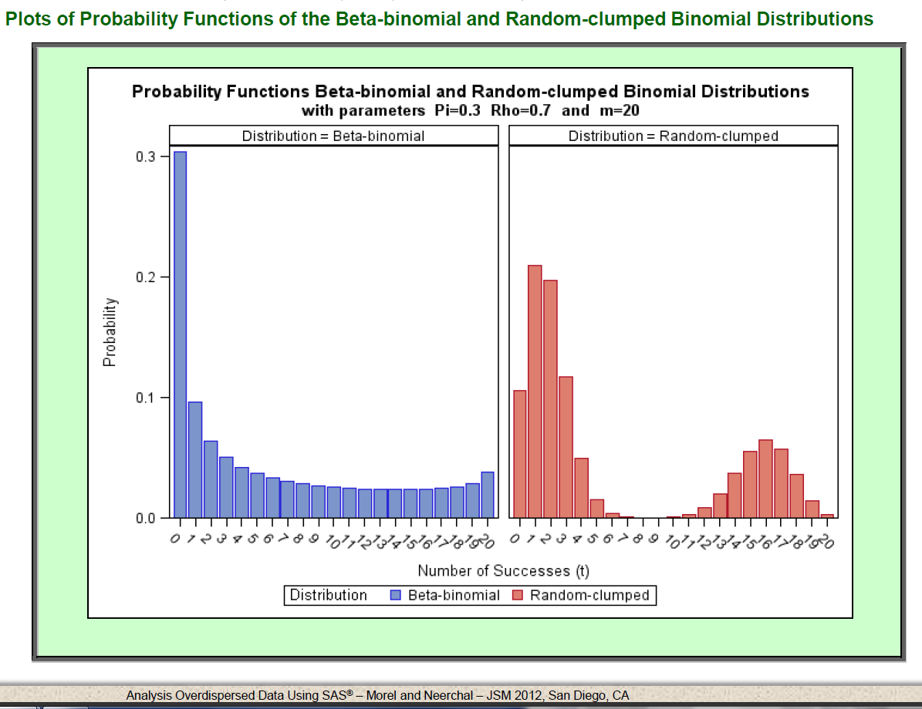
43

Slide 44
Example – BB and RCB
n=1
. . .
337
n=337 nuclei
Each nucleus has m=3 total number of chromosome pairs
t: number of chromosome pairs with association at meiosis (t=0, 1, 2, 3)
If probability of association at meiosis (t/m) is constant for all nuclei and the same for all chromosome pairs, then binomial distribution appropriate
If not → RCB or BB
44

Slide 45
Example – BB and RCB Data
45

Slide 46
BB and RCB – PROC NLMIXED
46

Slide 47
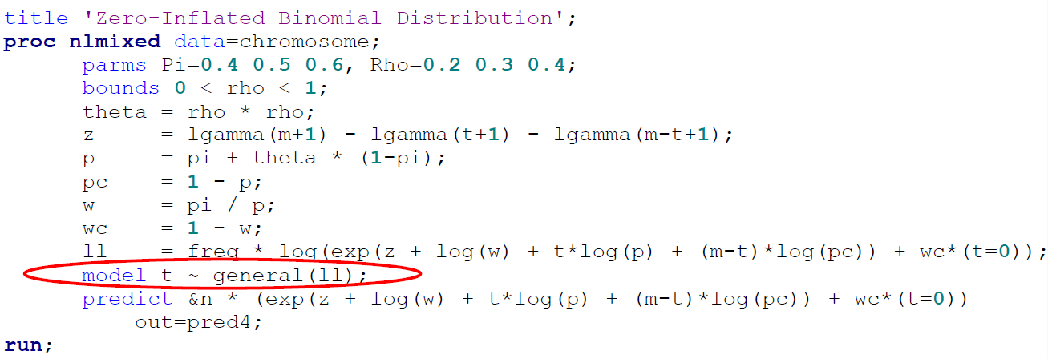
Binary data: ZIB
ZI model – simultaneously model the probability of being “always zero” and the probability of the event of interest conditional on being in the “not always zero” population
47

Slide 48
Binary Data - QLE - Example
Cases of toxoplasmosis in 34 cities in El Salvador
tox: 1=toxoplasmosis case, 0=no toxoplasmosis
rain: annual rainfall (cm)
Binary: “tox” Grouped: “num_tox/num_total”
city | tox | Subject
1 | 1 | 1
1 | 1 | 2
1 | 0 | 3
1 | 0 | 4
2 | 1 | 1
2 | 0 | 2
2 | 0 | 3
city | num_tox | num_total
1 | 2 | 4
2 | 1 | 3
48

Slide 49
QLE – SAS Code
*Grouped binary (1 observation for each city);
proc genmod data=tox;
model num_tox/num_total = rain | rain | rain/ dist=bin dscale;
run;
*Binary–multiple observations per city;
proc genmod data=test desc;
model tox = rain | rain | rain/ dist=bin dscale aggregate=city;
run;
49

Slide 50
QLE – SAS Output
Analysis Of Maximum Likelihood Parameter Estimates
Parameter | DF | Estimate | Standard Error | Wald 95% Confidence Limits |  | Wald Chi-Square | Pr > ChiSq
Intercept | 1 | 0.0994 | 0.1473 | -0.189 | 0.3882 | 0.46 | 0.4999
rain | 1 | -0.449 | 0.2242 | -0.888 | -0.009 | 4 | 0.0454
rain*rain | 1 | -0.187 | 0.1322 | -0.447 | 0.0719 | 2.01 | 0.1568
rain*rain*rain | 1 | 0.2134 | 0.092 | 0.033 | 0.3938 | 5.38 | 0.0204
Scale | 0 | 1.4449 | 0 | 1.4449 | 1.4449
Note: The scale parameter was estimated by the square root of DEVIANCE/DOF.
50

Slide 51
Binary Data - Empirical Variance
Grouped: “num_tox/num_total”
city | num_tox | num_total
1 | 2 | 4
2 | 1 | 3
*Grouped binary - one observation per city;
proc genmod data=tox;
class city;
model num_tox/num_total = rain | rain | rain/ dist=bin ;
repeated subject=city;
run;
51

Slide 52
Clustered Binary Data – multiple observations per cluster (cluster=city)
Binary: “tox”
city | tox | Subject
1 | 1 | 1
1 | 1 | 2
1 | 0 | 3
1 | 0 | 4
2 | 1 | 1
2 | 0 | 2
2 | 0 | 3
52

Slide 53
Clustered Binary Data – GEE
*Specify clustered by city and compound symmetry covariance structure;
proc genmod data=test desc;
class city;
model tox = rain | rain | rain/ dist=bin ;
repeated subject=city/type=cs;
run;
*MBN small sample bias correction - specify clustered by city and compound symmetry covariance structure;
proc glimmix data=test empirical=mbn;
class city;
model tox = rain | rain | rain / dist=bin s;
random _residual_/subject=city type=cs;
run;
53

Slide 54
Clustered Binary Data – GLMM
*Random effects model – conditional model;
proc glimmix data=test;
class city;
model tox = rain | rain | rain / dist=bin s;
random int / subject=city ;
run;
*Marginal model with compound symmetry covariance structure;
proc glimmix data=test;
class city;
model tox = rain | rain | rain / dist=bin s;
random _residual_/subject=city type=cs;
run;
54

Slide 55
Clustered Binary Data – SAS Output
Estimates for RAIN³ from logistic regressions with various adjustments for clustering/overdispersion.
Adjustment | Estimate | SE | P-Value
None | 0.21 | 0.06 | 0.001
QLE (GENMOD "DSCALE") | 0.21 | 0.09 | 0.020
Empirical Variance (GENMOD "REPEATED") | 0.21 | 0.09 | 0.020
GEE (GENMOD "REPEATED") | 0.25 | 0.09 | 0.009
GEE (GLIMMIX "EMPIRICAL=MBN") | 0.25 | 0.10 | 0.024
GLMM (GLIMMIX "RANDOM INT") | 0.25 | 0.11 | 0.022
GLMM (GLIMMIX "RANDOM _RESIDUAL_") | 0.25 | 0.11 | 0.030
Least conservative p-values from simple logistic and GEE without small sample bias correction

Slide 56
In Sum
Overdispersion is a common issue when using Poisson and binomial models
Overdispersion will increase false positive rates
For overdispersed data use:
Negative binomial rather than Poisson
RCB or BB rather than binomial
QLE: GENMOD “DSCALE”
Empirical variance: GENMOD “REPEATED”
Account for clustering - GLIMMIX or GENMOD
Zero-inflated models
56

Slide 57
Further Information
Plus:
Formal tests for overdispersion and for comparing models
GLOMM – Generalized Linear Overdispersion Mixed Models
57

Slide 58
Acknowledgements
CCH
CHIPTS Methods Core (sent me to JSM 2012!)
UCLA Biostatistics (I use my notes a lot!)
Morel JG, Neerchal NK. “Analysis of Overdispersed Data using SAS.” Joint Statistical Meetings, San Diego, CA. July 31, 2012.
58

Slide 59
References and Resources
Horton NJ, Kim E, Saitz R. A cautionary note regarding count models of alcohol consumption in randomized controlled trials. BMC Medical Research Methodology 2007, 7:9.
Morel JG, Neerchal NK. “Analysis of Overdispersed Data using SAS.” Joint Statistical Meetings, San Diego, CA. July 31, 2012.
Morel JG, Neerchal NK. Overdispersion Models in SAS. Cary, NC: SAS Publishing; 2012.
Pedan, A. Analysis of count data using the SAS system. 26th annual SAS Users Group International conference, Paper 247-26. Long Beach, California 22-25 April 2001. http://www2.sas.com/proceedings/sugi26/p247-26.pdf
Steventon JD, Bergerud WA, Ott PK. Analysis of Presence/Absence Data when
Absence is Uncertain (False Zeroes): An Example for the Northern Flying Squirrel
using SAS. Available at http://www.for.gov.bc.ca/hfd/pubs/docs/En/En74.pdf. Published July 2005.
Wang W, Albert JM. Estimation of mediation effects for zero-inflated regression models. Statistics in Medicine 2012, 31(26): 3118–3132.
Zou G. A modified Poisson regression approach to prospective studies with binary data. American Journal of Epidemiology 2004, 159: 702-706.
59

Slide 60
References and Resources
UCLA: Statistical Consulting Group
Poisson regression
http://www.ats.ucla.edu/stat/sas/output/sas_poisson_output.htm
http://www.ats.ucla.edu/stat/sas/output/sas_poisson_output.htm
Negative binomial regression
http://www.ats.ucla.edu/stat/sas/dae/negbinreg.htm
http://www.ats.ucla.edu/stat/sas/output/sas_negbin_output.htm
ZIP regression
http://www.ats.ucla.edu/stat/sas/dae/zipreg.htm
http://www.ats.ucla.edu/stat/sas/output/sas_zip.htm
ZINB regression
http://www.ats.ucla.edu/stat/sas/dae/zinbreg.htm
http://www.ats.ucla.edu/stat/sas/output/sas_zinbreg.htm
Logistic regression: http://www.ats.ucla.edu/stat/sas/seminars/sas_logistic/logistic1.htm
PROC FMM:
SAS/STAT(R) 9.3 User's Guide: http://support.sas.com/documentation/cdl/en/statug/63962/HTML/default/viewer.htm#statug_fmm_a0000000313.htm
SAS code for fitting zero-inflated binomial / site occupancy models: http://www.umesc.usgs.gov/staff/bios/bgray/code/zibsas.html
60

Slide 61
Thank you very much!
Questions?
JHarwood@mednet.ucla.edu
61

