Slide 1
NIH Public Access Policy Training
Adenike Omomukuyo
CHIPTS CORE Coordinator
Aomomukuyo@mednet.ucla.edu
10880 Wilshire BLVD., SUITE 1800

Slide 2
What is the NIH Public Access Policy?
The NIH Public Access Policy ensures the public has access to the published results of NIH funded research to help advance science and human health. The Policy has three aims:
ARCHIVE. A central collection of NIH-funded research publications preserves vital published research findings for years to come.
ADVANCE. The archive is an information resource for scientists to research publications and for NIH to manage better its entire research investment.
ACCESS. The archive makes available to the public research publications resulting from NIH-funded research.
Notes:
Assures all NIH funded research is available for public access.
Three main purposes-
Archive- stored within a central reserve.
Advance- research development
Access- availability for public research.

Slide 3
What is the NIH Public Access Policy?
Requires scientists to submit final peer-reviewed journal manuscripts that arise from NIH funds to PubMed Central (PMC)
Maximum 12-month embargo
Enforcement:
Anyone submitting an application, proposal or report to the NIH must include the PMC reference number (PMCID) when citing applicable papers that they author or that arise from their NIH-funded research.
NIH will delay processing of non-competing continuation grant awards if publications arising from that award are not in compliance with the NIH public access policy. The award will not be processed until recipients have demonstrated compliance.
Notes:
Everyone who uses peer-reviewed articles/obtained funding from NIH funded sources must submit final peer-reviewed manuscripts to PubMed Central.
If not compliant with this public access policy, award will be delayed until recipients demonstrate compliance.
*Note that the person responsible for assuring the manuscript is compliant is the leading PI (or any co-author on the publication who volunteers to manage its compliancy). But the PMCID created will be accessible to all the authors in the article.
Embargo- First thing to do in the submission process is to address the copyright transfer agreement of the final peer-reviewed journal. Note that some publishers will have 12-month embargo period, but you still must upload your manuscript into PMC immediately. It just won't be uploaded into the PMC system until after the publisher's embargo period has ended.
If you aren’t sure, you can add the addendum within your paper when you are submitting it to the journal. Most publishers should be aware of this compliance policy though.

Slide 4
What is PubMed Central?
http://www.ncbi.nlm.nih.gov/pmc/
Full text repository of 3.9 million articles
Not the same as PubMed
PMCIDs are the not the same as PMIDs
Notes:
Not the same as PubMed.
PubMed Central is a subset of items within PubMed that have these open-access policies.
PMCIDS are the final derivatives of the NIH submission process, and will be the main identifier for your compliant publication.

Slide 5
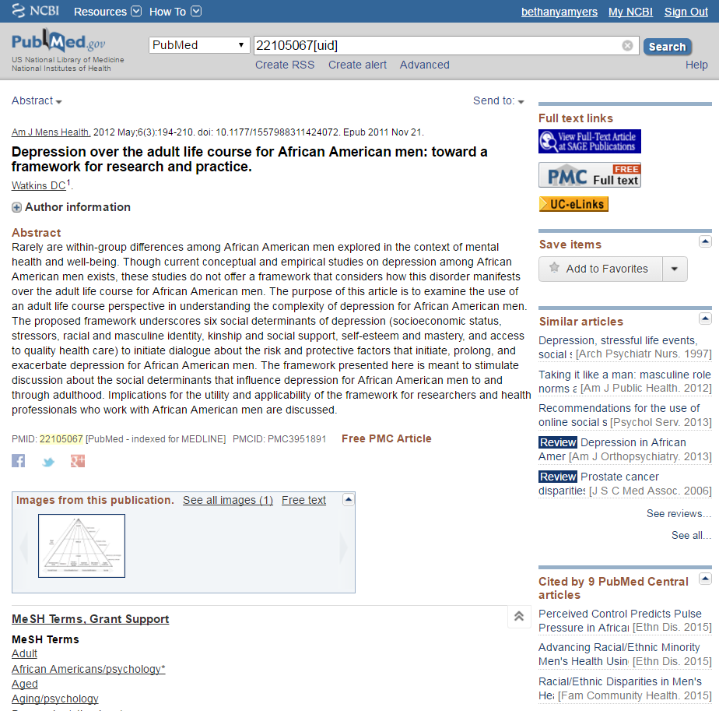
Notes:
Pub Med

Slide 6
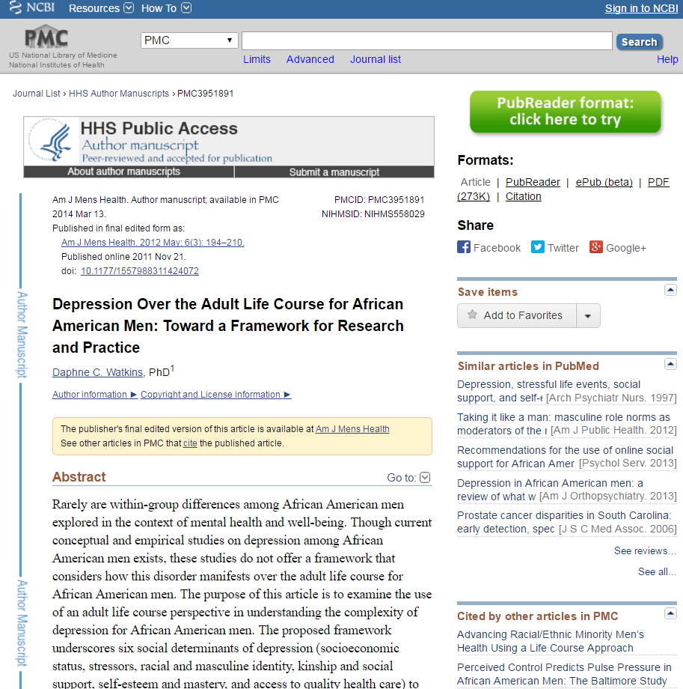
Notes:
Pub Med Central

Slide 7
How do I get my paper in PMC?
There are 4 ways that a paper can be added to PubMed Central and become compliant.
Helpfully called Methods A, B, C, and D
Methods A and B – publisher does all the work
Methods C and D – author does most/all of the work
Methods C and D involve the use of a system called NIHMS: the NIH Manuscript Submission System
Notes:
4 ways, 2 main categories to be added to PMC and to become compliant-
1st Set (Methods A and B)- Publisher does all the work
2nd Set (Methods C and D)- Author does all/some of the work, and will include use of the NIHMS system to manage publications.
Note that in Method A, B, and D, the publisher begins the process of submitting the manuscript, whereas in Method C, you will be beginning the process.
Also, Method A and B, manuscript is being submitted in publishers PDF format from the journal to NIHMS.
For Method C and D, manuscript being submitted as final- peer reviewed article being held by the author (this is the version before the galla print).

Slide 8
Method A: Open access journals who have a deal with PMC
Method A journals take care of the compliance process for their authors
The whole journal is open access and they put all their articles in PMC automatically
It is a limited list of journals
Notes:
1st Set- Method A (easiest)
- Do all the work.
These open access journals take care of the compliance for their authors. Automatically put their articles in PMC.
These journals are also much more limited.

Slide 9
Method B: Open access articles
Method B publishers take care of the compliance process for their authors, IF the authors opted in at the time of publication, usually paying an open access fee
Sometimes the whole journal may be open access, sometimes only certain articles may be open access
It is a limited list of journals/publishers that participate
Notes:
1st Set- Method B (has a fee- can be made available immediately)
The publishers take care of the process for authors, IF the author opted in at the time of publication. The entire journal may or may not be open access, and can be restricted to just certain articles.
Mind you, the cost can range anywhere from hundreds to thousands of dollars.

Slide 10
Method C: Author does it all
If you did not pay an open access fee/article processing charge to publish your article, chances are this is you
Gather some things:
Your eRA Commons username and password (they make you change passwords often so you may have to reset) OR your NCBI username and password
The final author version of your manuscript
NOT the published PDF
This is probably your last Word file before you sent it off to journal for the final time
Don’t forget any supplemental files/tables/figures/etc.
Go to the NIH Manuscript Submission System
https://www.nihms.nih.gov
Notes:
2nd Set- Method C
All you.
Will need your eRA commons or NCBI info. While you can use both login credentials, its important that you choose one as your primary account for this will be preserving all your publication data in one central place.
You will also need your final peer reviewed manuscript. Version before the galla print, not the publishers PDF, and should be a word document.
Any supplemental files, etc..
Once you have this, proceed to the NIH Manuscript Submission System

Slide 11
Notes:
NIHMS Process (through Method C)
Deposit files (submit), 2. Reviewed, 3. NIHMS Conversion to PMC, 4. Final Approval by Submitter, 5. PMCID Assigned, 6. Available.
Remember you will have to log into the NIHMS site at least two more times to approve versions before you get the official PMCID #. Super important and necessary.
Also, you may not get a notification of errors with uploading, hence why its important to continue monitoring the NIHMS site constantly.

Slide 12
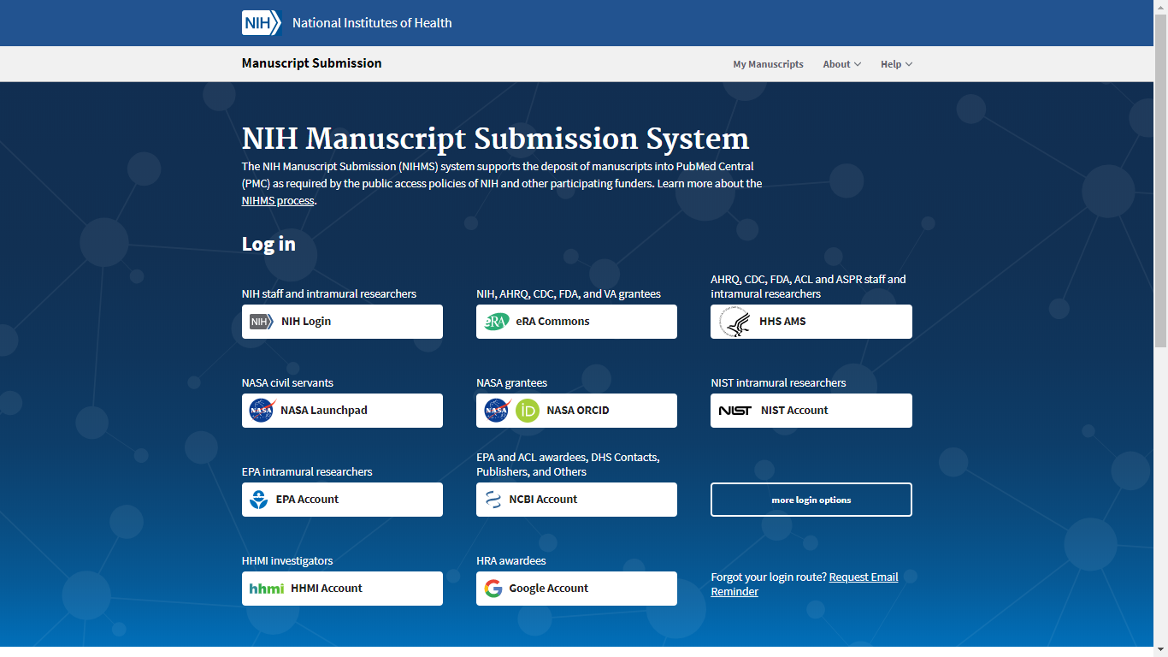
Notes:
Go to https://www.nihms.nih.gov/login/?next=/submission/
The NIHMS system recently updated

Slide 13
Click here if you have an eRA Commons login

Slide 14
Scroll down and click here if you don’t have an eRA Commons login

Slide 15
I’m logged into NIHMS, now what?
Follow the steps the upload your manuscript file
There are helpful tutorials on the site
Or call/email me or Bethany Meyers from the Biomedical Research Library if you need help.
bethanymyers@library.ucla.edu
aomomukuyo@mednet.ucla.edu

Slide 16
Uploading to NIHMS
Notes:
Main Manuscripts page.
Hit Submit New Manuscript

Slide 17
Uploading to NIHMS
Notes:
- Opt for Option 1- Citation in PubMed

Slide 18
Uploading to NIHMS
Notes:
You can search by publication name

Slide 19
Uploading to NIHMS
Notes:
Once correct publication chosen, the rest of the fields cited in publication should auto populate.

Slide 20
Uploading to NIHMS
Notes:
The next step is adding a funding source that supported the publication.

Slide 21
Uploading to NIHMS
Notes:
You can search by award numbers or awardee last name.
Add as many awards as applicable to your publication.

Slide 22
Uploading to NIHMS
Notes:
Upload all necessary documents.
1- Manuscripts: This should be the final peer- reviewed version, generally last word doc saved that was submitted to the journal. Also assure this is text only (pertains to publications being submitted with tables, figures, etc…)
2- Figures: Be sure to separate out all figures into individual files to be uploaded into the system. I.e., if you have 3 figures in your manuscript, copy, paste, and label each of them into their own individual files. Be sure to leave their place holder within the manuscript for where they should be placed so NIHMS knows where they should be uploaded as they process.
3- Tables: The same instructions for figures also applies to tables.
4- Videos: If you have any, upload as necessary.**
5- Supplementary materials: I.e., appendix.
When you’ve assured everything has in fact been uploaded, and PROPERLY LABELED check the box for the fine print then hit next.
We will do an example of this at the end.

Slide 23
Uploading to NIHMS
Check your journal’s policy
Notes:
The publication reviewer can be any of the co-authors on the publication that volunteers to assure they can responsibly track the publications' compliancy.
If you will be the reviewer for this manuscript, then select self, and the designated embargo provided under your journal’s policy.
Note: The reviewer (YOU) will be responsible for completing the initial and final approval requests and tracking the processing.
If you are submitting the manuscript on behalf of a PI/co-author on the publication (who would also be the reviewer/approval respondent), see the next slide.

Slide 24
Uploading to NIHMS
This should be the information of the reviewer/approval respondent.
Notes:
If you are submitting the manuscript on behalf of a PI/co-author (who would also be the reviewer/approval respondent), select “Enter name and email manually”.
You can then fill in the information for the PI/co-author that will be the reviewer. They will get an email requesting their initial approval of the manuscript. They will also be responsible for selecting the proper embargo for the manuscript.

Slide 25
Uploading to NIHMS
Notes:
Make sure that once you’ve uploaded in all the necessary files, you must check the receipt for accuracy, before moving onwards with submission process.
You will then be prompted to a dialog box displaying the converted PDF receipt of your submitted manuscript. Look through this and assure everything is properly included, labeled, etc.
Save this receipt also.

Slide 26
I submitted my manuscript, now what
It will take NCBI a period of time to work on your manuscript and convert it to PMC format
During this period of time, you must first grant the initial approval of the submitted manuscript. Your submitted manuscript will also receive an interim ID number: the NIHMSID
Then you will get an email notifying you that they need your final approval
Click the link in the email
If you lose the email, just log back into NIHMS and you’ll see the manuscript that needs your attention on your dashboard
Double check the converted manuscript to make sure it’s correct
You only get a PMCID after you do final approval
Notes:
As your manuscript is being reviewed and converted over to PMC format, you will get an interim NIHMSID.
Be sure the initial approval is also granted by the reviewer.
Once done, in time you will be asked for final approval- double check the converted manuscript to make sure its correct.
After you approve everything, then you get the PMCID number.
Note that these PMCIDs are vital in communicating with and to the NIH on NIH applications, proposals, and progress reports.
You have three months for citing the manuscript as either a PMC In Progress (using Method A or B), or using the temporary NIHMSID (Method C and D). After three months, must cite using the PMCID or will become incompliant and will need to figure out what the hold up is with your publication.

Slide 27
Method D: Opt-in for file submission only
Some publishers let you skip the first step of uploading your final author manuscript into NIHMS
This is usually an option at the time you’re submitting your manuscript
You still have to log into NIHMS to approve the files that the publisher uploads
Notes:
4th option- Method D
The publisher uploads final author manuscript into the NIHMS system.
Author is only responsible for reviewing the files uploaded/granting initial approval and final approval.

Slide 28
Notes:
For Method C, author is involved in all parts.
For Method D, author is only involved in stage 2 (initial approval) and stage 4 (final approval).

Slide 29
What could go wrong?
You may get other messages from NCBI
If you are missing tables/figures, etc
If so, log into NIHMS to make any corrections or updates
Notes:
Please be sure to check into your NIHMS system often to see what is happening with your manuscript that may delay the PMC conversion process.

Slide 30
How do I know if I have noncompliant articles?
Go to MyNCBI and click on My Bibliography
Notes:
1st go to MyNCBI on the PubMed homepage- https://www.ncbi.nlm.nih.gov/myncbi/
Go to My Bibliography. Search for publication in need of managing and the compliance status will be displayed to the right.

Slide 31
How do I know if I have noncompliant articles?
Notes:
If green, pub is compliant/”complete”. The PMCID should be displayed in the compliance status box.
*If red, pub is noncompliant/not defined. Go unto NIHMS system to track the publication’s status.

Slide 32
Identifying Publication Status in myNCBI Bibliography.
Processing
Not defined
Non-compliant
Compliant
Notes:
You can also view the total number of compliant, non-compliant, processing, and not defined articles at the top of your My Bibliography tool bar.
“?” For Not defined articles that have not had their NIHMSID/PMCID entered into the NCBI system.
“!” For Non-compliant articles that haven’t been fully processed by the NIHMS system due to errors in uploads.
“→” For Processing articles that have been submitted into the NIHMS system and are on the way to compliance status.
“Green Check” For Compliant articles that have been successfully processed in the NIHMS system and have received a PMCID.

Slide 33
How can I track my articles/submissions?
Enter in the PMID, NIHMSID, or PMCID of the pub.
Notes:
You can track the status of all your publications/submissions in NIHMS.
For noncompliant, not defined, or processing articles:
While your article may not have a PMCID yet, it will have either an PMID or NIHMSID. Either of these can be used to track the status of your submissions.

Slide 34
I’ve submitted my manuscript in NIHMS and it’s processing, but it still shows as a red compliance box in my NCBI bibliography. Why?
1. The publication appears as a red compliance status box because it is “Not defined”.
This is likely because in your my NCBI bibliography, the NCBI system has not yet received/processed the NIHMS submission.
You will have to input the NIHMSID (or PMCID if already assigned) into the NCBI system manually.
The NIHMSID (or PMCID) can be found the NIHMS system by searching for the manuscript using its PMID.

Slide 35
I’ve submitted my manuscript in NIHMS and it’s processing, but it still shows as a red compliance box in my NCBI bibliography. Why?
2. The publication appears as a red compliance status box because it is “Non-compliant.”
This is likely because there was an error in the NIHMS with the manuscript submission, hence its processing is delayed.
You will have to check the status of the publication in the NIHMS system using either the NIHMSID or PMID. Fix any errors, as necessary.

Slide 36
CHIPTS Acknowledgement in Publications
How to link publications to chipts
via
Publications and The MyNCBI portal

Slide 37
Linking By Publications
All CHIPTS and CHIPTS-affiliated investigators are strongly encouraged to cite the CHIPTS grant for any HIV-related publications or publications related to the Center’s scientific theme. Also any recipients of CHIPTS funds (including pilot grant recipients and scholarship awardees) should acknowledge the CHIPTS grant in their publications and presentations. See below for suggested language. You may edit accordingly.

Slide 38
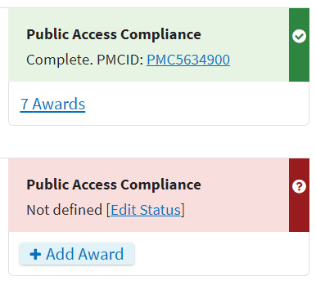
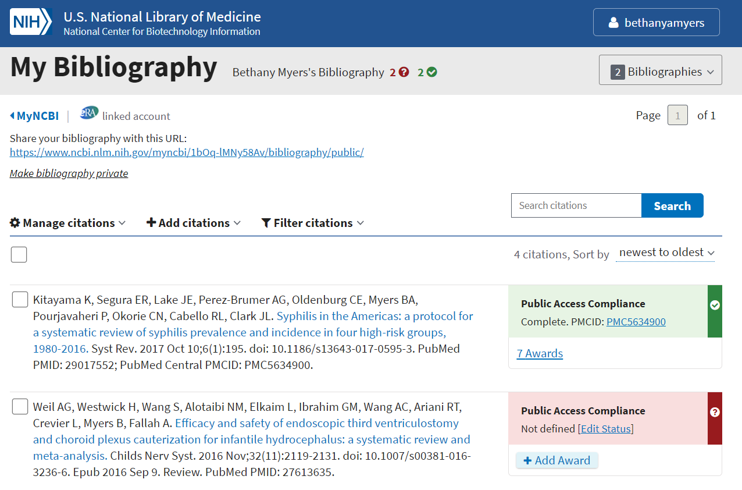
Linking By MyNCBI Portal
Go to MyNBCI and click on My Bibliography.
Find article in need of linking.
Select “Awards” in the compliance status box.

Slide 39
Linking By MyNCBI Portal
Go to MyNCBI and click on My Bibliography.
Find article in need of linking.
Select “Awards” in the status box.
Select CHIPTS Award.
The system will autosave it.
Notes:
NCBI contains this CHIPTS Award twice
P30 MH058107 - Center for HIV Identification, Prevention, and Treatment Services
P30 MH058107 - Center for HIV Identification, Prevention and Treatment Services (CHIPTS)
Either one is appropriate for publication linking to CHIPTS.

Slide 40
Unlinking By MyNCBI Portal
Go to MyNCBI and click on My Bibliography.
Find article in need of linking.
Select awards in the status box.
UNSELECT CHIPTS Award.
The system will autosave it.
Note: Only publications submitted via
Methods C and D can unlink awards.
For those submitted via
Methods A or B, please contact the Journal to help with unlinking.
Notes:
**Unlink if you decide not to have the CHIPTS grant associated with your publication, your publication is not compliant and the annual progress report deadline is approaching/can’t fix in time, etc…

Slide 41
Questions?
Adenike Omomukuyo
CHIPTS Core Coordinator, 10880 Wilshire BLVD. Suite 1800
AOMOMUKUYO@mednet.ucla.edu
Notes:
All of this information is available on our CHIPTS website: → Resources → NIH Public Access Policy
Please contact me if you develop any further questions/need help with anything!

Slide 42
What is the UC Open Access Policy?
For Academic Senate Faculty:
Your papers accepted for publication after July 23, 2013 need to be made open access
For everyone else:
Your papers accepted for publication after October 19, 2015 need to be made open access
You do not have to pay fees to make your papers open access
(But you can if you want to)

Slide 43
What is eScholarship?
https://escholarship.org/
The University of California’s open access repository
Notes:
Like PMC, eSholarship is the open access repository.

Slide 44
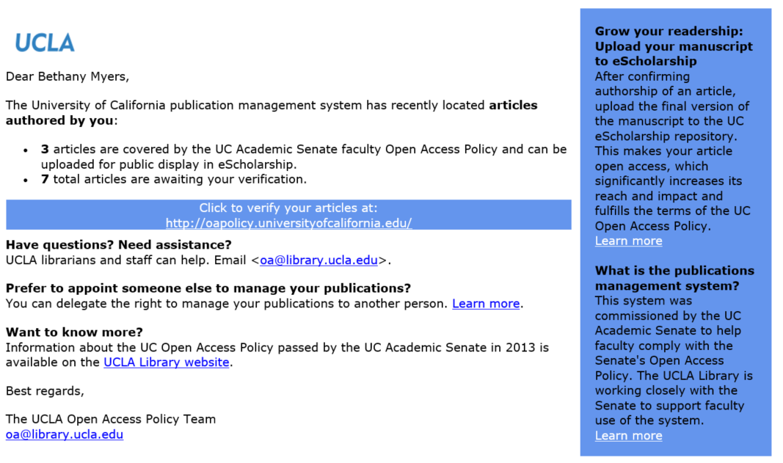
I got this email-

Slide 45
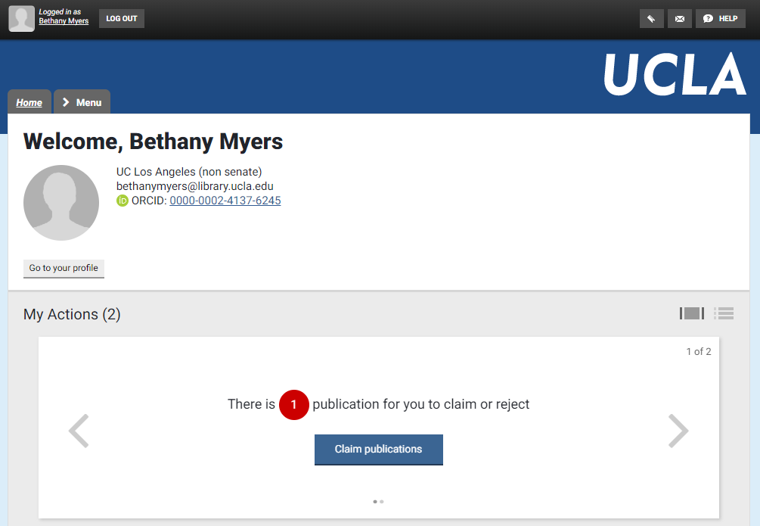
Claim and share

Slide 46
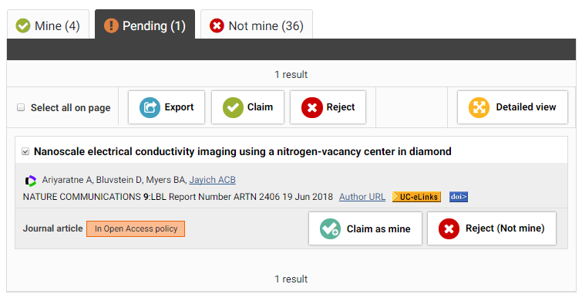
Claim and share

Slide 47
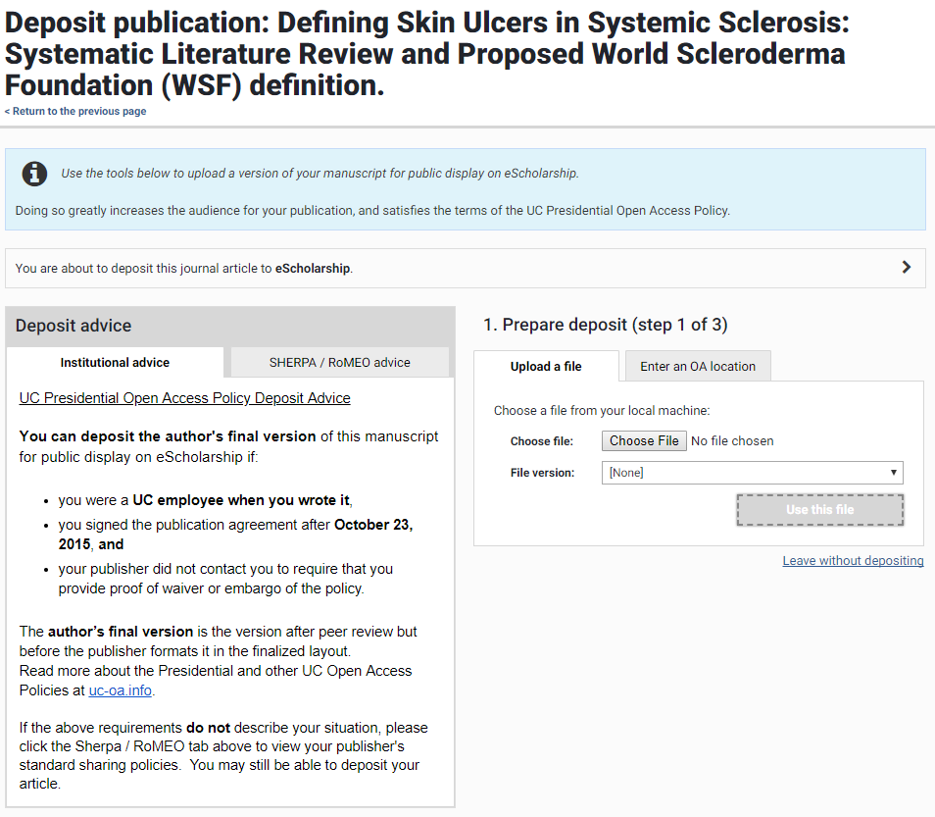
Notes:
- When you are claiming it, enter an OA location.

Slide 48
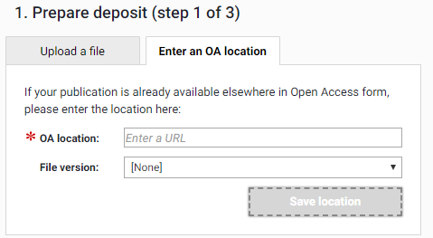

Slide 49
What if my publisher doesn’t want me to do this?
UC contacted publishers years ago informing them of this policy
Only a few publishers are asking authors for waivers to opt out
Mostly Nature
If the publisher doesn’t explicitly request that you opt out, you retain the right to upload your manuscript to eScholarship
Notes:
- Shouldn’t be asked not to do this generally, so you maintain the right to upload your manuscript to the eScholarship.

Slide 50
Questions?
Bethany Myers
Research Informationist, Biomedical Library
bethanymyers@library.ucla.edu
x42030

