Slide 1
Enrique Sanchez
Core Coordinator, CHIPTS
NIH Public
Access Policy
In this workshop, you will learn about your options for compliance.
Contact
EESanchez@mednet.ucla.edu

Slide 2
What is the NIH Public Access Policy?
The NIH Public Access Policy ensures the public has access to the published results of NIH funded research to help advance science and human health.
Policy Aims:
ARCHIVE. A central collection of NIH-funded research publications preserves vital published research findings for years to come.
ADVANCE. The archive is an information resource for scientists to research publications and for NIH to manage better its entire research investment.
ACCESS. The archive makes available to the public research publications resulting from NIH-funded research.

Slide 3
What is the NIH Public Access Policy?
Requires scientists to submit final peer-reviewed journal manuscripts that arise from NIH funds to PubMed Central (PMC).
Maximum 12-month embargo!
Enforcement:
Anyone submitting an application, proposal or report to the NIH must include the PMC reference number (PMCID) when citing applicable papers.
NIH will delay processing of non-competing continuation grant awards if publications arising from that award are not in compliance with the NIH public access policy.

Slide 4
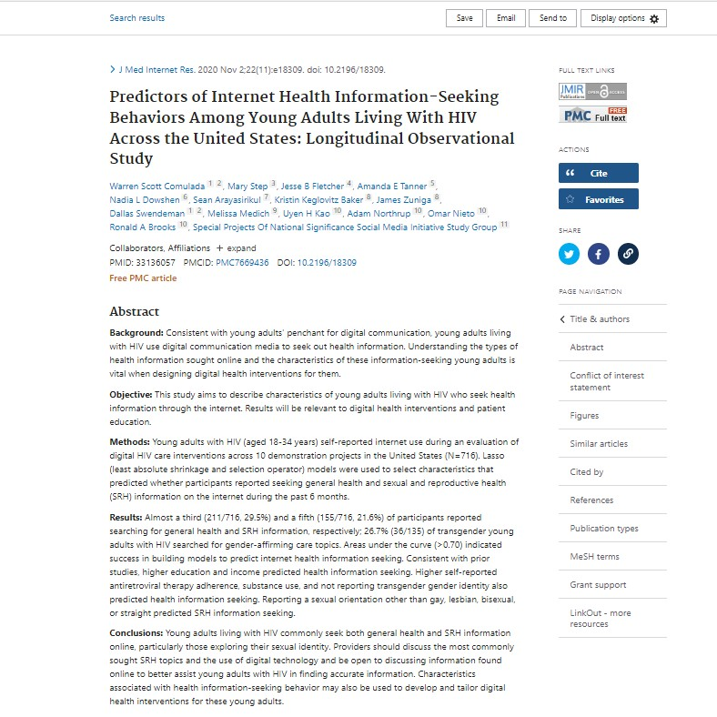
What is PubMed Central?
Understanding PMC
Link to PMC: http://www.ncbi.nlm.nih.gov/pmc/
Full-text repository of 3.9 million articles
Different from PubMed
PMCIDs are the not the same as PMIDs

Slide 5
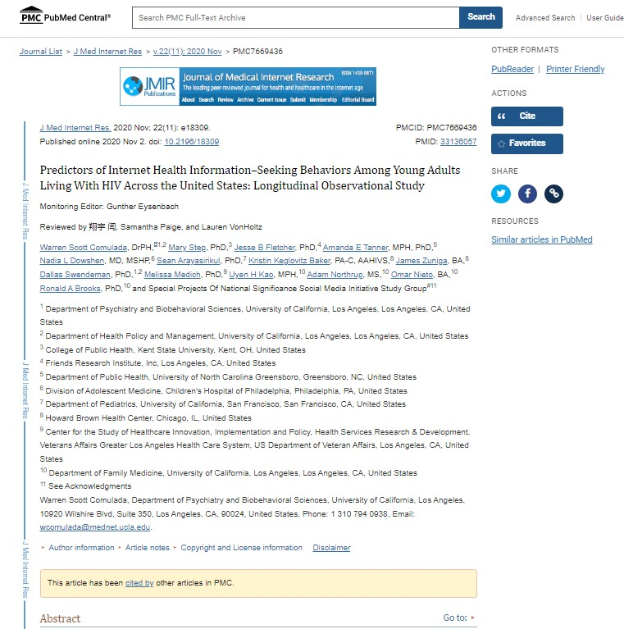
What is PubMed Central?
PMC Elements
Article title
Link to journal publication PMCID
Full-text article + downloadable PDF

Slide 6
Submitting Your Paper to PMC
There are 4 ways that a paper can be added to PubMed Central and become compliant.
Methods A-D
Methods A and B – publisher does all the work
Methods C and D – author does most/all the work
Methods C and D involve the use of a system called NIHMS: the NIH Manuscript Submission System

Slide 7
Method A
Method A: Journals take care of the compliance process for their authors. They put all their NIH-funded articles in PMC
automatically.
(List of Method A journals (Limited)
LET'S BEGIN!
Method B
Method B: Publishers take care of the compliance process for their authors, IF the authors opted in at the time of publication, usually paying an open access fee.
(List of Method B journals (Limited)

Slide 8
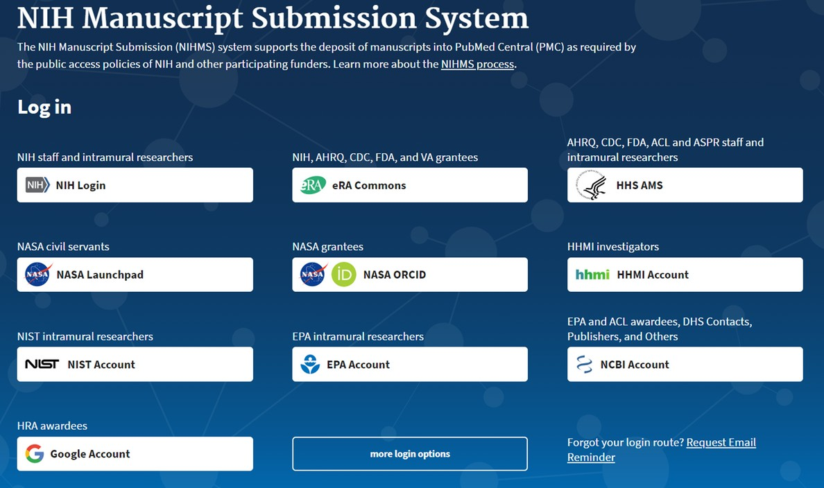
Method C
If your article was not published in a Method A OR Method B journal, chances are you will need to do Method C.
!
Things to Have:
An eRA Commons/ NCBI account (Login.Gov)
The final peer-reviewed author version of your manuscript (NOT the published PDF)
- This is probably your last Word file before you sent it off to journal for the final time
Any supplemental materials including: files, tables, figures, etc.

Slide 9
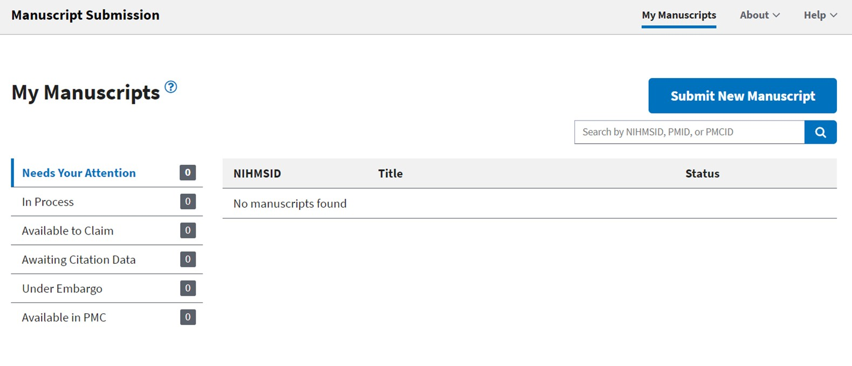
Depositing into NIHMS

Slide 10
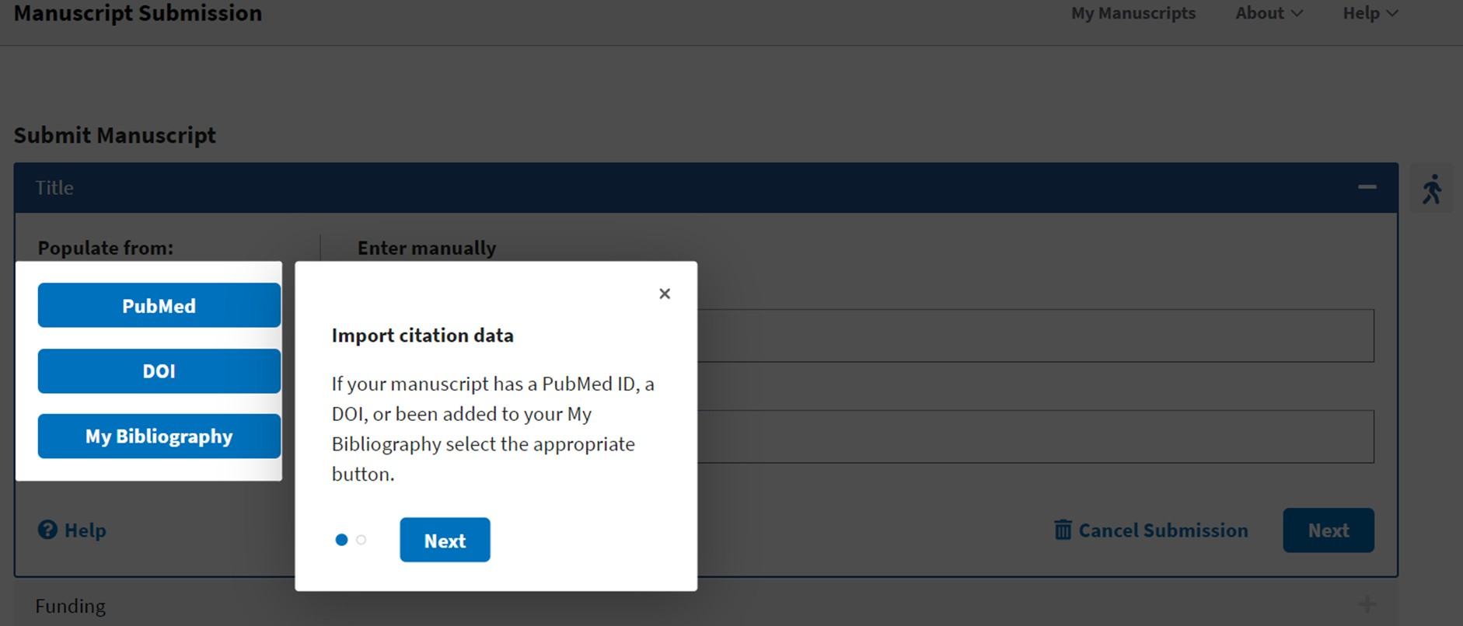
Depositing into NIHMS (Cont' 1)

Slide 11
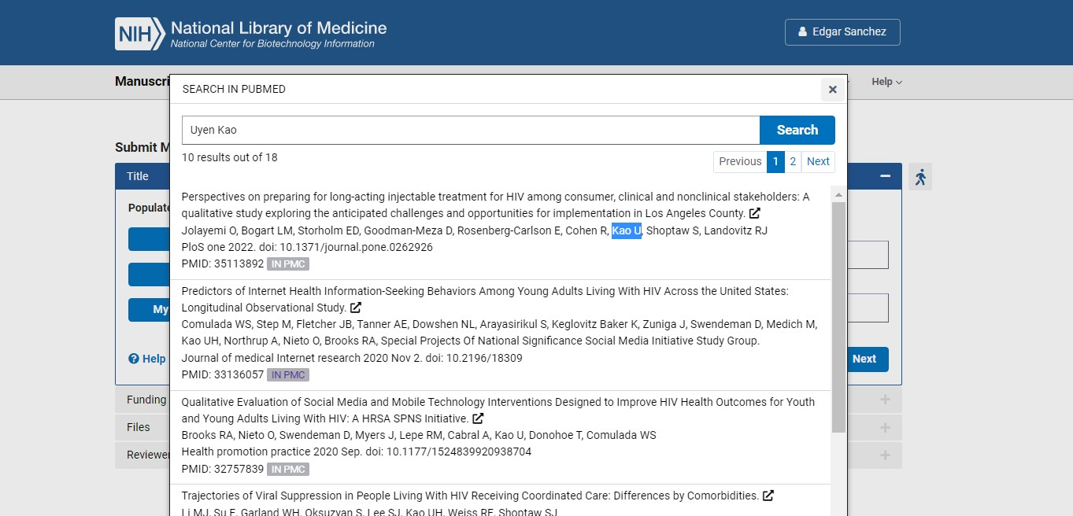
Depositing into NIHMS (Cont' 2)

Slide 12
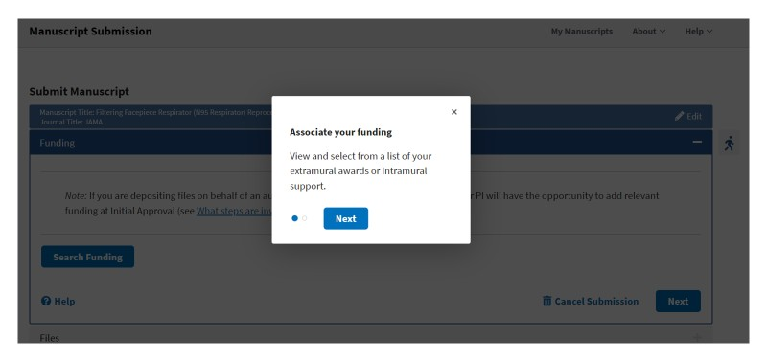
Depositing into NIHMS (Cont' 3)

Slide 13
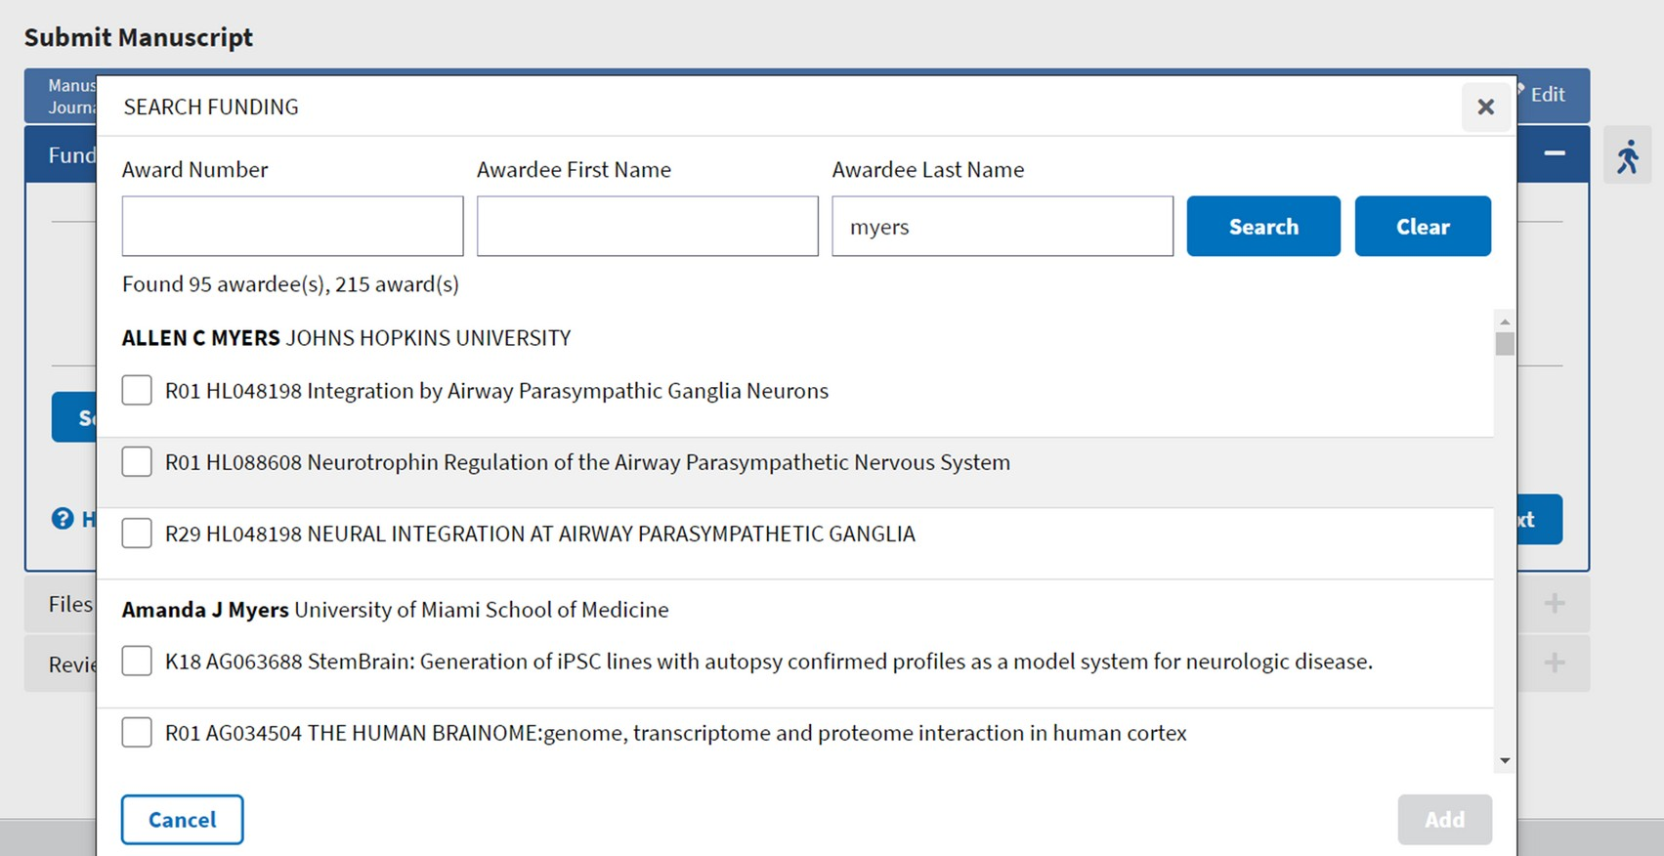
Depositing into NIHMS (Cont' 4)

Slide 14
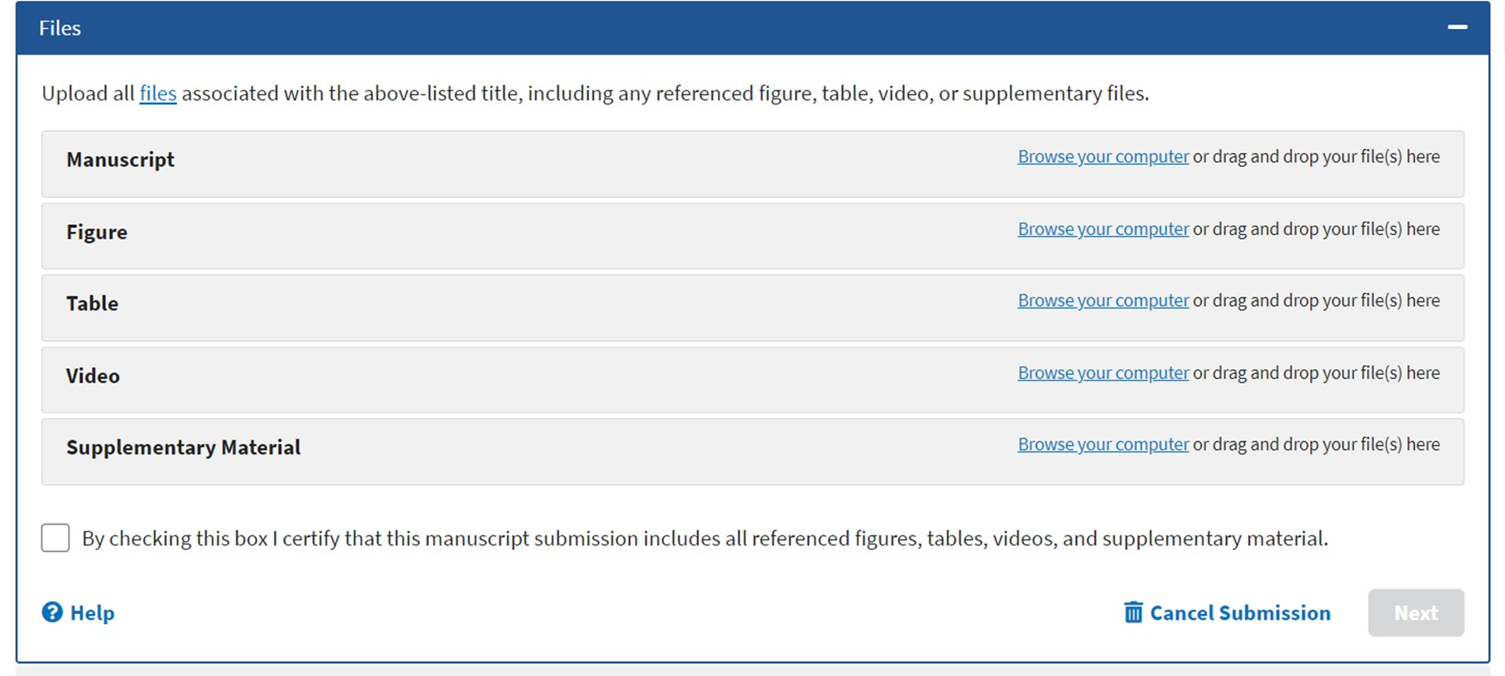
Depositing into NIHMS (Cont' 5)

Slide 15
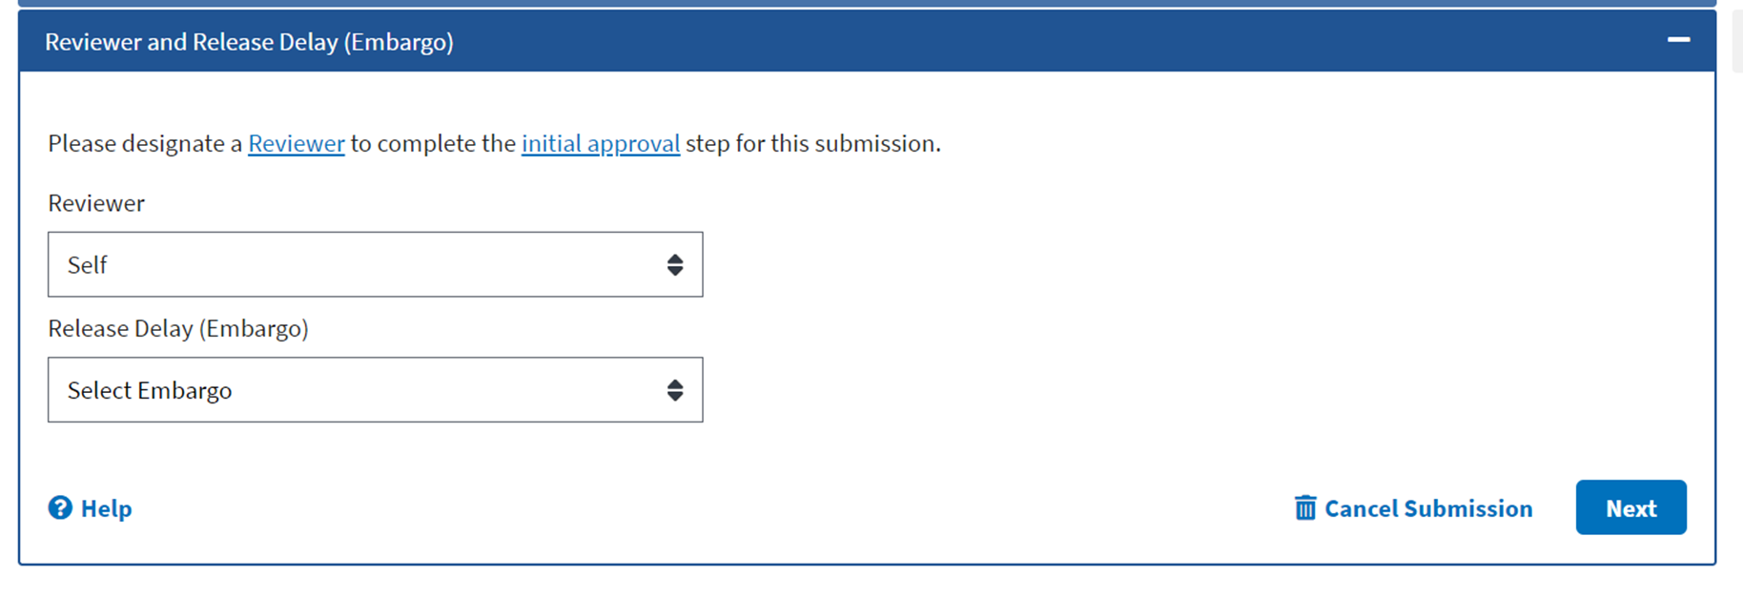
Depositing into NIHMS (Cont' 6)

Slide 16
After uploading into NIHMS, now what?
It will take NCBI a period of time to work on your manuscript and convert it to PMC format.
During this period of time, your submitted manuscript has an interim ID number (the NIHMSID).
Then you (reviewer) will get an email notifying you that they need your final approval.
If you lose the email, just log back into NIHMS and you’ll see the manuscript that needs your attention on your dashboard.
Double-check the converted manuscript to make sure it’s correct.
You only get a PMCID after you do final approval.

Slide 17
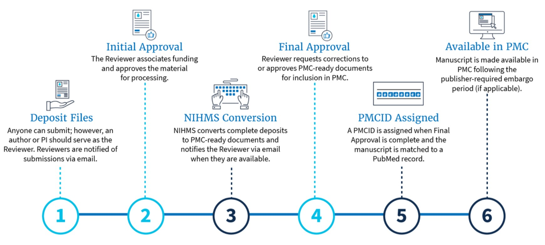
Recap of Process

Slide 18
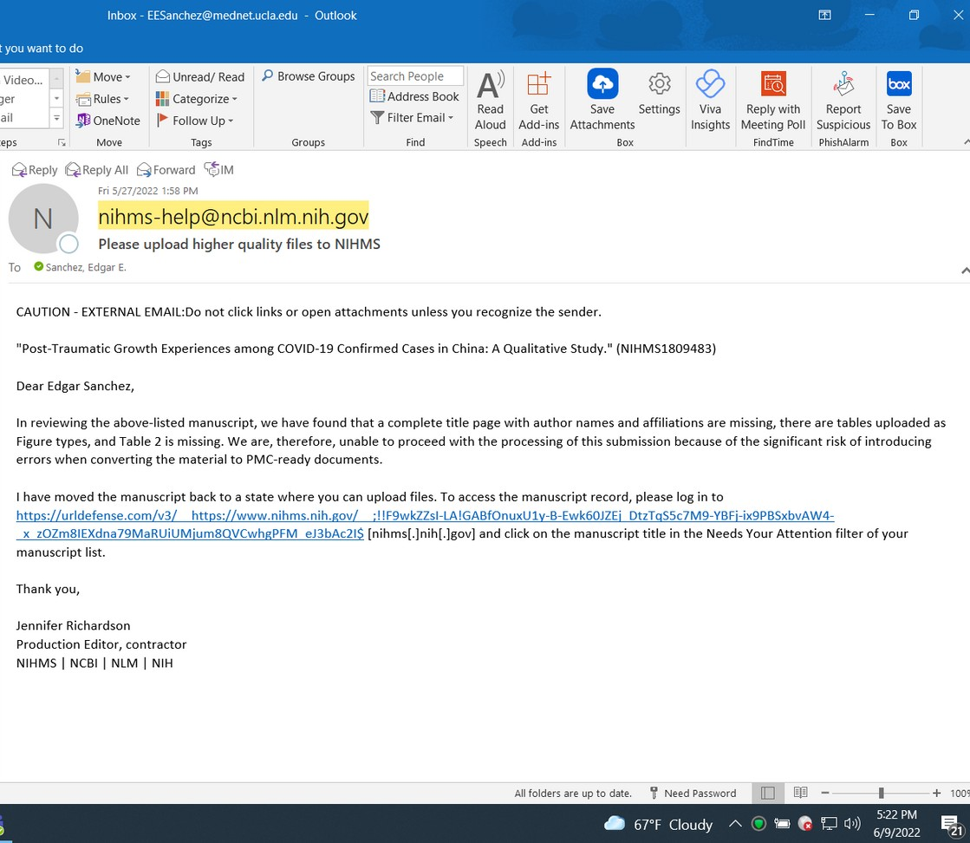
What could go wrong?
Submission Process
You may get other messages from NCBI if you are missing:
Tables Figures References
If so, log into NIHMS to make any corrections or updates.

Slide 19
Method D
Some publishers let you skip the first step of uploading your final author manuscript into NIHMS.
This is usually an option at the time you’re submitting your manuscript.
You still have to log into NIHMS to approve the files that the publisher uploads.

Slide 20
Checking Compliance
Go to MyNBCI and click on My Bibliography.

Slide 21
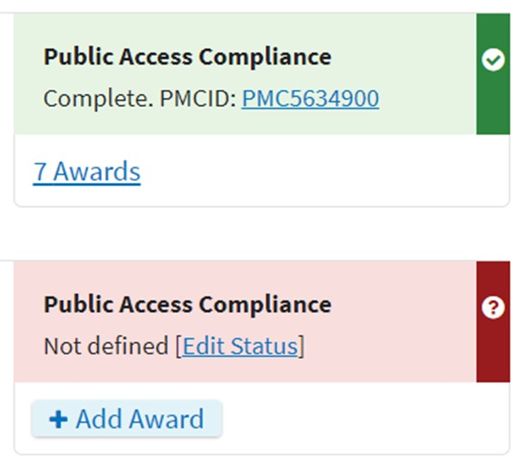
Checking Compliance (Cont')

Slide 22
Questions?
If you have any questions, please contact Enrique Sanchez at EESanchez@mednet.ucla.edu.
OR
Visit our publication management resource page on the CHIPTS website.…………………
Subscribe to the CHIPTS email listserv for updates on future lectures.

