Slide 1
Let’s Talk About PrEP! Tips and Tools for Effective Messaging
Presentation for the Equitable Injectable PrEP in Los Angeles County Initiative
Robbyn Kistler, Senior Consultant, KFF’s Social Impact Media
March 26, 2024
Notes:
RK introduces herself

Slide 2
GreaterThan.org/Materials
KFF’s Greater Than HIV
Effective PrEP Messaging
Resources to Support Your Outreach
Discussion & Questions
Agenda

Slide 3
KFF is an independent nonprofit health information organization.
Through our Social Impact Media program, we work with health departments and community partners as part of our Greater Than public information initiative.
Our primary focus is HIV and sexually transmitted diseases.
KFF’s Social Impact Media Program

Slide 5
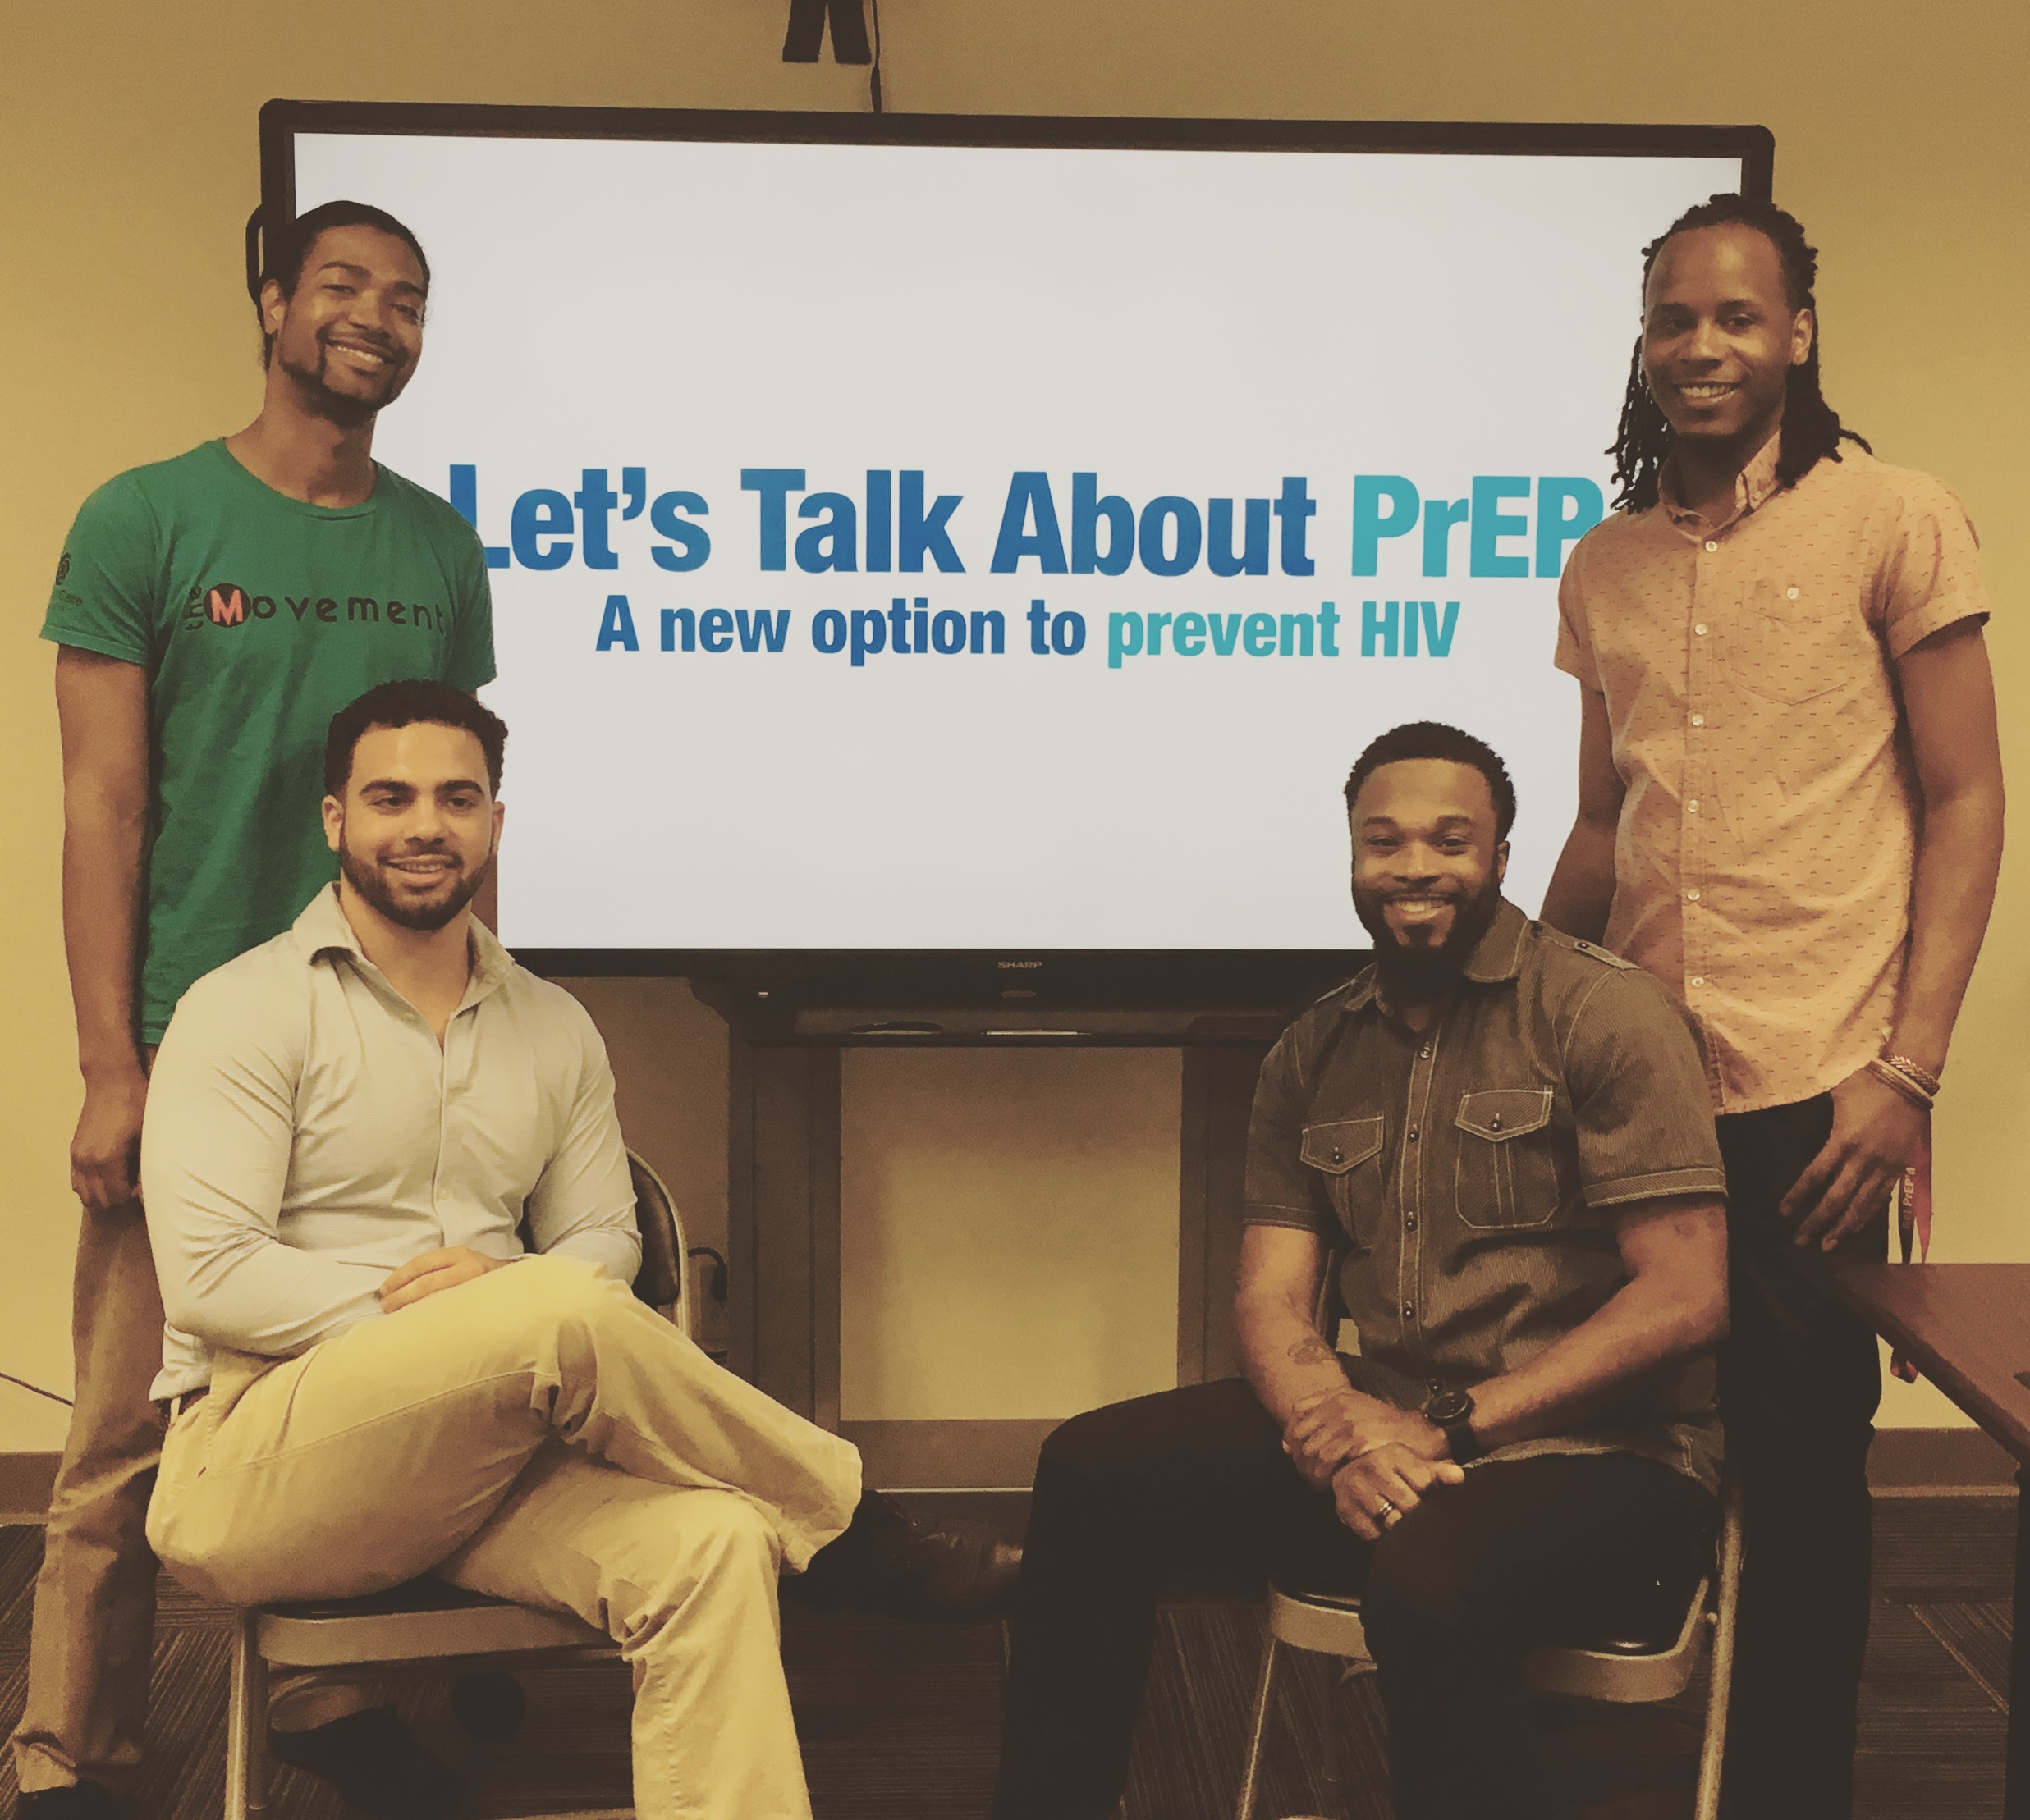
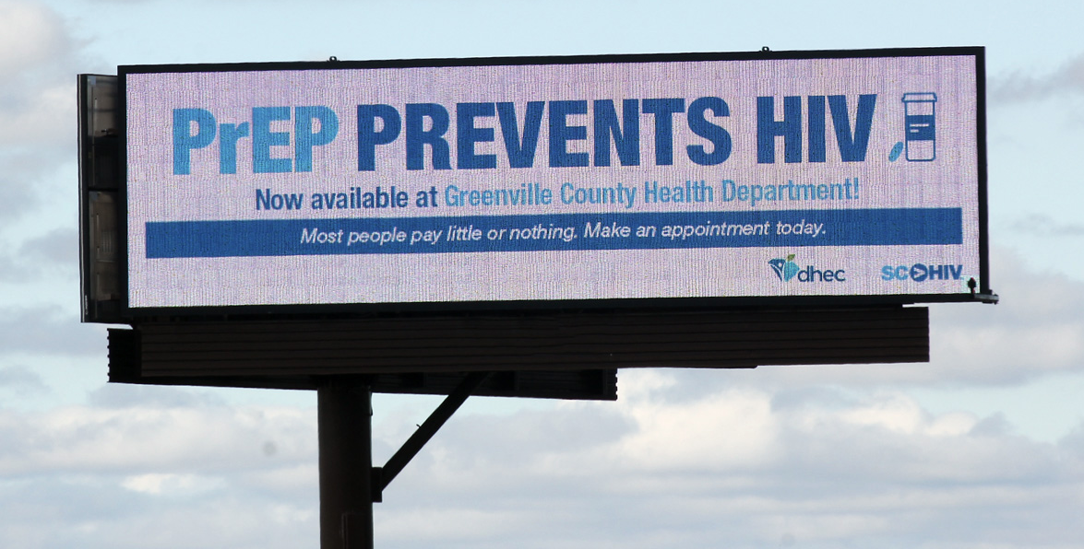
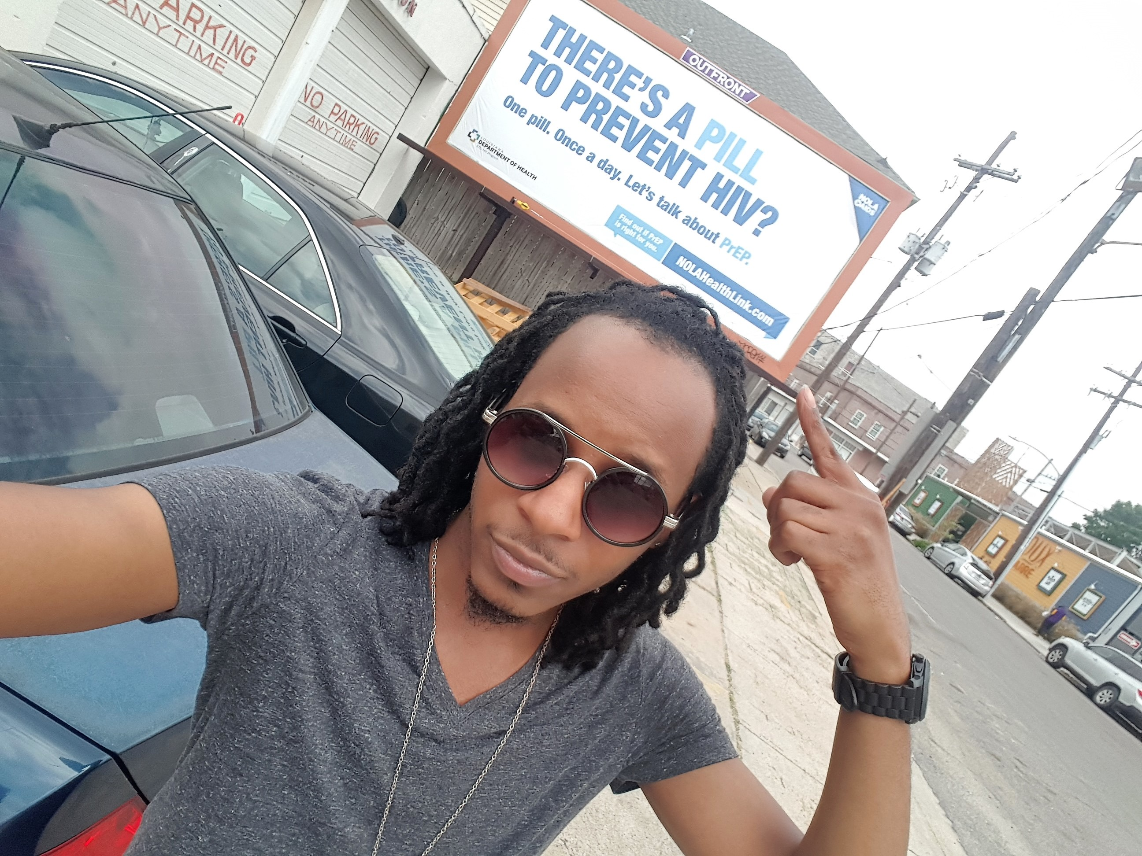
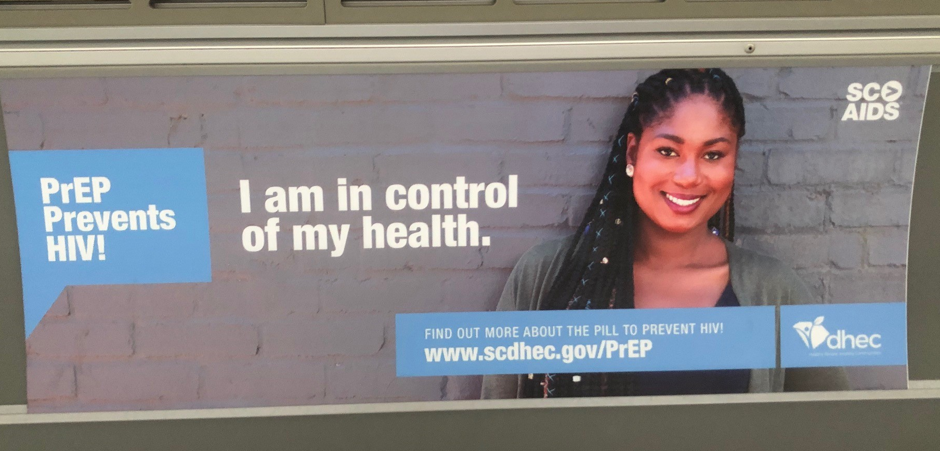
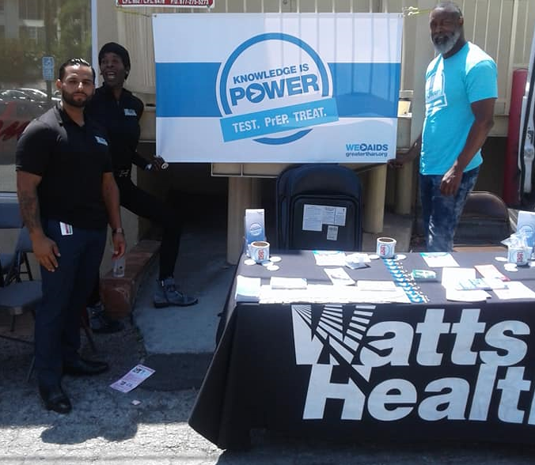
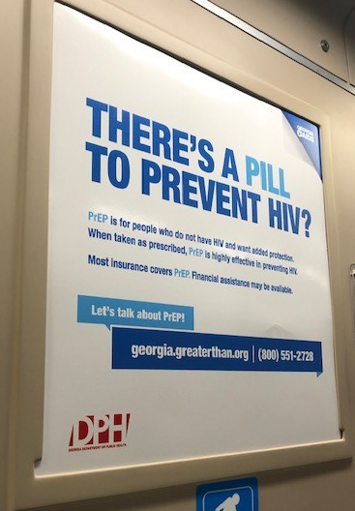

Slide 6
Make a Plan
Goals
Audience
Placement
Landscape
Measures of Success

Slide 7
Effective PrEP Messaging

Slide 8
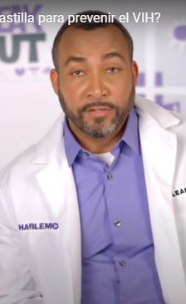
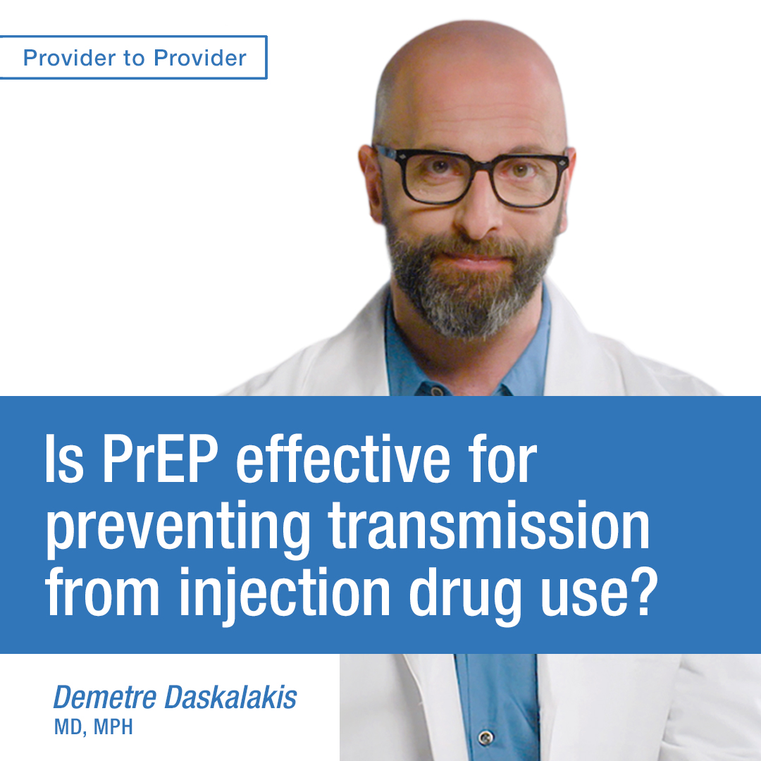
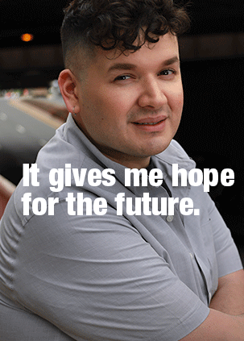

Slide 9
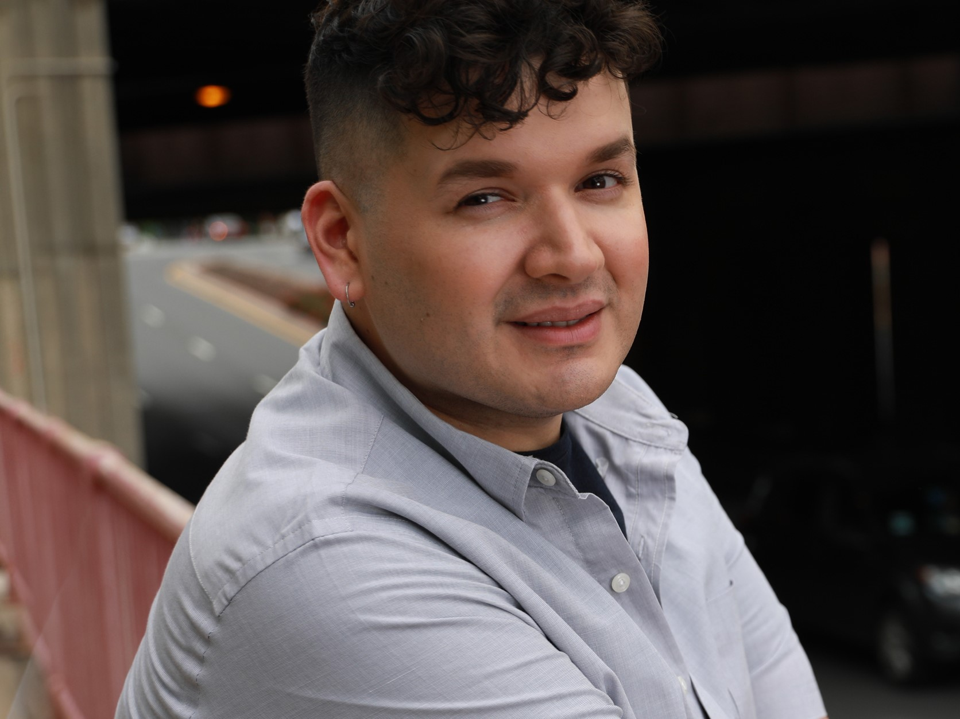
PrEP Basics
Prescription medication
For people who are NOT living with HIV
Options: pills and shots
Most pay little or nothing
Where to find

Slide 10
CLICK TO WATCH ANIMATED VIDEO “What is PrEP?”

Slide 11
Trustworthy
Relatable messengers
Honest conversations
Non-judgmental
Responsive to needs

Slide 12
CLICK TO WATCH VIDEO “Powered by PrEP: Michael”

Slide 13
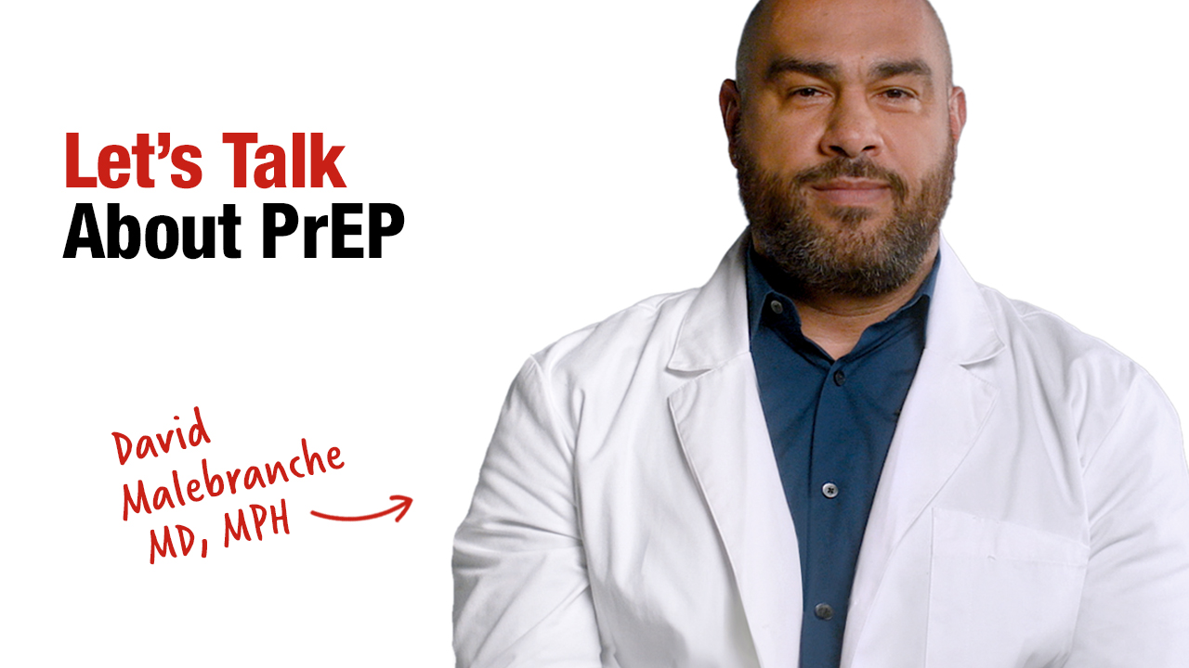
CLICK TO WATCH VIDEO “Let’s Talk About PrEP”

Slide 14
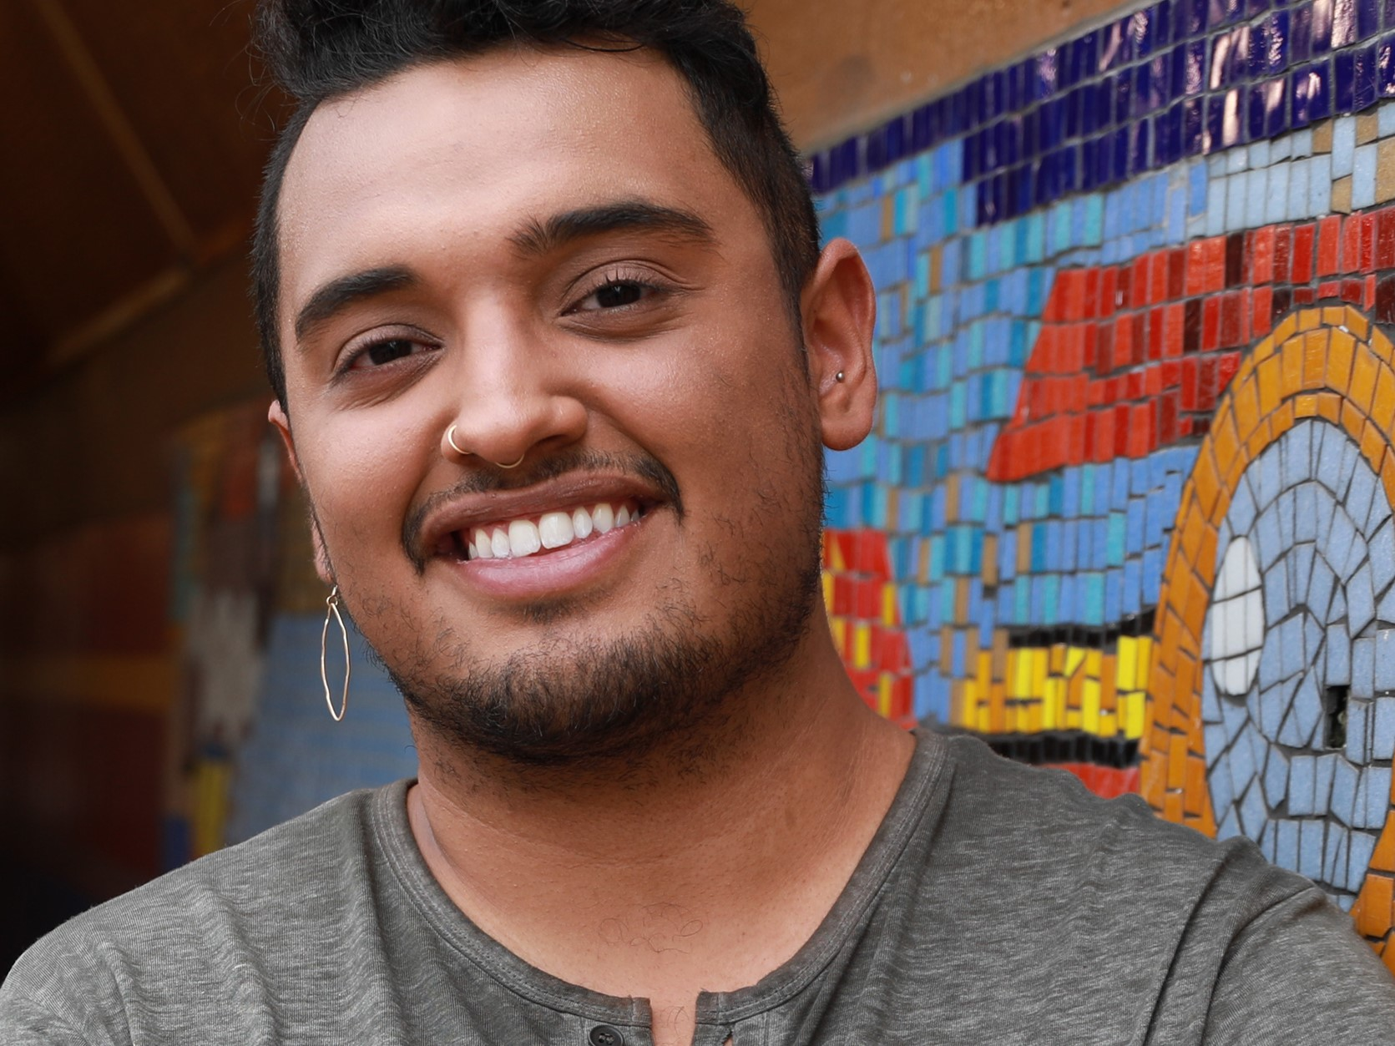
Engaging
Shows personal benefit
Empowering & hopeful
Appeals to mind & heart
Fits media platforms

Slide 15
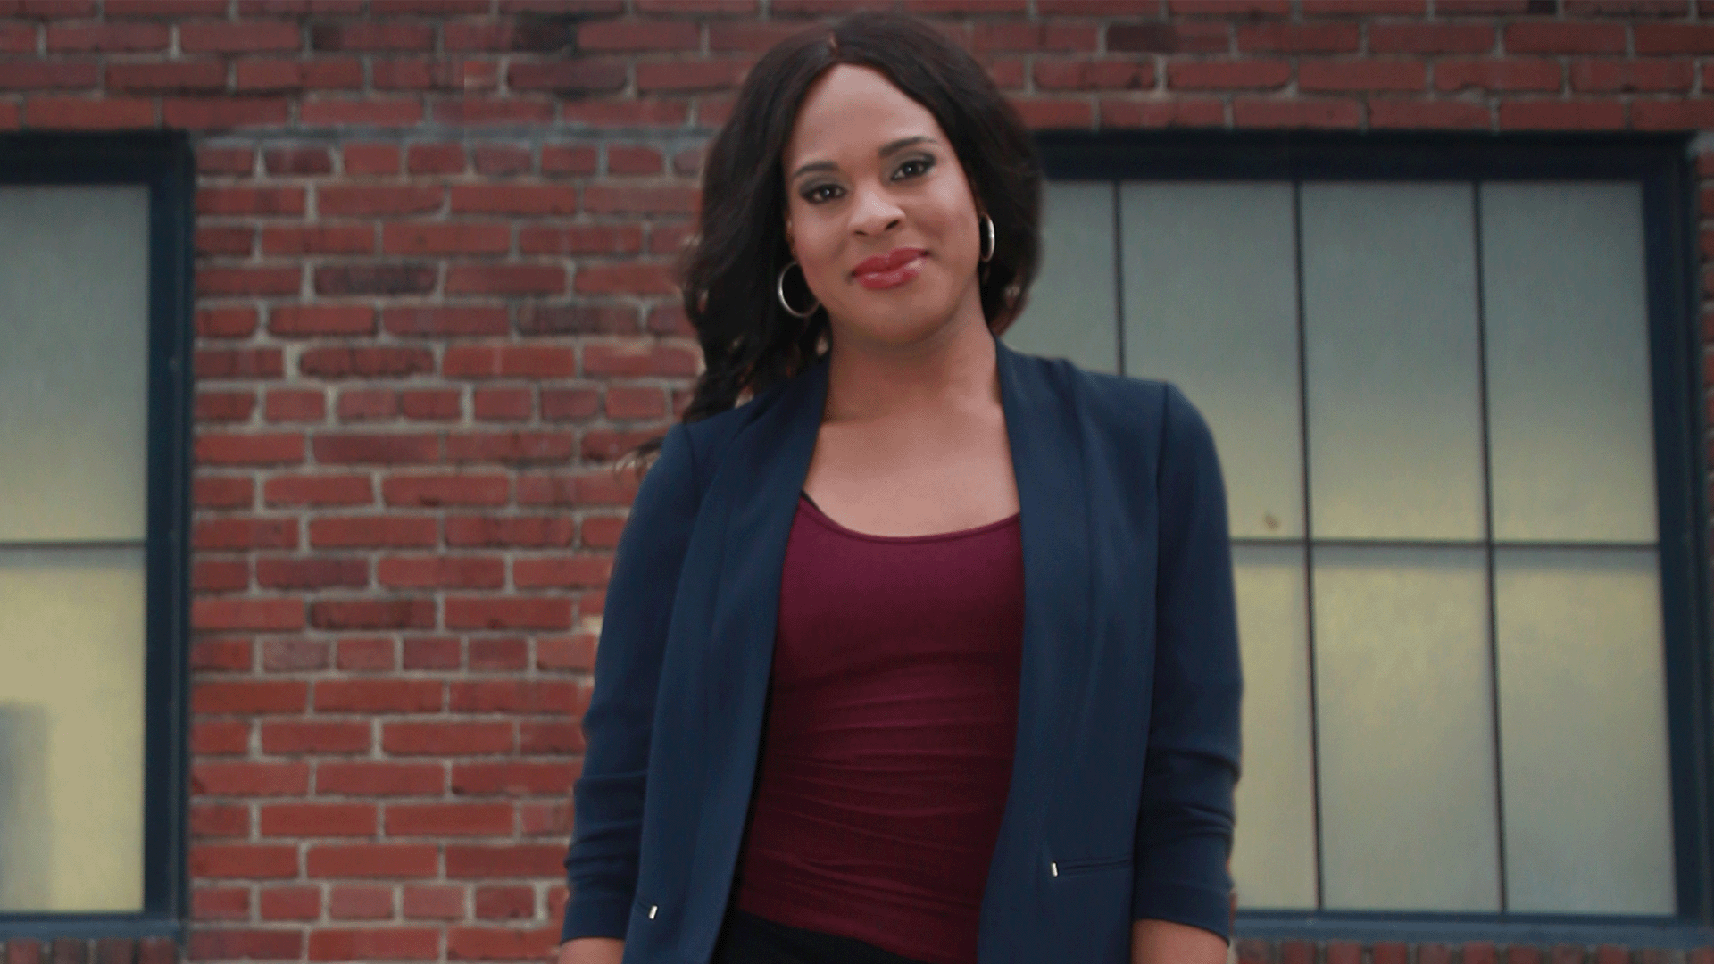
CLICK TO WATCH VIDEO “Powered by PrEP: Nichole”

Slide 16
Accessible
Language
Visuals
Size & colors
Voiceover
Subtitles
No jargon
Notes:
Simple language. In readable colors if there’s text. Or lighting if it’s a photo or video. Is the size right for the placement? Can I see what you want me to see. Or is it super tiny text.
Can I read what you want me to read? If you don’t speak Spanish…and can’t read what this images says…that’s how our Spanish-speaking neighbors experience an English-only campaign. Design for your audience.
If you’re making something in Spanish, do NOT use Google translate. Have a native speaker…better…a few native speakers…develop the language and review all formats. Just like you do in English…proofing, copy-editing…all of it.
Consider voiceover for videos to reach those with limited literacy or visual impairments. Subtitles for those with hearing differences. And, for folks who may watch a video with the sound off!

Slide 17
Actionable
Clear next steps
Shows pathways to overcoming barriers
Where to find more information
Connects to local resources
Notes:
OK…let’s watch a video that brings all of these points together.
Look for the the clear basic info about what PrEP is, the actionable next steps and resources at the end. Take a look.

Slide 18
Resources to Support Your Outreach

Slide 19
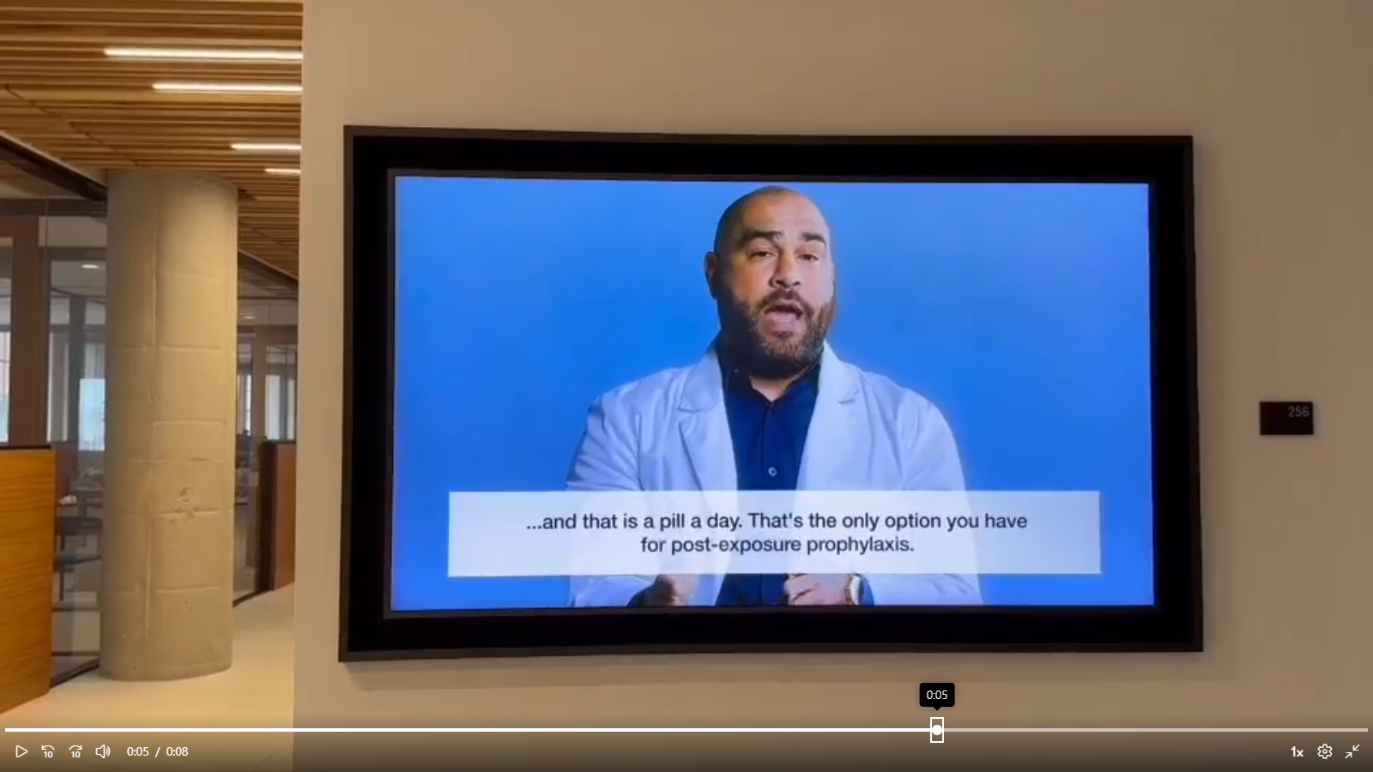
Greater Than HIV Materials Are For You
Notes:
Post to social media (tag #GreaterThanSTIs / #GreaterThanHIV)
Embed or link on websites
Show in clinics and at events
Include in e-newsletters
Train staff to start conversations with clients
Buy digital ads

Slide 20
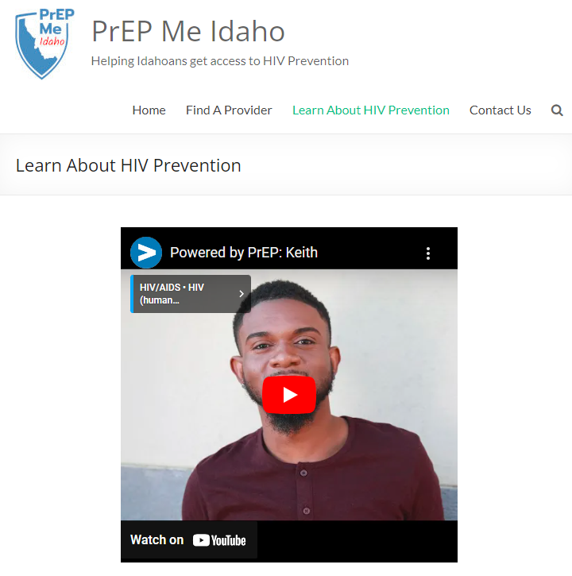
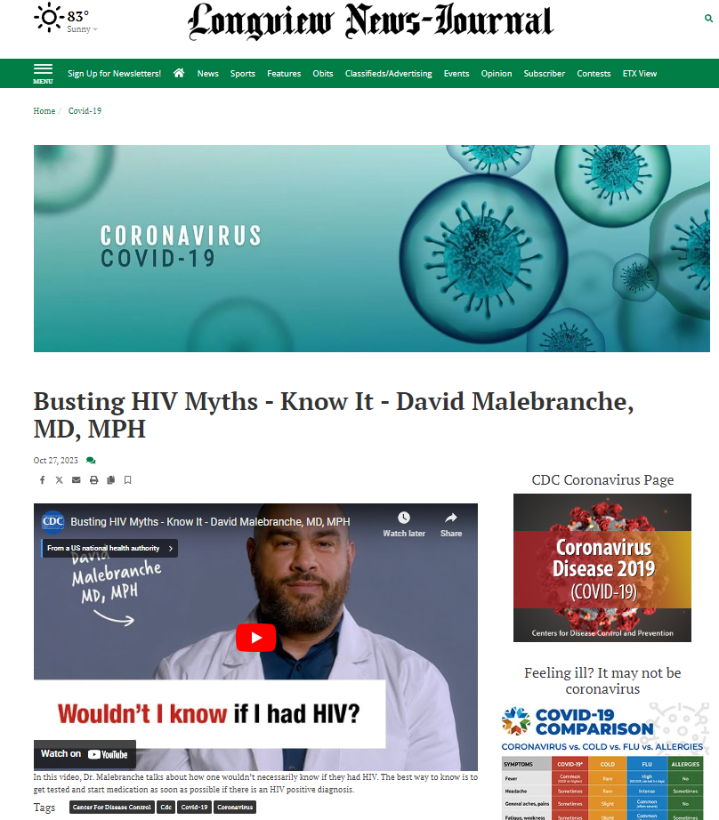
Greater Than HIV Materials Are For You
Notes:
Post to social media (tag #GreaterThanSTIs / #GreaterThanHIV)
Embed or link on websites
Show in clinics and at events
Include in e-newsletters
Train staff to start conversations with clients
Buy digital ads

Slide 21
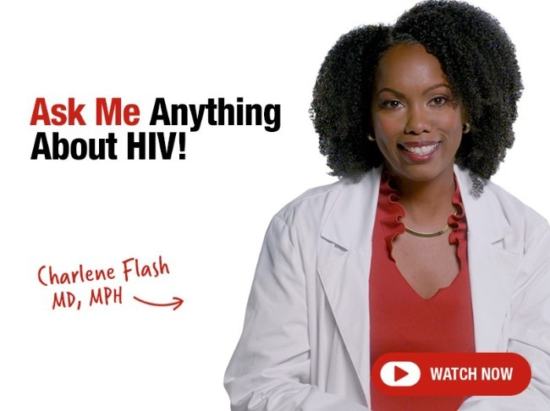
Greater Than HIV Materials Are For You

Slide 22
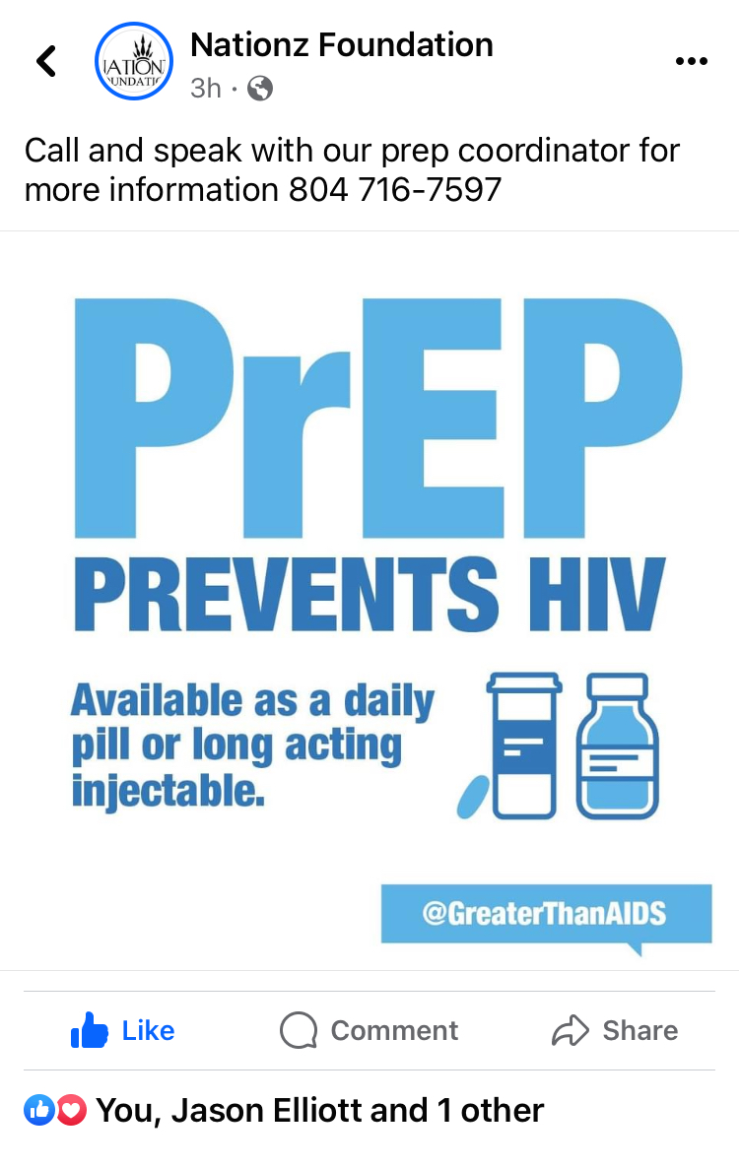
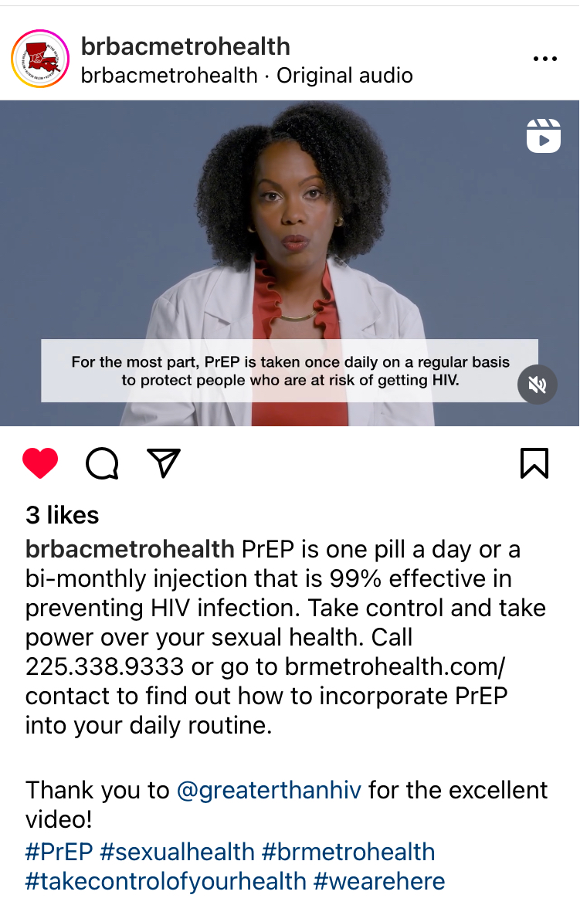
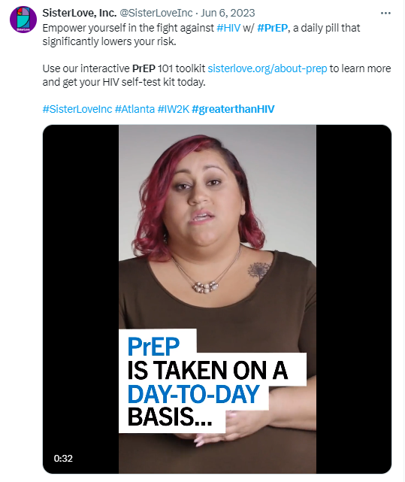
Greater Than HIV Materials Are For You

Slide 23
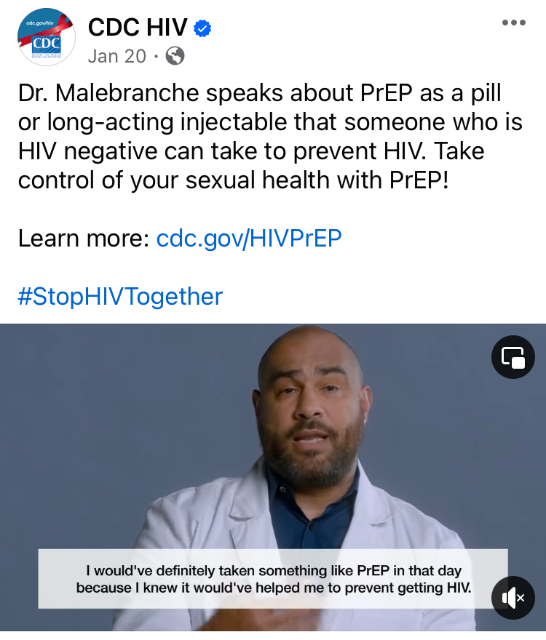
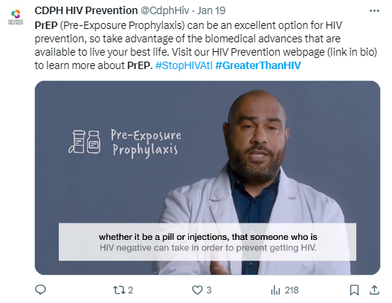
Greater Than HIV Materials Are For You

Slide 24
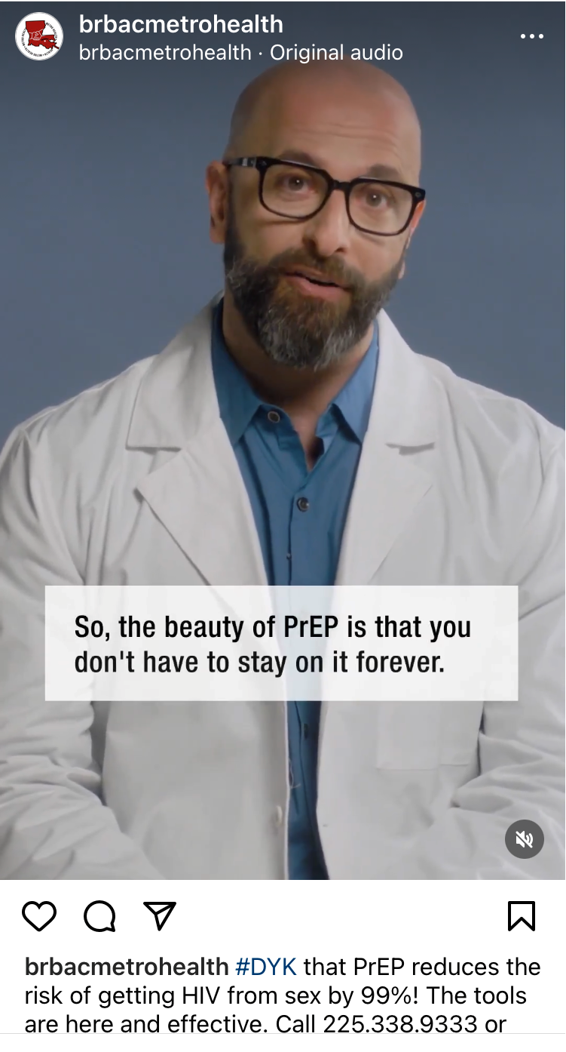
Greater Than HIV Materials Are For You

Slide 25
@GreaterThanHIV

Slide 26
@GreaterThanHIV

Slide 27
@GreaterThanHIV

Slide 28
GreaterThan.org/Materials
GreaterThan.org/Materials
GreaterThan.org/Materials

Slide 29
Stay Connected!
@GreaterThanHIV
GreaterThan.org
GreaterThan@kff.org

Slide 30
Discussion & Questions
What is one action step you’ll take when you’re done with this webinar?

