Slide 1
Dimagi Inc.
CommCare Overview
July, 2012
Washington, D.C.
Dr. Neal Lesh, CSO Dimagi
nlesh@dimagi.com

Slide 2
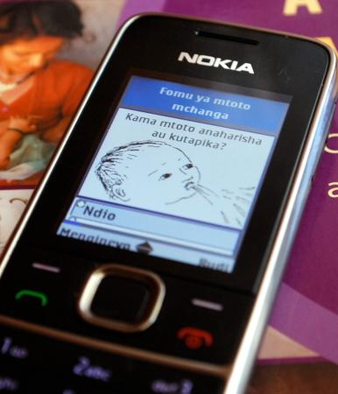
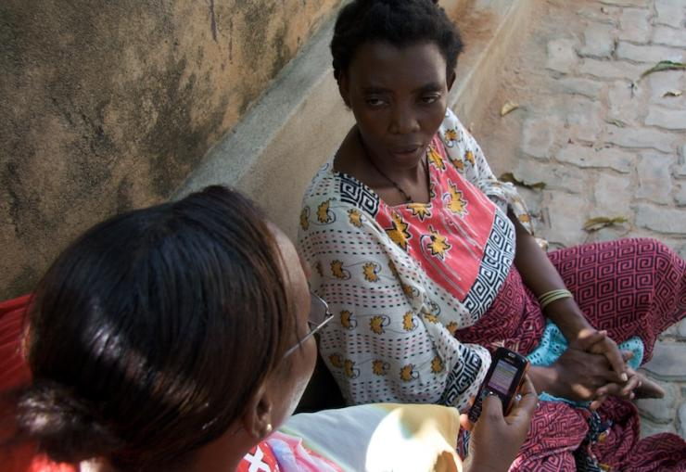
CommCare: DEMO
http://tinyurl.com/commcarevideo

Slide 3
Open, Community-oriented Products
Product
Same code supporting 50 community health programs in 25 countries.
Standard pricing, implementation, packages.
Community
Author CommCare apps at www.commcarehq.org
Developing “App store” for content sharing.
Open source
Enables local ownership.
Governments more and more requiring this to scale.

Slide 4
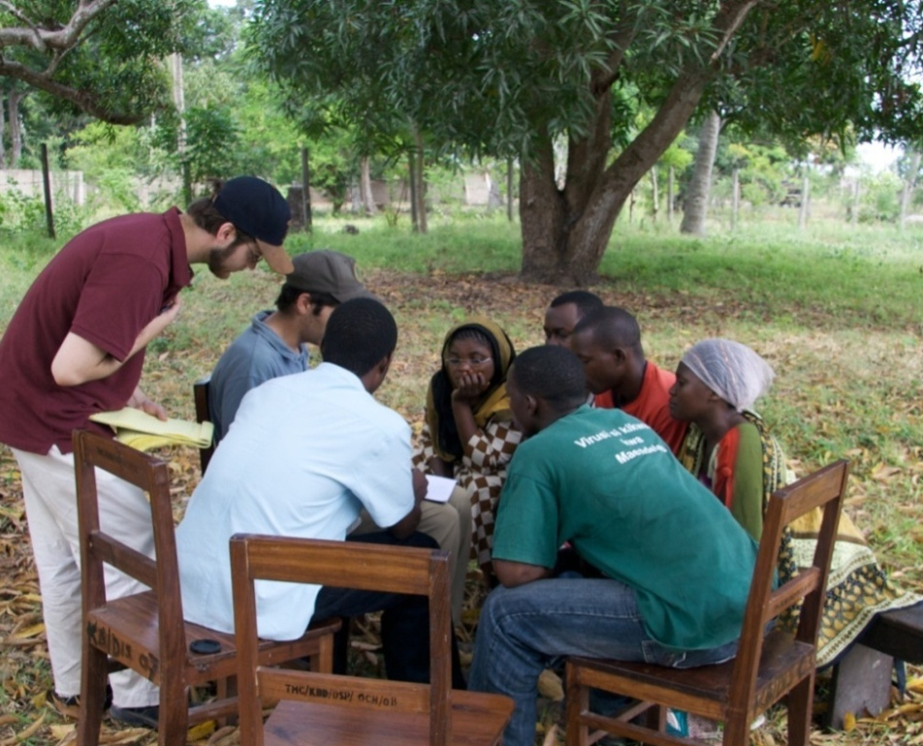
Design Under the Mango Tree

Slide 5
Challenge
Global HQ
In-country HQ
Field Managers
Talking to CHWs
Working with CHWs
IDEAL INTERVENTION
ACTUAL INTERVENTION

Slide 6
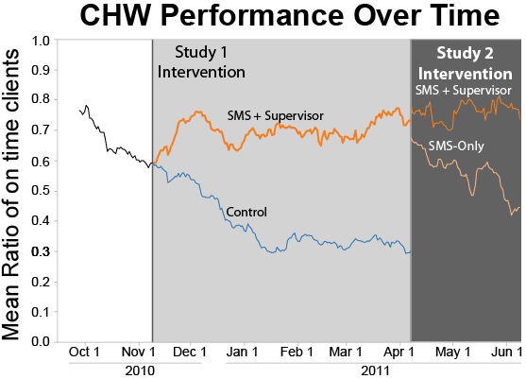
Improved Access (Work by Brian DeRenzi et. al ‘2012)
85% More timely Visits
Randomized Controlled Trial
B. DeRenzi, L. Findlater, G. Borriello, J. Jackson, J. Payne, B. Birnbaum, T. Parikh, N. Lesh, “Improving Community Health Worker Performance Through Automated SMS”, ICTD 2012, to appear
Notes:
Ran study in Tanzania—through D-tree and Pathfinder
CHWs are expected to visit each client at least once per month
Study was on 87 CHWs using CommCare.
First study
Half got nothing, half got SMS intervention
SMS intervention was messages starting the day before visit due and continuing daily until form submitted
On day 3 got message saying supervisor would be alerted (escalation)
Dramatic results as shown in graph. 85% more timely visits.
Second study
Tested effect of escalation, by removing supervisor alerts from some of those getting it, and adding in SMS without supervisor alerts to others.
Smaller samples but results indicate that supervisor alerts are key to the success of the program.

Slide 7
Building mHealth Capacity (India results)
100%
91%
91%
82%
64%
Commitment to Proof of Concept (POC)
Successful Pilot (POC)
Evaluation
Plan to Scale-up
Scale-Up
11 Orgs in India in 2011
10 Orgs completed pilot with 10 free phones & field support
10 Orgs completed internal evaluation
6 Orgs did rigorous evaluation
9 Orgs plan to scale-up
6 Orgs coordinated Gov’t Support
4 Orgs contracted Dimagi after POC
7 Orgs scaling
3 of Orgs trained CHWs on CommCare WITHOUT Dimagi
Provide 10 free phones and field support for proof of concepts (POC)
885 CHWs successfully trained on CommCare
1,340 CHWs planned to be trained from POC Orgs

Slide 8
Thank you!
Contact: nlesh@dimagi.com or jjackson@dimagi.com
Additional Videos:
CommCare Overview Video: http://youtu.be/ZpfvISKxylE
CommCare Demo Video with multi-lingual support from India: http://youtu.be/30Ftk6STM3U
Recorded Webex of CommCare Presentation given to NetHope: http://bit.ly/tiLaYy
Additional Resources:
http://groups.google.com/group/ict4chw
http://www.commcarehq.org
http://www.dimagi.com

Slide 9
Dimagi Global Head-office
585 Massachusetts Ave
Cambridge, MA 02139 USA
T: +1.617.649.2214
F: +1.617.274.8393
For more Information
E: information@dimagi.com
W: www.dimagi.com
W: www.commcarehq.org
W: www.dimagi.com/category/blog/

