Slide 1
A Trust-Building Intervention to Help Address Critical HIV Outcomes Justicia Une a Nuestras Mujeres Trans y Oficiales de Policías Hacia la Salud JUNTOS Justice Unites our Trans Women and Police Officers Toward Health TOGETHER
This project is possible thanks to:
The CHIPTS Pilot Mentored Program (P30MH05810 ) &
the support received from Latina Transgender Women and the Los Angeles Police Department
Presenter: Joanna L. Barreras, PhD, MSW
CSULB- School of Social Work
Bienestar Human Services, Inc
Co-I: Sarah MacCarthy, ScD
Mentor: Laura Bogart, PhD
RAND Corporation

Slide 2
Background
HIV-related inequities affect Latinx communities, especially Latina transgender women (LTGW)
LTGW experience high levels of violence, stigma, and discrimination, which may lead to increased HIV risk behaviors
In the 2015 U.S. Transgender Survey, among respondents identifying as Latino/a,
48% reported being sexually assaulted in their lifetime
12% reported being sexually assaulted in the past year
59% said they would feel somewhat or very uncomfortable asking the police for help
Not seeking or receiving support after trauma exacerbates negative physical and mental health outcomes generally, and HIV-related outcomes specifically

Slide 3
Study Goal & Methods
Study Goal: To develop an intervention to increase trust between law enforcement and LTGW, and improve HIV-related outcomes, using community-based participatory research methods
LTGW identified need for such an intervention, developed by LTGW for LTGW
Conducting qualitative semi-structured interviews with 15 LTGW and 5 law enforcement stakeholders (from the LAPD)
16 interviews completed so far (with 11 LTGW and 5 LAPD)
Qualitative content analysis will be used to allow for themes about potential intervention components to emerge through a bottom-up, iterative coding process
Qualitative results will be presented at a one-day structured community workshop in March 2021 with LTGW and LAPD participants, to develop the intervention using a participatory engagement process

Slide 4
Preliminary Results: Potential Intervention Components
Include relevant topics in law enforcement training
Respect
Empathy
Safety
Profiling
Link LTGW to resources through law enforcement
Legal services
Basic needs (e.g., housing, organizations known to hire LTGW)
Mental health and substance use services
Mechanisms for reporting hate crimes (including policies– ”how are hate crimes defined”)
Linkage to HIV prevention & treatment (PrEP and PEP)
Formal systems offering support to LTGW found to be doing sex work (e.g., sex work diversion program)
(”police officers can’t do it all alone, community organizations and law enforcement can support court referrals…”)
Create spaces for positive interactions between LTGW + LAPD, to build trust
LAPD present at transgender focused community meetings and events
LTGW volunteering at police stations
LTGW participating in officer trainings (testimonials)

Slide 5
Preliminary Results: Quotes
“I have lost trust; I feel like they’re not going to help. They don’t arrive on time and I feel discriminated because they see that I am transgender. And they see we’re not all the same… a lot of police officers think that a lot of transgenders are on drugs and crazy, and they’re the worst …and not all of them [transgender women] are the same. I am a transgender woman that isn’t a prostitute, I have a clean record, I like to work and study, I treat people with respect, but I don’t feel safe if I call the police because I feel like they won’t help me because of my identity and gender. I don’t have trust anymore… the experiences that I have had, I feel sad about them. But I would like for all police departments to take into account all cases because the harm that is done is so big that we are the victims of violence and discrimination… both them [police officers] and the aggressors who attack us and give us psychological harm.“ (46 year-old Mexican LTGW)

Slide 6
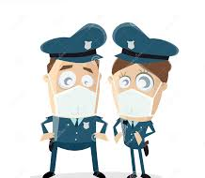
“We don’t know what we don’t know in law enforcement.. We need to take steps to bring light to the problem (s).” (LAPD Officer)
“We need to know what the community needs from us…” (LAPD officer)
“We need to build trust… get to know each other.” (LAPD officer)

Slide 7
In summary, all participants said a program to improve relationships between LTGW and police officers is ”very important and necessary”… “change is needed to improve”
End stereotypes (“not all transgender women are doing sex work”; “not all police officers are bad”)
Not to generalize…get to know who we are, not all transgender women are hair stylist, sex workers...
Come together- Build Trust→ get to know each other (e.g., socials, community meetings, listening during encounters)
Deeper understanding– know the struggles, where they come from
Gain trust– that I’ll come to help not to investigate you
Provide connection to resources
Beyond training– “exposure”

Slide 8
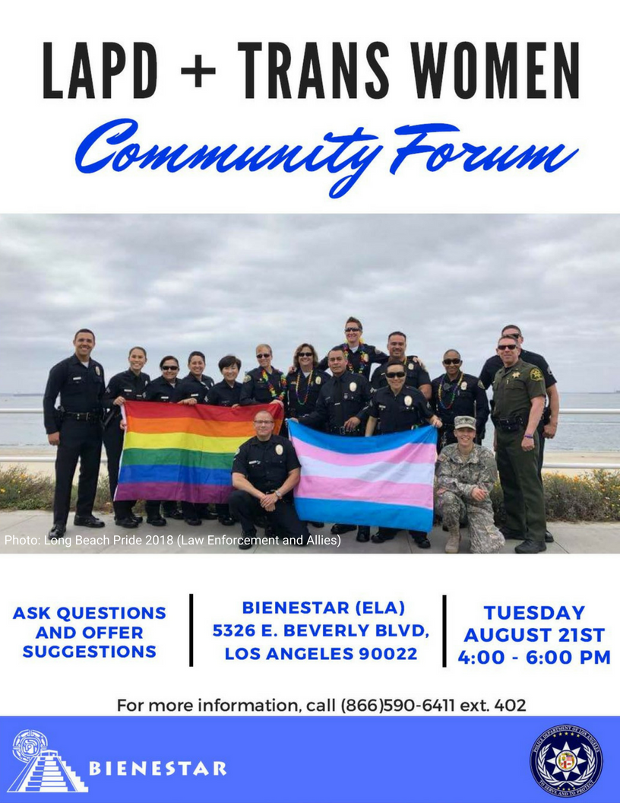
Discussion
Proposed Intervention Components
Create safe spaces to build trust and mutual empathy
Direct
LAPD + LGBTQ Safety
Community forums/meetings
LAPD town halls
Training program (e.g., LTGW presenting at officer trainings)
Indirect
Testimonials about each other’s daily lives and experiences with each other
Using videos
Police ride-alongs and simulation exercises
Develop trainings for law enforcement to know how to respond to the needs of LTGW appropriately (upholding respect and demonstrating empathy) and connecting them to the help they (may) need
Officers to use referral card
Connect LTGW to local supportive resources (known to be LGBT friendly, if available)

Slide 9
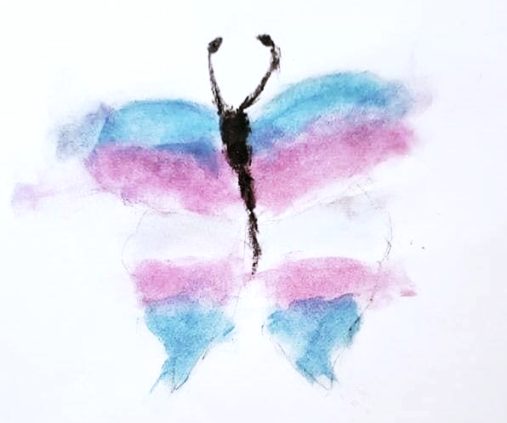
Discussion
After a traumatic experience, victims should feel comfortable reporting the assault to law enforcement
JUNTOS aims to improve:
Mental health (e.g., through increased help-seeking, quality social support, and likelihood/comfort reporting crimes)
HIV-related health behaviors (e.g., retention in preventive care, medication adherence)
Law enforcement should have access to local linkage to care resources and/or counsel LTGW on the importance of following up with their provider
Recent trauma is associated with antiretroviral failure; thus, the role of law enforcement responding to any traumatic experience/event faced by LTGW is key to continued retention in care and ultimately, achievement of viral suppression

Slide 10
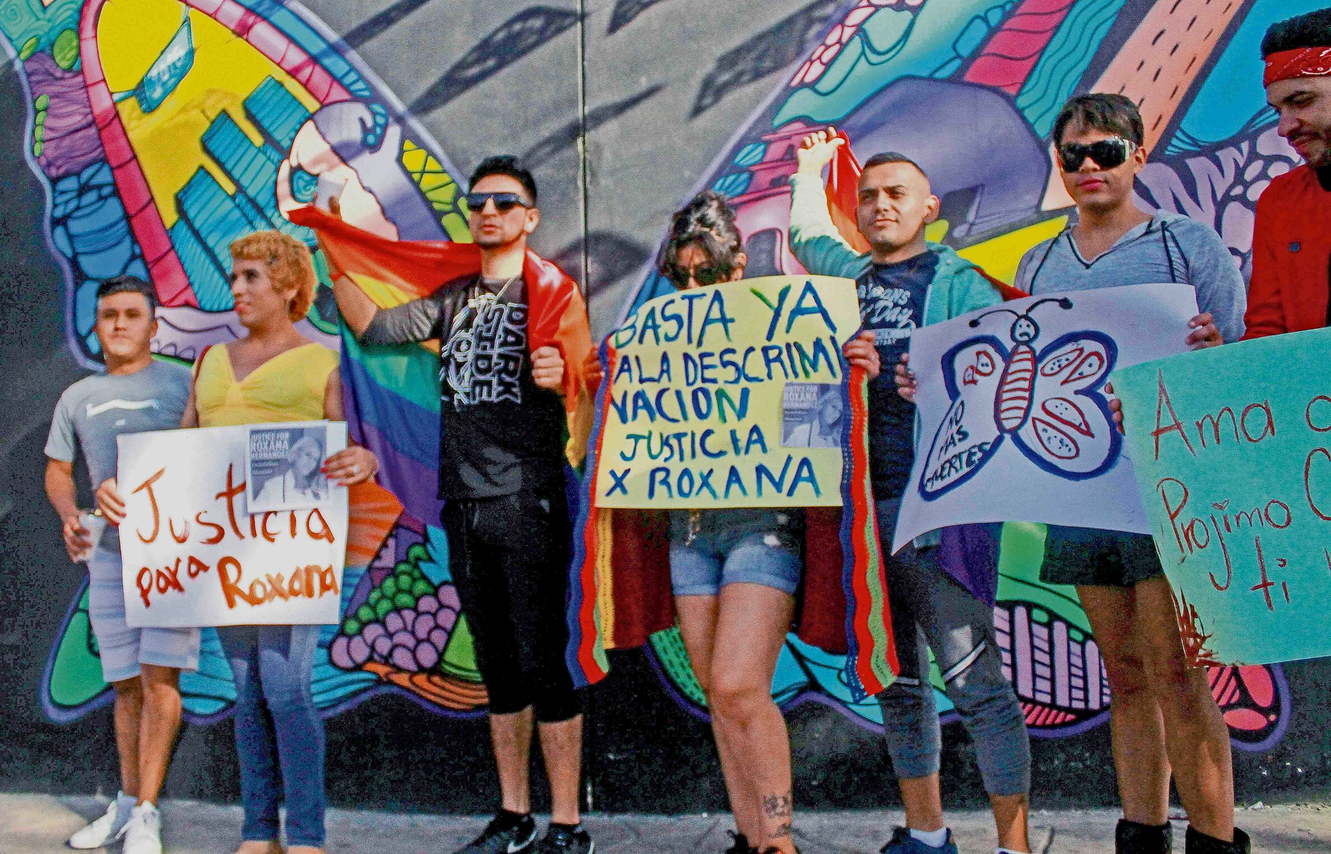
Future Directions
Information from the qualitative interviews and the feedback/evaluation forms from the one-day structured community workshop will be used to draft an intervention protocol for pilot testing (R21)
Will continue involving community and stakeholders in research
Will include other law enforcement departments

Slide 11
Questions/Comments Thank You!
Jbarreras@Bienestar.org

