Slide 1
Is The Pandemic Over?
What You Need To Know About COVID-19, The Variants And Vaccines
Friday, July 23, 2021 from 3:00 p.m. – 4:30 p.m. PST
1

Slide 2
University of California Los Angeles Center for Behavioral and Addiction Medicine
Dilara Üsküp, PhD, PhD (Co-pi)
Steve Shoptaw, PhD (Co-PI)
Nina Harawa, PhD, MPH
Uyen Kao, MPH
Damilola Jolayemi, MSc
Chelsea Shover, PHD
Vickie MayS, PHD
Enrique Sanchez, BS

Slide 3
About UCLA CBAM
Multidisciplinary center that seeks to advance the prevention and treatment of chronic illnesses
Conducts clinical trials and behavioral studies
Focus is on communities with health disparities
UCLA CBAM led the COVID-19 Moderna Vaccine clinical trials
Vine Street Clinic

Slide 4
COVID-19 Vaccine Services and Resources
Funded by the California Community Foundation
Aims of the project are to:
Facilitate (community, public, private, and governmental partnerships to reduce COVID-19 vaccine inequity);
Educate (communities of color in South LA about the COVID-19 vaccines through virtual town halls); and
Navigate (communities of color in South LA on how to access COVID-19 vaccines)

Slide 5
Project Team Contact Information
Dilara Üsküp, PhD, PhD, Co-Principal Investigator duskup@ucla.edu
Steve Shoptaw, PhD, Co-Principal Investigator sshoptaw@ucla.edu
Damilola Jolayemi, MSc, Project Coordinator ojolayemi@mednet.ucla.edu

Slide 6
Agenda:
Overview:
The goal of this summit is to share the latest information about COVID-19, the variants, and available vaccines for adults and children in the Los Angeles County (South Los Angeles)
3:00 p.m.-3:10 p.m. (10 minutes)
Welcome and Opening Remarks – Dilara Üsküp, PhD, PhD
3:10 p.m.-4:00 p.m. (50 minutes)
Speaker’s Discussions – (Director Branch, Drs. Pang, Okonkwo, Gonzalez, Clark)
Speakers:
Cheryl Branch,MS
Frances Pang, MD
Nonye Okonkwo, MD, MS
Eloisa Gonzalez, MD, MPH
Jesse Clark, MD
4:00 p.m.-4:25 p.m. (25 minutes)
Question & Answer Session – Dilara Üsküp, PhD, PhD
4:25 p.m.-4:30 p.m. (5 minutes)
Closing Remarks – Dilara Üsküp, PhD, PhD

Slide 7
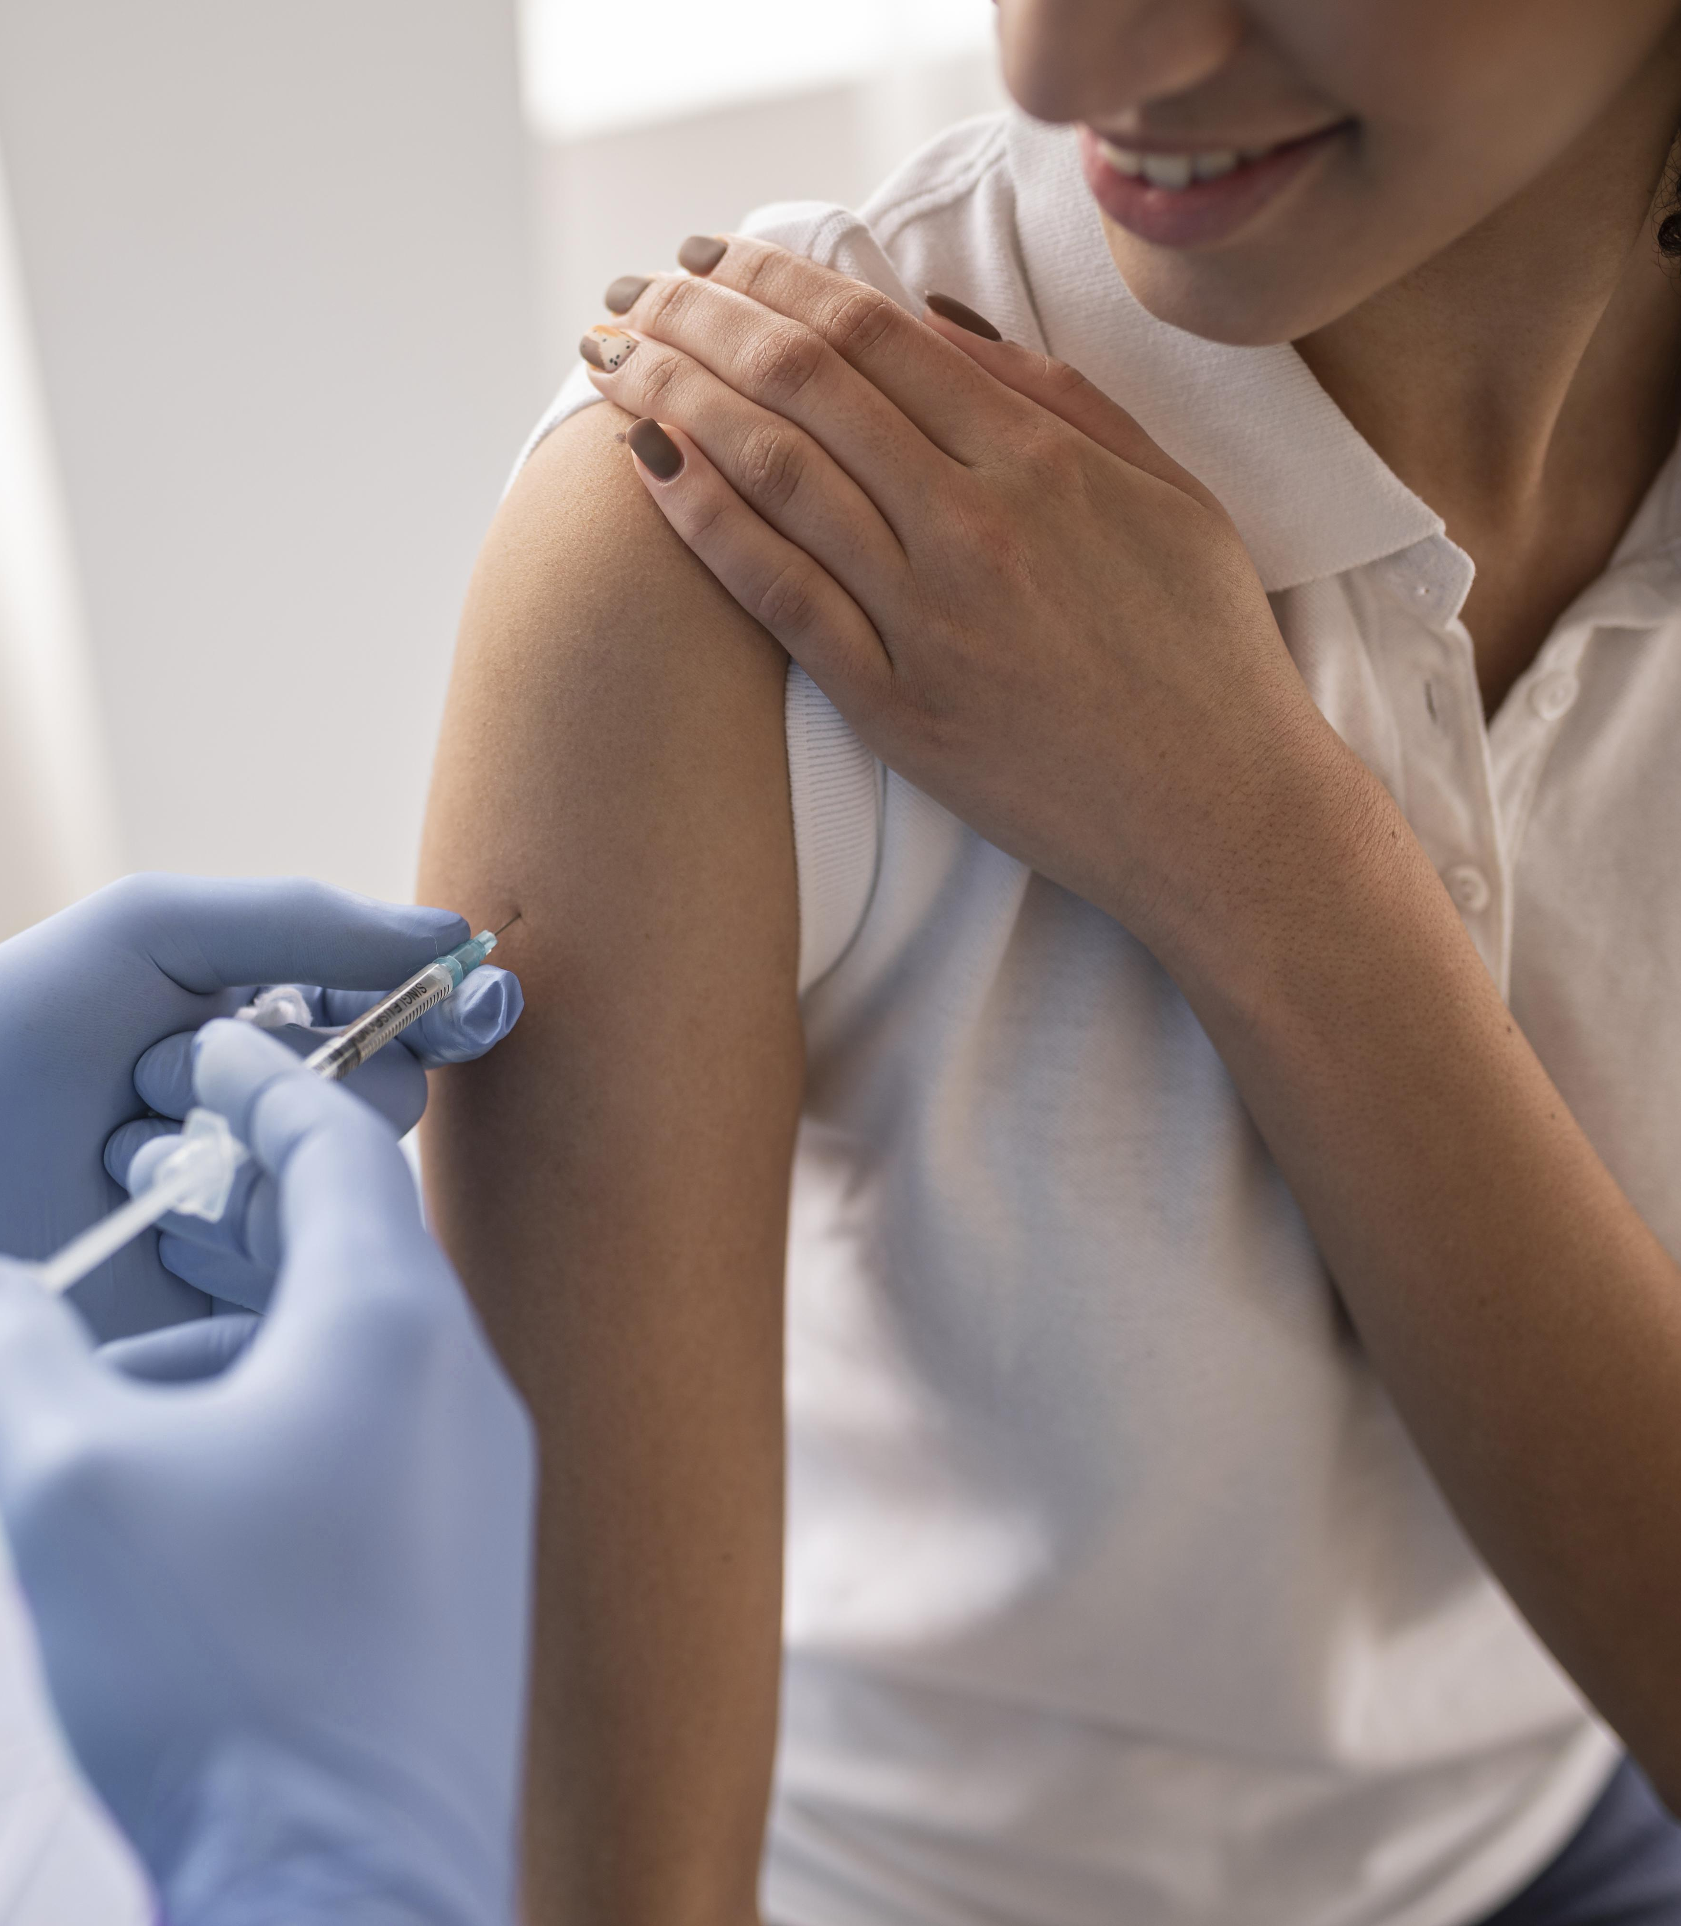
Discussions
01. Is the Pandemic over?
02. What is the state of COVID-19 in Los Angeles County?
03. COVID-19 variants
04. Vaccination Information for adults and children
05. Community Outreach

Slide 8
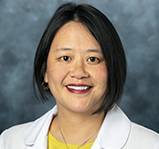
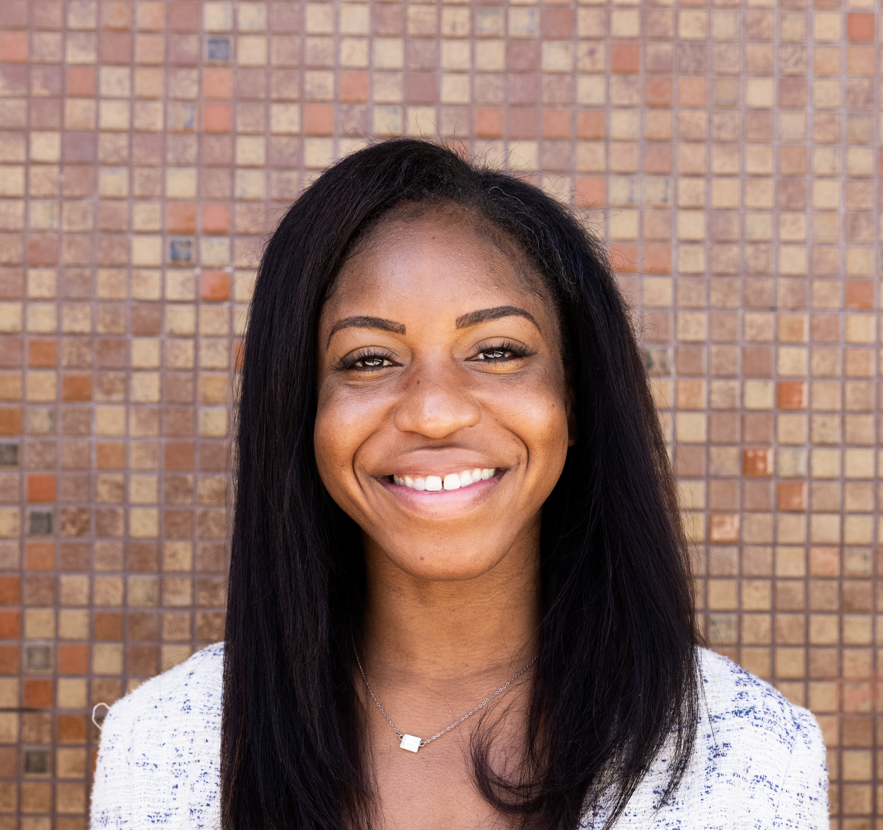
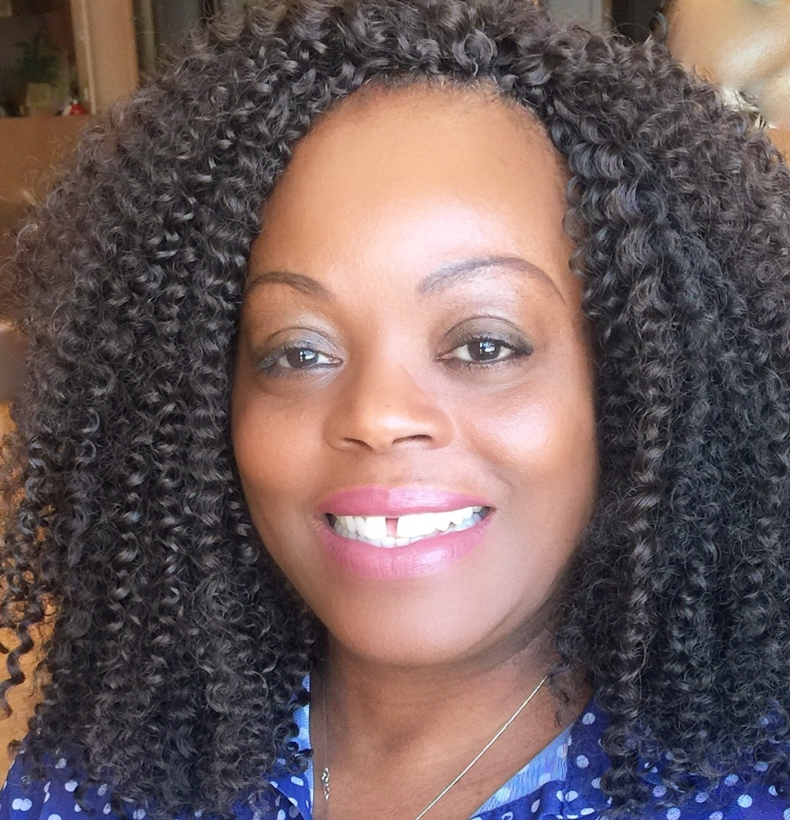
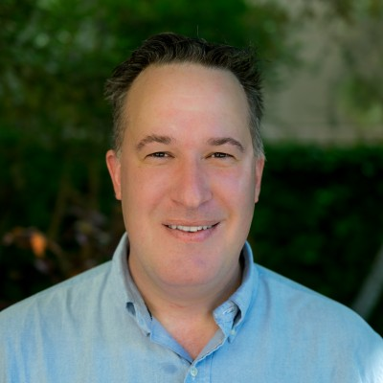
Speaker Information
Eloisa Gonzalez, MD, MPH
Frances Pang, MD
Pediatrician, Cedars-Sinai Medical Group
Cardiovascular and School Health, Los Angeles County Department of Public Health
Nonye Okonkwo, MD, MS
Cheryl Branch, MS
Executive Director, Los Angeles Metropolitan Churches Managing Partner, CRSSLA
Deputy, Clinical - Operations, COVID-19 Vaccine Program Kedren Community Health Center
JESSE CLARK, MD
Associate Professor, Department of Medicine, David Geffen School of Medicine at UCLA.

Slide 9
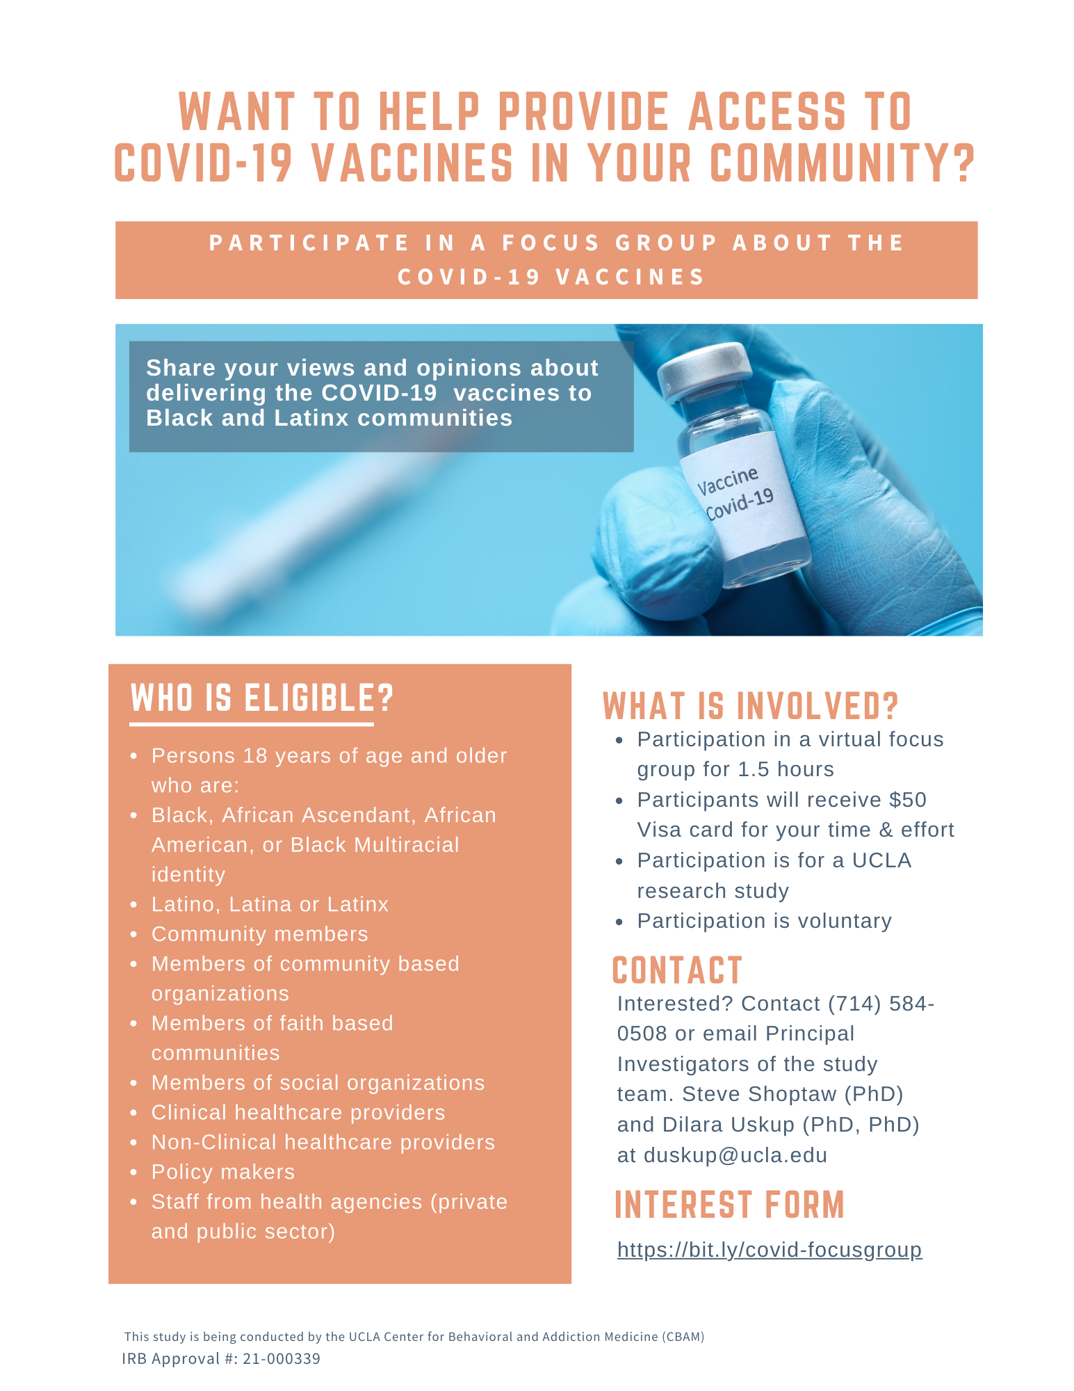
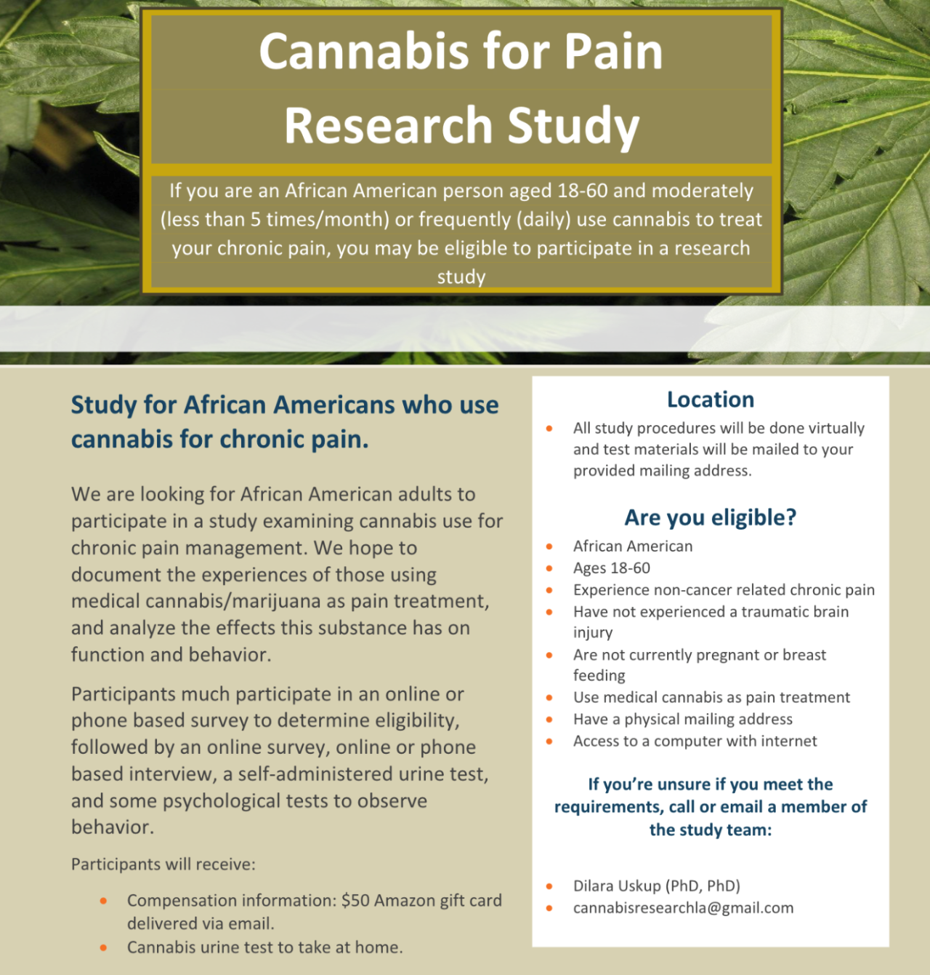
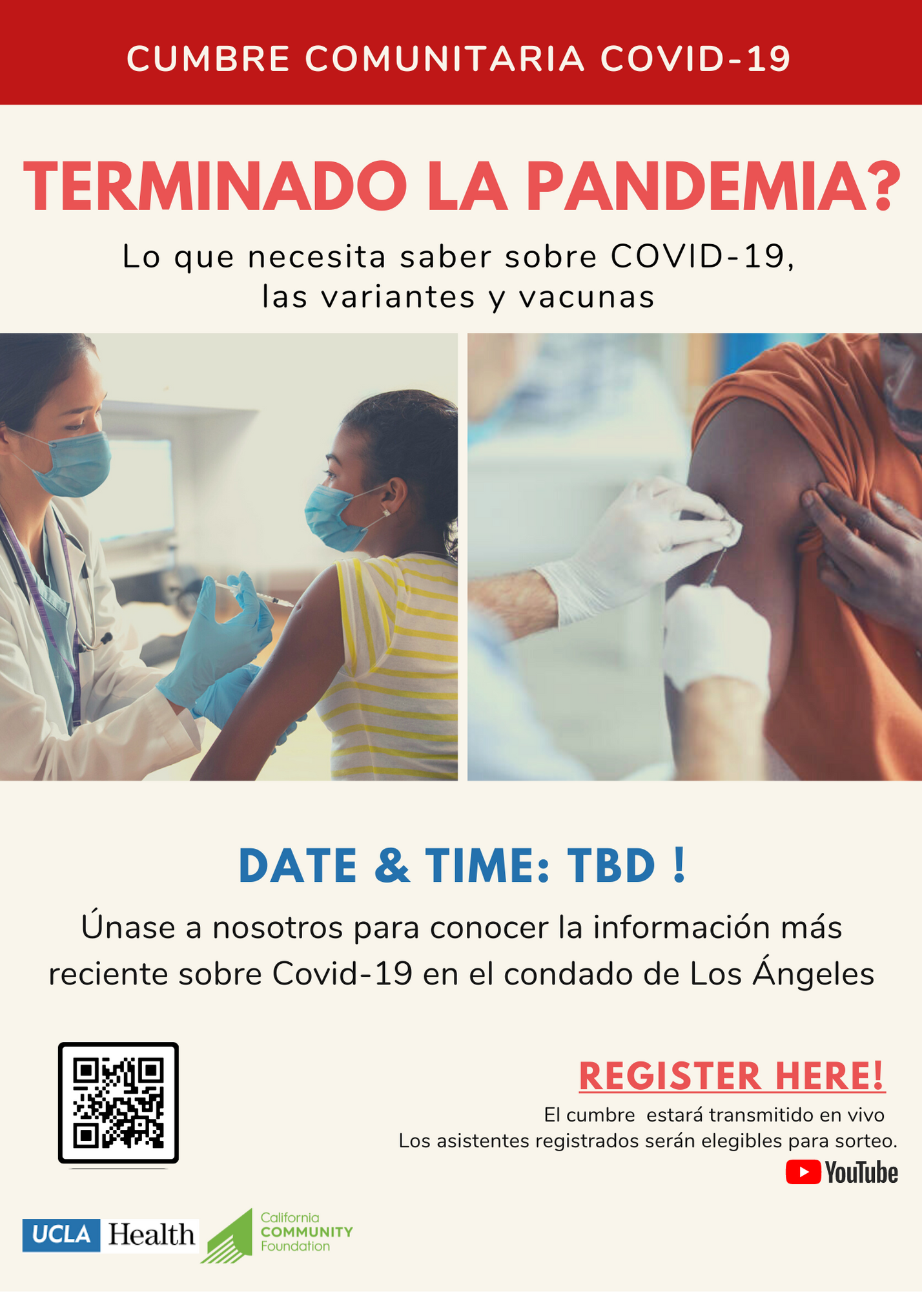
Promotional Material
COVID-19 Vaccine Focus Group
A. Community Focus Group (English) – Monday, July 26, 2021 @5pm-6:30pm, PST
B. Provider Focus Group – Tuesday, August 24, 2021 @1pm-2:30pm, PST
Cannabis for Pain Research Study
We are looking for African American adults to participate in a study examining cannabis use for chronic pain management.
COVID-19 Provider Townhall – Friday, August 20, 2021 @1pm-2:30pm
This townhall is among providers, to share best practices and lessons learned around COVID-19 in an effort to improve vaccination access and equity.
COVID-19 Community Summit (Spanish)

Slide 10
Closing Remarks:
Thank you ! To the speakers and attendees who made the “COVID-19 Community Summit” possible!
We plan to conduct a qualitative survey/focus groups and will be recruiting participants. Please sign up using this form and we will contact you with more information: https://bit.ly/covid-focusgroup
Contact:
Dilara Üsküp, PhD, PhD, Co-Principal Investigator duskup@ucla.edu
Steve Shoptaw, PhD, Co-Principal Investigator sshoptaw@ucla.edu
Damilola Jolayemi, MSc, Project Coordinator ojolayemi@mednet.ucla.edu
Please sign up for the COVID-19 Community Summit in Spanish held in August, Terminado la Pandemia? Lo Que Necesita Saber Sobre COVID-19, Las Variantes y Vacunas : https://uclahs.zoom.us/j/92736354579
Please take a moment to quickly complete this brief conference evaluation. The information will help us plan future programs and processes.

