Slide 1
2024
CHIPTS HIV NEXT GENERATION CONFERENCE
HIV and hepatitis C virus infection and co-infection among trans women in San Francisco, 2020
Izzy Chiu
- UCLA Department of Epidemiology MPH student
- Center for Public Health Research @
San Francisco Department of Public Health
Notes:
of 10 minutes with 4 minutes allotted for questions and answers for
each presenter/team.

Slide 2
National HIV Behavioral Surveillance (NHBS)-Trans
NHBS: Conducted in populations with high burden of HIV, to conduct an HIV-related bio-behavioral survey to monitor behavioral risks, prevention usage, and HIV prevalence
San Francisco site: one of seven NHBS-Trans project areas, 2019-2020
Eligibility: ID as a transgender woman or woman, assigned male at birth, over 18 years old, resident of San Francisco or San Mateo County
Objective: To characterize epidemiological, behavioral, treatment access, and structural interactions between HIV and hepatitis infections among trans women in San Francisco
2024 CHIPTS HIV NEXT GENERATION CONFERENCE

Slide 3
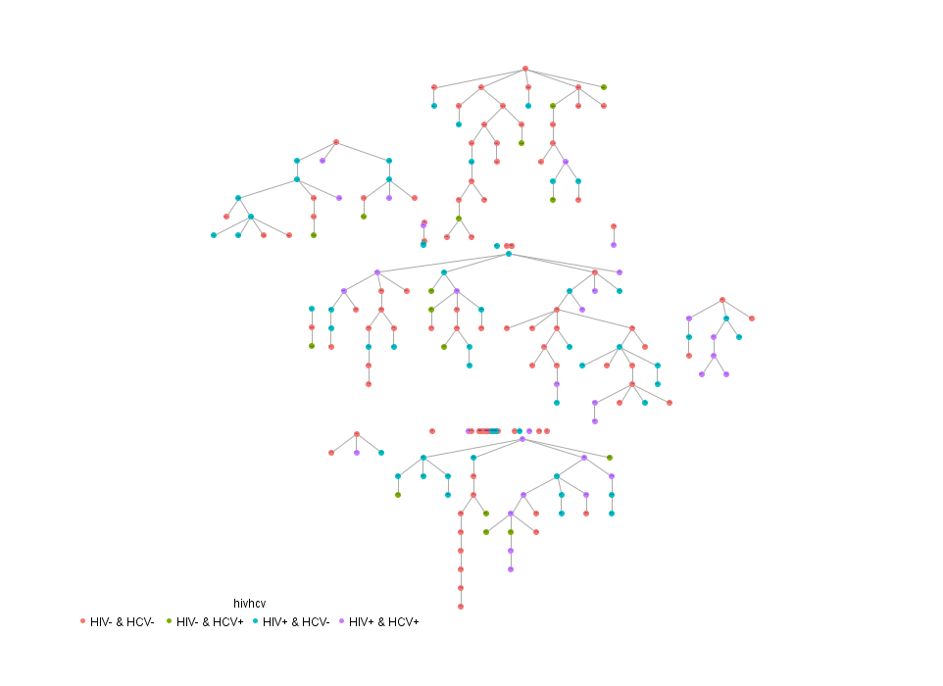
Methods
Respondent driven sampling (RDS)
Recruited initial participants (seeds) until N=201
Focused on recruiting Black/Latina identifying trans women
Each seed received 5 coupons to refer peers
All other participants receive up to 5 coupons to refer peers
Procedure
1-hour NHBS survey led by research associate
HIV rapid tests (Insti), w, confirmatory test if positive
HCV rapid test (OraQuick)
84% were women of color
Study Participants
60% homeless during the past 12 months
2/3 report lifetime experience of incarceration
90% had health insurance, 75% with Medicaid
2024 CHIPTS HIV NEXT GENERATION CONFERENCE
Notes:
Can describe the population here

Slide 4
Results: Population
HIV
infection
42.3%
n = 85
HCV
infection
28.9%
n = 58
Prevalence of HIV, HCV, and co-infections
“HIV Infection” definition
testing HIV positive versus testing HIV negative
“HCV Infection” definition:
Testing HCV positive or self-reported history of HCV, versus never testing positive for HCV.
HIV/HCV co-infection
18.3%
n = 38
Evidence of an interaction between HIV and HCV: The prevalence of co-infection is 50% greater than would be expected in the absence of an interaction (i.e., 18.3% vs 12.2%, p<.001).
2024 CHIPTS HIV NEXT GENERATION CONFERENCE
Notes:
More than two out of five trans women in San Francisco are living with HIV; nearly one in three have had HCV; nearly one in five were possibly co-infected with HIV and HCV

Slide 5
Results: HIV among trans women in San Francisco
Treatment engagement for HIV is high: 90-90-90 targets met
N=85
n=79
n=78
n=71
n=65
2024 CHIPTS HIV NEXT GENERATION CONFERENCE

Slide 6
Results: Hepatitis C among trans women in San Francisco
Engagement in HCV care still has major gaps
N=58
n=11
n=10
n=47
n=37
n=28
n=24
n=3
2024 CHIPTS HIV NEXT GENERATION CONFERENCE

Slide 7
Results: Multivariate model and Discussion
 | Model I: HIV seropositivity |  |  | Model II: HCV seropositivity/ history of infection |  |  | Model III: HIV/HCV co-infection
Associated factor | AOR | 95% CI | p-value | AOR | 95% CI | p-value | AOR | 95% CI | p-value
Injection drug use, ever | 2.28 | 1.06, 4.89 | 0.035 | 22.95 | 8.38 , 62.86 | <.001 | 5.20 | 2.16, 12.49 | <.001
Sexual partner who injected drugs (lifetime) | 3.30 | 1.58, 6.90 | 0.002 | -- | -- | -- | -- | -- | --
Did not lack care due to cost, last 12 months | 2.63 | 1.03, 6.67 | 0.045 | 5.08 | 1.15, 22.55 | 0.032 | -- | -- | --
Receives emotional support from family | 2.85 | 1.43, 5.65 | 0.003 | -- | -- | -- | -- | -- | --
Family emotional support: neutral answer | -- | -- | -- | 0.10 | .02, .63 | 0.014 | 0.09 | .01, .79 | 0.03
Black/African American | 2.59 | 1.16, 5.79 | 0.021 | -- | -- | -- | -- | -- | --
Ever incarcerated | -- | -- | -- | 3.46 | 1.10, 10.91 | 0.034 | 4.27 | 1.13, 16.07 | 0.032
Age per year | -- | -- | -- | 1.1 | 1.05, 1.15 | <.001 | 1.06 | 1.02, 1.11 | 0.004
History of injection drug use was the only correlate significantly associated with HIV, HCV, and co-infection
Structural factors affect HIV and HCV differently (e.g., Black/African-American women are disproportionately affected by HIV, whereas incarceration and older age increased the risk of HCV)
2024 CHIPTS HIV NEXT GENERATION CONFERENCE
Notes:
Our data contribute evidence that the synergy between HIV and HCV transmission may lie most strongly in injection-related behaviors, rather than sexual behaviors
Transmission through sexual exposure may be less efficient compared with transmission through percutaneous exposures, although sex with an infected partner has been identified in some studies as a risk factor for HCV transmission
Socio-structural factors that may be common to both infections
Black/African-Americans consistently showing a higher prevalence
Incarceration can be a high-risk environment perpetuating transmission of HCV and HIV
Treatment engagement in care

Slide 8
Future Directions
HIV prevalence remains extremely high
Need for primary prevention of HIV to be strengthened – uptake of PrEP
Greater interventions are needed to improve HCV care and treatment
Especially to test HCV-positive women and to connect HCV-positive women to DAA treatment
More research on the effect of HIV/HCV co-infection for trans women is needed considering HIV & HCV’s many interactions and concurrent risk factors.
Scale-up of interventions for trans women who inject drugs and their partners who inject drugs may have the greatest effect on reducing these dual epidemics.
2024 CHIPTS HIV NEXT GENERATION CONFERENCE
Notes:
Engagement in care for HIV looks promising, engagement in care for HCV still has major gaps

Slide 9
Thank you!
Izzy Chiu
ijchiu@g.ucla.edu
2024 CHIPTS HIV NEXT GENERATION CONFERENCE
Notes:
Engagement in care for HIV looks promising, engagement in care for HCV still has major gaps

