Slide 1
The Opioid Crisis in Los Angeles County
Gary Tsai, MD, FAPA, FASAM
gtsai@ph.lacounty.gov
Medical Director & Science Officer
Substance Abuse Prevention and Control
County of Los Angeles Department of Public Health

Slide 2
Outline
The Opioid Crisis in Los Angeles County
What
Framing the Issue: Scope of the Opioid
Why
Key Factors in the Evolution of the Opioid Epidemic
How
Targeting the Key Drivers of the Opioid Crisis: A Community Coalition Approach
Other Approaches to Address the Opioid Crisis
Progress in Los Angeles – Safe Med LA and Beyond
Looking Ahead
Emerging Priorities & Future Considerations

Slide 3
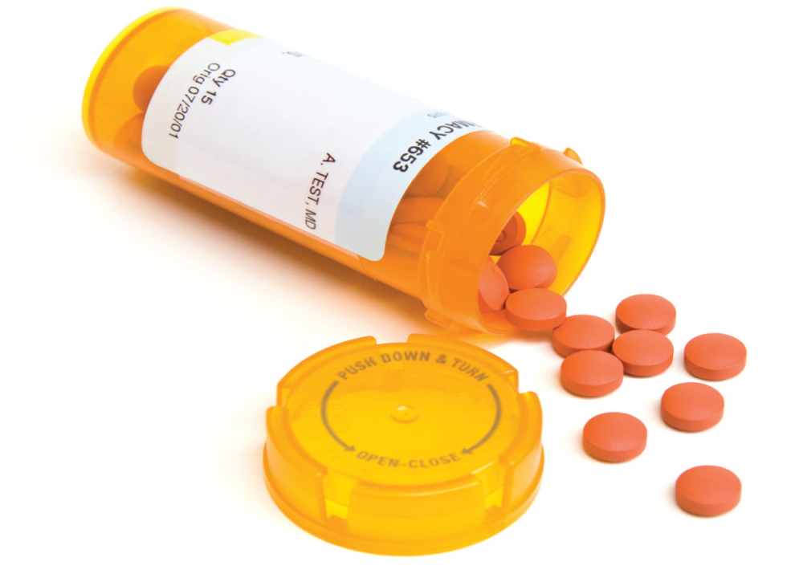
Framing the Issue: The Opioid Epidemic from the Past to Present, in LA and Beyond
The “WHAT”
2

Slide 4
Opioid Use on a Global Scale (2010)
3
Manchikanti, L (2010). Therapeutic Use, Abuse, Nonmedical use of Opioids: A Ten-Year Perspective, Pain Physician, 13, 401-435
Notes:
This is my favorite slide bc I think it encapsulates the opioid epidemic perfectly.
Even though the U.S. only comprises 5% of the world’s population, we consumer 80% of the world’s opioids, and 99% of the world’s hydrocodone. So clearly the U.S. reaches for opioid pain medications in ways that others around the world simply don’t, which speaks to a deeply ingrained cultural issue in terms of how the U.S. views and responds to pain, both from the consumer perspective and the healthcare provider’s perspective.

Slide 5
Drug Overdose Deaths, US and LAC
United States
Los Angeles County
Rx Opioids – Upward Trend
Heroin – Upward Trend
Fentanyl – Upward Trend
~131 Americans died every day from opioid overdose in 2016
Nearly 424,000 people died from opioid overdoses from 1999–2016
Rx Opioids – Stable Trend
Heroin – Stable Trend
Fentanyl – Likely Upward Trend
More than 1 person died every day from opioid overdose in 2016
Nearly 7,700 people died from opioid overdose from 1999-2016
Source: Centers for Disease Control and Prevention, National Center for Health Statistics.
Multiple Cause of Death 1999-2014 on CDC WONDER Online Database, released 2015.

Slide 6
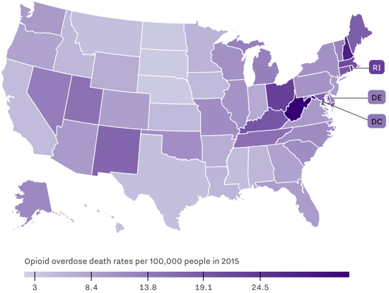
The Impact of the Opioid Epidemic by State
Source: Centers for Disease Control and Prevention (CDC); via Vox article at: https://www.vox.com/science-and-health/2017/3/23/14987892/opioid-heroin-epidemic-charts
5

Slide 7
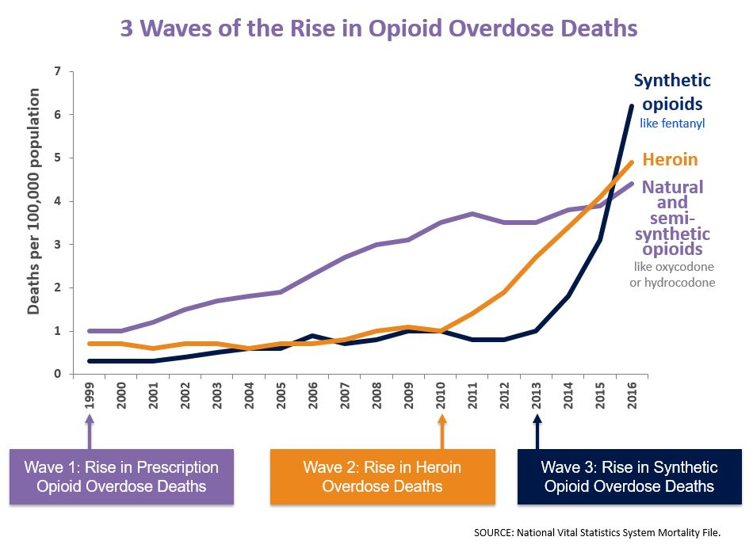
3 Waves of the Rise in Opioid Overdose Deaths
6
Source: National Vital Statistics System Mortality File
Notes:
This is my favorite slide bc I think it encapsulates the opioid epidemic perfectly.
Even though the U.S. only comprises 5% of the world’s population, we consumer 80% of the world’s opioids, and 99% of the world’s hydrocodone. So clearly the U.S. reaches for opioid pain medications in ways that others around the world simply don’t, which speaks to a deeply ingrained cultural issue in terms of how the U.S. views and responds to pain, both from the consumer perspective and the healthcare provider’s perspective.

Slide 8
Waves of Opioid Overdose Deaths in the U.S. vs. LA County
1st Wave
2nd Wave
*
*
3rd Wave
1st Wave
Synthetic opioids (e.g., fentanyl)
Heroin
Natural and semi-synthetic opioids
(e.g., oxycodone)
*
*
Source: Centers for Disease Control and Prevention, National Center for Health Statistics.
Multiple Cause of Death 1999-2014 on CDC WONDER Online Database, released 2015.
*Small numbers were suppressed.

Slide 9
Opioid-Related Deaths in LAC, 2006-2013
Los Angeles County Medical Examiner’s Coroner Data
8
Notes:
See last slide for talking points

Slide 10
Opioid-Related Death Rates by Race/Ethnicity and Gender in Los Angeles County
Trends:
Men >> Women
Whites >> Blacks > Latinos > Asians
Rates per 100,000 population. API: Asian or Pacific Islander.
Source: Multiple cause of death data. California Department of Public Health.

Slide 11
Key Factors in the Evolution of the Opioid Epidemic
“Quick fix” culture → Pain pills are often quicker and less work than alternative therapies
Misinformation from pharmaceutical companies pushed notion that opioids were not addictive unless given to people with dependencies already
Lobbying for pain as the “5th vital sign” → Institutionalized pain treatment during every patient encounter
Under-resourced SUD systems
Under-utilization of Medications for Addiction Treatment & Naloxone
Lack of addiction specialists
Increasing potency of opioids (fentanyl, carfentanil) → Counterfeit pills have exacerbated risk
Overuse of opioids
Lack of Treatment Options
Increased overdose risks

Slide 12
Why the Opioid Epidemic Has Impacted Some Areas of the U.S. Harder Than Others
In general, the opioid crisis has disproportionately hit the Northeast and Southeast of the U.S. compared to other areas of the country. Possible explanations:
Cultural Influences → An instance where diversity (and disparity) may be protective?
Access to Substance Use Disorder (SUD) Treatment → Greater access to SUD treatment improves outcomes
Urban vs. Rural → Rural overdose rates are outpacing urban overdose rates
Workplace Injuries → “Blue collar” workers may be at higher likelihood of developing chronic pain or injuries that lead to opioid use
Social Connection as a Protective Factor → Social determinants influence the likelihood of diseases of despair
11

Slide 13
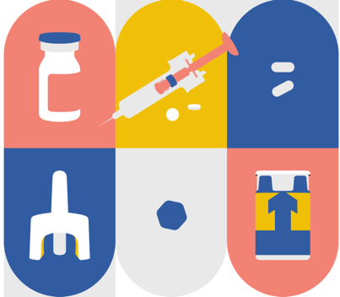
Targeting the Key Drivers of the Opioid Crisis: A Community Coalition Approach
12

Slide 14
Effective Solutions Must Be Informed by the Nature of the Problems They Attempt to Solve
The opioid epidemic is a complex, multi-factorial, communitywide public health problem without a single cause → One-dimensional approaches are unlikely to be effective.
The nature of the opioid epidemic suggests that a broad, comprehensive, and inclusive strategy that engages multiple entities will be necessary to tackle the opioid issue.
13

Slide 15
The “Balloon Phenomenon”
Addressing complex, multi-factorial problems with interventions that incompletely target its spectrum of causes oftentimes can result in unintended worsening of aspects of the problem.
Need to avoid squeezing down on one end of a balloon only to have the other end balloon up

Slide 16
The “Blanket Approach”
Complex, multi-factorial problems with a spectrum of causes generally require a spectrum of interventions that are implemented simultaneously in order to effectively address the root of the problem.
Need to address the multiple causes of complex problems simultaneously to avoid problems related to the “balloon phenomenon”

Slide 17
Poll Question
How many people have heard of Safe Med LA?

Slide 18
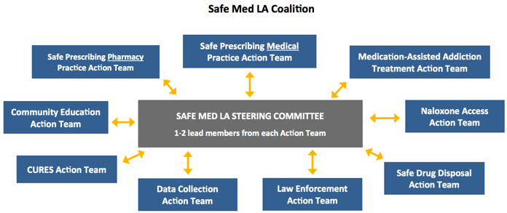
Safe Med LA
Safe Med LA is a broad, cross-sector coalition that is taking a coordinated and multi-pronged approach to comprehensively address prescription drug abuse in Los Angeles County → www.SafeMedLA.org
17

Slide 19
Coalition Members
Cross-sector, public-private representation*:
County Departments (Public Health, Health Services, Mental Health, Public Works, LA Sheriff’s Dept)
Health Plans (LA Care, Health Net, Kaiser Permanente, Blue Shield of California, Care 1st, Molina, Anthem Blue Cross, Cigna, etc.)
Healthcare Organizations (Community Clinic Association of Los Angeles County, LA County Medical Association, Hospital Association of LA County, LA Dental Society, Health Services Advisory Group, etc.)
Health Providers (LAC DHS, UCLA Health System, KP, HealthCare Partners, LA LGBT Center, Exer Urgent Care, Venice Family Clinic, Synovation Medical Group, AltaMed, Facey, Providence, US HealthWorks, etc.)
Behavioral Health Providers (Tarzana Treatment Centers, Behavioral Health Services, Prototypes, JWCH Institute, LA Community Health Project, Homeless Health Care Los Angeles, etc)
Others (Pharmacist Associations, City of Long Beach, City of Pasadena, etc)
*Note: Above list of Safe Med LA participants is not exhaustive
18

Slide 20
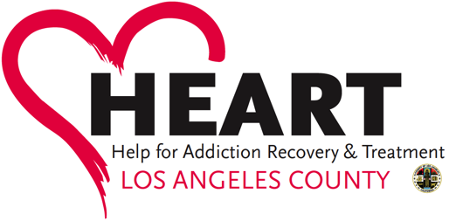
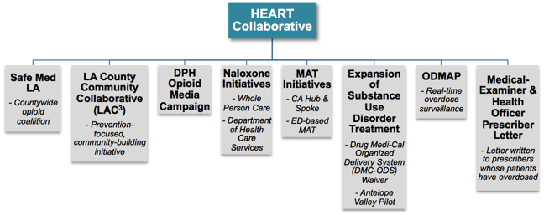
Other Opioid-Related Efforts Across LA County
19

Slide 21
Progress in Los Angeles – Safe Med LA and Beyond
20

Slide 22
Safe Prescribing – Successes
Implemented safe prescribing guidelines at all 78 emergency departments and 80 urgent care clinics (UCC) throughout LAC.
In process of implementing safe prescribing guidelines at remaining 160 UCCs, as well as additional primary care clinics across the County.
Educated 5000 dentists across LAC on safe prescribing.
Convened six Medical Practice Round Table meetings including all major health plans in LA County to establish and adopt standardized safe prescribing benchmarks.
Outcomes
11% decrease in the opioid prescribing rate during the first two years of Safe Med LA’s establishment, from 2015 – 2017 (data from CDPH).
50% decrease in “doctor shoppers” from 2015 – 2016 (defined as patients who used > 5 prescribers and 5 pharmacies over 6 months; data from CURES).
21

Slide 23
Medications for Addiction Treatment (MAT) – Successes
Trained > 300 new buprenorphine prescribers in LAC.
Leading two MAT learning collaboratives, one focused on supporting MAT in primary care and another on supporting MAT in the specialty SUD system.
Supported 8 community health centers (FQHC’s) in implementation of MAT programs, with additional FQHC’s coming online in the future.
Supported over 10 community substance use disorder (SUD) treatment provider agencies in implementation of MAT programs, with additional agencies coming online in the future.
Worked with UCLA to launch web-based MAT Resource Library to support expansion of MAT programs → http://publichealth.lacounty.gov/sapc/mat/index.html
Outcomes
8% increase in the annual buprenorphine prescribing rate in LAC from 2015 – 2017 (data from CDPH).
22

Slide 24
Naloxone – Successes
Trained > 235 pharmacists on the State-required training to enable them to furnish naloxone without a physician prescription.
As a component of the Drug Medi-Cal Organized Delivery System (DMC-ODS) Waiver implemented by LA County’s SAPC, added over 50 additional sites across the County where naloxone is accessible to the community through Opioid Treatment Programs (OTP) via Drug Medi-Cal.
Supported LASD with the launch of its naloxone program, which is one of the largest in the country, with 14 lives saved since implementation of LASD’s naloxone program in 2017.
Collaborated with the LA County Fire Department and LASD to obtain their naloxone administration field data to take a data-driven approach to inform the County’s naloxone intervention efforts.
Outcomes
Distributed > 21,000 doses of naloxone to community-based organizations and law enforcement in LAC through CHCF grant and CDPH naloxone grant.
23

Slide 25
PROGRESS – Other Opioid-Related Efforts
Surveyed 9,500 LAC residents on prescription drug abuse, focusing on the following domains: risk perception, perception of access/availability, attitude toward use, patterns of use, motivation for use, and consequences of use.
This data was used to take a data-driven approach to inform the work of the Safe Med LA Action Teams, in particular the Community Education Action Team.
Safe Med LA’s Community Education Action Team engaged over 40 substance use prevention providers to develop regional strategies to provide community education and engagement on the opioid epidemic and prescription drug abuse that is tailored to their unique communities.
Safe Med LA’s Safe Drug Disposal Action Team worked with the Community Education Action Team to expand the number of annual safe drug disposal take-back events throughout LA County. Sheriff stations and DEA Offices now organize drug take-back events on a monthly basis, in addition to the national drug take-back days.
Distributed 5,300 fentanyl test strips to support fentanyl-related education and the distribution in the community, particularly in the high-risk populations served by the LGBT Center and their partner agency, the Community Health Project of Los Angeles (CHPLA).
24

Slide 26
Looking Ahead
25

Slide 27
Emerging Priorities & Future Considerations
No routine screening for fentanyl until mid-2016
Cheap, high-potency synthetic opioids (e.g., fentanyl, carfentanil)
Increasing # of overdoses related to illegally manufactured fentanyl being found in illicit drugs → Need to address both supply and demand aspects of these synthetic opioids, while also maximizing treatment options.
Fentanyl Deaths by Year
Source: Los Angeles County Medical Examiner’s Coroner Data
26

Slide 28
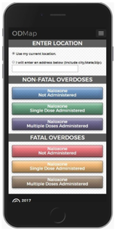
Emerging Priorities & Future Considerations (cont’d)
Opioid overdose surveillance and tracking
Need more real-time method of tracking outbreaks before (through predictive modeling) and during the outbreaks to inform preventative and immediate interventions, and minimize harms.
In process of implementing ODMAP (http://www.hidta.org/odmap/)
27

Slide 29
Emerging Priorities & Future Considerations (cont’d)
Workforce enhancement across health systems
More health care professionals trained on MAT and naloxone.
Enhanced integration of medical interventions for addiction in specialty substance use disorder treatment systems.
Enhanced integration of addiction treatment in primary care and specialty mental health settings.
With the resources being funneled toward the opioid epidemic, there will be an increasing need to ensure strategic focus and coordination of efforts to maximally benefit from those resources and avoid inefficiencies resulting from incoordination.
28

Slide 30
SUD-Related Resources
Substance Abuse Prevention and Control (SAPC) website – http://publichealth.lacounty.gov/sapc/index.htm
Substance Abuse Service Helpline (SASH) for SUD treatment referrals – 844-804-7500
Service and Bed Availability Tool (SBAT) to find a SUD treatment provider in LA County – http://sapccis.ph.lacounty.gov/sbat/
Safe Med LA – Resources to address the opioid crisis and prescription drug abuse (www.SafeMedLA.org)
29

Slide 31
Q&A / Discussion
“The opposite of addiction is not sobriety; the opposite of addiction is social connection.”
- Johann Hari

