Slide 1
Getting to 2020: Top Challenges in Biomedical HIV Prevention . . . and the Role of Behavioral Intervention Research to Address Them
Jane M. Simoni, Ph.D.
Department of Psychology
University of Washington
UCLA Seminar, June 1, 2018
Notes:
1
3-year NIMH-funded project (2008-11) to address depression and HIV medication adherence in HIV+ Latino men and women receiving care on the U.S.-Mexico border

Slide 2
Overview
Behavioral science
Key populations & their specific challenges
Behavioral intervention research designed to address challenges

Slide 3

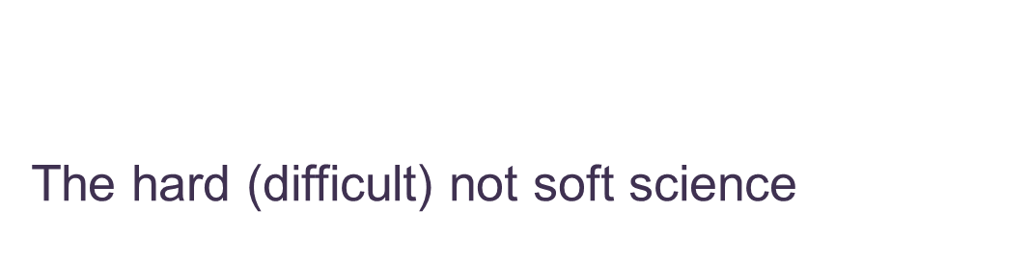
Behavioral Science
Biomedical → bio-behavioral

Slide 4
Key Populations
Pregnant and breast-feeding women
Children
Adolescents
MSM
Transwomen
Sex workers
Immigrants/migrants
People who inject drugs
Prisoners
Marginalized
Disempowered
Nachega et al., 2018 Invited Commentary in CID DOI:10.1093.cid/ciy008

Slide 5
Specific Challenges of
Key Populations

Slide 6

Pregnant and breast-feeding women
Poor ART adherence and retention in care, especially post-partum
Gender inequity
Partner violence
Postpartum depression, stress, fatigue (30% w/viral rebound)
Lack of social and male partner support
Transition fro PMTCT services to general HIV care

Slide 7

Children
Missed opportunities for early infant diagnosis
Limited pediatric ART formulations
Limited caregiver competency
Only 50% of HIV+ children on ART
in 2015
Poor virologic suppression
Fear of HIV status disclosure

Slide 8
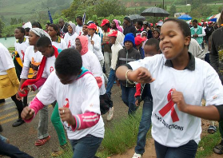
Adolescents
Missed opportunities for diagnosis
Poor linkage, adherence, viral suppression, and retention in care
Lack of disclosure to perinatally infected youth
Developmental limitations/tasks
Poor healthcare transitioning

Slide 9

MSM
High community HIV prevalence
Stigma
Trauma
Mental health/substance use
Criminalization
Non-disclosure
Social Isolation

Slide 10

Transgender Women
High community HIV prevalence
Stigma
Trauma
Mental health/substance use
Criminalization of sex work
Non-disclosure
Social Isolation

Slide 11

Sex Workers
Stigma
Gender-based violence
Criminalization
$$ Incentives for non-disclosure and unsafe sex
Hidden population (compounded by digital technology)

Slide 12

Migrants
Late entry into healthcare system
Lack of direct access to healthcare services
Exposure to difficult or oppressive work environments
Separation friends/family and a familiar sociocultural environment
Inability to effectively communicate
Possibility of deportation or expulsion
Tanser F1, Bärnighausen T, Vandormael A, Dobra A. Curr Opin HIV AIDS. 2015 Nov;10(6):430-8. PMID: 26352396

Slide 13

People who Inject Drugs
Stigma
Criminalization (of IDU and harm reduction)

Slide 14

Prisoners
Stigma
Criminalization of protection (clean needles, condoms)
Insufficient preparation for release

Slide 15
Opportunities for
Behavioral Science
Adherence Promotion
Mental Health Treatment
Disclosure Strategizing
Stigma Reduction
HIV Provider Education & Training

Slide 16
Project PAL
Promoting Adherence for Life
Peer & Pager Support to Enhance Antiretroviral Adherence
NIMH R01s MH58986 & MH58986
PI: Jane Simoni
1999-2002/2003-2007
Seattle, WA
Notes:
16

Slide 17
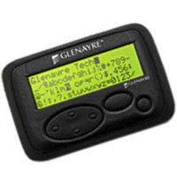
Project PAL: Intervention
Conducted RCT to compare peer support and pager messaging as strategies to improve ART adherence
Intervention period: 3 months, follow up at 6 months
Peer Support
Peer meetings 2x per month to discuss adherence challenges
Weekly phone calls with individualized support
Pager
Daily individualized messages with specific medication reminders
Educational and joke SMS sent once per day
Outcomes: adherence assessed by self-report and EDM, VL and CD4 data

Slide 18
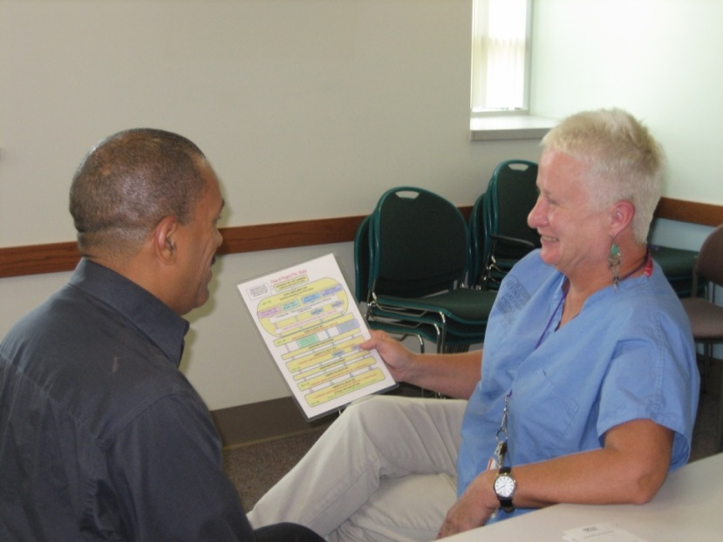
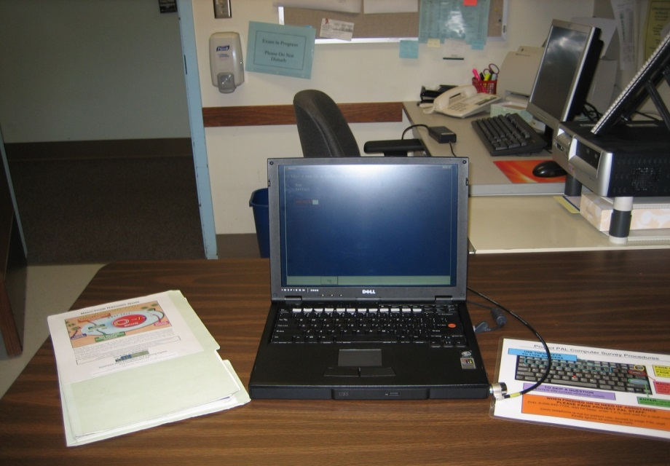
Project PAL: Methods
223 adult patients receiving primary HIV care at Madison Clinic in Seattle, WA
Participants were recruited through study nurse and provider referrals
Computer assisted self-interviews were conducted at the clinic
Notes:
18

Slide 19
Project PAL: Results
Peer support (not pager) led to better self-reported adherence and had a small effect on EDM adherence
  BUT no significant effect on VL or CD4
Pagers decreased VL and improved CD4 up to 6 months post intervention
Greater attendance at peer support meetings was associated with lower VL
Higher pager response rate was associated with lower VL load and improved CD4

Slide 20
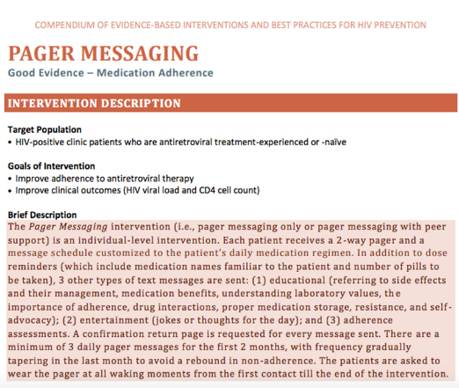
CDC Best Practices

Slide 21
Intervention Adaptations
This framework has been incorporated into the “Every Dose Every Day” app

Slide 22
Project PAL: Implications
Task-shifting:
  HIV+ peers can be trained to provide support and promote adherence
  Can function face-to-face and via phone
Technology:
  Can supplement human contact and support
  Can be highly automated
  Increasingly available and affordable
Notes:
22

Slide 23

Nuevo Dia
Mental Health and HIV on US-Mexico Border
Supported by NIMH R34 MH084674 & MH084674-S1
PI: Jane Simoni
2008-2011
Purpose: to address depression and ART adherence among PLWHA receiving care on the US-Mexico border

Slide 24
Nuevo Dia: Intervention
Adapt an empirically supported cognitive-behavioral therapy program (Safren et al., 2009) for ART adherence and symptoms of depression (CBT-AD)
  Weekly sessions every week for 4 months
  Two booster sessions at months 5 and 6
Modules
    Psycho-education, motivational interviewing
    Adherence training
    Cognitive restructuring
    Relaxation training & diaphragmatic breathing
Train local non-professionals to deliver the treatment

Slide 25
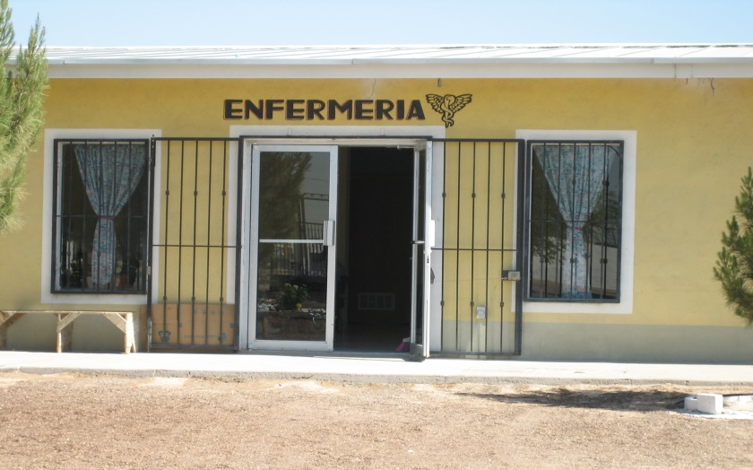
Nuevo Dia: Methods
Recruited depressed and non-adherent patients from La Fe HIV Primary Clinic
Randomized to 6-month treatment or usual care
Outcome measurement: EDM to measure adherence
Assessed depression with
self-report (BDI) and clinical
interview (MADRS)
Baseline, post-intervention,
  3-month follow-up

Slide 26

Nuevo Dia: Results
Compared to standard of care, participants in the intervention arm demonstrated
Reduced depression based on assessment (BDI) and clinical interview (MADRS)
Improved self-report adherence

Slide 27

Nuevo Dia: Implications
Can adapt an intervention developed and tested in a White, Western context for Latinos on the border
  Intervention feasible, with high interest and low attrition
Must consider context: stigma of HIV and homosexuality, importance of family and religion, multiple other stressors
Can train graduate students to implement

Slide 28

Project ARC
ART Adherence Research in China
Collaboration among:
  University of Washington
  China CDC
  Beijing Ditan Hospital
Supported by NIMH R34 MH074364 & MH074364-S1
PI: Jane Simoni
2005-2008

Slide 29

Project ARC: Intervention
Based on qualitative interviews with patients and caregivers, designed a culturally sensitive, theoretically-driven, and reproducible nurse counseling program to improve ART adherence
An RCT compared minimal vs, enhance care
Minimal Intervention
Referral to community support
Pill box
30-min basic HIV & ART edu
Enhanced Intervention
Minimal intervention, plus:
Electronic reminder
Indiv/dyadic LIFE Steps counseling (Safren)

Slide 30
Project ARC: Intervention
Components of the enhanced intervention included:
Benefits of adherence (to increase motivation)
Definition of adherence
General education about HIV medications and adherence
Patient’s own HAART Regimen
Dispensing of pills
Daily medication scheduling and sorting
Reminder strategies
Dealing with side effects
Communication with treatment team
Getting to appointments
Family, community, social support, and privacy
Handling slips of non-adherence
Problem-solving about additional barriers to adherence
Notes:
30

Slide 31

Project ARC: Methods
70 patients receiving primary HIV care at Beijing Ditan Hospital
Participants were recruited through study nurse and provider referrals
Data collection points:
  Survey at baseline, 13 and 25 weeks
  Phone survey at 7 and 19 weeks
Outcomes Measurement:
  EDM adherence data collected at 13 weeks and 25 weeks
  Blood drawn for VL and CD4 at baseline, 13 weeks and 25 weeks

Slide 32
Project ARC: Results
Compared to minimal intervention, enhanced intervention demonstrated:
Better 30 day self-report adherence
Better EDM adherence
Notable decrease in viral load
Slight increase in CD4 count

Slide 33
Project ARC: Implications
Can adapt a problem-solving and counseling intervention for Chinese HIV+ patients
Nurses are receptive to training
Chinese HIV+ patients will participate in adherence counseling individually or in dyads
Technology can bolster intervention

Slide 34
Reducing Parental HIV disclosure Distress in China with Nurse-Delivered Counseling
PI: J. Simoni
R21HD07414
2012-14

Slide 35
Intervention Sessions
Session 1
  Parents share HIV diagnosis story
  Brief assessment of parent, child, and family’s current strengths
  Discussion of advantages and disadvantages (pros/cons) of disclosure
  Nurse provides didactic information about useful family communication skills, parents are asked to practice for homework
Session 2
  Psycho-education about cognitive, social, and emotional abilities of children at different stages of development
  Parents asked to imagine where they are on a disclosure ladder
Session 3
  Parents develop plan for achieving their position on the continuum, anticipate questions from child, troubleshoot and role-play the plan

Slide 36
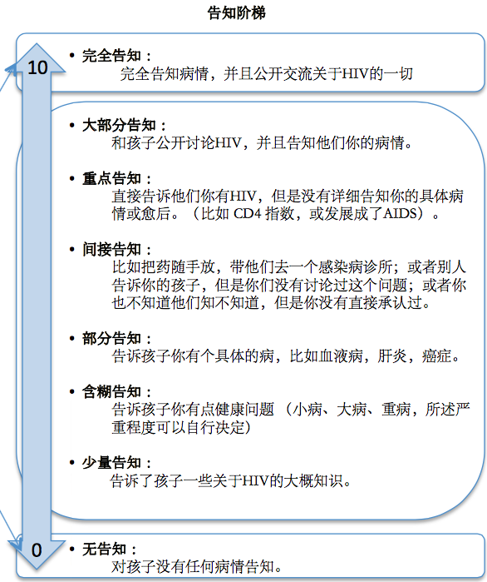
Disclosure Continuum handout for participants

Slide 37
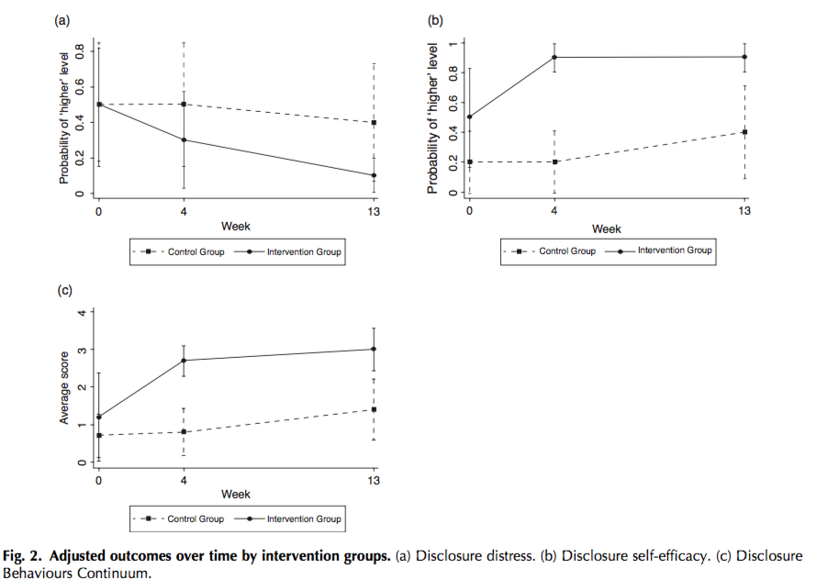
Intervention outcomes
(N=20 PLWHA)

Slide 38

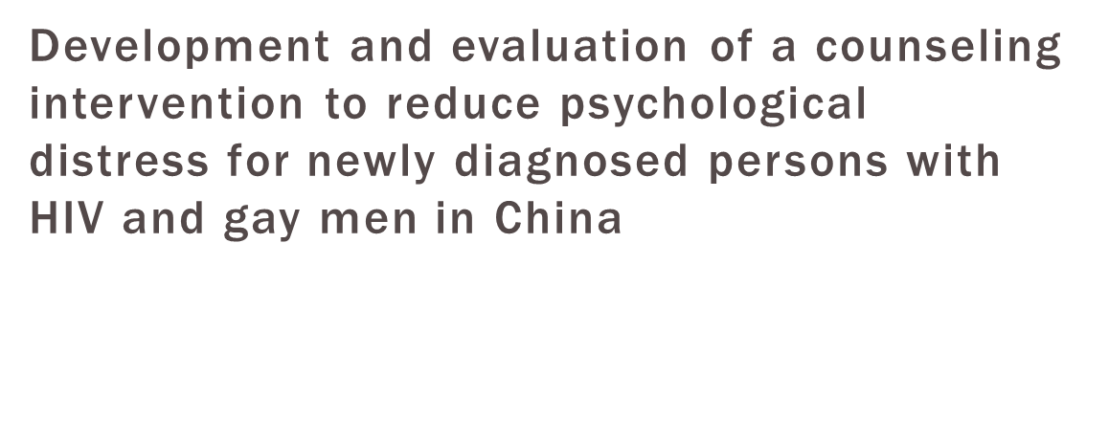
Joyce Yang - F31 MH099925 2012-16

Slide 39

Intervention Contents
Session 1
Session 2
Session 3
HIV diagnosis story
Unstructured assessment of mental health, disclosure, and coping skills
Teach Automatic Thought Record (ATR)⁴⁰ skill using example from qual data and participant’s example
Review ATR homework
Explore avoidance patterns that resulted from having HIV
Teach behavioral activation TRAP⁴¹: trigger response avoidance pattern & TRAC: trigger response alternative coping skill
Review homework of taking steps to get out of a TRAP and on TRAC
Assess anxiety experienced as a result of HIV
Teach Paced reathing⁴² skill and practice
⁴⁰Beck, 2011; ⁴¹Martell et al., 2010; ⁴²Linehan, 1993

Slide 40
Mental health outcomes (N=10 MSM PLWHA)
 | Baseline |  | Post Intervention
Measure | M (SD) | Range | M (SD) | Range | t (df = 9) | p | Effect size d_{z}⁵²
PHQ Depression | 10.3 (6.8) | 1-21 | 6.5 (3.6) | 1-13 | -2.62 | .03 | |-.83|
HIV Coping | 20.3 (5.3) | 15-24 | 26.1 (2.3) | 22-31 | 5.16 | .001 | 1.63
HIV Distress | 25.6 (5.4) | 18 - 36 | 23.2 (5.3) | 17-34 | -1.78 | .11 | |-.56|
BASE-6 Problems in Adjustment | 20.3 (8.0) | 6-31 | 14.3 (5.5) | 7-22 | -2.40 | .04 | |-.76|
⁵²Lakens, 2013

Slide 41
Turning to Sunshine
A Computer-based Program to Promote ART Adherence, Mental Health, and Treatment Engagement among PLWHA in China: Development and Initial Acceptability
NIMH K24 MH093243
PI: Jane Simoni
2011-2014

Slide 42
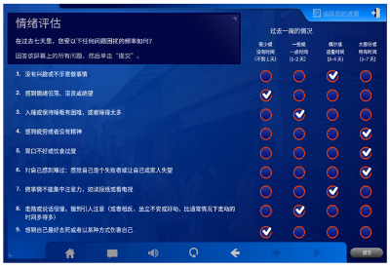
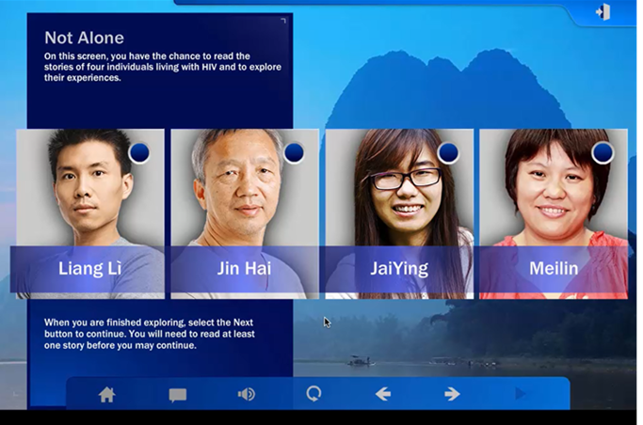
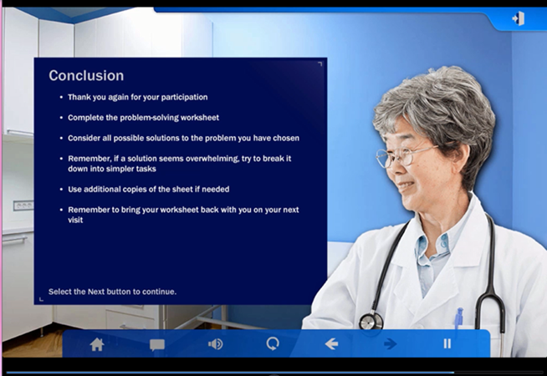
Turning to Sunshine: Intervention
Intervention modules draw from behavioral therapy, behavioral activation, and problem-solving strategies (see http://tinyurl.com/turningsunshine)

Slide 43


Slide 44
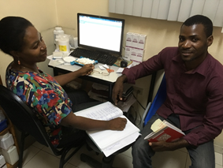

InfoPlus Adherence
Provider-Delivered Electronic Medication Record (EMR) Alert-based ART Adherence Counseling Program in Haiti
NIMH R34 MH112378
MPI: Nancy Puttkammer, Jane Simoni
2016-2019
Purpose: develop and test a clinic-based EMR and counseling intervention to address ART adherence in Haiti

Slide 45
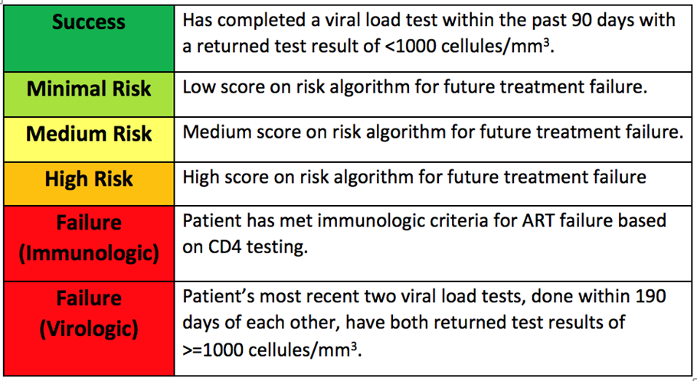
InfoPlus Adherence: Intervention
1. EMR-Based Alert
  Alert with 6 levels of color coding to appear on patient cover page of EMR
  Pop-up window with visual summary of recent ART medication possession, and job aide on counseling approach
  Printable summary report listing patients with high risk or evidence of treatment failure

Slide 46
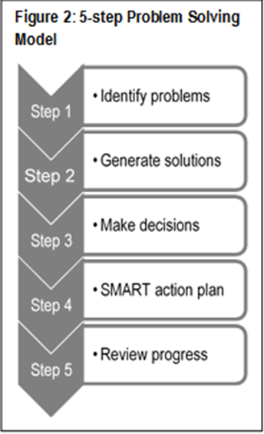

InfoPlus Adherence: Intervention
2. ART adherence counseling
“My Adherence Stories” builds on the strengths of Haitian culture, including the strong oral tradition in Creole-speaking communities
Values the communication of personal narratives (Good Day/Bad Day) over the completion of structured modules
Emphasizes patient-centered communication and problem-solving approach

Slide 47
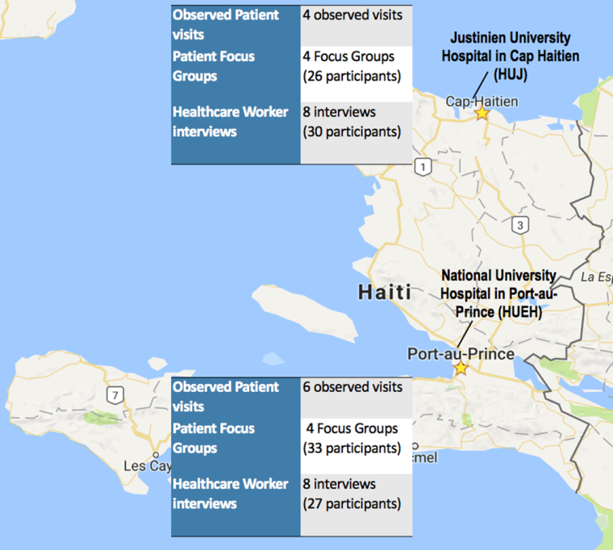
InfoPlus Adherence: Methods
Qualitative methods for formative assessment of provider and patient beliefs and attitudes toward the intervention (see figure)
9-month quasi-experimental design
2 large public-sector ART clinics: Port-au-Prince (control) and Cap Haitien (intervention)
65 patients each site initiating ART
Outcome measurement:
  Retention in care
  ART adherence
  ART treatment failure by WHO criteria
  HIV viral suppression

Slide 48

InfoPlus Adherence: Results
Coming soon . . .

Slide 49
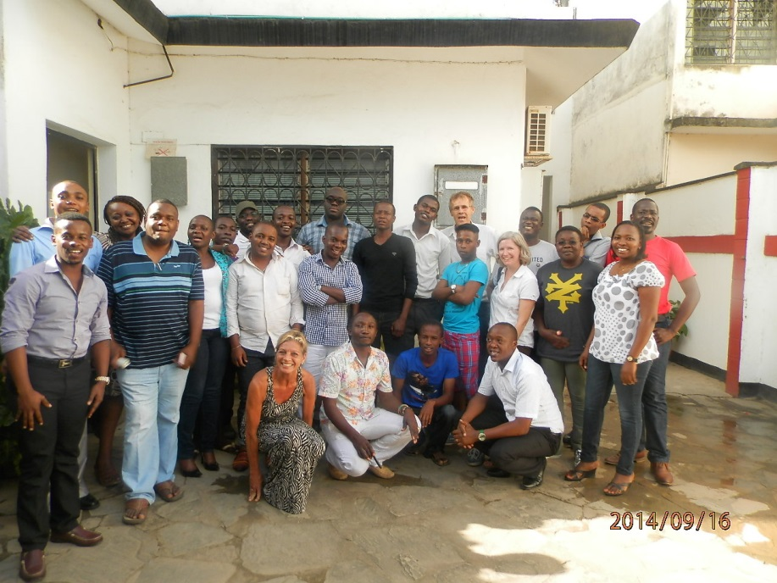
Shikamana Intervention
Supporting ART Adherence and Care Engagement for Kenyan MSM
NIMH R34 099946
PI: Susan Graham
Co-I: Jane Simoni
2012-2015
Notes:
49
(Kiswahili for “to form a bond or stick together”) was developed to enlist HIV care providers and HIV-positive peers to support Kenyan MSM living with HIV

Slide 50
Shikamana: Intervention
Based on focus group discussions, developed peer support intervention to improve ART adherence among HIV+ MSM in Kenya
RCT enrolled 60 men assigned to the Shikamana intervention vs. standard care (informational counseling with no assigned peer) for 6 months of follow-up

Slide 51
Shikamana: Intervention
Sensitivity training. All Shikamana clinicians and counselors took a free on-line training course on MSM sexual health.
Patient-centered care. This approach focuses on developing goals of care with the patient, to enhance patient motivation.
Motivational Interviewing. Next Step Counseling, used to promote PrEP adherence in iPrEx, was adapted to the Kenyan context.
Peer support. Shikamana peers were HIV-positive men with ART experience who were trained to provide support and meet with men monthly. Based on Project PAL.
Mental health screening and support. Counselors and peers trained to recognize mental health problems and refer as needed.

Slide 52
Shikamana: Methods
Enrolled 60 Kenyan MSM into RCT
Block randomization by ART status (experienced vs. naïve), with men selecting own envelope from relevant stack
Monthly ART refills with adherence data collection by self-report measures and MEMS caps
Quarterly blood draw for CD4 count and viral load testing
Quarterly ACASI measures of IMB constructs, self-efficacy, trust in providers, social support, stigma, mental health
Staff and peers (Washikaji) provided formal feedback at exit interviews
Notes:
52

Slide 53
Shikamana: Results
MEMS data on 59/60 participants (98.3%)
Of 375 refill visits, MEMS collected on 290 (77.3%)
  MEMS bottle forgotten, lost, misplaced
Pills remaining at visit: median 3, range 0-31
In GEE analysis with adjustment for baseline suppression (<40 copies/mL), men in the intervention group had an increased odds of virologic suppression at months 3 and 6, as did men with virologic suppression at baseline (aOR, 5.7, 95% CI 1.1-30.7, p=0.04), (aOR 23.0, 95% CI 2.7-196.7, p=0.004)

Slide 54
Shikamana: Conclusions
The Shikamana intervention appears to be safe, acceptable, and feasible
MEMS data capture was complicated in this population
Results suggest that Shikamana may increase ART adherence among Kenyan GBMSM
A larger trial to evaluate efficacy is needed
A combined provider and peer support approach may also improve PrEP adherence in this population
Notes:
54

Slide 55
Motivation Matters!
Supported by GRANT NUMBERS
PI: Scott McClelland, Co-I: Jane Simoni, Trainee: Frances Aunon
2015-present

Slide 56
Motivation Matters!: Intervention
Develop an interactive, theory-informed SMS intervention to improve ART adherence and reduce VL among newly diagnosed HIV+ female sex workers (FSW) in Kenya
Conducted focus group discussions with HIV+ FSW to create and refine SMS content and structure
2-3 messages sent per week, focusing on providing information, motivation and behavioral suggestions
Standard of Care Condition
Monthly ART refills and counseling
VL and CD4 every 3 months
Followed for 6 months
Intervention Condition
Standard of care, plus:
SMS messages for 6 weeks

Slide 57
Motivation Matters!: Methods
Enrolled 120 HIV+ FSW newly initiating ART treatment
Randomized for 6-month treatment or standard of care
Outcome measurement: self-report, VAS, pill count, VL, CD4 (assessed at baseline, 3 month, and 6 month)
Meet monthly with counselors for ART refill
Conducting a social network assessment at baseline to understand how network characteristics (including social support and stigma) may moderate the impact of the intervention on ART adh/VL

Slide 58
Motivation Matters: Results
Stay tuned!

Slide 59
Reducing Stigma
Societal/structural level^{1,2}
  Removal of institutional stigmas (e.g. ADA)
  Economic independence → microfinance programs
  Community organizing
  Contact between stigmatized and potential/actual perpetuators of stigma
Individual level^{3,4}
  Education/Information
  Coping Skills Acquisition
  Contact with peers → Social Support
¹Link & Phelan, 2001; ²Sen, 1995; ³ Brown, Trujillo, Macintyre, 2001
Notes:
Deepa

Slide 60
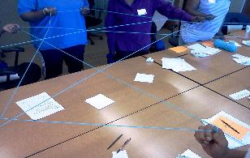
The UNITY Health Study
JAIDS

Slide 61
Methods
Setting
  Chicago (Private & Public Hospital Clinic)
  Birmingham (University Hospital Clinic)
Randomized Controlled Trial Design
  UNITY workshop vs. Breast Health workshop
  Mixed Effects Regression
  Data collected May 2013 to December 2016
Participants
  African American women over the age of 18
Self-reported data
  Primary Outcome → 14-Item Stigma Scale for Chronic Illness (SSCI)
  Baseline, post-intervention, 6, 8, 10, and 14 months

Slide 62
Concurrency messaging for Black Communities:
A Community-based Approach
Michele P. Andrasik, UW
To translate research on sexual networks and concurrency into culturally-relevant HIV prevention messages for the African-American and African-born communities in Seattle and King County.
1
Formative Research
2
Message Development
3
4
Dissemination of Findings
Message Piloting and Evaluation
Notes:
Michele
The project has been divided into four Phases:
Phase one: Formative Research consisted of key informant interviews and focus group discussions to generate community data to inform the message development.
Phase two was Message Development which consisted of the disparities working group (comprised of community members, UW researchers, and Public Health Seattle/King county representatives reviewing the data and working with an identified marketing firm to develop the concurrency messages
Piloting and evaluation of messaging occurred in phase 3. Message piloting was a three month intensive grassroots campaign mixed with television, radio, newspaper and internet exposure
Finally, Phase 4 consisted of Dissemination of the findings to the local community, the larger scientific community and nationally. This presentation is part of our national dissemination efforts.
I will now hand it over to Solomon, a community partner with the Center for Multicultural Health, who has been involved in the project from the beginning. This is his second national presentation of this project. He presented the project in 2010 to the US Conference on African Immigrant Health when we were in the message development phase of the project.
Thank you!

Slide 63
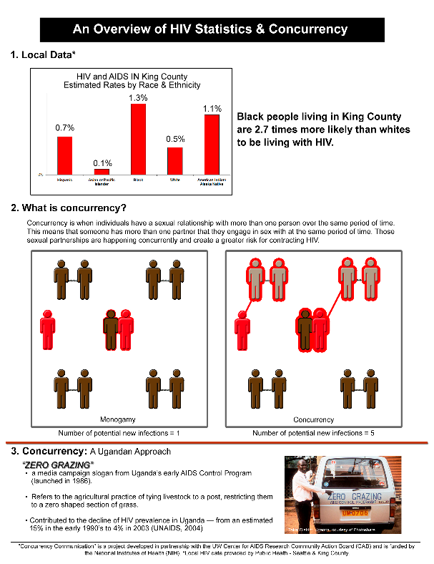
Translating Concurrency: Educational Sheet
Notes:
Vanessa
This education sheet actually took quite a while. There were numerous iterations. The fist round was created during a project meeting with a graphic designer from the community, interviewers, and primary researchers. It was then presented to the entire working group, critiqued, reworked etc. And this is the final piece.

Slide 64
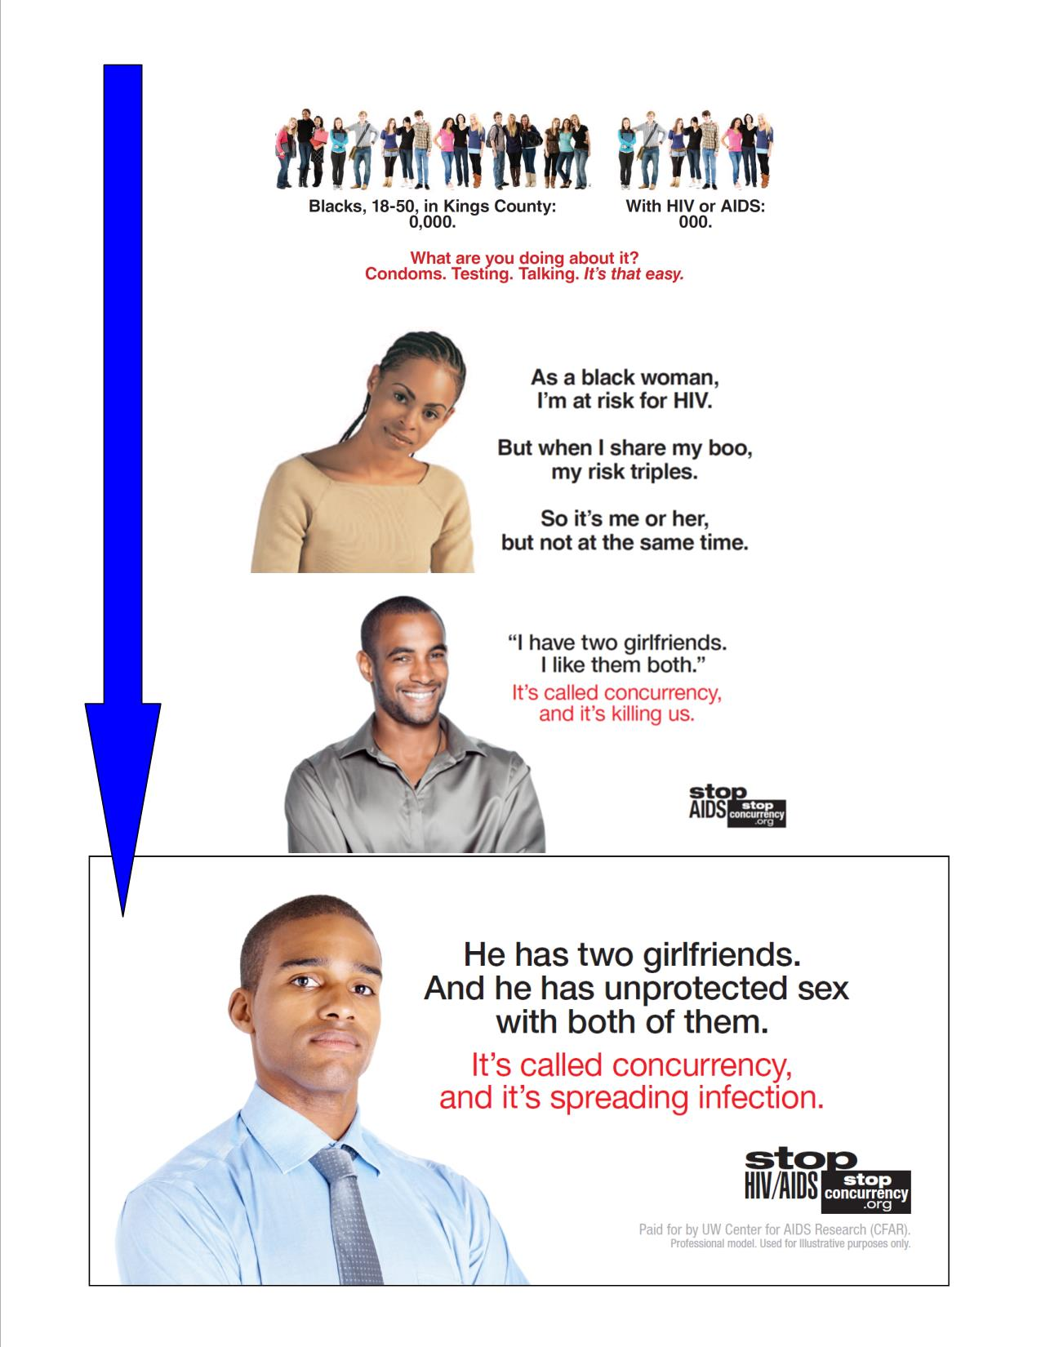
Developing the Flyers
Notes:
Vanessa
We made these placards (of which there are 18 iterations, in different translations), which also went through an evolution based on community input. They started out trying to show the network (multicultural focus), and then were narrowed down to focusing specifically on the black communities of Seattle.

Slide 65
Path Forward
Biomedical → bio-behavioral
Interdisciplinary research

Slide 66
NIH Priorities
(1) Reducing the incidence of HIV/AIDS;
(2) Developing the next generation of HIV therapies;
(3) Identifying strategies towards a cure;
(4) Improving the prevention and treatment of HIV-associated comorbidities, coinfections, and complications; and
(5) Cross-cutting areas that includes basic research, behavioral and social sciences research, health disparities, trainings, capacity-building, and infrastructure.
https://grants.nih.gov/​grants/​guide/​notice-files/​NOT-OD-15-137.html)

Slide 67
The functional framework for HIV/AIDS behavioral and social science research by Gaist and Stirratt (2017, JAIDS)

Slide 68
The “Uncharted Frontier” of Medicine
New drugs and treatments won’t work if we don’t simultaneously target human behavior, (for which we have) no marker, no biopsy, no powerful predictive test.
Doctors need experimental tools to understand, survey, and change medicine’s least familiar frontier: human behavior.
Siddhartha Mukherjee, MD
NY Times, 5/20/2018

Slide 69
Acknowledgments
NIH Funding
  NIMH Project officers (Michael Stirrat, Chris Gordon)
University of Washington
  Colleagues
  Grad/Undergraduates
  Project Staff
Participants

Slide 70
Thank You

Slide 71
For more information, slides, or to join the
HIV Medication Adherence Listserv
Jane Simoni
jsimoni@uw.edu

