Slide 1
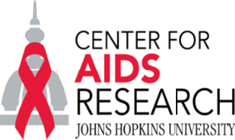
Getting to 2020: Top Challenges in Biomedical HIV Prevention
Beyond Individual Risks
CHIPTS, June 1, 2018
Chris Beyrer MD, MPH
Desmond M. Tutu Professor
Associate Director, JHU CFAR
Johns Hopkins Bloomberg School of Public Health

Slide 2
Outline
The Epidemic in 2018: Why are we not achieving control?
HIV Prevention Challenges in PWID
  The Research Agenda for HIV and Substance Use
HIV Prevention Challenges in MSM
  Social, Structural, Political, Human Rights
  The Research Agenda for MSM

Slide 3
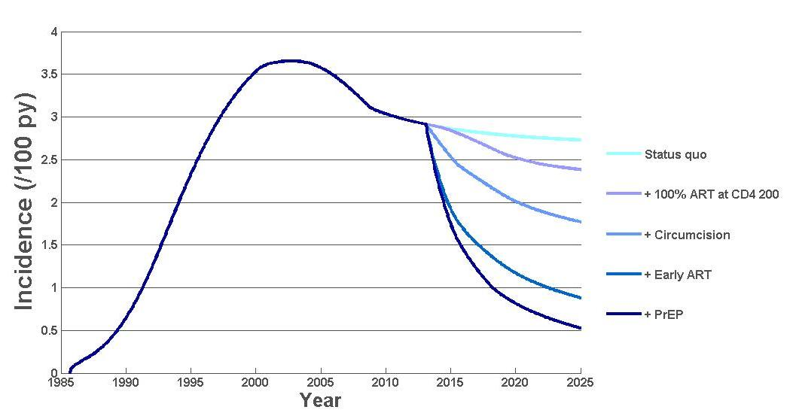
Is HIV epidemic control achievable?
Is ending AIDS as a public health threat achievable?
Status quo
+ 100% ART at CD4 200
+ Circumcision
+ Early ART + structural
+ PrEP + behavioral
Yes, HIV epidemic control is achievable!
But, a vaccine and / or cure is essential to totally eradicate HIV
Source: Cremin I. et al. AIDS 2013

Slide 4
The Beginning of the End of AIDS?
Diane Havlir, M.D., and Chris Beyrer, M.D., M.P.H. N Engl J Med 2012
A series of scientific breakthroughs...
Efficacy of oral and topical chemoprophylaxis
The first evidence of efficacy for an HIV vaccine candidate
The first cure of an HIV-infected person
Early initiation of antiretroviral therapy can both improve individual patient outcomes and reduce the risk of HIV transmission to sexual partners by 96%
…has led many to assert what had so long seemed impossible: that control of the HIV pandemic may be achievable.

Slide 5
Where are we?
39 (28.9-41.5) million deaths
36.7 (30.8-42.9) million living with HIV
1.8 (1.6-2.1) million new infections (2016)
20.9 million on TX > Half of PLWHA
>40 Countries implementing PrEP
US, France, RSA, Kenya, Peru, Canada, Israel, Australia, EU
Adapted from UNAIDS Global Report 2017

Slide 6
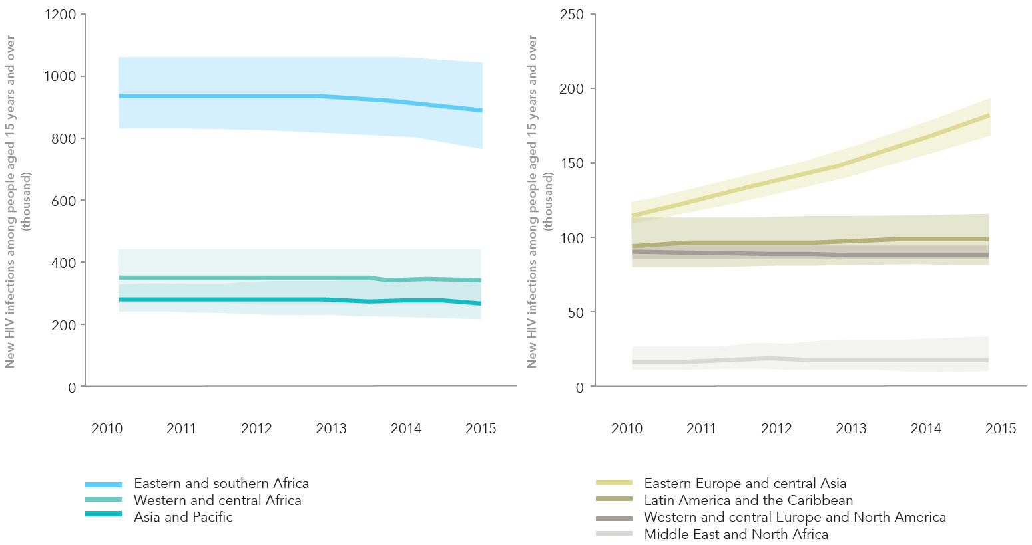
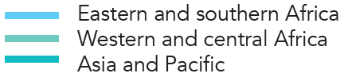
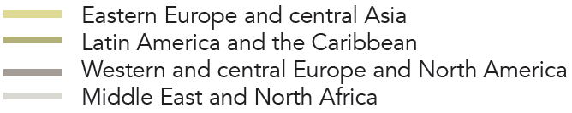
New HIV infections among people aged 15 years and over, 2010–2015
Source: UNAIDS 2016 estimates.

Slide 7
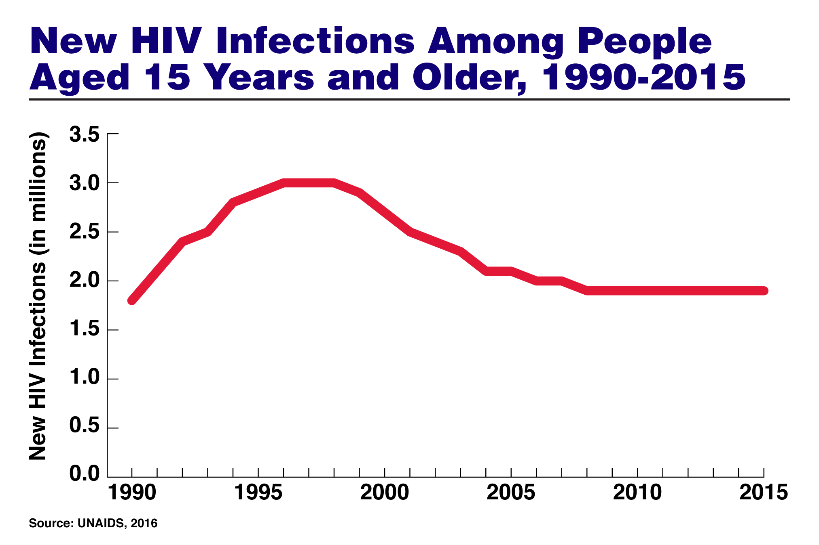

Slide 9
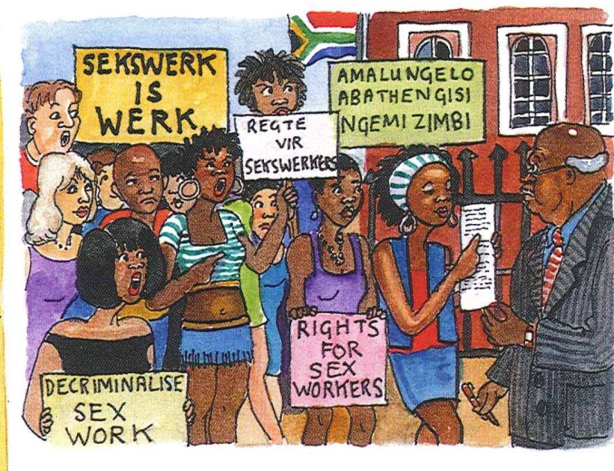
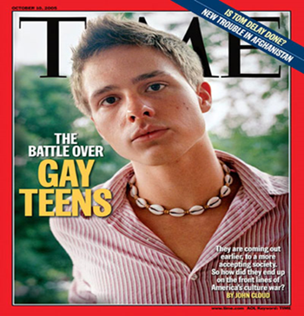
Key populations
People Who Inject Drugs
Gay men and other men who have sex with men

Slide 10
Key Populations and HIV
Key populations are those individuals and communities who have disproportionate burdens of HIV risk and disease and lack of access to essential HIV services
Gay, Bisexual, and other men who have sex with men (MSM)
Sex Workers of all genders
People who inject drugs (PWID) of all genders
Transgender Women who have sex with men
Prisoners and detainees
Women and Girls in South, East African hyper-epidemics
HIV uninfected partners in discordant relationships
Adolescents from all of these communities

Slide 11
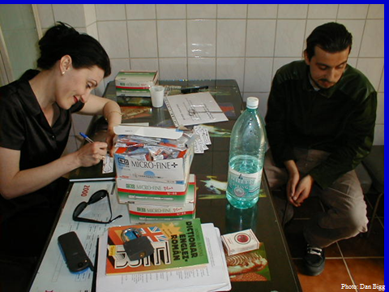
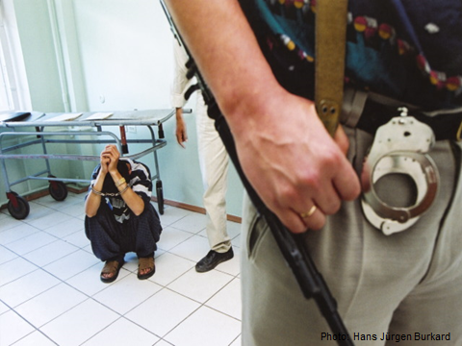
People who inject drugs

Slide 12
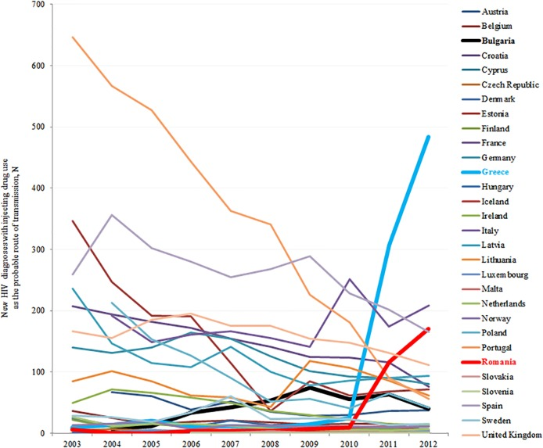
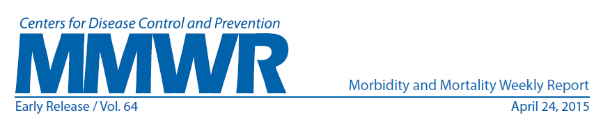
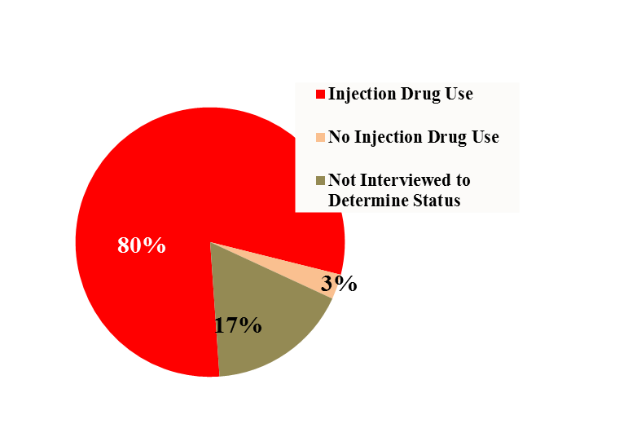
HIV can disseminate very rapidly among PWID
Outbreak of HIV in Greece and Romania
Outbreak of HIV Linked to Oxymorphone in Indiana, USA, 2015
Average 9 syringe-sharing
partners, sex partners
In Scott County, which is a community of 4200 people there have been 173 new HIV Infections since January of 2015
In Greece there were: 2000-2010, 9-19 new HIV cases in IDU (2%–3% of all cases); in 2011, 266 cases in IDU ( 28% of HIV cases) and in 2012, 547 cases in IDU (46% of HIV cases)

Slide 13
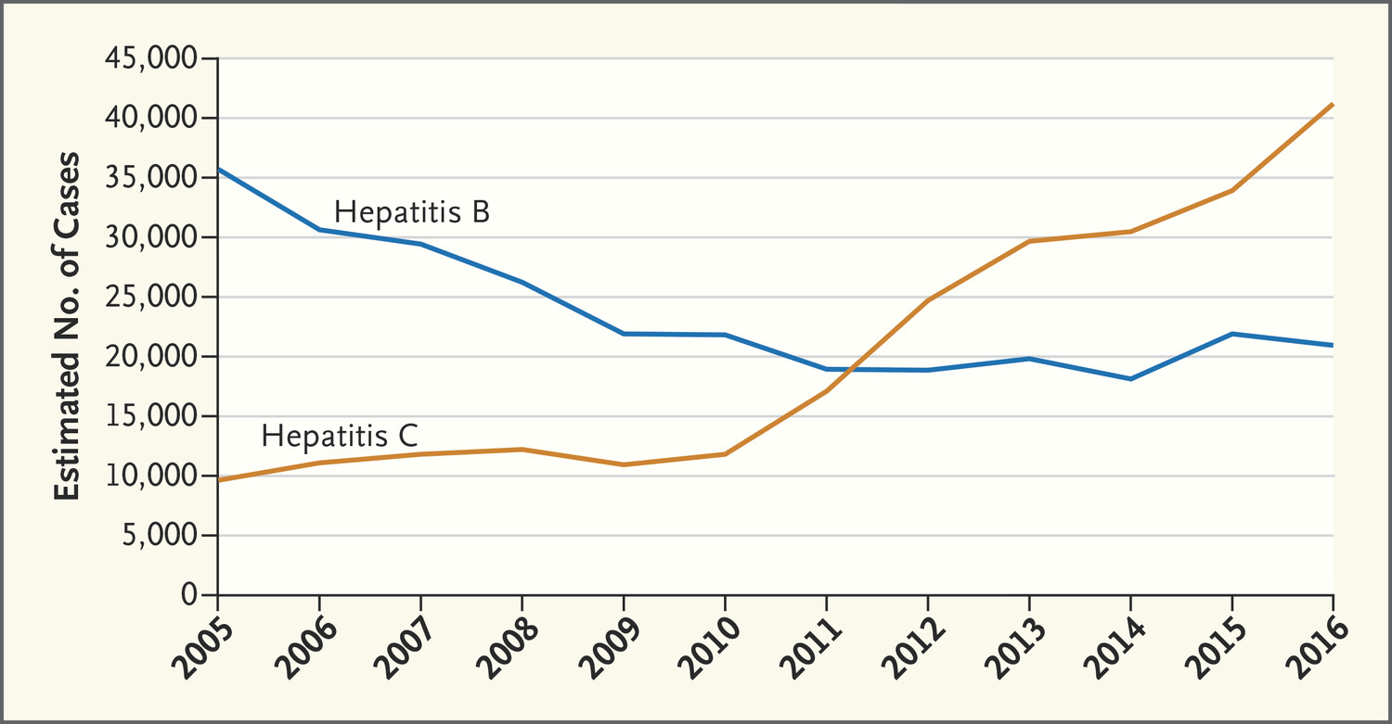

TJ Liang, JW Ward. N Engl J Med 2018;378:1169-1171.
Estimated Number of New HBV and HCV infections in the US by year, 2005-2016., by Year.
Notes:
Estimated Number of New Hepatitis B and Hepatitis C Infections in the United States, by Year. Data are from the Centers for Disease Control and Prevention and are adjusted for the expected number of people with acute hepatitis B virus and HCV infections who become symptomatic, seek medical care, and are reported to state or local public health surveillance.

Slide 14
Epidemiology into Policy: Scott County, Indiana
State Actions
NSEP and legal access to over-the-counter needles
Screening and referral to free or affordable drug treatment
Reimbursement for medication assisted therapies
Provide free HIV testing and initiation of HAART for HIV+ substance users
Monitor state HIV and HCV epi data to respond to outbreaks early
Physicians/Providers
Screen for substance use
Test for HIV, HCV, STI
For HIV, HCV + offer immediate tx
Provide HBV vaccine
Naloxone to community
Drug treatment on demand
Get licensed to provide OST
Provide NSEP or refer
Lobby for law/policy reform
Threading the Needle — How to Stop the HIV Outbreak in Rural Indiana. NEJM, June 2015. Strathdee & Beyrer.

Slide 15

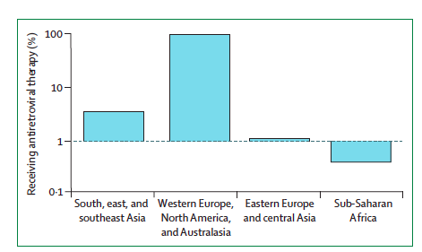
JHU-Lancet Commission on Drug Policy and Health, 2016.
Proportion of injecting drug users living with
HIV who receive antiretroviral therapy, by region
Notes:
Data on the y-axis are on a log scale. No data are available for Latin America and
the Caribbean, or for the Middle East and north Africa. Adapted with permission
from UNAIDS, 2014.55

Slide 16
Research Agenda for HIV and Substance Use: Network, Social, Structural Levels
Integration of services
  HR, MAT, HIV treatment, overdose prevention
  Safe injection facilities and prevention of infection
Substance use and sexual risks (MSM)
  Network level risks and interventions
  Social media
  HCV and MSM networks
The Opioid Crisis
  Shifting Demography, Geography, Communities
  Adapting PWID interventions for rural/suburban use
  Novel interventions for overdose (fentanyl testing; naloxone distribution)
  Policy and legal reform/interventions
  Decriminalization (cannabis impacts on opiates)
Incarceration, Rehab, Release, and HIV
  Continuum of care
  Post-release and overdose
  Social-Community impacts of mass incarceration

Slide 17
Return to Maximum Sentencing
May, 2017, Attorney General Jeff Sessions directed federal prosecutors to seek the maximum penalty possible in every case
“Instead of providing people who commit low-level drug offenses or who are struggling with mental illness with treatment, support and rehabilitation programs, the policy will subject them to decades of incarceration,” they wrote. “In essence, the Attorney General has reinvigorated the failed ‘war on drugs.’ ”
Townes, C. The War on Drugs Never Ended. Slate, Aug 1, 2017

Slide 18
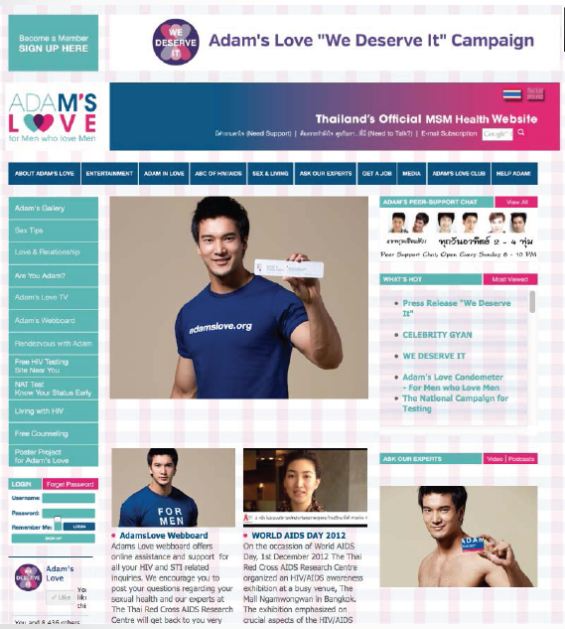

Gay, Bisexual and other MSM

Slide 19
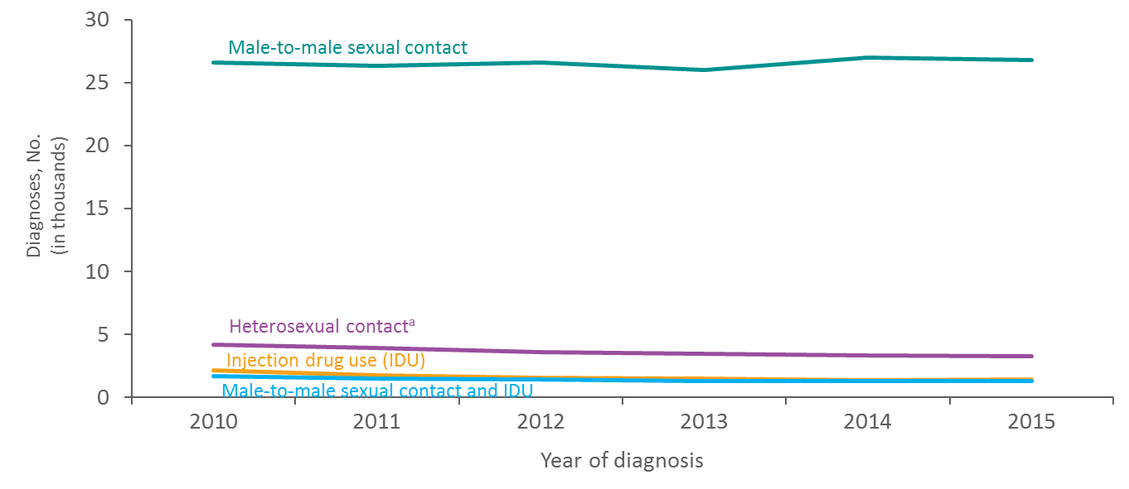
Diagnoses of HIV Infection among Male Adults and Adolescents, by Transmission Category, 2010–2015—United States and 6 Dependent Areas
Note. Data have been statistically adjusted to account for missing transmission category. “Other” transmission category not displayed as it comprises less than 1% of cases.
ª Heterosexual contact with a person known to have, or to be at high risk for, HIV infection.
Notes:
This slide presents the distribution of diagnoses of HIV infection among male adults and adolescents with infection diagnosed from 2010 through 2015, by transmission category, for the United states and 6 dependent areas.
The number of diagnoses of HIV infection among male adults and adolescents attributed to male-to-male sexual contact remained stable, 26,577 in 2010 to 26,753 in 2015. From 2010 through 2015, among male adults and adolescents, the number of diagnoses of HIV infection attributed to heterosexual contact decreased by 22% (from 4,175 in 2010 to 3,274 in 2015); diagnoses of infections attributed to injection drug use decreased by 34% (from 2,125 in 2010 to 1,403 in 2015); and diagnoses of HIV infections attributed to male-to-male sexual contact and injection drug use decreased by 22% (from 1,652 in 2010 to 1,288 in 2015). The “Other” transmission category is not displayed as it comprises 1% of all reported cases. The category includes hemophilia, blood transfusion, perinatal exposure, and risk factor not reported or not identified.
Data have been statistically adjusted to account for missing transmission category.
Heterosexual contact is with a person known to have, or to be at high risk for, HIV infection.

Slide 20

Tools to Reach Hidden Populations: HIV among Moscow MSM
5 year NIMH-funded RO1 study conducted in Moscow
Collaboration between Johns Hopkins, AIDS Infoshare, and the SANAM clinic
Objectives
  Characterize the HIV epidemic and risk factors among MSM
  Provide anonymous, voluntary testing in LGBT friendly space
  We recruited 1541 Gay, Bi, MSM: HIV prevalence was 15.5% (RDS adj: 12.4 (95% CI 9.3-16.1)
Notes:
Dates: Formative: April – August 2010 Quantitative: October 2010 – April 2013; HPV: Jan 2012-2013
Eligibility: 18yrs +, report sex with a man in last 12 mo.

Slide 21
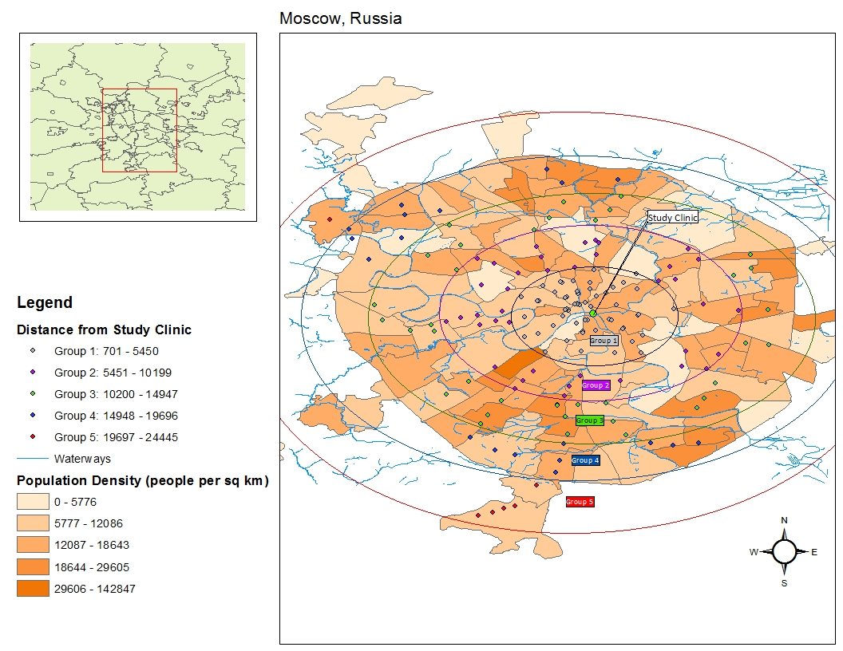
Moscow MSM: Recruitment

Slide 22
HIV Care Continuum for MSM in Moscow
* Weighted with RDS-II estimator
Wirtz et al. Sex Trans Infect 2015
Notes:
Among those linked to care, 48.4% were on ART
Add bar to represent total sample living with HIV; add error bars for RDS estimates

Slide 23
Social-Ecological Model for HIV Risk in MSM
HIV Epidemic Stage
Exclusion from National Surveillance, Criminalization,
Human Rights Contexts, Sexual Health Education
Access to preventive services, Stigma,
VCT Access, ARV Access, STI Care
STI Prevalence, Condom/PrEP/TasP use
IDUs, MSW
Level of Risks
Unprotected Receptive Anal Intercourse, GUD,
frequency of male partners,
high lifetime partners, IDU, NIDU
Stage of Epidemic
Public Policy
Community
Network
Individual
Adapted from: Baral and Beyrer, 2006

Slide 24





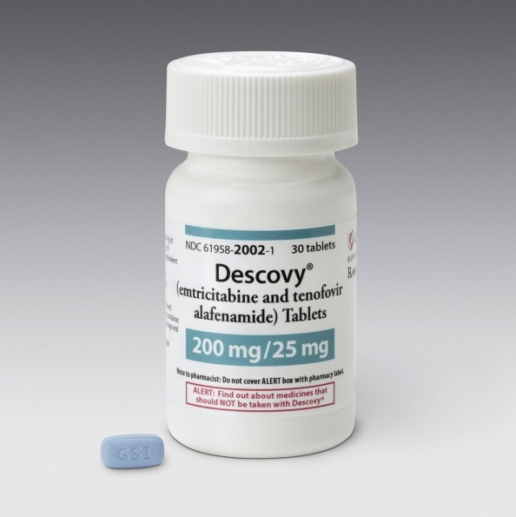
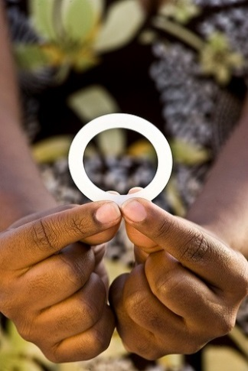


How to improve chemoprophylaxis effectiveness?
Novel adherence strategies
New oral PrEP drugs and dosing strategies
Hard-to-reach populations; PWUD
Alternative delivery systems and formulations
Injectables:
ARVs and mAbs
(Cabotegravir, VRC01)
Vaginal & Rectal Microbicides
Intravaginal rings
(Dapivirine, Tenofovir +/- Contraception)

Slide 25
Research Agenda for Gay, Bisexual, other MSM: at Network, Social, Structural Levels
Antivirals for prevention
  Disparities in access, uptake, adherence (Black, Latinx men, adolescents)
  PrEP/TasP and transmission networks
  PrEP, STI, HBV/HCV transmission dynamics, IS
Recruitment and Retention
  Epidemiologic advances
  Social media recruitment, platforms
Stigma Reduction Interventions
  LGBT
  HIV stigma and PrEP
  Strategic litigation
Adolescent/young adult GB/MSM
  Access
  Research participation/assent and consent
  School based interventions
  Unstable housing
Novel interventions
  Impact on disparities
  Social and Structural Aspects

Slide 27

AMERICA LAST
How the ‘Trump Effect’ Is Endangering LGBT People Worldwide International activists say the effects of the Trump administration’s actions (and inactions) are already being felt.
The Daily Beast
Jay Michaelson
05.19.17 1:00 AM ET
Human Rights Undermined
“It’s not just liberal democracy in danger,”
“It’s the rule of law internationally. It’s the international system itself. It’s the notion that human rights are universal and sacred. That’s what’s at stake with the Trump administration.”
--Jessica Stern, OutRight Action International
.

Slide 28
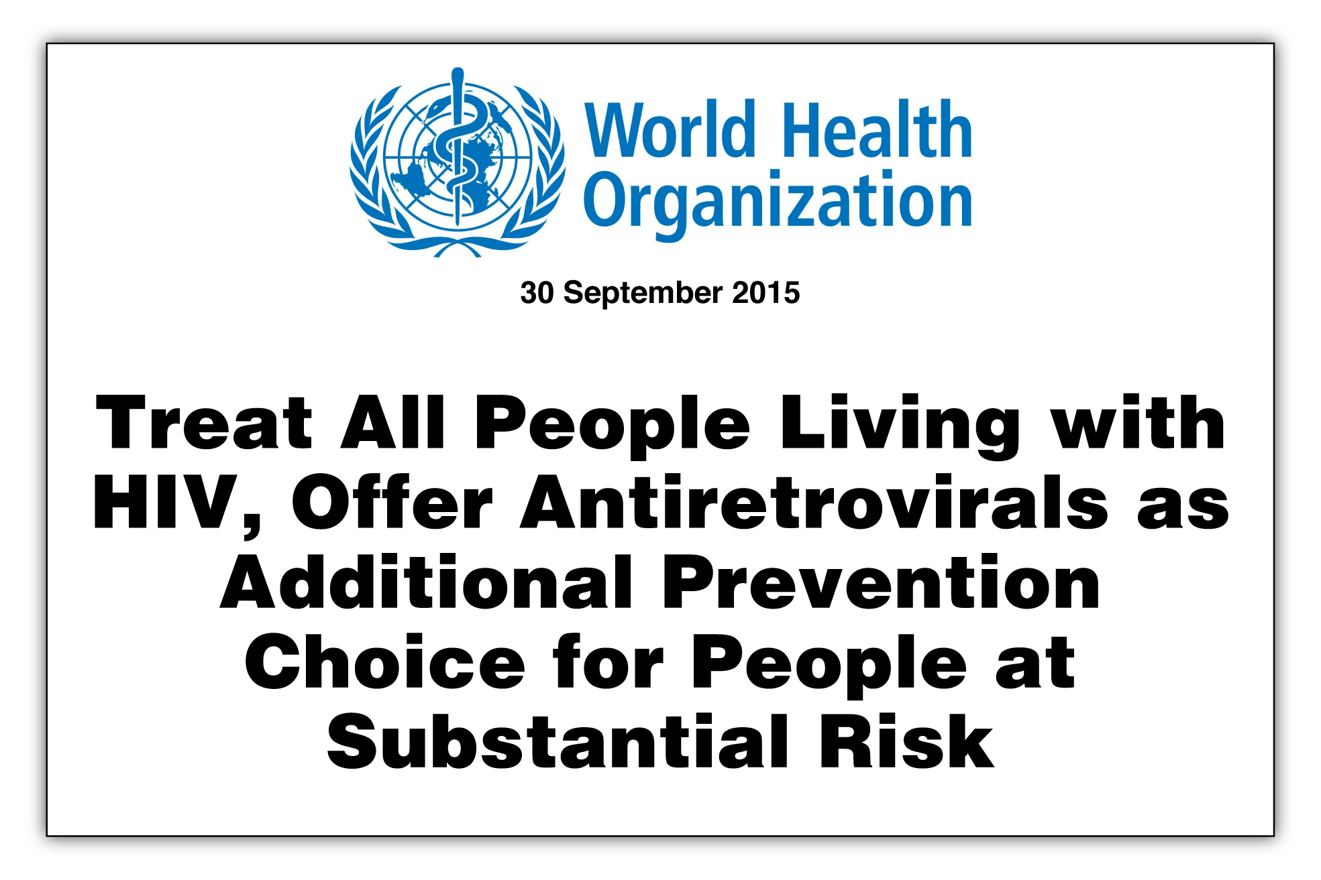

Slide 29


Acknowledgements
Johns Hopkins
Dick Chaisson, Stef Baral, Michele Decker, Carl Latkin, Tonia Poteat, Brian Weir, Andrea Wirtz
IAS
Linda-Gail Bekker, Ken Mayer, Adeeba Kamarulzaman
Supported by grants to the Center for Public Health and Human Rights at John Hopkins from
The John Hopkins Center for AIDS Research (NIAID, 1P30AI094189-01A1)
Desmond M. Tutu Professorship

