Slide 1
NIH Public Access Policy
Bethany Myers
Research Informationist, Biomedical Library
bethanymyers@library.ucla.edu
x42030

Slide 2
What is the NIH Public Access Policy?
The NIH Public Access Policy ensures the public has access to the published results of NIH funded research to help advance science and human health. The Policy has three aims:
ARCHIVE. A central collection of NIH-funded research publications preserves vital published research findings for years to come.
ADVANCE. The archive is an information resource for scientists to research publications and for NIH to manage better its entire research investment.
ACCESS. The archive makes available to the public research publications resulting from NIH-funded research.

Slide 3
What is the NIH Public Access Policy?
Requires scientists to submit final peer-reviewed journal manuscripts that arise from NIH funds to PubMed Central (PMC)
Maximum 12-month embargo
Enforcement:
Anyone submitting an application, proposal or report to the NIH must include the PMC reference number (PMCID) when citing applicable papers that they author or that arise from their NIH-funded research.
NIH will delay processing of non-competing continuation grant awards if publications arising from that award are not in compliance with the NIH public access policy. The award will not be processed until recipients have demonstrated compliance.

Slide 4
What is PubMed Central?
http://www.ncbi.nlm.nih.gov/pmc/
Full text repository of 3.9 million articles
Not the same as PubMed
PMCIDs are the not the same as PMIDs

Slide 5
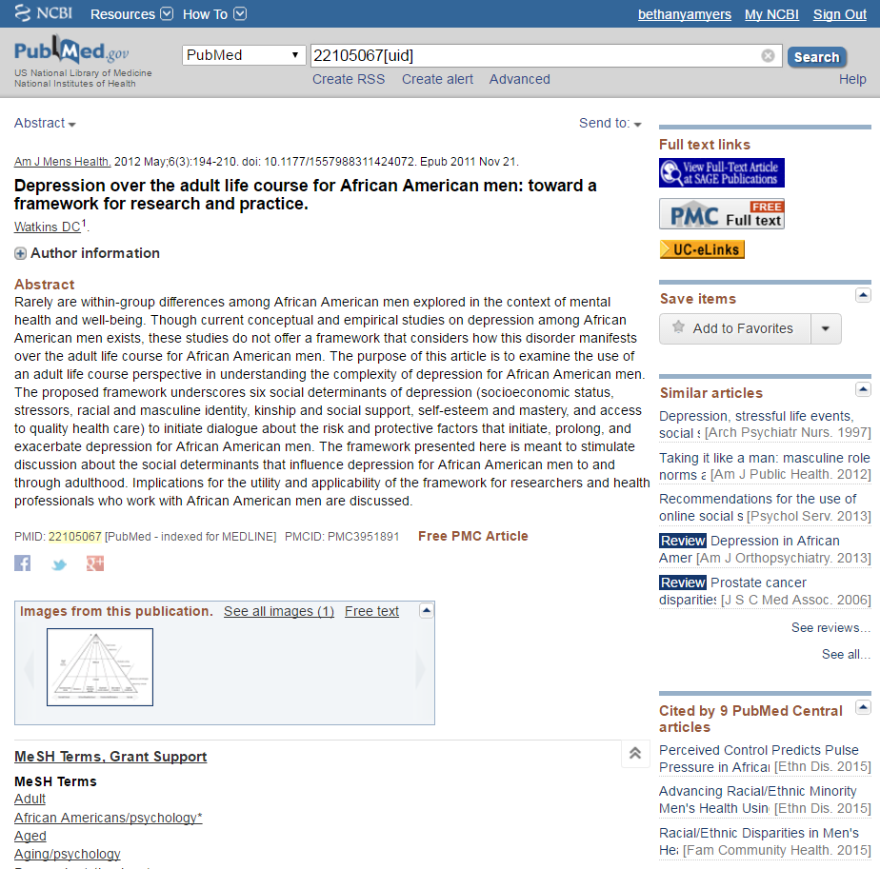

Slide 6
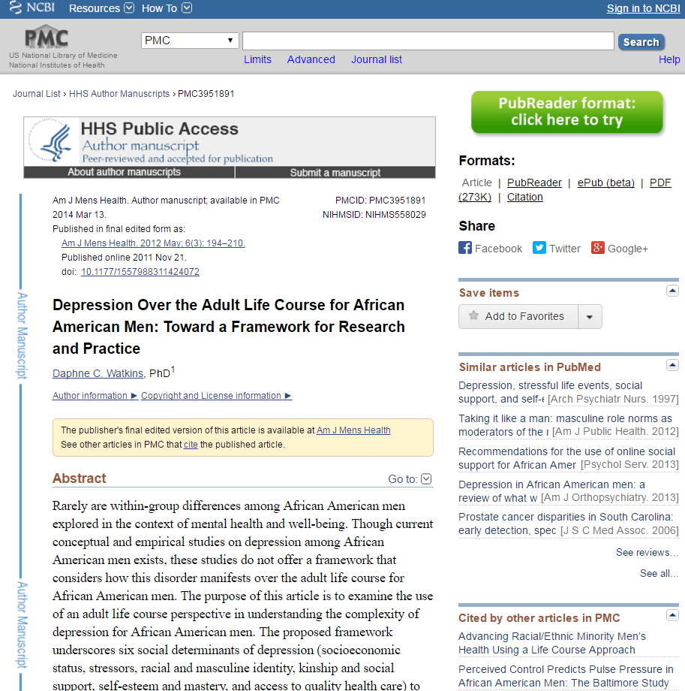

Slide 7
How do I get my paper in PMC?
There are 4 ways that a paper can be added to PubMed Central and become compliant.
Helpfully called Methods A, B, C, and D
Methods A and B – publisher does all the work
Methods C and D – author does most/all of the work
Methods C and D involve the use of a system called NIHMS: the NIH Manuscript Submission System

Slide 8
Method A: Open access journals who have a deal with PMC
Method A journals take care of the compliance process for their authors
The whole journal is open access and they put all their articles in PMC automatically
It is a limited list of journals

Slide 9
Method B: Open access articles
Method B publishers take care of the compliance process for their authors, IF the authors opted in at the time of publication, usually paying an open access fee
Sometimes the whole journal may be open access, sometimes only certain articles may be open access
It is a limited list of journals/publishers that participate

Slide 10
Method C: Author does it all
If you did not pay an open access fee/article processing charge to publish your article, chances are this is you
Gather some things:
Your eRA Commons username and password (they make you change passwords often so you may have to reset) OR your NCBI username and password
The final author version of your manuscript
NOT the published PDF
This is probably your last Word file before you sent it off to journal for the final time
Don’t forget any supplemental files/tables/figures/etc.
Go to the NIH Manuscript Submission System
https://www.nihms.nih.gov

Slide 11
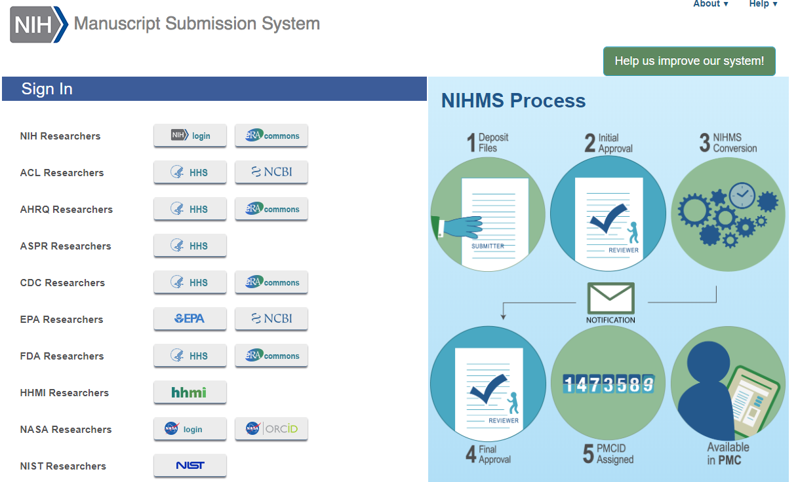

Slide 12
Click here if you have an eRA Commons login

Slide 13
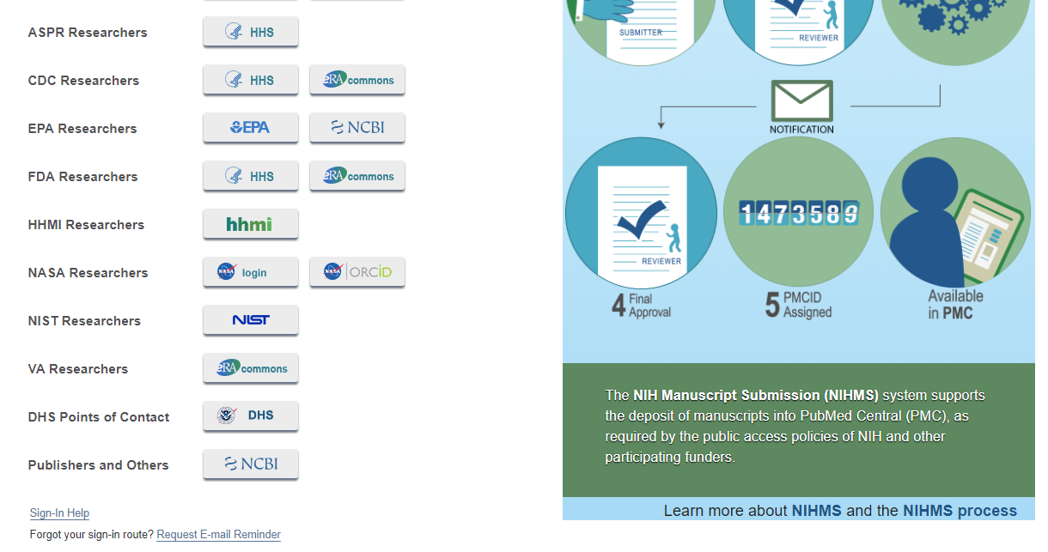
Scroll down and click here if you don’t have an eRA Commons login

Slide 14
I’m logged into NIHMS, now what?
Follow the steps the upload your manuscript file
There are helpful tutorials on the site
Or call/email me if you need help
bethanymyers@library.ucla.edu
x42030

Slide 15
Uploading to NIHMS

Slide 16
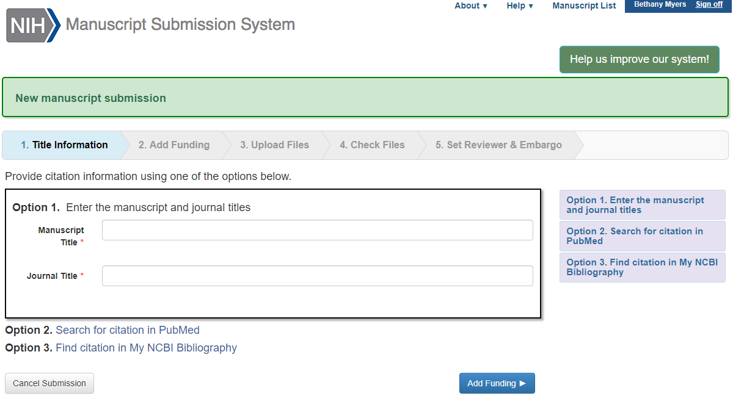
Uploading to NIHMS

Slide 17
Uploading to NIHMS

Slide 18
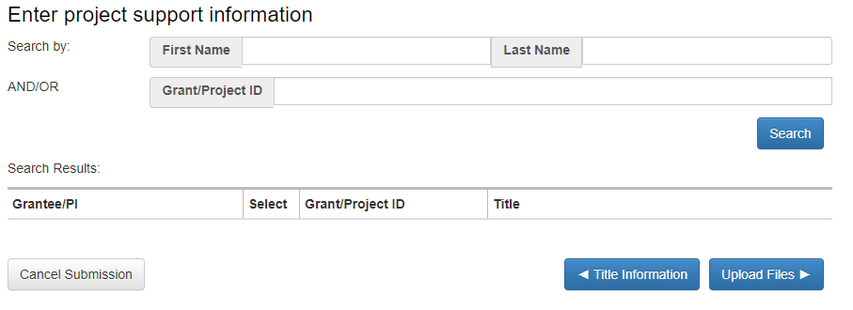
Uploading to NIHMS

Slide 19
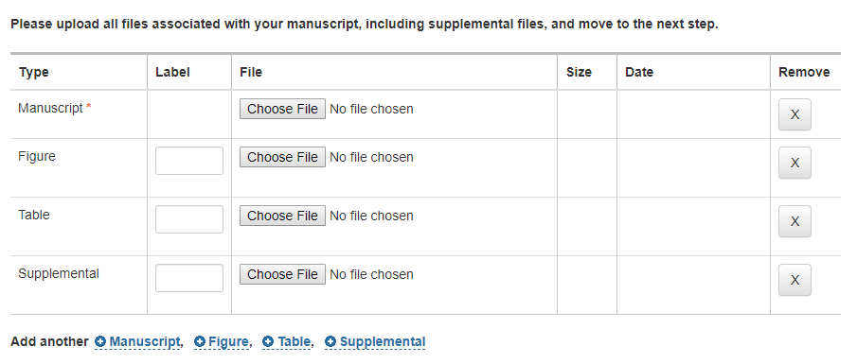
Uploading to NIHMS

Slide 20
Uploading to NIHMS
You have to click here and make sure the PDF is accurate

Slide 21
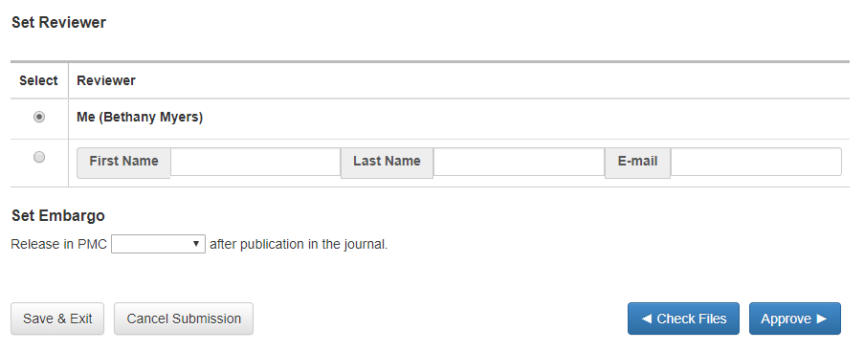
Uploading to NIHMS
Check your journal’s policy

Slide 22
I submitted my manuscript, now what
It will take NCBI a period of time to work on your manuscript and convert it to PMC format
During this period of time, your submitted manuscript has an interim ID number: the NIHMSID
Then you will get an email notifying you that they need your final approval
Click the link in the email
If you lose the email, just log back into NIHMS and you’ll see the manuscript that needs your attention on your dashboard
Double check the converted manuscript to make sure it’s correct
You only get a PMCID after you do final approval

Slide 23
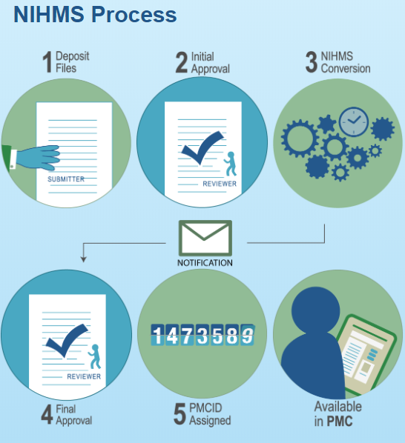

Slide 24
What could go wrong?
You may get other messages from NCBI
If you are missing tables/figures, etc
If so, log into NIHMS to make any corrections or updates

Slide 25
Method D: Opt-in for file submission only
Some publishers let you skip the first step of uploading your final author manuscript into NIHMS
This is usually an option at the time you’re submitting your manuscript
You still have to log into NIHMS to approve the files that the publisher uploads

Slide 26
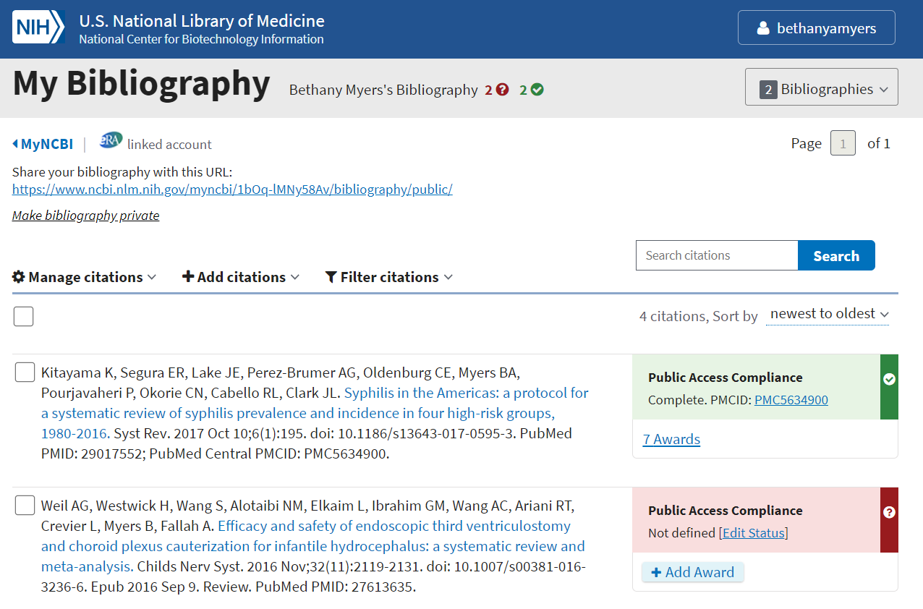
How do I know if I have noncompliant articles?
Go to MyNBCI and click on My Bibliography

Slide 27
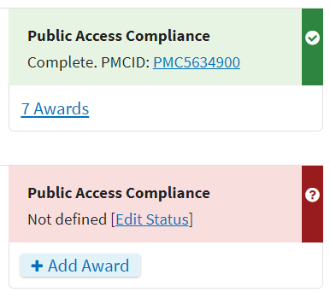
How do I know if I have noncompliant articles?

Slide 28
How do I know if I have noncompliant articles?
Clicking Edit Status lets you begin the compliance process in NIHMS or mark the record as exempt

Slide 29
Questions?
Bethany Myers
Research Informationist, Biomedical Library
bethanymyers@library.ucla.edu
x42030

Slide 30
What is the UC Open Access Policy?
For Academic Senate Faculty:
Your papers accepted for publication after July 23, 2013 need to be made open access
For everyone else:
Your papers accepted for publication after October 19, 2015 need to be made open access
You do not have to pay fees to make your papers open access
(But you can if you want to)

Slide 31
What is eScholarship?
https://escholarship.org/
The University of California’s open access repository

Slide 32
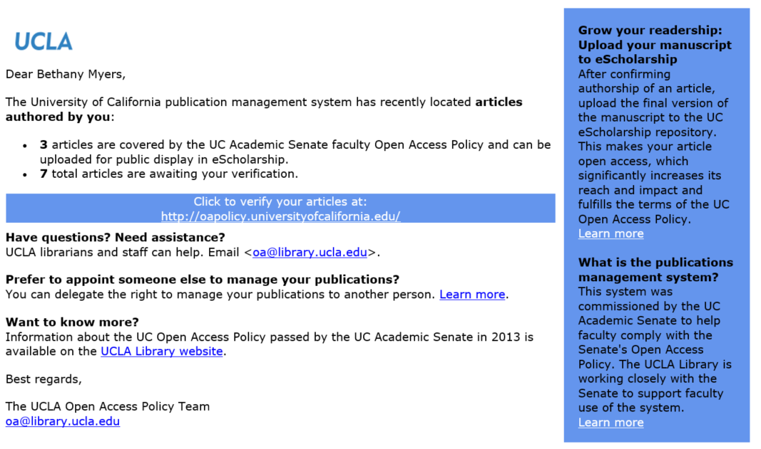
I got this email-

Slide 33
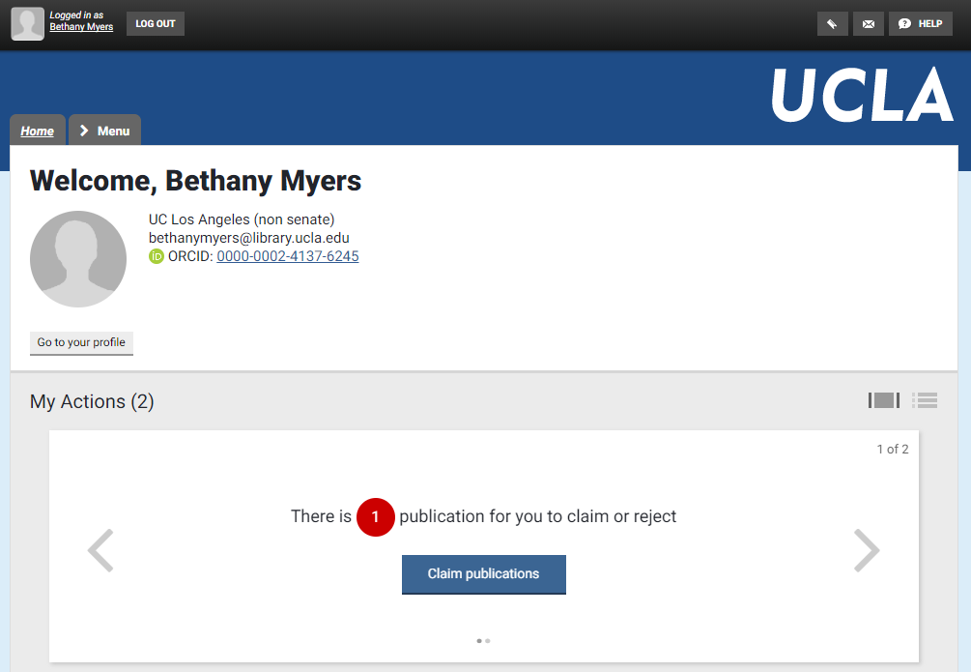
Claim and share

Slide 34
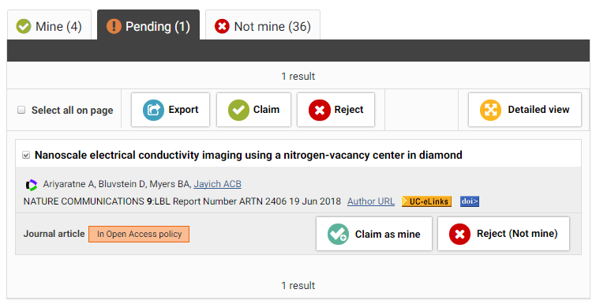
Claim and share

Slide 35
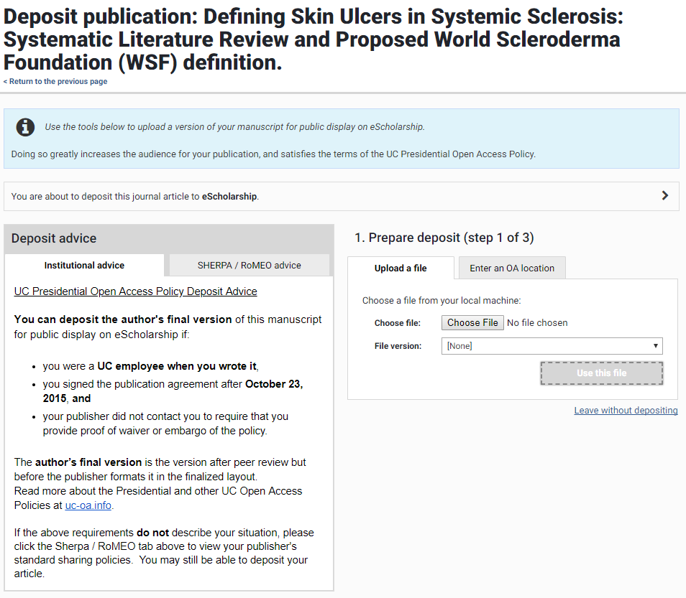

Slide 36
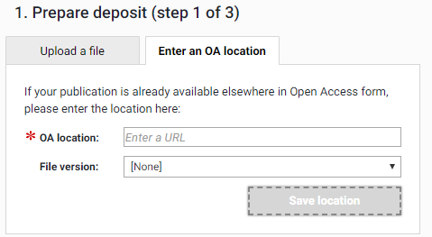

Slide 37
What if my publisher doesn’t want me to do this?
UC contacted publishers years ago informing them of this policy
Only a few publishers are asking authors for waivers to opt out
Mostly Nature
If the publisher doesn’t explicitly request that you opt out, you retain the right to upload your manuscript to eScholarship

Slide 38
Questions?
Bethany Myers
Research Informationist, Biomedical Library
bethanymyers@library.ucla.edu
x42030

