Slide 1


Treatment of Substance Use Disorders as HIV Prevention
Advancing the prevention and treatment of chronic illnesses
UCLA Department of Family Medicine

Slide 2
Psychoactive Drugs and HIV
Steven Shoptaw, PhD
UCLA Center for Behavioral and Addiction Medicine
Department of Family Medicine
sshoptaw@mednet.ucla.edu
August 26, 2013
Advancing the prevention and treatment of chronic illnesses
UCLA Department of Family Medicine

Slide 3

What You Need to Know
Most users of substances don’t inject
Proposed mechanisms linking substance use and HIV transmission for people who do not inject
  Indirect links between drug abuse treatment as HIV prevention
Two evidence-based case examples
Discussion
Advancing the prevention and treatment of chronic illnesses
UCLA Department of Family Medicine

Slide 4
Substances
Sedative/barbs – ALCOHOL, benzodiazepines, GHB
Stimulants – cocaine, speed, NICOTINE, Ecstasy (MDMA)
Opiates – heroin, percodan, dilaudid, vicodin
Hallucinogens – LSD, mescaline, peyote
Tranquilizers/anesthetics – ketamine, PCP
Cannabinoids – POT, hash
Inhalants – poppers, solvents

Slide 5
Substance Use Prevalence, 2011
Substance Δ from 2010 | %
Current Cigarette Smokers -- | 22.1%
Alcohol Use (any in past month) -- | 51.8%
Heavy Alcohol Drink (5+ drinks, 5+ days past month) ↓ | 6.2%
Marijuana Use (past month) ↑ 5.8% in 07 | 7.0%
Prescription Drug Misuse (past month) ↓ | 2.4%
Heroin Use (past month) -- | 0.3%
Cocaine Use (past month) -- | 0.5%
Methamphetamine Use (past month) ↓ | 0.2%
www.samhsa.gov National Survey on Drug Use and Health, 2012
Advancing the prevention and treatment of chronic illnesses
UCLA Department of Family Medicine

Slide 6
Drug Use is Normative in U.S.
In 2011, 20.6 million (8.0% of adults aged 12 and over) met criteria for substance abuse or dependence not including tobacco dependence (National Survey on Drug Use and Health, 2012).
Alcohol abuse and dependence represents the majority (14.1 million or 68.4% of those with abuse or dependence)
  remainder splits between drug disorders only and comorbid illicit drug use and alcohol use disorders.
www.samhsa.gov, National Survey on Drug Use and Health
Advancing the prevention and treatment of chronic illnesses
UCLA Department of Family Medicine

Slide 7

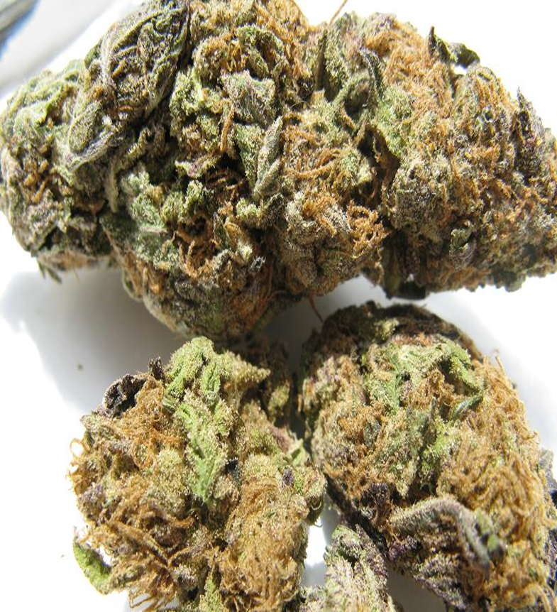
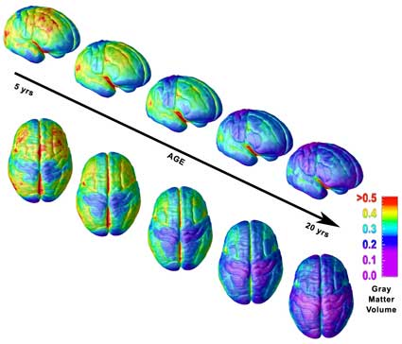
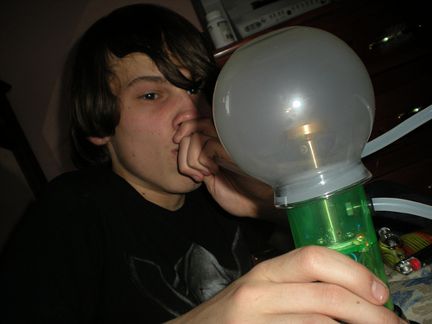
A Word About Marijuana
Frances Jensen and David Urion
Advancing the prevention and treatment of chronic illnesses
UCLA Department of Family Medicine

Slide 8
Not Just the Needle: A Complicated Equation for HIV Transmission
NIDU + HIV = Risk
Substance Use Prevalence Transmission Potential
Type of Substance
Stimulant
Alcohol
NOT cannabis
Route of Use
Oral
Eating
Smoked
Inhaled
Inserted anally
Local Factors on HIV Prevalence
Dual Diagnosed
Poverty
Incarceration
MSM
Street youth
Women
Race/ethnicity
HIV Transmission Risks
Blood (?)
Drug-facilitated sexual transmission
Advancing the prevention and treatment of chronic illnesses
UCLA Department of Family Medicine

Slide 9
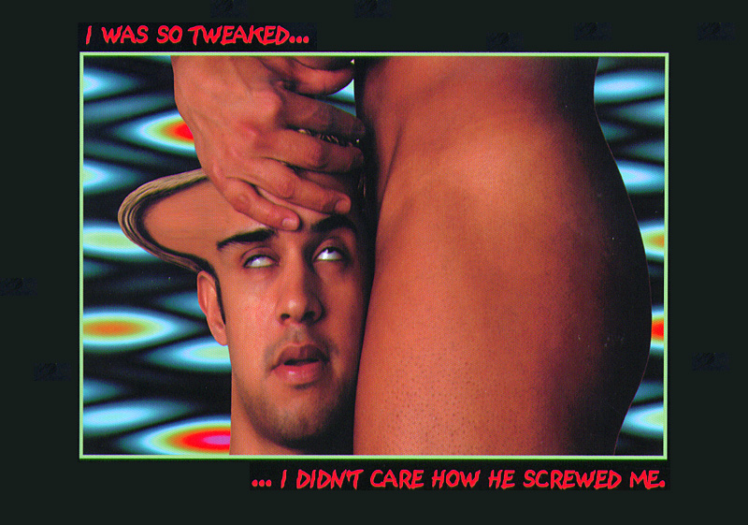

Slide 10
Meth Use and HIV Transmission in MSM
Meth use correlates with 2-4 fold increases in risk for HIV transmission in:
  Cohort Studies (Plankey et al., 2007)
  New Infections (Drumright et al., 2007; 2009)
  STI settings (Buchacz et al., 2005; Buchbinder et al., 2005)
Carey et al., AIDS & Beh, 2008
Advancing the prevention and treatment of chronic illnesses
UCLA Department of Family Medicine

Slide 11
Methamphetamine
HIV Transmission
A Probabilistic Event Determined by:
  Characteristics of the behavior
    Unprotected anal (↑ receptive; ↓ insertive)
    Unprotected vaginal (↑ receptive; ↓ insertive)
    Oral behaviors
  Characteristics of the individual
    Other STIs
    Bruised/bleeding mucosa
    Viral load
    Concurrency
  Characteristics of the event
    Single; multiple sources of virus
Advancing the prevention and treatment of chronic illnesses
UCLA Department of Family Medicine

Slide 12
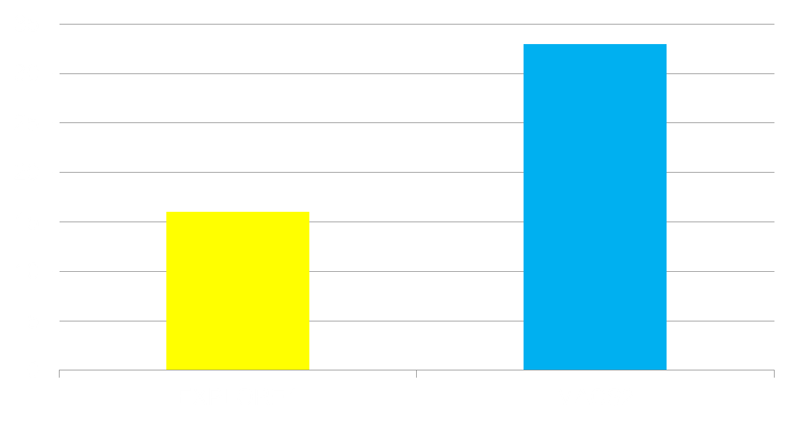
Attributable Risk for HIV Transmission from Stimulant Use in MSM
¹ Koblin et al., 2006, AIDS, 20, 731-739
² Ostrow et al., 2009, Journal of Acquired Immune Deficiency Syndrome, 51(3), 349-355
Advancing the prevention and treatment of chronic illnesses
UCLA Department of Family Medicine

Slide 13
Policy Model for Methamphetamine Use, HIV Prevalence and Interventions
Shoptaw & Reback, J Urban Health, 2006
Advancing the prevention and treatment of chronic illnesses
UCLA Department of Family Medicine

Slide 14
Treatment of Substance Use Disorders as HIV Prevention
Advancing the prevention and treatment of chronic illnesses
UCLA Department of Family Medicine

Slide 15
Behavioral Drug Abuse Treatment as HIV Risk Reduction
Behavioral Therapies
  Friends Getting Off (Reback & Shoptaw, 2011)
  Contingency Management (Shoptaw et al., 2005)
    Limits to treatment settings (Menza et al., 2010)
    Heterosexual meth users show parallel reductions in injection and sex risk behaivors (Corsi et al., 2012)
Medication Therapies
  Mirtazapine (30 mg/d) for meth-dependent MSM (Colfax et al., 2011) showed reductions in meth use and concomitant HIV sexual transmission behaviors
Advancing the prevention and treatment of chronic illnesses
UCLA Department of Family Medicine

Slide 16
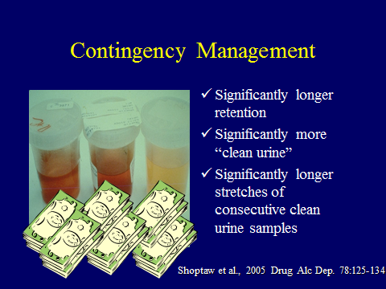
Advancing the prevention and treatment of chronic illnesses
UCLA Department of Family Medicine

Slide 17
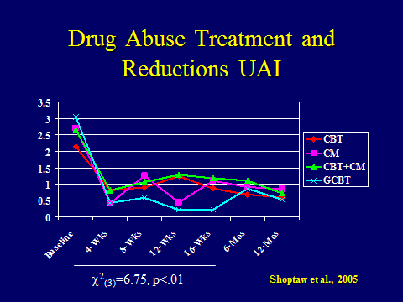
Advancing the prevention and treatment of chronic illnesses
UCLA Department of Family Medicine

Slide 18
HIV Prevention Strategies for Non-Treatment Seeking Substance Users
Advancing the prevention and treatment of chronic illnesses
UCLA Department of Family Medicine

Slide 19
Behavioral Prevention for HIV+ Substance Users
After 30+ years, behavioral prevention reliably reduces risk behaviors, but no demonstration of infections averted
  Need for inclusion of HIV biomarkers in designs
CDC Compendium and SAMHSA NREPP programs catalog interventions with efficacy in reducing risk behaviors
  Project EDGE (Mausbach et al., 2007) safer sex program for MSM HIV+ meth users.
Advancing the prevention and treatment of chronic illnesses
UCLA Department of Family Medicine

Slide 20
Strategy for HIV Combination Prevention in HIV- Substance Users
Lower susceptibility: Reduce infection in HIV-negative groups
  Biobehavioral approaches – PrEP, PEP for substance using MSM; other groups at high risk
  Behavioral programs – condom distribution, EBIs can address structural determinants of risk related to substance use; no evidence of infections averted
  Surveillance of emerging epidemics linked to drug use
Kurth et al., 2011, Current HIV/AIDS Reports,1-11
Advancing the prevention and treatment of chronic illnesses
UCLA Department of Family Medicine

Slide 21
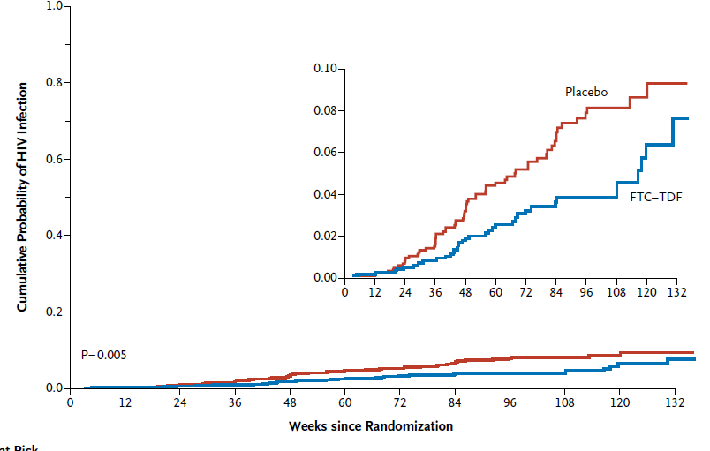
iPrEX Results
Grant RM et al N Engl J Med. 2010 363:2587-99.
Advancing the prevention and treatment of chronic illnesses
UCLA Department of Family Medicine

Slide 22
iPrEX Findings
Of 100 seroconversions, 36 in Truvada group, a reduction of 44% over placebo (p=0.005)
Efficacy was higher in men who reported UAI (58%) than those who did not
Adherent men (90%+) showed 73% efficacy
Efficacy of all subjects was 47% (p=0.001)
Questions remain about adverse effects, feasibility/acceptability/ethics
No indication about substance users as they were excluded from trials
Advancing the prevention and treatment of chronic illnesses
UCLA Department of Family Medicine

Slide 23
PEP in MSM
In Project EXPLORE, MSM who reported any non-injection drug use increased odds for PEP by 50% (aOR: 1.5, 95% CI:1.1, 1.9)
  Smoked cocaine, poppers, crack cocaine, amphetamines and hallucinogens increased odds
  IDUs significantly higher odds of PEP use (aOR: 2.44, 95%CI: 1.69, 3.51).
  Marijuana or cocaine that was snorted or sniffed or alcohol drinking did not associate with increased odds for PEP
  No evidence of risk compensation
Donnell et al., 2010, AIDS Behav 14:1182–1189
Advancing the prevention and treatment of chronic illnesses
UCLA Department of Family Medicine

Slide 24
PEP in Methamphetamine
Using MSM
When integrated with CM, PEP use among meth-using MSM appears to be safe and feasible
Time to PEP initiation (37 h) and reported adherence rates (96%) are comparable to non-meth-using PEP findings
CM increased PEP adherence 2% for each MA-negative urine sample; CM increased PEP completion by 17%
Meth-using MSM had high rates of risk behavior: high prevalent STI rates
Small sample size (n=53), 1 incident seroconversion – non-adherent to meds and multiple exposures
Landovitz et al. 2012 AIDS Pt Care STDS, 26:320-328
Advancing the prevention and treatment of chronic illnesses
UCLA Department of Family Medicine

Slide 25
Where Will All the Drug Come From?
At the end of 2010, 6.6 million on ART (UNAIDS)
  42% of those in need (CD4 ≤ 350 cells/mm)
9 million eligible and in need of treatment now; 28 million HIV-infected globally
  Attrition cascade at all points from testing to ART initiation to chronic care
New infections: 2.6 million in 2010¹
Advancements in TasP, PEP and PrEP create even more demand for ART
¹http://wwwunaidsorg/unaids_resources/aidsat30/aids-at-30pdf
Advancing the prevention and treatment of chronic illnesses
UCLA Department of Family Medicine

Slide 26
Behavioral Prevention for HIV-Negative Substance Users
Woman focused HIV risk reduction program for African American crack smokers (Wechsberg et al., 2004)
Fast Lane, HIV-risk reduction program for HIV-negative heterosexual meth users (Mausbach et al., 2007)
Advancing the prevention and treatment of chronic illnesses
UCLA Department of Family Medicine

Slide 27
Final Thoughts
Advancing the prevention and treatment of chronic illnesses
UCLA Department of Family Medicine

