Slide 1
Building a Budget
Financial Basics for Research Proposals
Laura Sheehan
Manager of Research Administration, Dept. of Family Medicine

Slide 2
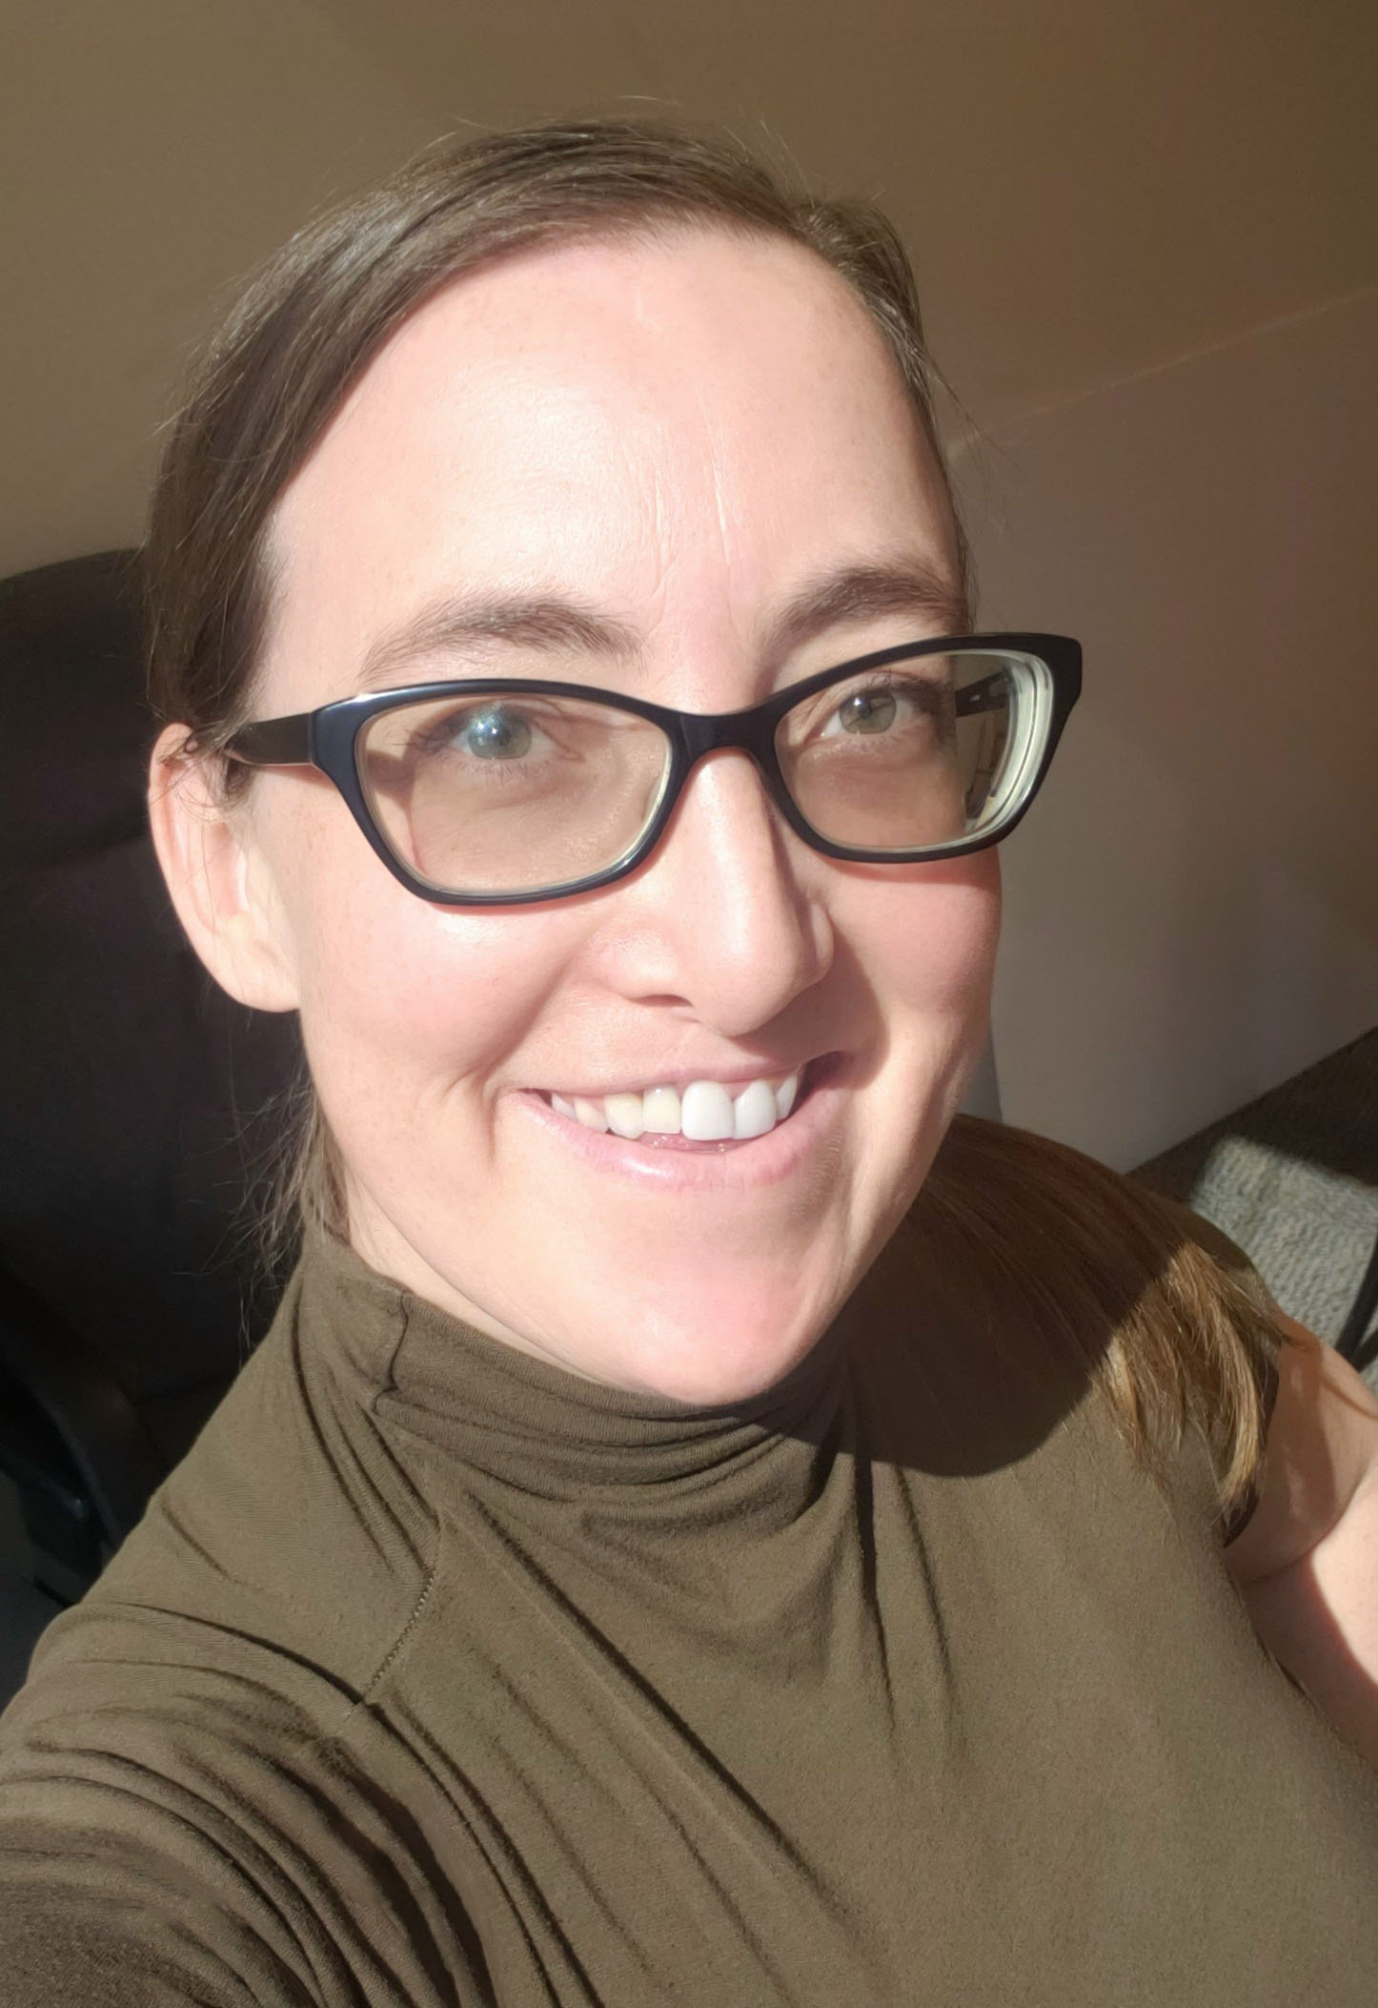
Laura Sheehan
Manager of Research Administration, Department of Family Medicine, David Geffen School of Medicine at UCLA
23 years in academic research administration
3 years in Civil/Environmental Engineering research administration at University of Southern California (USC)
10 years in Pediatric Infectious Diseases research and fellowship administration, and divisional financial management at UCLA
10 years in Family Medicine research administration and financial management at UCLA
Management of approximately $10M in contract and grant funding annually
Department consistently ranks in top 10 nationwide for federal funding among all Family Medicine Departments

Slide 3
Objectives
Identifying common elements of a research budget
Dissecting sponsor guidelines to glean important information needed to create a strong budget proposal
Determining how project needs might affect specific budget line items
Describing best practices for crafting a budget justification

Slide 4
Previous Material
Presented by CHIPTS in September 2022

Slide 5
Budget Basics
What is a budget?
A detailed estimation of costs that support a sponsored project. Budgets should include both the Direct and Indirect Costs necessary to achieve the stated goals of the project. Costs should be derived from the project description and must follow all sponsor and institutional guidelines and restrictions. Budgets should follow the format requested by the sponsor.

Slide 6
Budget Cost Principles
Allowable
Allocable
Reasonable
Necessary
Consistently applied (regardless of funding source)
Relevant to/benefits the project

Slide 7
Types of Budgets / Payment Basis
Cost Reimbursement
Payment is based on actual costs incurred, most common
Revenue is earned when allowable and applicable costs incurred up to the total budget approved
Unspent funds in the budget must be returned to the sponsor
Firm Fixed-Price
Payment is based on a fixed specified amount, regardless of costs incurred
Unspent funds can often be retained by the institution after close
Firm Fixed-Rate
Payment is based on a fixed rate applied to number of units performed
Unspent funds can often be retained by the institution after close
Some projects have more than one payment basis

Slide 8
Types of Budgets / Payment Basis
Cost Reimbursement
Payment is based on actual costs incurred, most common
Revenue is earned when allowable and applicable costs incurred up to the total budget approved
Unspent funds in the budget must be returned to the sponsor
Firm Fixed-Price
Payment is based on a fixed specified amount, regardless of costs incurred
Unspent funds can often be retained by the institution after close
Firm Fixed-Rate
Payment is based on a fixed rate applied to number of units performed
Unspent funds can often be retained by the institution after close
Clinical Trials

Slide 9
Sample Clinical Trial Budget
Fixed Price per Participant

Slide 10
Budget Periods and Project Periods
Budget Period 1
Budget Period 2
Budget
Period 3
Project Period (Period of Performance)

Slide 11
Direct vs. Indirect Costs
Expenses involved with maintaining and running an institution.
Frequently called “IDC,” “overhead costs,” or “facility and administrative costs” (F&A).
Used to cover things like building, utilities, operations, maintenance, construction, I.T., central services administration, etc.
DIRECT COSTS
Connected to specific project.
Only will be incurred if project is funded.
Examples include: salary/benefits for project personnel for effort directly attributable to the project, project-specific supplies, project-specific travel, participant incentives, etc.
INDIRECT COSTS

Slide 12
Indirect Costs
Indirect Cost Rate
Set ratio/percentage of direct cost or Modified Total Direct Costs (MTDC)
May be more than one (e.g. on-campus vs. off-campus)
Standardized and often is required to be approved federally. (Non-profit institutions without a federally-approved IDC Rate Agreement can utilize the Federal De Minimis rate of 10%.)
Sponsors may restrict IDC to a maximum amount or unallow them entirely
Must be a published, standardized policy for all award recipients
Your institution may require approval to accept such an award
Reach out to your Department Admin or Authorized Official prior to creating your budget to ensure IDCs are correctly calculated.

Slide 13
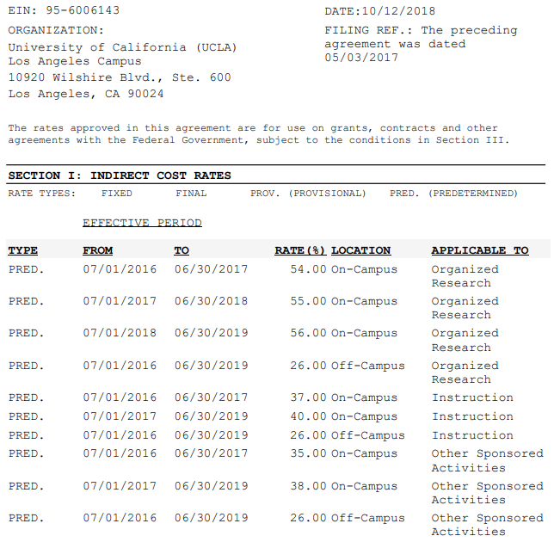
Example

Slide 14
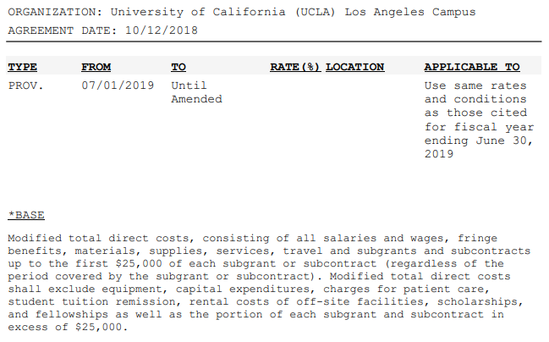
Example

Slide 15
Find your institution’s indirect cost rate agreement
Review it for key points (type, rate, base, effective dates)
Notes:
Type
Rate
Base (What is included? What is exempt?)
Effective dates

Slide 16
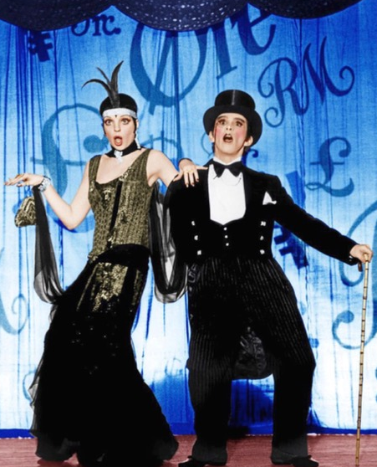
Research Project Process
Idea
Find Funding
Develop Proposal
Route Proposal for Internal Approval
Authorized Official Submits Proposal
Award Processed
Initiate and Manage Project
Close-Out
Money makes the world go round

Slide 17
Idea Phase
Things to consider
Significance
Innovation
Building your team

Slide 18
Building Your Team
Take roll: who is already on your team and what will they be responsible for?
Identify weaknesses:
Expertise
Availability
Sponsor guidelines and expectations:
Does the grant opportunity emphasize the need for multiple or different types of collaborators? (e.g. community partners)
Think about programmatic needs, but don’t forget administrative needs
Admin Indicators:
Event(s)
Lots of purchasing or reimbursement needs
Heavy scheduling
Correspondence

Slide 19
If you need to expand your team…
Identify partners:
Internal
Within your unit
Interdisciplinary
To Be Hired
External
Subaward
Consultant/Contractor
Vendor
Other Significant Contributor
Get buy-in from other Unit’s leadership
Check with HR re: title, salary, hiring process
Notes:
If interdisc: need buy-in from other dept leadership; TBH get input from HR regarding title, salary, hiring process

Slide 20
External Partners
Subaward
Recipient is at an institution and will carry out an intellectually significant portion of the award, has an identified site lead/investigator, expected to co-author publications, uses funds to carry out a program for public purpose, has a detailed/line-item budget
Consultant
Procurement relationship, services are primarily advisory in nature and address a clearly delineated problem or provides a fee-for-service function, typically paid on an hourly or daily rate or some other fixed-price rate for deliverables.

Slide 21
External Partners
Vendor
Procurement relationship, provides goods/services within normal operations or to many different purchasers, performs series of repetitive activities requiring little discretionary judgment, normally operates in a competitive environment. Consultants are often considered Vendors, but not all Vendors are Consultants.
Other Significant Contributors
(NIH primarily) Contributes to the scientific development or execution of a project but does not commit any specified measurable effort, no budget/funds for participation. E.g. mentors.

Slide 22
Expanding your Team
How does this affect your budget?
Internal Partners: easy to determine salary/benefits, other costs
Subawards: allow for extra time, communicate to determine sal/bens/other, allow for F&A (at both sites)
Consultants/Vendors: obtain quotes/bids as needed, determine rate and quantity
Other Significant Contributor: no costs
Subawards take more time to set up during proposal phase
Consultants take more time to set up after funds are awarded

Slide 23
Research Project Process
Idea
Find Funding
Develop Proposal
Route Proposal for Internal Approval
Authorized Official Submits Proposal
Award Processed
Initiate and Manage Project
Close-Out

Slide 24
Sponsor Types
Often smaller, shorter turnaround, simple rules, no IDC
Often biggest budgets, longer turnaround, complicated but standardized rules, standard IDC rates
Most variable, often shorter turnaround, frequent IDC exceptions
Internal
Government
Federal
State
Local
Private/Non-profit
Higher Education Institutions
Foundations
For-Profit
Pharmaceutical
Business
Strictest rules, both from sponsor and from your institution

Slide 25
Sponsor Guidelines
READ
THE
GUIDELINES

Slide 26
Reading the Guidelines
Basics
RFA/PA/FOA name/number
Deadline
Eligibility / Limited submission
Does your project fit the sponsor’s objectives/mission?
Sections/Required documentation
Review Criteria
Formatting, page limits, required templates
Project period, start/end dates, length
Submission method

Slide 27
Reading the Guidelines
Budget specific
Required template/format
Caps/Maximums
Direct Costs
IDC
Total Costs
Salary Caps
Cost-sharing requirement?
Required items
Unallowable expenses
Budget Justification requirements

Slide 28
Example

Slide 29
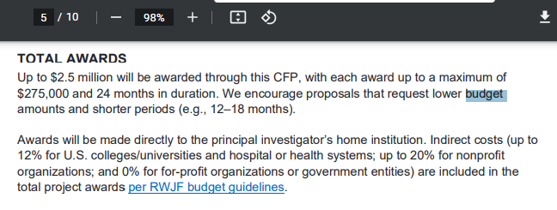
Example

Slide 30
Find a sample funding announcement / RFA / guideline
Review it for key points

Slide 31
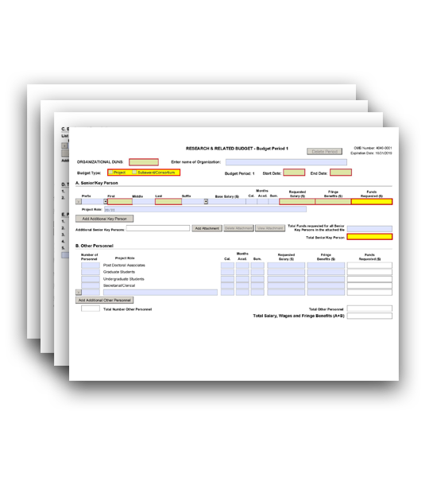
Templates
SF424 (NIH)

Slide 32
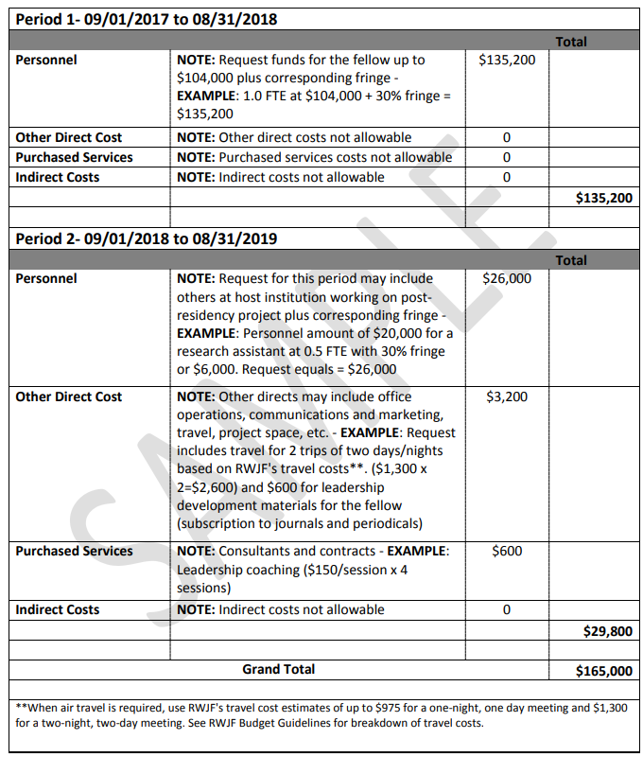
Templates
RWJF

Slide 33
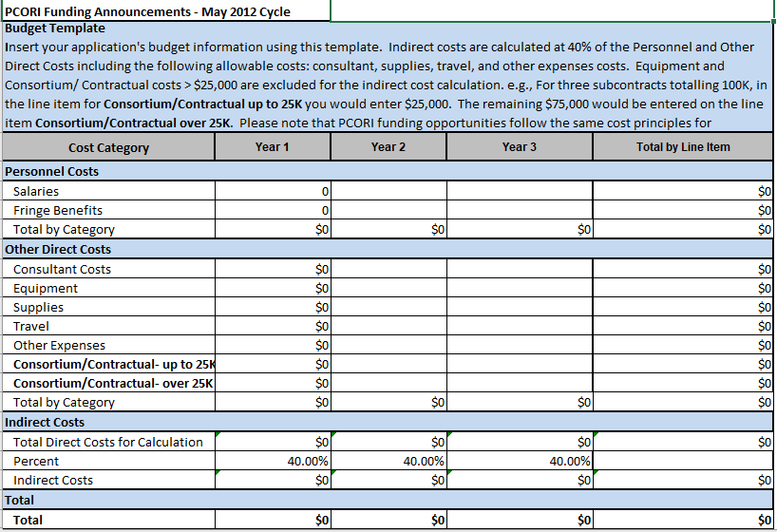
Templates
PCORI

Slide 34
Templates – Worksheets
Put in Excel so you can confirm figures and use formulas
Check with your department/institution to find existing worksheets (don’t reinvent the wheel)
Use a standardized format that you can easily translate
Automatically calculate standardized/required institutional costs

Slide 35
Research Project Process
Idea
Find Funding
Develop Proposal
Route Proposal for Internal Approval
Authorized Official Submits Proposal
Award Processed
Initiate and Manage Project
Close-Out

Slide 36
Time Out
Before you progress further, now is when should seek guidance/assistance from a C&G/financial/pre-award expert at your institution

Slide 37
Personnel
Key Personnel
Typically PI and Co-Investigators, rarely includes other titles
Typically require CV/Biosketch for each person listed
Often requires sponsor permission to replace/reduce effort
Other Personnel
Project Coordinators, Lab Technicians, Research Assistants, and other staff
Post-Doctoral and Graduate Student Researchers
Could be KP or Other
Be aware of Tuition remission fees for GSRs

Slide 38
Personnel
Employees only (no consultants or subaward personnel)
Name and Role on Project
Base Salary
Effort in percentage or person months
Fringe benefits (UCLA: CBR)
Things to consider: salary/ben escalation, changes in effort across budget periods, salary caps
How do I estimate effort?

Slide 39
Too Little? Too Much?
Unable to achieve scope; hiring / retention issues
Loss of reviewer confidence; Less likely to be funded

Slide 40
Estimating Effort
Review your Scope, do a power study
Determine individual roles and responsibilities
Quantify those tasks over the course of the project
How many hours per day/week/month?
Will tasks / effort change in later phases of the project?

Slide 41
Estimating Effort

Slide 42
“Typical” Effort
DISCLAIMER: No such thing!
Co-Investigators:
New PI: Co-I’s should have less effort
Mid- or Senior PI: not necessarily, but usually less effort than PI
PI’s:
New investigators: at least 25%
Mid- or Senior Level investigators: less
MPI: slightly less
STTR: minimum 10%/1.2 cal mos
R series: 15%/1.8 mos
K series: 75%/9 cal mos
Non-Key Personnel:
Common for Project Coordinators to be 100%; also 25%, 50%, or 75%
Research Assistants: often more variable in different phases
Better to over- than underestimate

Slide 43
Sample Personnel Budget
 |  | YEAR 1 |  |  |  |  |  |  |  | YEAR 2
PERSONNEL |  | Role | Eft | Cal | Base | Salary | Ben Rate | FB | Total | Eft | Cal | Base | Salary | Ben Rate | FB | Total
 | Tony Stark | PI | 15% | 1.8 | 203,700 | 30,555 | 32% | 9,778 | 40,333 | 15% | 1.8 | 203,700 | 30,555 | 32% | 9,778 | 40,333
 | Bruce Banner | Co-I | 10% | 1.2 | 203,700 | 20,370 | 32% | 6,518 | 26,888 | 12% | 1.4 | 203,700 | 24,444 | 32% | 7,822 | 32,266
 | Natasha Romanoff | Proj Dir | 30% | 3.6 | 150,000 | 45,000 | 41% | 18,450 | 63,450 | 45% | 5.4 | 150,000 | 67,500 | 41% | 27,675 | 95,175
 | Peter Parker | Res Asst | 50% | 6.0 | 70,000 | 35,000 | 47% | 16,555 | 51,555 | 75% | 9.0 | 70,000 | 52,500 | 47% | 24,833 | 77,333
 | TOTAL PERSONNEL |  |  |  |  | 130,925 |  | 51,301 | 182,226 |  |  |  | 174,999 |  | 70,108 | 245,107

Slide 44
Travel
Meetings / Conferences
 | Cost | # People per trip | Qty per trip | # Mtgs per year | Total
Registration | $650 | 2 | 1 | 2 | $2,600
Airfare | $275 | 2 | 1 | 2 | $1,100
Hotel | $212 | 2 | 4 | 2 | $3,392
Meals | $72 | 2 | 5 | 2 | $1,440
Ground | $35 | 2 | 4 | 2 | $560
Meetings / Conferences Subtotal: |  |  |  |  | $9,092
Local Travel / Mileage
 | Cost | # people | # miles | # per yr | Total
Mileage | $0.585 | 2 | 25 | 20 | $585
Parking | $15 | 2 |  | 20 | $600
 |  | Local / Mileage Subtotal: |  |  | $1,185
 |  |  | Total Travel |  | $10,277
Must be directly related to project
Study travel vs. conference travel
Foreign vs. domestic vs. local
Expenses to include:
Gas/mileage and parking fees
Airfare and ground transportation
Lodging/Hotel
Meals
Visa fees
Conference registration
https://www.gsa.gov/travel/plan-book/per-diem-rates

Slide 45
Materials and Supplies
If less than $1,000, you typically do not need to itemize, but you do need to provide general explanation
Common expenses you may need to itemize individually: Computers, recording devices, tablets
“General Supplies” or
“Office Supplies”
“Project-Specific Supplies”
“Supplies for the creation, organization, distribution, and storage of study data and materials”

Slide 46
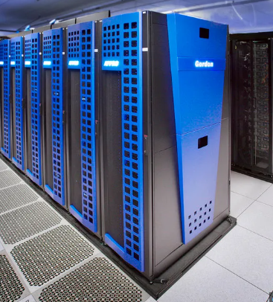
Equipment
Different from Materials and Supplies
Typically must be more than $5,000 per unit
Obtain multiple quotes, include in justification
Generally exempt from Indirect Costs/Overhead
✓

Slide 47
Participant Incentives
If human subjects research: IRB approval will be required
Amount should incentivize but not coerce; should be reasonable
Consider including $ for transportation/food if warranted
Requires documentation and admin oversight: which member of your team will be responsible? Budget for appropriate effort
# participants | Visit Type | $/visit | Subtotal
100 | Initial | $50 | $5,000
90 | 6-month f/u | $50 | $4,500
81 | 12-month f/u | $50 | $4,050
73 | Final | $75 | $5,475
Participant Incentives Total: |  |  | $19,025

Slide 48
Other Participant Costs
Recruitment/Advertising
IRB
Translation
Communication to participants
Space to conduct focus groups or interviews
Transcription

Slide 49
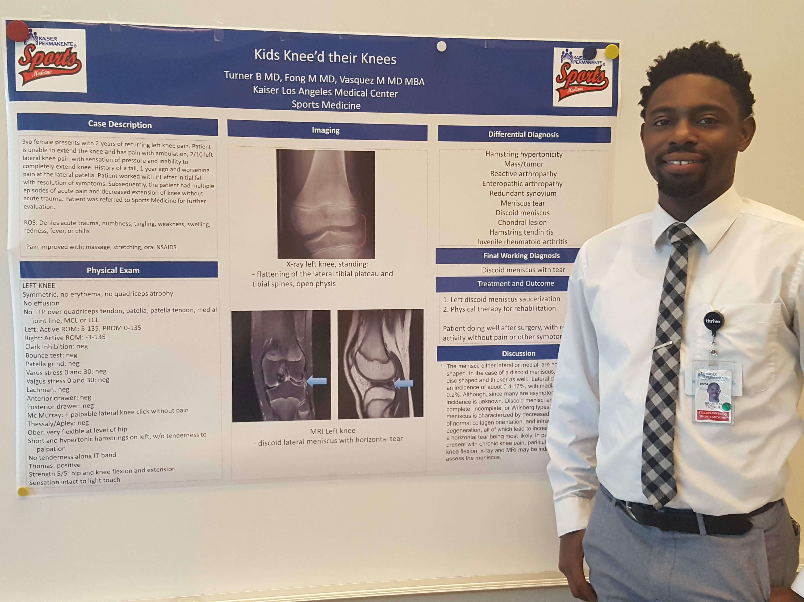
Publication Costs
Costs associated with publishing and disseminating research findings
Common examples include: Journal publication charges, color figures, creation of posters
Typically budgeted in the later years of a study
Data Management and Sharing
Curating data
Developing documentation and formatting data
Data repository fees
De-identifying data
Preparing metadata to foster discoverability, interpretation, and reuse

Slide 50
Various Required Institutional Costs
Check with your institution
Often mandatory
Common examples include: Technology Infrastructure Fee (TIF), General Liability (GAEL), Rent

Slide 51
Consultants
Provide advice, but not involved in making decisions for the direction of the research
Cannot be employees, not considered Key Personnel
Fixed rate (per hour or per milestone), sponsors may have rate limits
Typically not subject to salary cap restrictions, but must be “reasonable”
If you will be covering consultant’s travel, itemize that in justification

Slide 52
Subawards
Subsite’s participation represents and intellectually significant portion of the overall programmatic effort
Each subsite needs to have its own mini-proposal (budget, justification, scope of work, etc.) approved by their Authorized Official
PI often will give draft budget or budget maximum to subsites
SOW is the main thrust of the agreement with subsite
A site lead or site PI should be identified
Subsite personnel are often expected to co-author publications on project results

Slide 53
Subawards and Indirect Costs
Subsites should include Indirect Costs in their subaward budget, as per their institution’s F&A Rate Agreement
Most sponsors and rate agreements allow the primary site to also include Indirect Costs on the primary budget for the subaward costs, but usually only on the first $25,000.

Slide 54
Other Considerations
Multiple years
Round to nearest dollar unless otherwise stated
In general, sponsors usually allow a certain degree of rebudgeting within and between budget categories if needed; check Notice of Award for details

Slide 55
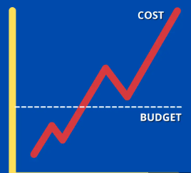
What if I’m Over Budget?
Start by trimming all line items that can afford it
If still over budget: look at effort
If still over budget: look at scope

Slide 56
Budget Justification
Narrative explanation
Justify how each item is necessary to achieve project aims
Clarify how the costs were calculated
Prove reasonableness
Organized in same order and with same sections as budget
Categories less than $1,000 can have minimal (e.g. 1 or 2 sentence) explanations
Unusual or expensive items should be justified in detail, including cost-comparisons/alternative explored
Make sure your figures match

Slide 57
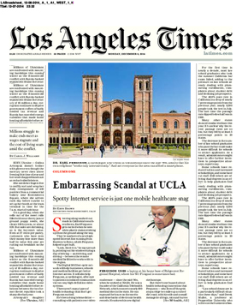
Researcher purchases ridiculous item from tax-payer funds
Fake LA Times Cover

Slide 58
Be the reviewer
Read these sample justification blurbs and see if you can spot the weaknesses

Slide 59
Sample Personnel Justification
Peter Parker will create participant recruitment materials, prepare Institutional Review Board applications, schedule participant visits, manage participant incentives, assist with report preparation, and maintain study files. He is budgeted for 9 calendar months effort (75%) in Years 1-2, and 3 calendar months effort (25%) in Year 3.
Peter Parker (Research Assistant). Working under Dr. Banner’s direction, Mr. Parker will create participant recruitment materials, prepare Institutional Review Board applications, schedule participant visits, and manage participant incentives (including ordering, dissemination, and documentation of gift cards) for Phase 1 of the study (Years 1-2). After the participant-phase of the study, his responsibilities will shift to assist Dr. Banner with report preparation and maintain study files (Year 3). He is therefore budgeted for 9 calendar months effort (75%) in Years 1-2, and 3 calendar months effort (25%) in Year 3.

Slide 60
Sample Personnel Justification
Tony Stark is CEO of Stark Enterprises and will serve as PI on this project. He has established long-term partnerships will the Co-Investigators on this study through their prior experience on a 10-year federally-funded Avengers project. He is budgeted for 1.8 calendar months in all years of the study.
Tony Stark (Principal Investigator) is CEO of Stark Enterprises and has established long-term partnerships will the Co-Investigators on this study through their prior experience on a 10-year federally-funded Avengers project. As PI of this proposed project, Mr. Stark will be responsible for the overall project design, management, intervention implementation, and data collection, analysis and interpretation. He also will oversee reporting and administrative/financial aspects of the project, ensure that project milestones are met, and interface with other participating investigators. He is budgeted for 1.8 calendar months in all years of the study.

Slide 61
Sample Travel Justification
Travel: We budget $10,000 per year for travel-related expenses for the PI to attend two national conferences annually ($30,000 total across all 3 years of the project).
Travel: We are budgeting for the PI to attend two national conferences per year to disseminate research findings: the National HIV Conference (typically held in Washington, DC) and the US AIDS Conference (or similar). We budget $4,380 per year, for a total of $13,140 across all 3 years of the project. Expenses include registration, airfare, lodging, meals, and ground transportation and are itemized as follows:
 | Cost | # People per trip | # Quantity per trip | # Mtgs per year | Total
Registration | $650 | 1 | 1 | 2 | $1,300
Airfare | $275 | 1 | 1 | 2 | $550
Hotel | $200 | 1 | 4 | 2 | $1,600
Meals | $65 | 1 | 5 | 2 | $650
Ground Transp | $35 | 1 | 4 | 2 | $280
Annual Total |  |  |  |  | $4,380

Slide 62
INFORMATION

Slide 63
Resources
UCLA Family Medicine Research Unit Website: https://www.uclahealth.org/departments/family-medicine/research/family-medicine-research-unit-employees
NIH: Develop Your Budget:
https://grants.nih.gov/grants/how-to-apply-application-guide/format-and-write/develop-your-budget.htm

Slide 64
Special thanks to Joel Grey and Liza Minelli, the Kombucha Meme Girl, that kid drinking from a fire hose, and the CHIPTS Team

