Slide 1
No Stigma, No Shade, No Shame!
Addressing Life, Love, Sex and HIV
Through Digital Media
Presented By
Natalie Sanchez, MPH
Hilda Sandoval, PHD
Ramon Garcia, MBA

Slide 2
Objectives
Sin Vergüenza
Season Three
Describe the process of developing a HIV Social Marketing Campaign that is relevant and accessible to Latinos across multiple generations.
Demonstrate the effectiveness of using the Sin Vergüenza Season 3 Telenovela for igniting conversation in Latino communities around HIV treatment and treatment adherence through the use of educational entertainment.
Evaluate the use of entertaining content to increase awareness on HIV-related issues including STD testing and treatment, HIV stigma, Transphobia, and LGBT shame and stigma.

Slide 3
Who We Are
Sin Vergüenza
Season Three
The largest independent Federally Qualified Community Health Center in the U.S.
Delivering more than 930,000 annual patient visits through its 43 sites in Los Angeles and Orange Counties
Notes:
Ramon

Slide 4
AltaMed HIV Services
Sin Vergüenza
Season Three
5 HIV Treatment Sites
2009 Opt-out HIV screening
Los Angeles & Orange County
1,700 HIV positive clients
2011 Systemize routine HIV testing in all clinics
Screen all persons 13-64
1986
HIV Testing
Founded with Substance Abuse Treatment
Expanded Care now includes
Medical & Oral Health
Psychosocial Services
Prevention Services
Over 5,000 HIV targeted tests annually
Over 30,000 Opt out HIV tests annually
Over 70 HIV+ persons identified annually
Notes:
Ramon

Slide 5
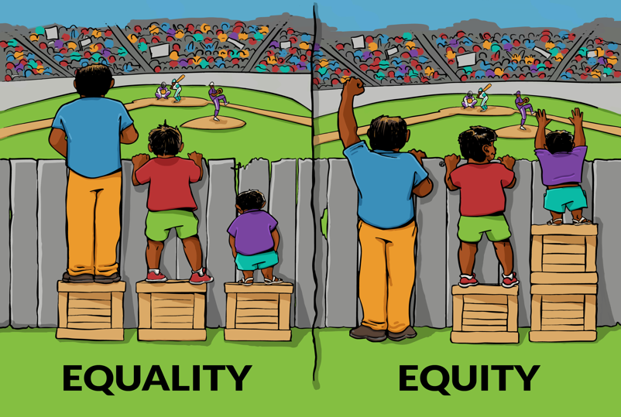
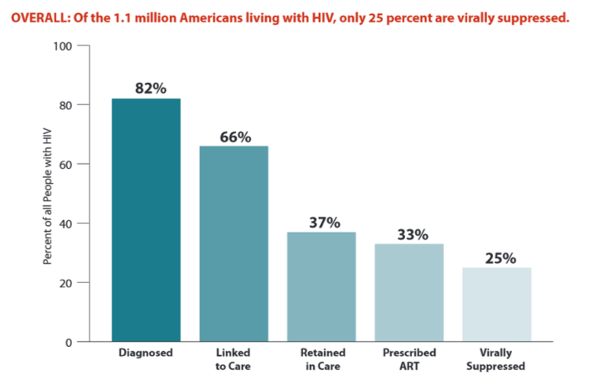
HIV in the US
Sin Vergüenza
Season Three
Centers for Disease Control and Prevention
(July 2012)
Released the Stages of Care, a comprehensive analysis showing that only 25% of the 1.1 million Americans living with HIV have their virus under control
-Interaction Institute for Social Change | Artist: Angus Maguire.
Notes:
Alonso
“Interaction Institute for Social Change | Artist: Angus Maguire.” For online use please provide links: interactioninstitute.org and madewithangus.com.
NHAS Goals to reduce stigma and discrimination experienced by people living with HIV
36.9 Million on Earth Living with HIV- 25.8 in Subsaharan Africa
In Los Angeles, 60,000 PLWHA
42% Latino
2,000 new diagnosis in LA County each year- 45% Latino (2013 data)
Los Angeles contributes to 4% of new cases identified in the US and to 38% of cases identified in CA
LA second to NY highest # of persons diagnosed with HIV.
LA- 20-29yr olds 33%, 30-39 year olds 28%, 40-49 yearl olds 21% and 50-59 11%

Slide 6
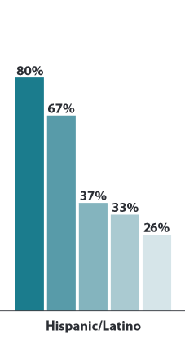
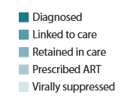
HIV & Latinos in the US
Sin Vergüenza
Season Three
Centers for Disease Control and Prevention (July 2012)
New HIV infection among Latinos in US was more than 3x as high as that of whites.
Among Latino men who have sex with men (MSM), 67% of estimated new HIV infections occurred in those under age 35.
70% of Latinas living with HIV/AIDS were infected through heterosexual contact
Notes:
Alonso

Slide 7
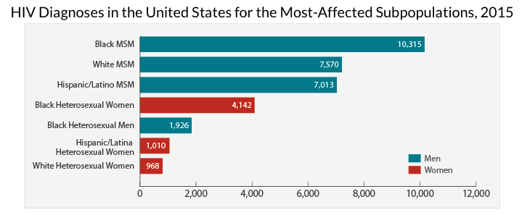
Women and HIV/AIDS
Sin Vergüenza
Season Three
Centers for Disease Control and Prevention (July 2015)
Overall 86% of HIV diagnoses among women were attributed to heterosexual sex.
Among all women with HIV diagnosed in 2015, 61% were African American, 19% were White, and 15% were Hispanic/Latino.
Women represent 23% of the cumulative HIV/AIDS in the U.S.
Only 76% are linked to HIV care.
Notes:
Ramon

Slide 8
About the Series
Created in 2012, the series encourages people to seek HIV testing by featuring character stories highlighting the impact HIV has on Latino families.
11-episode Telenovela web series
Bilingual: English and Spanish
Watch at SVseries.org
Notes:
Alonso

Slide 9
Why a telenovela?
Telenovelas are a fundamental part of the Latino experience and culture in the US
Have roots in Latin America
Are a cultural touchstone, especially for Spanish speakers across the globe.
Popular story arcs like long-lost family members resonate with Latinos whose families may have emigrated.
Telenovela viewership in the United States is booming with 5.6 million people tuning in across the country(Jacobson, 2012)
Notes:
Alonso

Slide 10
Cultural Strengths
Sin Vergüenza
Season Three
Cultural Strengths
Unidad
Tradicion Culture Tradition
Communi-cation
Language/ Bilingualism
Respeto
Familismo- Expanded sense of family
Notes:
Alonso

Slide 11
Sin Vergüenza
Season Three
Sin Vergüenza = Without Shame
Notes:
Ramon

Slide 12
Sin Vergüenza
Season Three
Shame
Informs you of an internal state of inadequacy, unworthiness, dishonor, or regret about which others may or may not be aware.
Another person, circumstance, or situation can trigger shame in you, but so can a failure to meet your own ideals or standards whether or not they are perfectionist (Lamia, 2011)
Notes:
Alonso

Slide 13
Sin Vergüenza
Season Three
Shame
Depression
Low Self-Esteem
Anxiety
Anger
Isolation
Decreased Self-Efficacy
Feeling Silenced

Slide 14
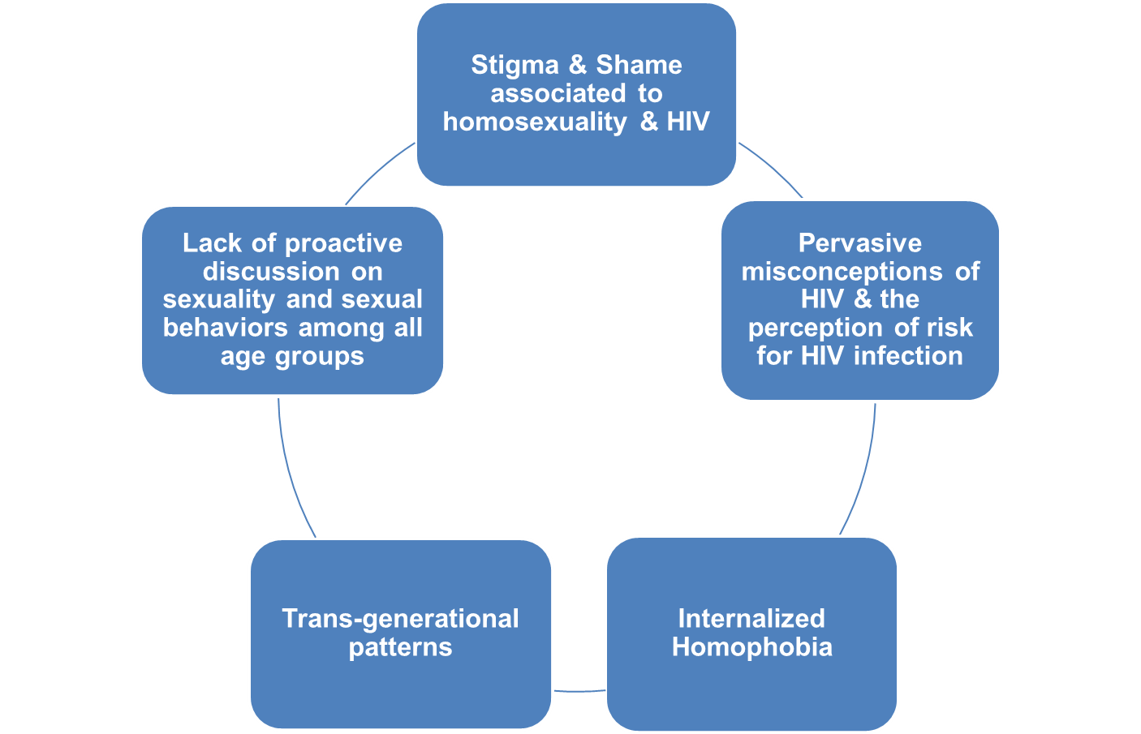
Themes/Contributors of Risk
Sin Vergüenza
Season Three
Notes:
Alonso

Slide 15
Season One
Goals for the season:
Encourages people to seek HIV testing.
Raises awareness of HIV risk regardless of age, gender, relationship status or sexual orientation.
Addresses shame and stigma associated to sexual orientation and HIV.
Notes:
Alonso

Slide 16
Season Two
Goals for the season:
Combats stigma and shame tied to HIV
Promotes treatment as a form of prevention for those living with HIV and PrEP for those at risk of becoming infected with HIV.
Addresses prevention methods to reduce Mother to Child transmission of HIV
Addresses the differences in coping for persons living with HIV (mental health, substance abuse, and disclosure)
Notes:
Alonso

Slide 17
Sin Vergüenza Season Three

Slide 18
Meet The Salazars
Sin Vergüenza
Season Three
Notes:
Alonso
https://www.youtube.com/watch?v=Sdmf_H0KlMk&list=PLR54SAUu3EbaDLQkO77f2UsNANZmt1Ko9&index=1

Slide 19
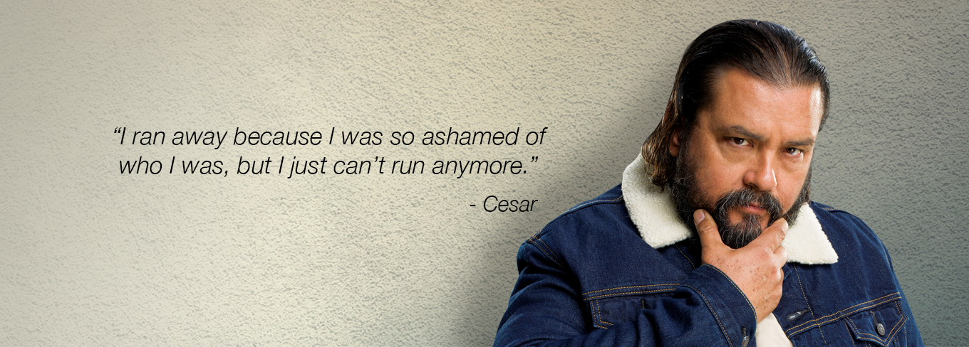
Cesar Salazar
Sin Vergüenza
Season Three

Slide 20
Cesar Salazar
Sin Vergüenza
Season Three
HIV positive and infected his wife of 28 years. He turned to alcohol as a means to cope and accessed the 12-step program to deal with shame and guilt.

Slide 21
Adriana Salazar
Sin Vergüenza
Season Three

Slide 22
Adriana Salazar
Sin Vergüenza
Season Three
She’s coping with her HIV diagnosis by accessing mental health to work through changes in her relationship and health

Slide 23
Tatiana
Sin Vergüenza
Season Three

Slide 24
Tatiana
Sin Vergüenza
Season Three
She represents transwomen who have been victims of assault and abuse. Her character highlights chronic abuse experienced and the challenges in accessing protections from authorities.

Slide 25
Enrique Salazar
Sin Vergüenza
Season Three

Slide 26
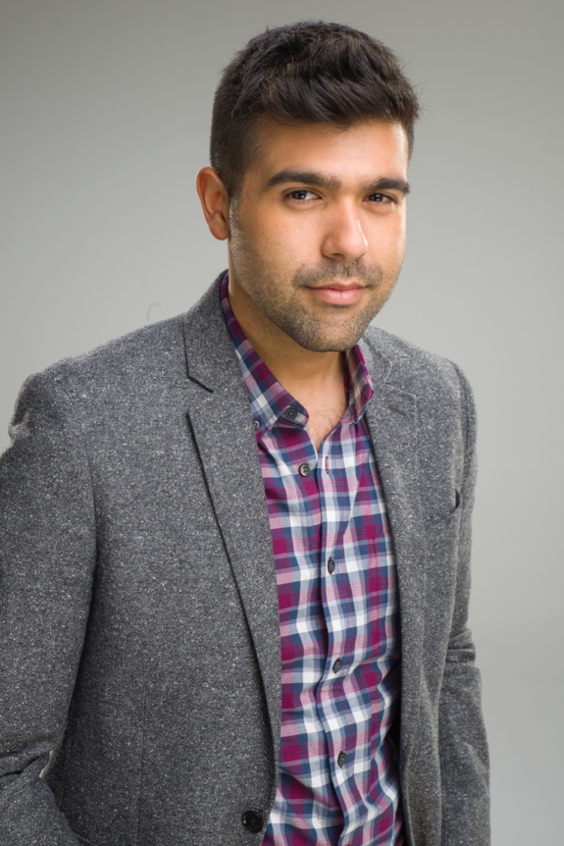
Enrique Salazar
Sin Vergüenza
Season Three
Young openly gay man who is knowledgeable and proactive in HIV prevention and self-care. He’s an LGBT advocate and helps those who are underrepresented.

Slide 27
Christina Salazar
Sin Vergüenza
Season Three
“You can’t get HIV like you catch a flu.”
– Christina

Slide 28
Christina Salazar
Sin Vergüenza
Season Three
She has been deeply impacted by her parents’ HIV diagnosis and family secrets. As a young mother, she is trying to stop her dysfunctional relationship with her son’s father and reclaim her voice.

Slide 29
Esther Salazar
Sin Vergüenza
Season Three

Slide 30
Esther Salazar
Sin Vergüenza
Season Three
La Abuela is struggling to to adjust to changes in her family. She is forced to re-evaluate her expectations of a woman’s role in the family and explore the benefits of dating.

Slide 31
Sin Vergüenza Season Three
Episode One

Slide 32
Transphobia
Sin Vergüenza
Season Three
Call for justice.
Stand up against discrimination and crimes of hate against the transgender community
Notes:
Ramon

Slide 33
Sin Vergüenza Season Three
Episode Two

Slide 34
HIV Stigma
Sin Vergüenza
Season Three
Eliminating shame, stigma and misconceptions about HIV in our community.
Highlighting the value of HIV treatment compliance.
Undetectable = Untransmittable
Notes:
Ramon

Slide 35
Sin Vergüenza Season Three
Episode Three

Slide 36
STD Testing & Treatment
Sin Vergüenza
Season Three
The rate of new HIV and STD infections continues to rise each year.
PrEP and regular condom use are important ways to reduce the risk of transmission of HIV and other STDs
Notes:
Ramon

Slide 37
Sin Vergüenza Season Three
Episode Four

Slide 38
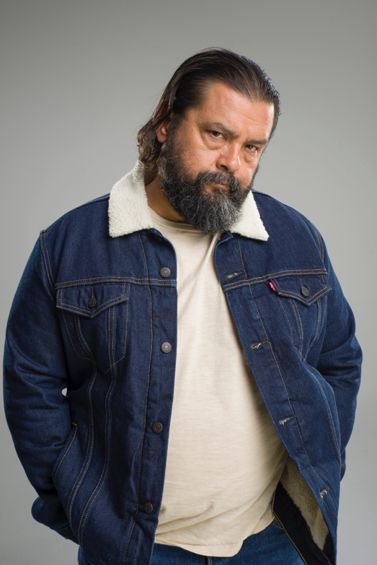
LGBT Shame & Stigma
Sin Vergüenza
Season Three
Eliminate homophobic messages that are both harmful and hateful.
These impact many LGBT persons and can cause a deep sense of shame and stigma about who they are.
Notes:
Ramon

Slide 39
Sin Vergüenza
Season Three
What’s Being Done to Disseminate and Engage the Community?
Social Media
Press Media
Partnerships
Community Showings
You!
Notes:
Ramon

Slide 40
What’s Next
Survey to Assess Impact of SVII Developed in Collaboration with Gino Galvez, PhD, CSULB
Media Kits for Season Three Available to Share the Telenovela with your Communities
Notes:
Ramon

Slide 41
Connect With Us
Watch at SVseries.org
Follow us for updates on:
@AltaPride
Notes:
Ramon

Slide 42
Sin Vergüenza Season Three
Contact Us
Hilda Sandoval, PHD
Mental Health Manager
HSandoval@altamed.org
(323) 869-5459
Natalie Sanchez, MPH
Clinic Administrator, HIV/HCV
NSanchez@altamed.org
(323) 869-5468
Ramon Garcia, MBA
HIV Marketing Manager
RamGarcia@altamed.org
(323) 278-4239

